Slide 1




Communicating Science Through UANews
Raymond Sánchez
Mentor: Daniel Stolte, Science Writer & Public Information Officer, UANews
The University of Arizona, University Relations – Communications
24th Annual Arizona NASA Space Grant Consortium Symposium
April 18th, 2015

Slide 2
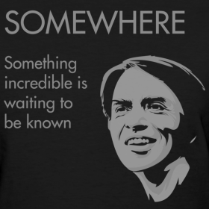
Science & Technology are progressing at
an astounding rate…
http://lefthemispheres.blogspot.com/2011/11/happy-birthday-carl-sagan.html
Notes:
Science & Tech progressing rapidly – as someone studying science this is super inspiring, huge impact on our daily lives

Slide 3
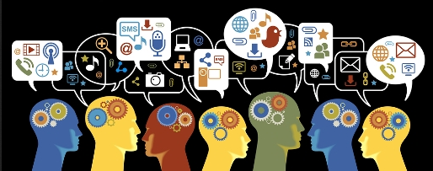
In a world inundated with both information and misinformation,
how do we keep up?
http://blog.brandify.com/2013/10/the-right-brain-left-brain-divide-on-social-media/
“Cognitively, it is much easier for people to accept a given piece of information than to evaluate its truthfulness.” – Professor Stephan Lewandowsky, University of Bristol
Notes:
With social media and all of the other online platforms, there’s an absurd amount of information out there, and not all of it’s good. Science stories especially tend to get sensationalized and miscommunicated due to the complexity of a lot of scientific studies that are performed.

Slide 4
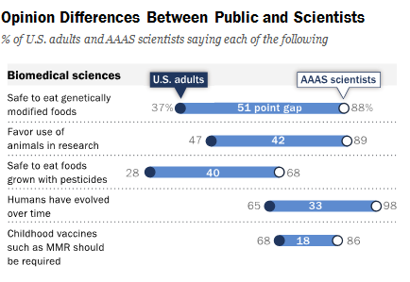
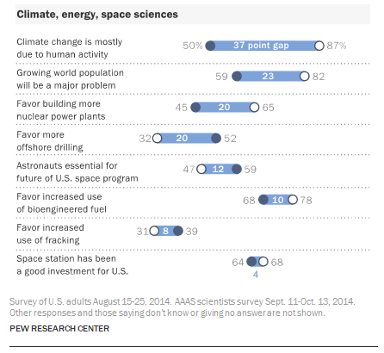
Pew Study – Science has a bit of an image problem…
Notes:
Pew study shows that there’s a pretty significant opinion gap between scientists and citizens about a lot of important scientific issues that will have a major impact on society in the coming years. There has also been an increase in negative opinion and perception of science over the last five years. This means that both scientists and journalists need to do a better job at communicating their work!

Slide 5
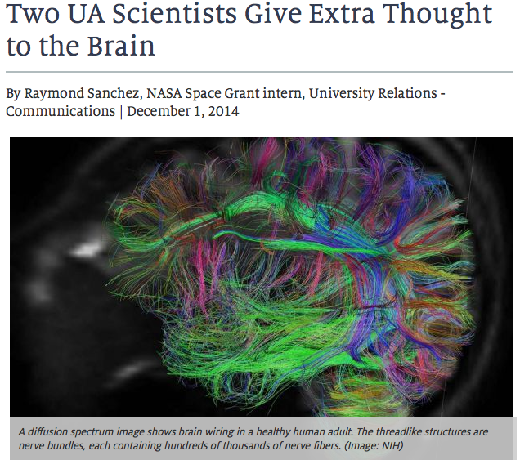
Science Communication at UANews
Out of the lab and into the field…
Interviewing researchers about their work
Writing stories about their science
Preparing press releases about new publications and grants
On-the-ground coverage of STEM-related events on campus
Notes:
Seeing how science gets communicated, both at its best and its worst, led me to an interest in becoming a science communicator myself. These are my responsibilities at UANews

Slide 6
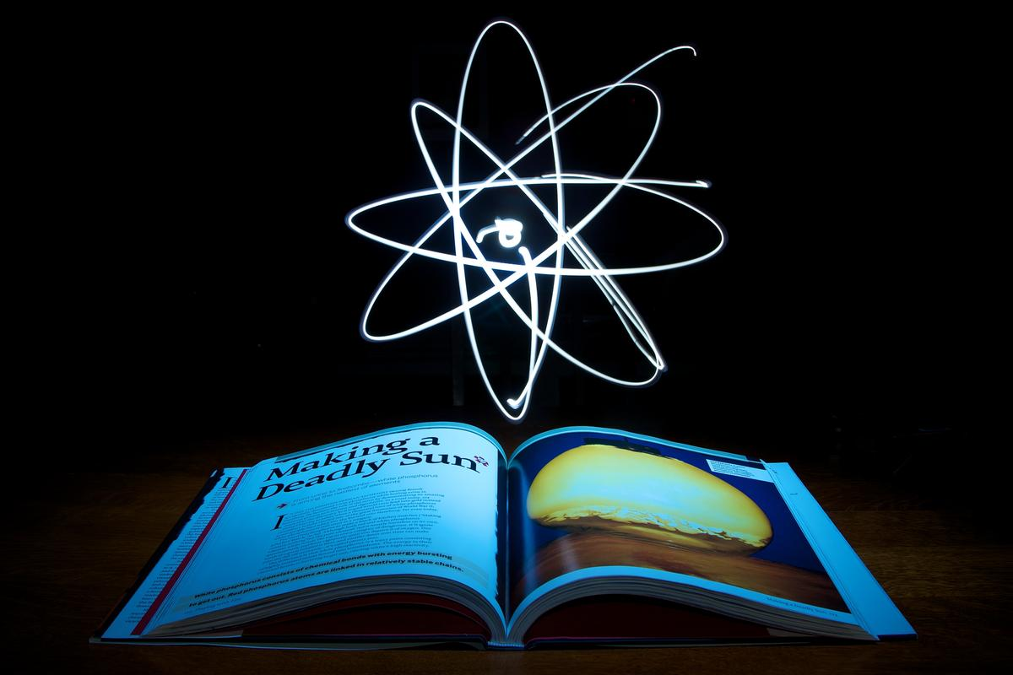
What have I learned about
communicating science?
Three Key Takeaways
Do your homework
Know your audience
Understand how to think like a scientist
http://wyomingpublicmedia.org/post/board-education-votes-suspend-science-standards-review
Notes:
While I’ve learned a tremendous amount during my internship, three key takeaways stand out to me as the most important things to learn when beginning a career as a science communicator is to understand the material deeply BEFORE you even do the interview (do your homework), know the audience you’re communicating to, and learn to think like a scientist.

Slide 7
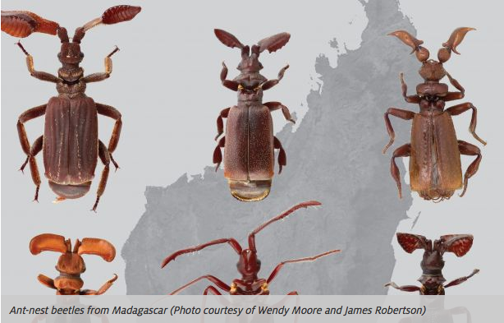
Do your homework
Have a strong understanding of the work ahead of time
Hone verbal communication and interview skills
ESPECIALLY important for highly technical (or obscure) work
Notes:
Explain the difficulties with the beetle story – this was a story about beetle evolution and phylogeny – a lot of complex relationships and unfamiliar terms that were completely outside of my wheelhouse. I thought I understood the material better than I did, and as a result, I wasn’t able to ask as many deep/probing questions during my interview and the story required me to do a significant amount of clarifications/editing with the authors of the study after the fact.

Slide 8
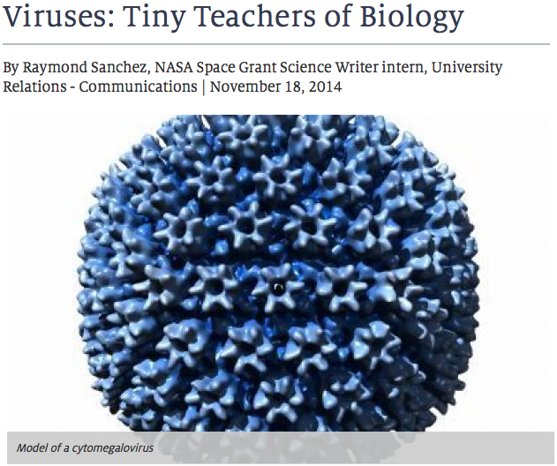
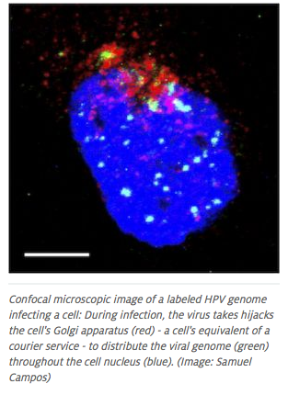
Seeing the Difference
Notes:
Also outside of my field – reading papers deeply ahead of time helped me to ask more detailed questions and communicate the science more effectively. I got a lot of positive comments about this story.

Slide 9
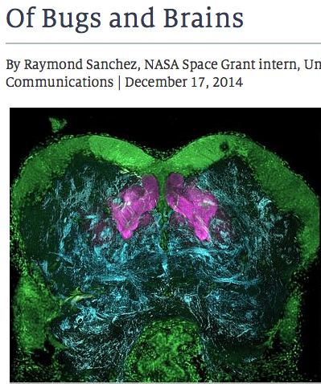
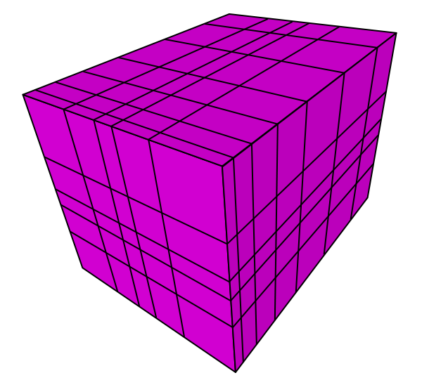
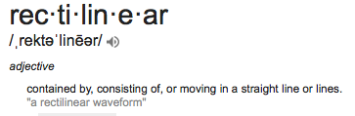
Know your audience
http://commons.wikimedia.org/wiki/File:Rectilinear_grid.svg
Notes:
Explain fiasco with rectilinear – another complicated story that required the introduction of a lot of terms that the public wouldn’t be familiar with. Particularly problematic was the word “rectilinear”, which mostly accurately describes the structure of the neural networks in question. My mentor and I thought this word would mean very little to people, while the author of the study insisted we include it and not play to the people who either don’t know the word or are unwilling to reach for a dictionary. This raised an interesting debate – my mentor and I agreed with this logic in some sense, but also wanted the story to be clear and enjoyable to a wide number of people.

Slide 10

Finding a Happy Medium?
Gauge both prior knowledge and interest level of your audience
This may require making some tough decisions about how to communicate complicated information…
Notes:
Compromised to the best of our ability – this has been a recurrent theme throughout the course of my internship, and I imagine in the work of all science communicators in general – and the word “rectilinear” is far from being the most complicated term we’ve come across! What’s the best way to translate complicated scientific information so that it’s easily understandable, but is not oversimplified or conveyed inaccurately?

Slide 11
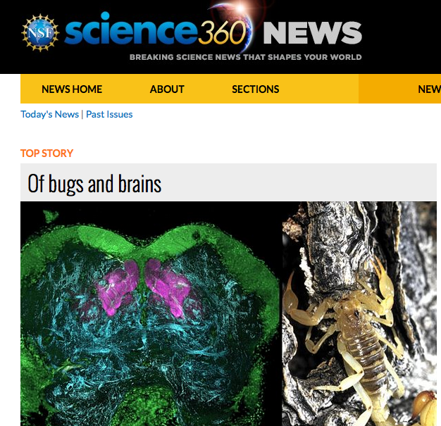
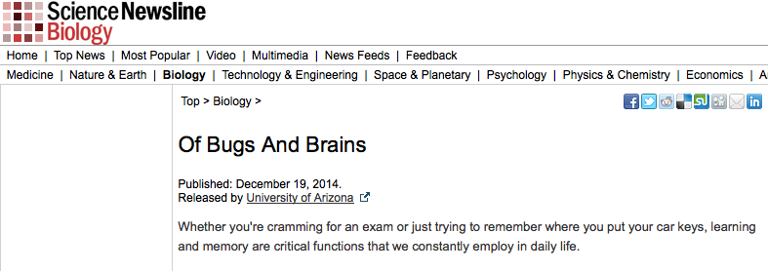
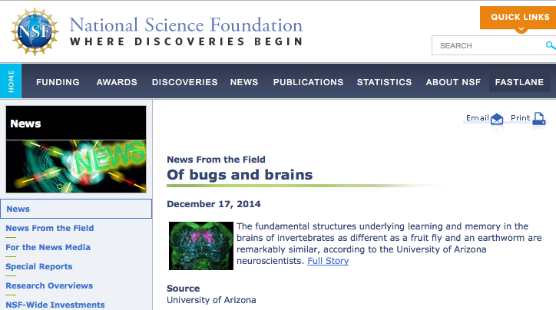
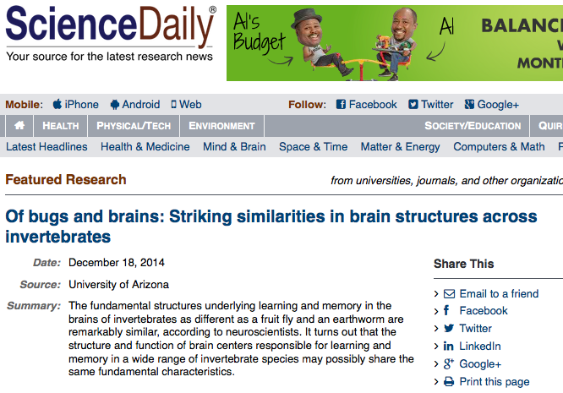
Notes:
Worked out in the end – this piece had by far the widest readership of any other piece I’ve written.

Slide 12
Scientists and journalists can learn a
lot from each other…
Think like a scientist → understand the work and ask better questions → more effective science communication
Think like a journalist → make stories more lay-friendly
The scientist should learn to appreciate the difficulties of being a science communicator
Notes:
The scientific method is a beautiful thing - it provides a framework for us to objectively assess our predictions about the world and continue to build upon that newly gained knowledge
Understanding scientific thinking can not only help the science communicator get inside the mind of a scientist, which will help them to better understand complex work and communicate it effectively
It can also improve their work as a journalist/science communicator
Journalism as a field is evolving just as rapidly as many scientific fields are - the modern journalist must possess a wide range of technical skills and knowledge about an unbelievably diverse range of topics
Journalists who can assess their work in an objective way by making predictions based on observations and assumptions, comparing those predictions to their results, and analyzing the reasons their predictions did or did not hold true can help to improve their writing, communciation etc.

Slide 13
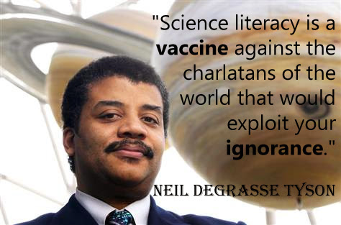
http://udapbio.wikispaces.com/Peter+Xu
Notes:
The scientific method is a beautiful thing - it provides a framework for us to objectively assess our predictions about the world and continue to build upon that newly gained knowledge
Understanding scientific thinking can not only help the science communicator get inside the mind of a scientist, which will help them to better understand complex work and communicate it effectively
It can also improve their work as a journalist/science communicator
Journalism as a field is evolving just as rapidly as many scientific fields are - the modern journalist must possess a wide range of technical skills and knowledge about an unbelievably diverse range of topics
Journalists who can assess their work in an objective way by making predictions based on observations and assumptions, comparing those predictions to their results, and analyzing the reasons their predictions did or did not hold true can help to improve their writing, communciation etc.

Slide 14
Acknowledgments
Daniel Stolte – Science Writer, UANews
Susan Brew – Manager, Arizona/NASA Space Grant Consortium
La Monica Everett-Haynes – Senior Communications Manager, UANews
Doug Carroll – Director of Media Relations and Communications, UANews
Andrea Smiley – Associate Vice President of Communications, University of Arizona
University of Arizona Communications Team Members
Arizona and University of Arizona Space Grant Managers
All of the UA faculty, staff and students that granted me their time for interviews
Notes:
The scientific method is a beautiful thing - it provides a framework for us to objectively assess our predictions about the world and continue to build upon that newly gained knowledge
Understanding scientific thinking can not only help the science communicator get inside the mind of a scientist, which will help them to better understand complex work and communicate it effectively
It can also improve their work as a journalist/science communicator
Journalism as a field is evolving just as rapidly as many scientific fields are - the modern journalist must possess a wide range of technical skills and knowledge about an unbelievably diverse range of topics
Journalists who can assess their work in an objective way by making predictions based on observations and assumptions, comparing those predictions to their results, and analyzing the reasons their predictions did or did not hold true can help to improve their writing, communciation etc.

Slide 15
Thank you!
Notes:
The scientific method is a beautiful thing - it provides a framework for us to objectively assess our predictions about the world and continue to build upon that newly gained knowledge
Understanding scientific thinking can not only help the science communicator get inside the mind of a scientist, which will help them to better understand complex work and communicate it effectively
It can also improve their work as a journalist/science communicator
Journalism as a field is evolving just as rapidly as many scientific fields are - the modern journalist must possess a wide range of technical skills and knowledge about an unbelievably diverse range of topics
Journalists who can assess their work in an objective way by making predictions based on observations and assumptions, comparing those predictions to their results, and analyzing the reasons their predictions did or did not hold true can help to improve their writing, communciation etc.

