Slide 1



Energy Education
Consumption & Radiation Awareness
By: Colton C. Bennett | Mentor: Mansel A. Nelson

Slide 2
Energy Education Awareness
Energy Consumption
Energy Reduction
Radiation Concept

Slide 3
Average kWh Annually

Slide 4
Comparison
30% of residences on the N.N. Reservation are without electricity.
Electricity is so abundant in major cities that it is taken for granted.
More space = more electrical appliances.
 | Flagstaff | N.N. Reservation
Household 1 | 16,600 kWh | 1,960 kWh
Household 2 | 19,800 kWh | 3,200 kWh
Household 3 | 15,500 kWh | 1,240 kWh

Slide 5
Electrical usage in the Work Area

Slide 6
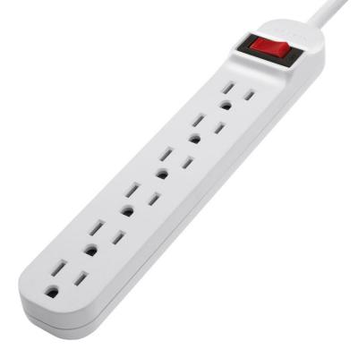
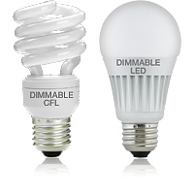
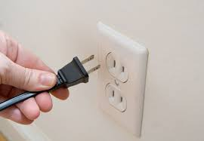
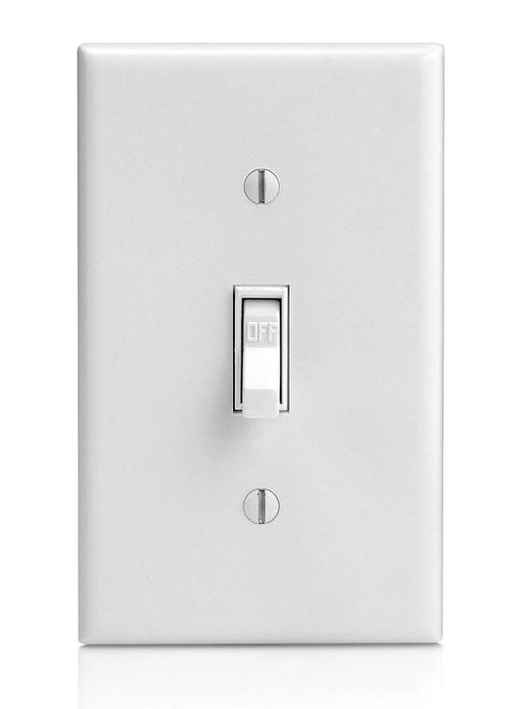
How to reduce energy consumption.
Buy a Power Strip
Switch from Incandescent to CFLs or LEDs
Distinguish which electrical appliance are necessary and unnecessary
Remember to unplug unused electrical appliances
Flip the switch

Slide 7
Radiation Concept
Ionizing Radiation
Non-Ionizing Radiation
Alpha particles
Beta particles
Gamma rays
Microwaves
Radio waves
Infrared

Slide 8
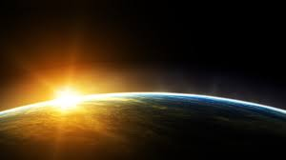
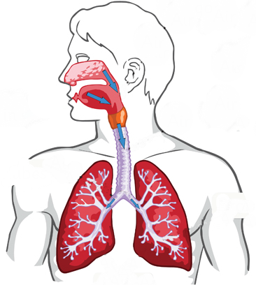

Background Radiation
Cosmic
Internal
Terrestrial

Slide 9
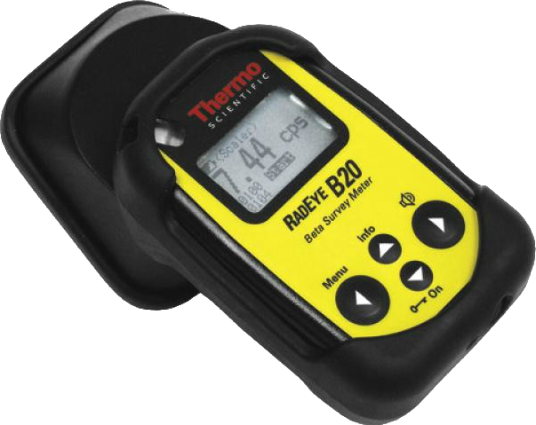
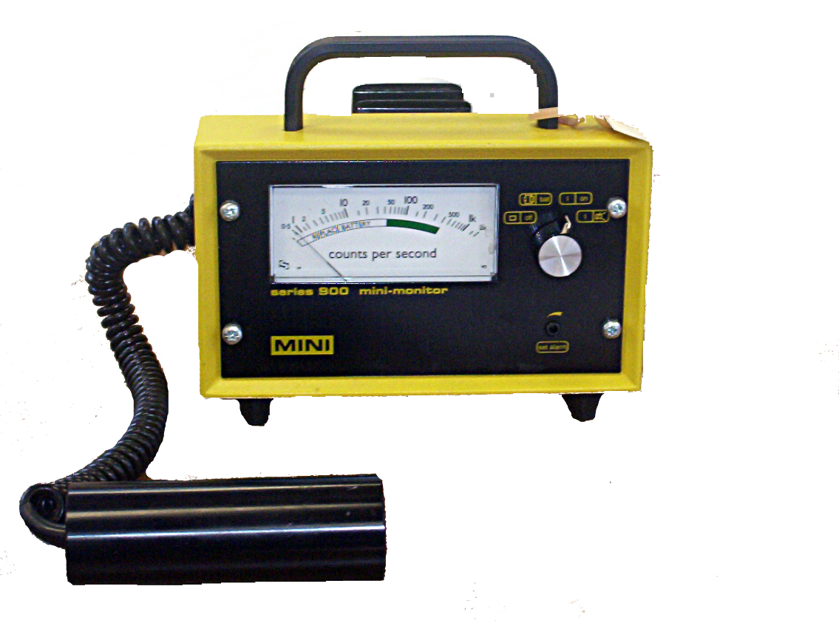
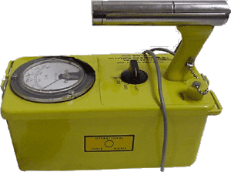
How is radiation detected &measured?
Sv – Sieverts
Rem – Roentgen equivalent man

Slide 10
Cameron, AZ

Slide 11
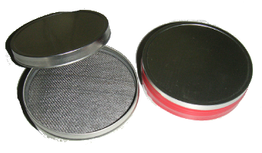

Slide 12
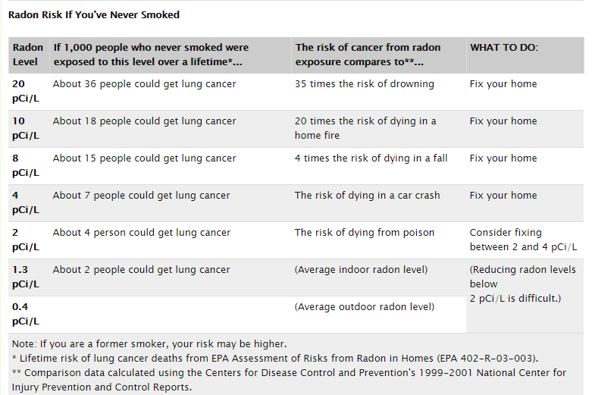
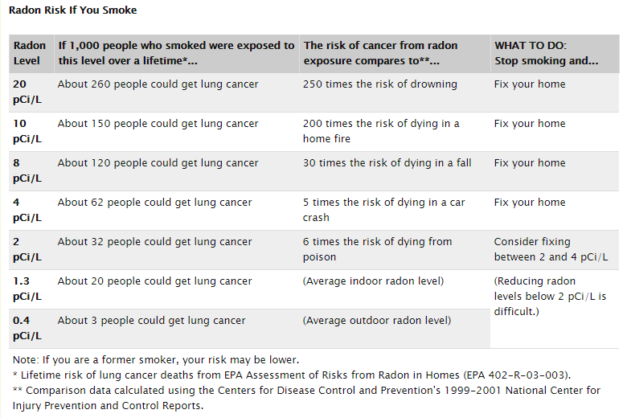
Radon in the Air

Slide 13
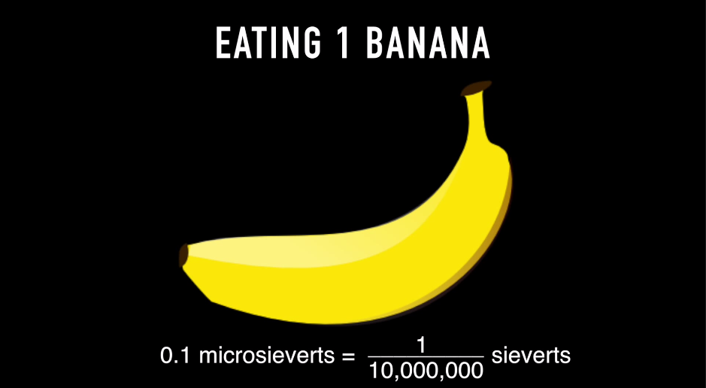

Slide 14
Who has the most Radiation dosage Annually?

Slide 15
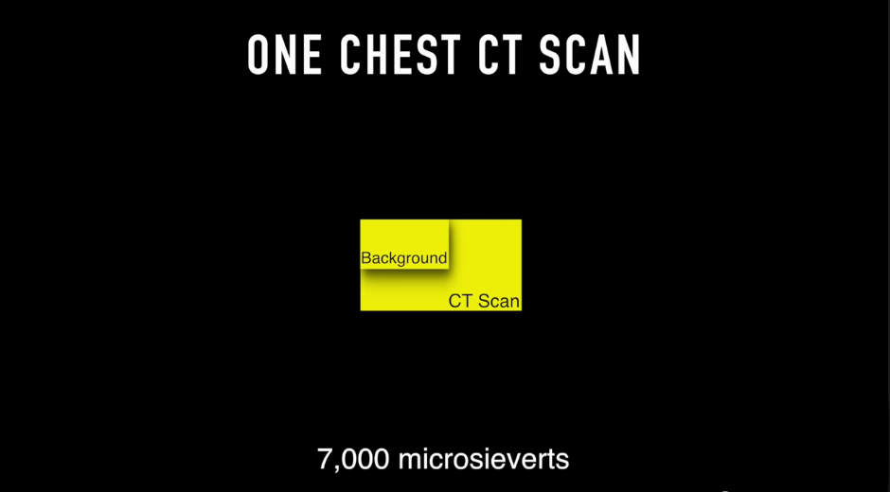
= .07 rem

Slide 16
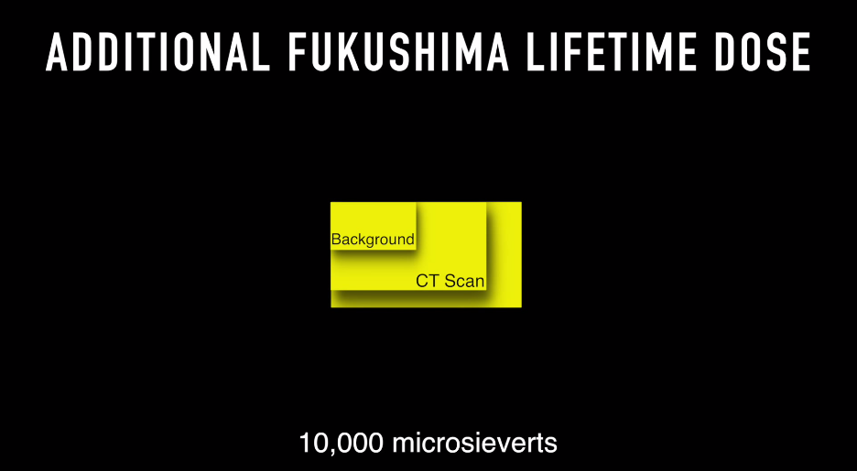
= 0.10 rem

Slide 17
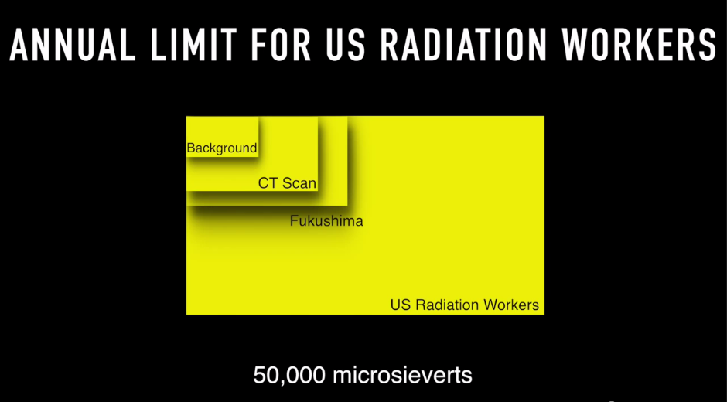
= 0.50 rem

Slide 18
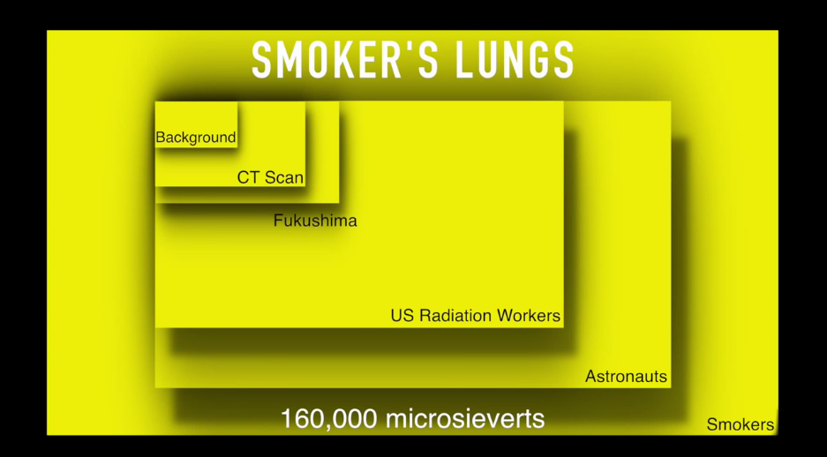
= 1.6 rem

Slide 19
Thanks to all who participated in the Surveys
Acknowledgements
Mentor Mansel A. Nelson
Kathleen Stigmon
NASA Space Grant
Northern Arizona University
Students
Schools

