Slide 1



Characterization of Laser Energy Deposition for Aerodynamic Flow Control
Tierra Roller
Aerospace Engineering, University of Arizona
Mentor: Dr. Jesse Little
Assistant Professor, Department of Aerospace and Mechanical Engineering,
University of Arizona
Arizona Space Grant Consortium
April 18, 2015
Phoenix, AZ

Slide 2



Acknowledgements
Research Group Members:
Clark Pederson
Liliana Saldaña
David Akins
Robyn Dawson
Space Grant Administrators and Mentors
Air Force Office of Scientific Research

Slide 3
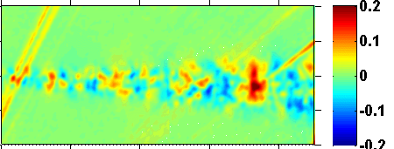
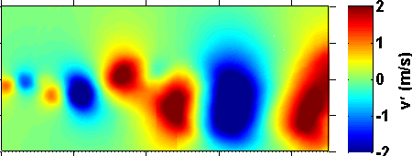
Flow Control
Flow control: improves the aerodynamic performance of a surface
Active: not a permanent alteration of the surface
Energy deposition: adding energy to the flow
Baseline
Control
Images from Ely and Little, 2013

Slide 4
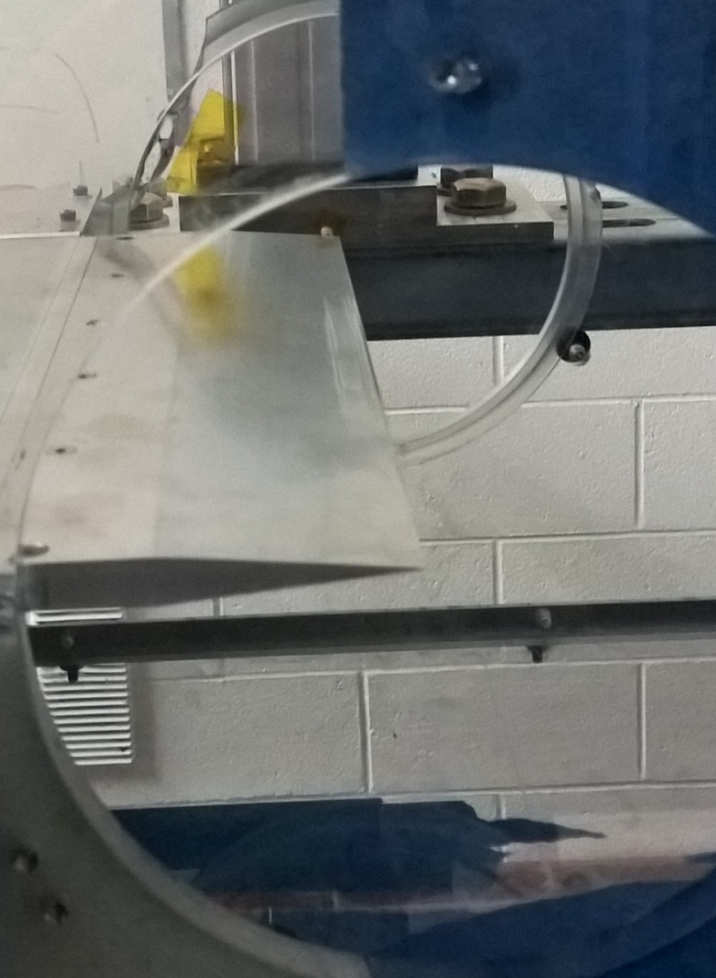
Wind Tunnel Test
High velocity
Trailing edge
Low velocity
Notes:
Graph shows a jump in velocity once laser is turned on. The ablation of the material shows a clear increase in velocity because that is the only factor that has changed during this 30 second trial
Velocity arrows on picture

Slide 5
Effect of the Laser
Notes:
10% decrease in velocity from 2.5 minutes to 10.5 minutes of laser exposure
This shows that something is changing and degrading as the wind tunnel tests go on. The strength of the ablation is decreasing over time

Slide 6
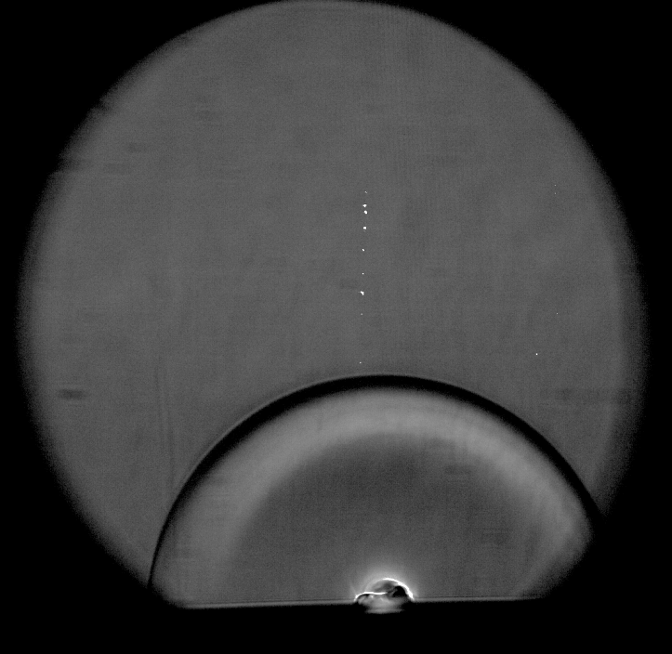
Schlieren Imaging
Bending of light through density gradients
Propagating shock wave associated with the rapid heating of the surface
Shock wave
Low density region
Notes:
Double check this slide, too complicated? Fix contrast of images
JL: looks good. Use heat/asphalt analogy.

Slide 7
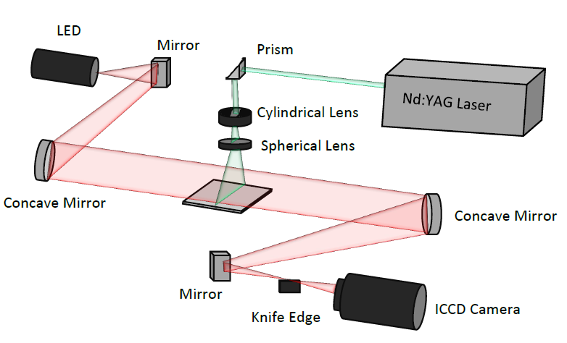
Schlieren Imaging Setup
Laser – Plate Interaction
Notes:
Not necessary; extra slides label test section

Slide 8
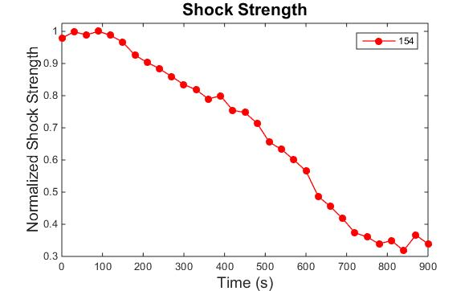
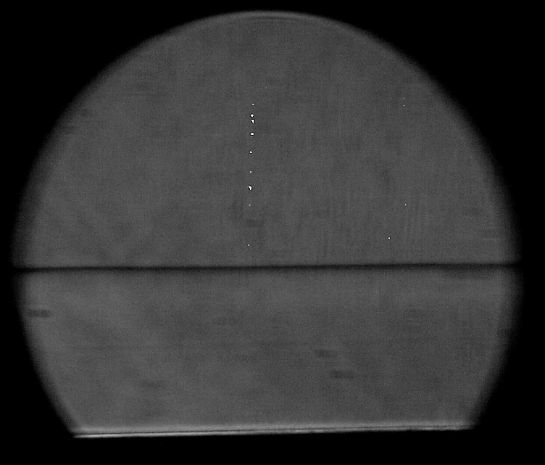
Quantitative Results
Shock wave
Notes:
JL: may need to point out that you are looking at the wave from a different angle than before.

Slide 9
Analysis
Similar curves
Need better tunnel data
Notes:
Normalized shock strength, fix shock

Slide 10
Next Steps
Get a fuller, more accurate curve for velocity change
Run the tunnel test keeping the velocity measurement in the same location
Repeat the process with various metals
Steel and copper
Improve wind tunnel testing
Notes:
Get rid of pitot tube

Slide 11
Thank you

Slide 12
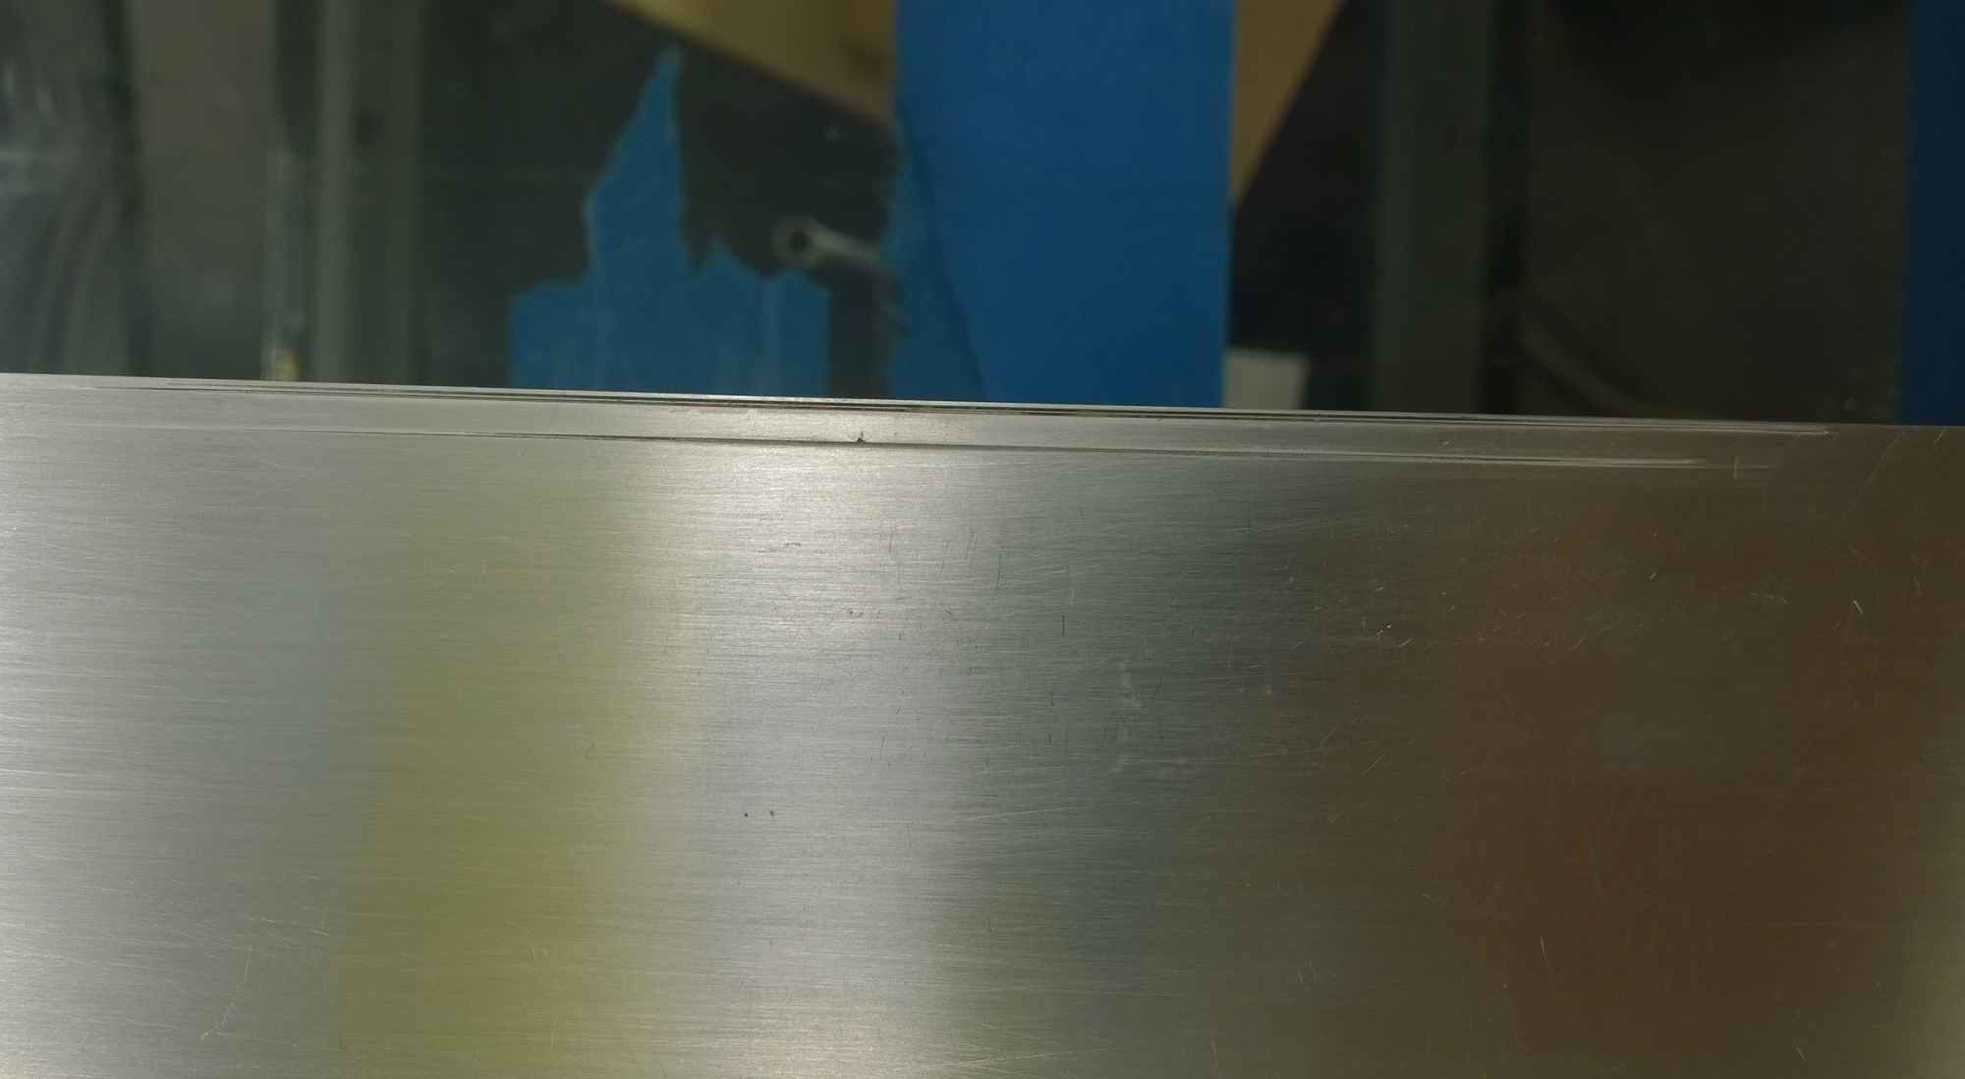
Ablation Damage
Permanent damage due to ablation

Slide 13
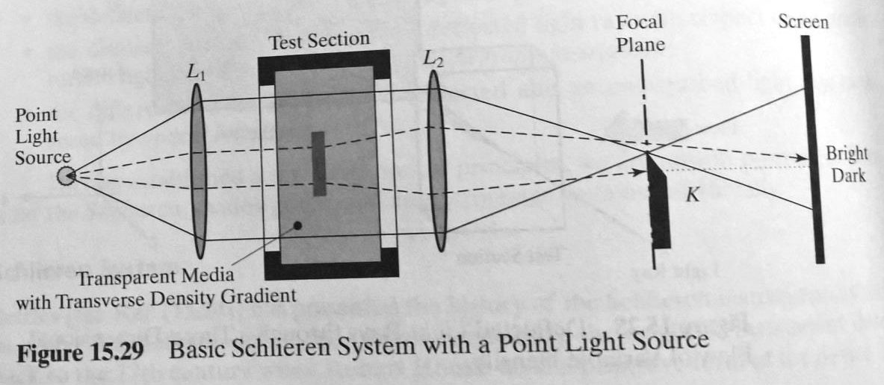
Schlieren Imaging
Image from John and Keith 2006
Notes:
Shows the knife edge

