Slide 1



Laser Energy Deposition for Control of Turbulent Mixing Layers
Liliana Saldana
University of Arizona
Advisor: Dr. Jesse Little
Assistant Professor, Department of Aerospace and Mechanical Engineering
Arizona Space Grant Consortium
April 18, 2015
Tucson, AZ

Slide 2
Acknowledgments
Research Advisor: Dr. Jesse Little
NASA Space Grant Manager: Susan Brew
Research Group, including:
  Clark Pederson
  Tierra Roller
  David Akins
Air Force Office of Scientific Research

Slide 3
Importance
Aerodynamic flow control can be used to improve performance and/or efficiency of flight systems.
Applications:
  Greater range of maneuvers in military aircraft
  Shorter take-off and landing
  More efficient compressor blades for turbine engines

Slide 4
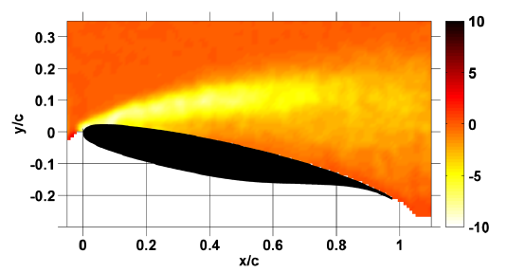
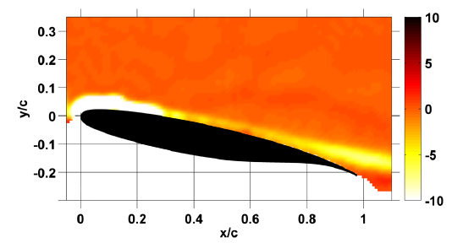
Background of Plasma Actuators
Plasma actuators use high voltage pulses to generate coherent spanwise vortices
These actuators have limited amplitude
Vorticity of an Airfoil without Plasma Actuator
Vorticity of an Airfoil with Plasma Actuator
Images from Little 2012
Notes:
Actuators have been proven in reattaching separated flow on airfoils thus preventing stall
These actuators have limited amplitude by the available power supply and actuator material

Slide 5
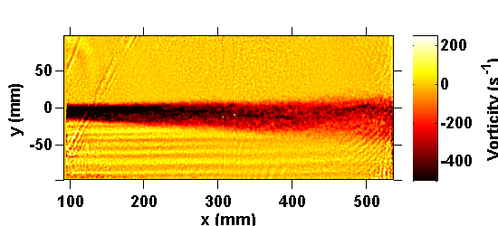
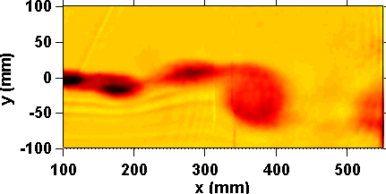
Objective
Use laser energy deposition to study flow control at amplitudes that are not currently possible with plasma actuators.
Baseline
Control
Videos from Dr. Little
Notes:
We are studying mixing layers since they are a simple model for flow over an airfoil.
Mixing layer showing baseline and control. Note that the structure is organized and the mixing layer is thicker in the control case.
The increased thickness (higher velocity) is what you measured with the pitot probe
Laser produced plasmas have similar effects and are not as limited in terms of amplitude.
Lasers are limited in frequency

Slide 6
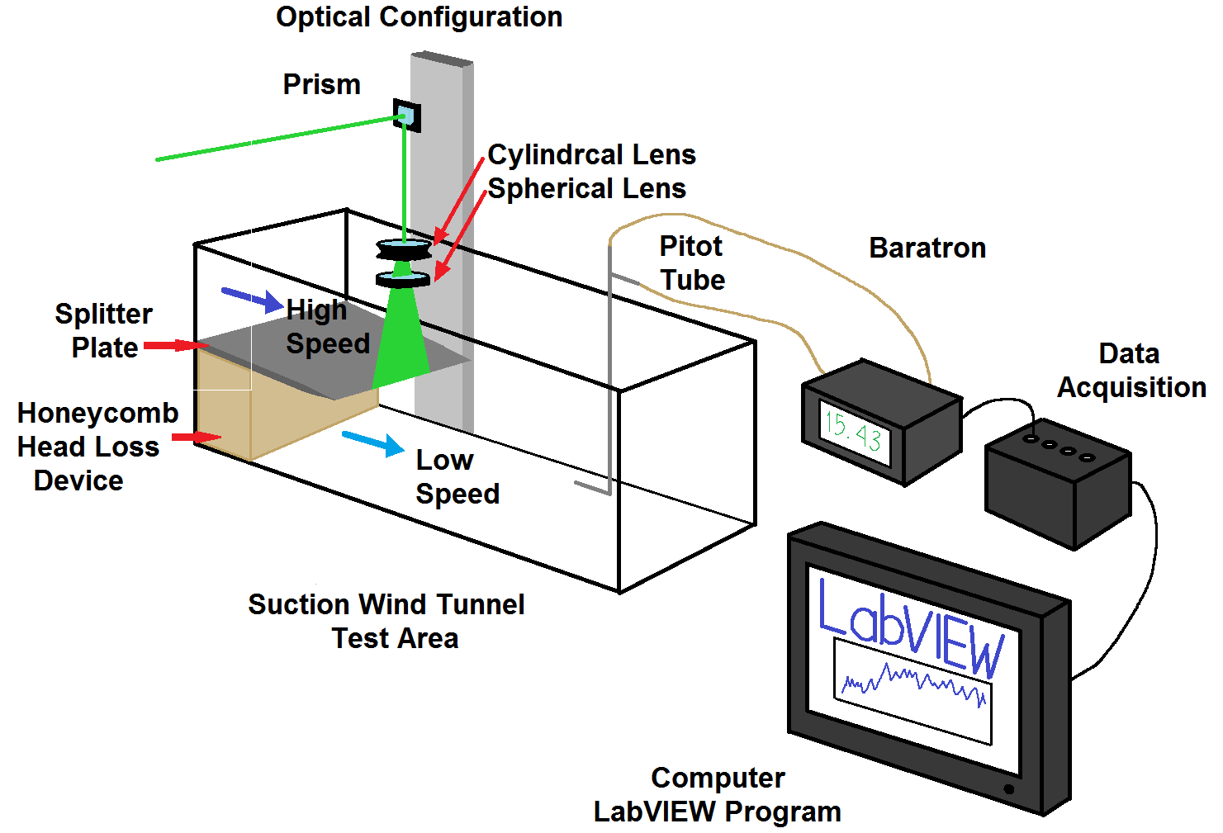
Experimental Setup: Schematic

Slide 7
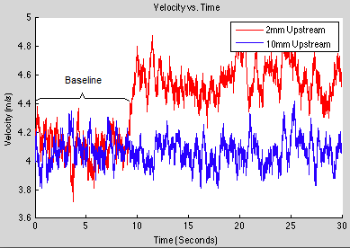
Results: Pressure Vs. Time

Slide 8
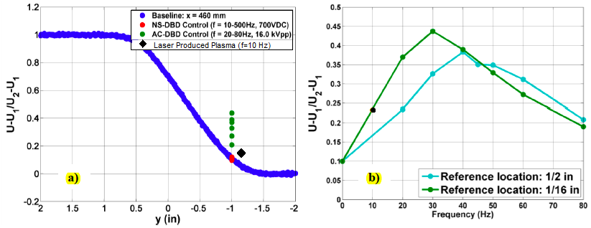
Results: Comparison with Actuator
Images from Little and Ely 2013 (Modified)

Slide 9
Conclusion
Method | Frequency (Hz) | Y-location (mm) | Dimensionless Baseline | Dimensionless Control
Laser | 10 | -30 | 0.09 | 0.139
Actuator | 10 | -25.4 | 0.1 | 0.1
Laser: increase of 49% from baseline
Actuator: did not increase
This shows the capability of laser energy deposition and can be used to examine the physics behind flow control using thermal perturbations
Notes:
Plasma actuator (Thermal Actuator, NS DBD Actuator)
Momentum Base Actuator (AC DBD Actuator)

Slide 10
Future Research
Perform PIV (Particle Image Velocimetry) experiments
Find a new ablation material that will last longer

Slide 11
Thank you

Slide 12
References
Greenblatt, D. and Wygnanski, I., "The Control of Flow Separation by Periodic Excitation," Progress in Aerospace Sciences, Vol. 36, 2000, pp. 487-545.
Ely, R. and Little, J., "Mixing Layer Excitation by Dielectric Barrier Discharge Plasma Actuators," AIAA Paper 2013-1012, 2013.
Anderson, John D. Fundamentals of Aerodynamics. 5th edition. N.p.:McGraw-Hill, 2005. N. Print
http://recreationalflying.com/tutorials/groundschool/index.html

Slide 13
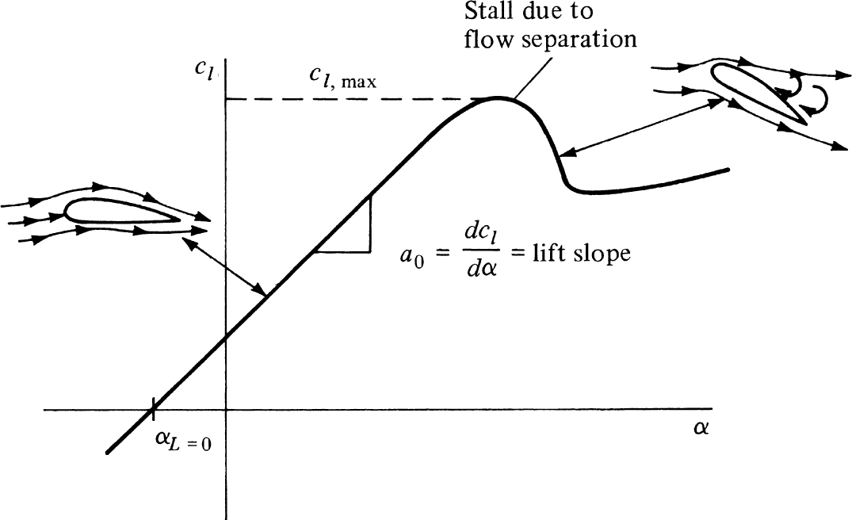
Example
Flow separation is caused by adverse pressure gradient and/or geometrical aberration.
Anderson, Aerodynamics 5th Ed
Notes:
JL: see the figure I attached. Shows stall as well. Reference your 320 book. Go quickly here. I changed title to “Example”. I think you can leave this slide out if you are short on time. Can just skip to the next one.
Separation is associated with losses, including loss of lift and drag increase.

Slide 14
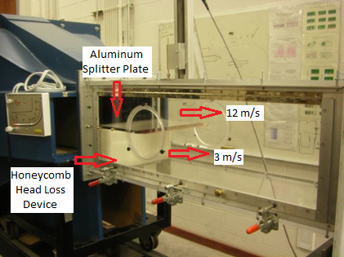
Experimental Setup
Test Section of the wind tunnel
Image from Little and Ely 2013 (Modified)
Notes:
Put it at the end

Slide 15
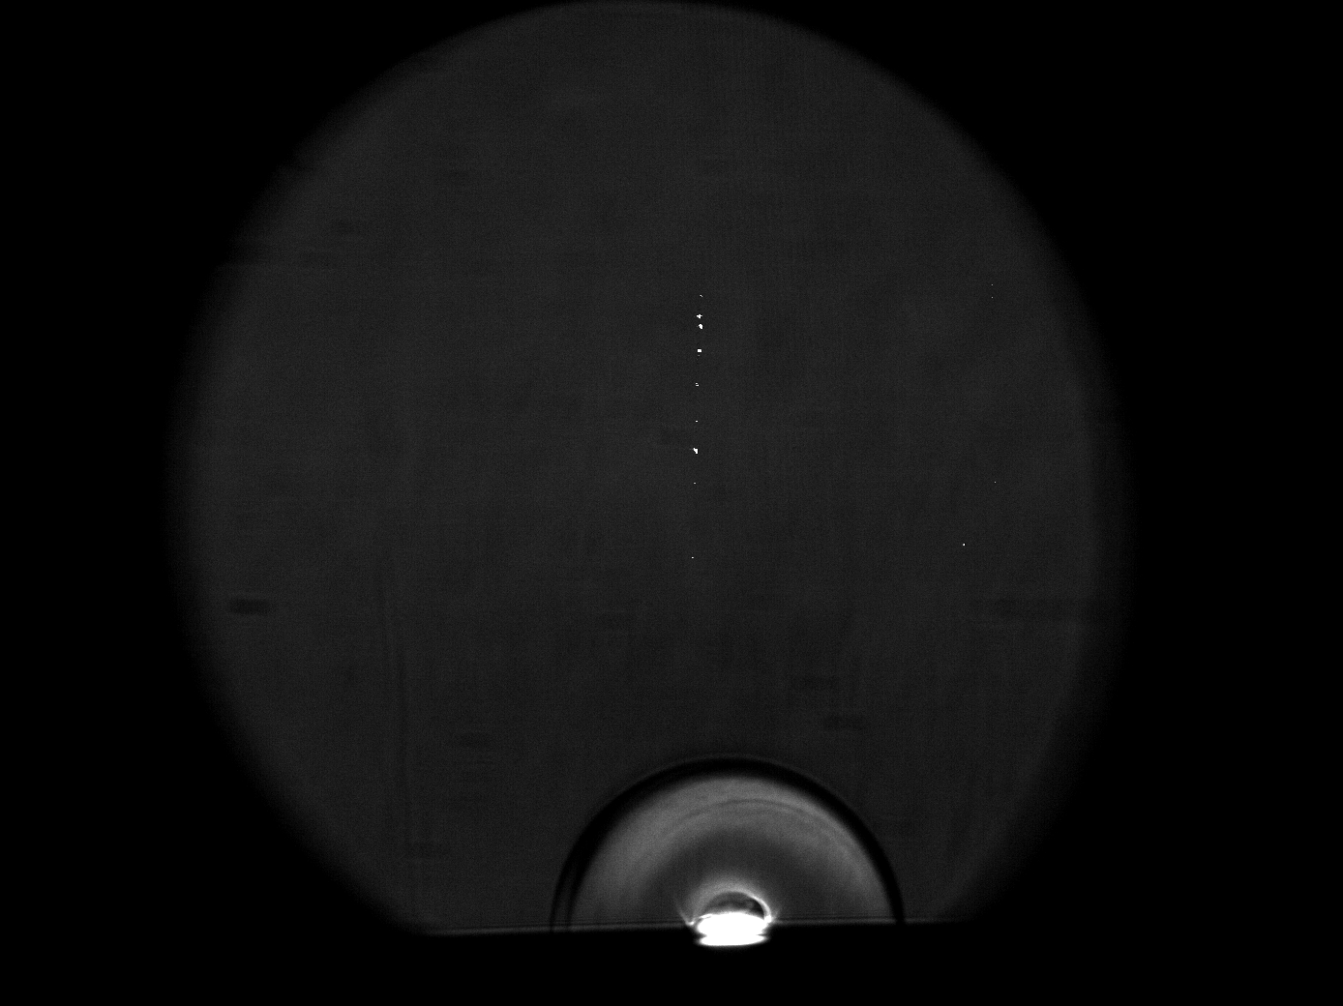
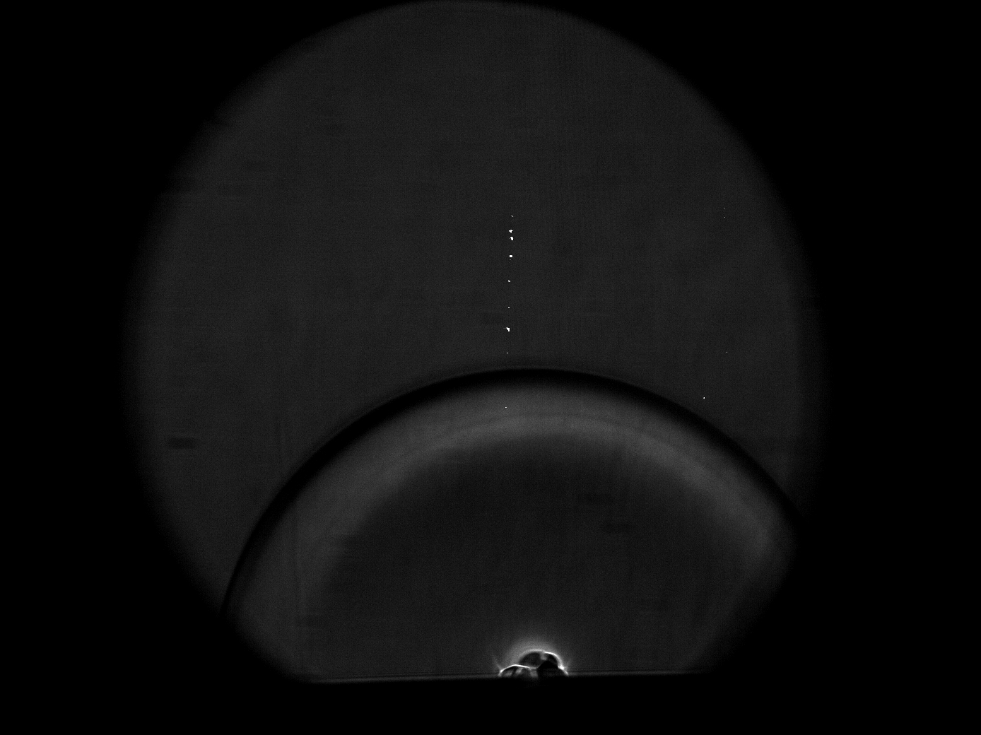
Laser Produced Plasma
The laser superheats the aluminum trailing edge turning the surface into plasma.
Images from Tierra Roller
Notes:
JL: Just spend 30 seconds or less, refer back to Tia. May even remove if short on time
JL I switched this with original slide 8 since they may not be able to understand without seeing the figure first

