Slide 1
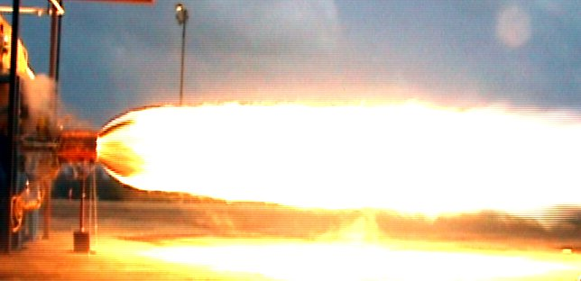
Design of a Rocket Engine Thrust Augmentation Ejector Nozzle
By: Sepideh Jafarzadeh
Mentor: Dr. Timothy Takahashi
Arizona State University
Ira A. Fulton Schools of Engineering

Slide 2
Background
The use of rocket propulsion to power various types of winged, high-speed vehicles during take-off and cruise
Augment the thrust produced by the rocket engine
By obtaining maximum production of mass flow while minimizing fuel consumption
Following previous work, a numerical procedure was developed to design a high-performance ejector nozzle optimized to specific flight conditions

Slide 3
Objective
To test this numerical method for its validity and real world boundary conditions
Conduct cold flow testing to better understand the mass flow and the pressure distribution throughout the system
The resultant boundary conditions will be used to modify and improve the nozzle design
Once an ideal nozzle design is achieved, a hybrid rocket engine will be used to simulate flight environments

Slide 4
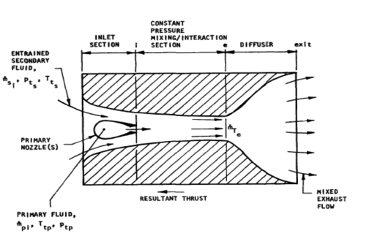
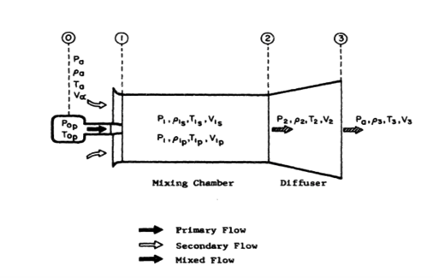
Initial Research
Prior to analysis of the nozzle design obtained from the numerical optimizer, extensive research was conducted on the following topics:
Measurements of air flow characteristics using various probes
Nozzle testing using hybrid engines
Wing tunnel testing involving pressure measurements

Slide 5
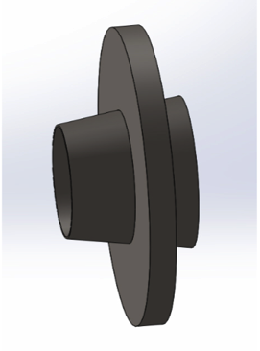
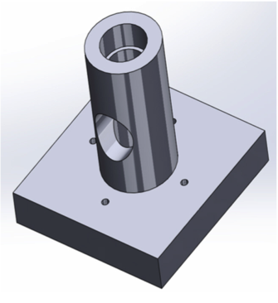
Preliminary Design
CAD models of the ejector nozzle along with the mounting plate for testing on a small hybrid engine were designed
Based on the geometry and dimensions obtained, it was determined that cold-flow testing was to be done to improve the nozzle design before machining the parts

Slide 6
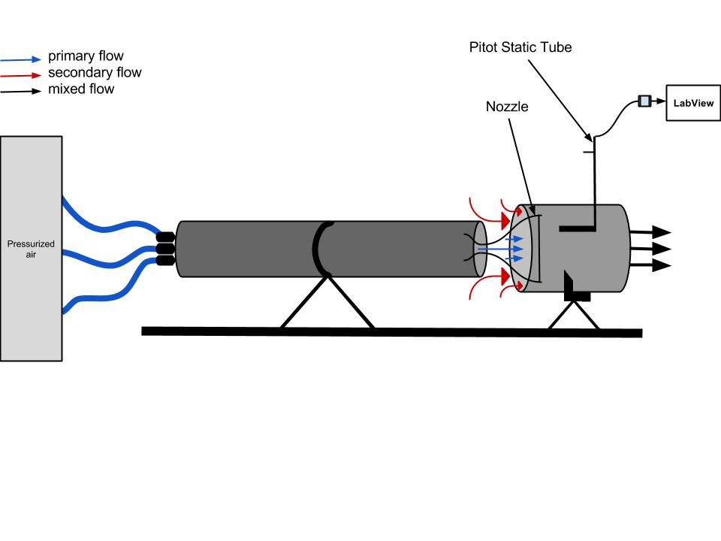
Experimental Set up

Slide 7
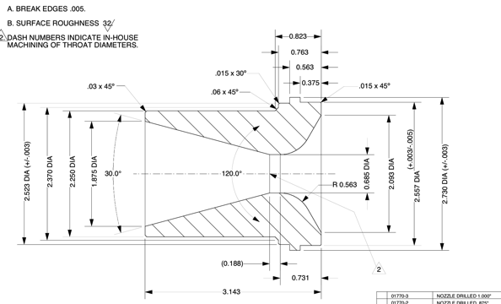
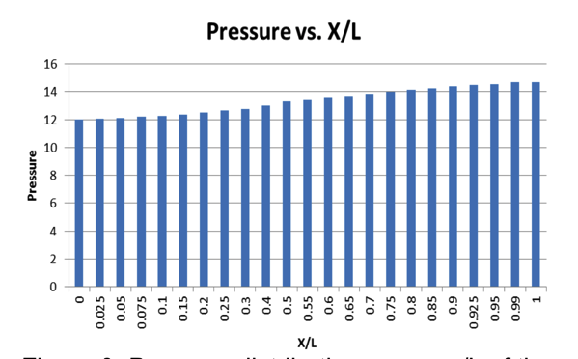
Experimental Design
Single-throat nozzle was used to simulate high-speed flow using compressed air
The objective was to compare the experimental pressure distribution and the mass flow gradient with the theoretical trends obtained using numerical procedures
A constant-area duct was used to serve as the controlled parameter

Slide 8
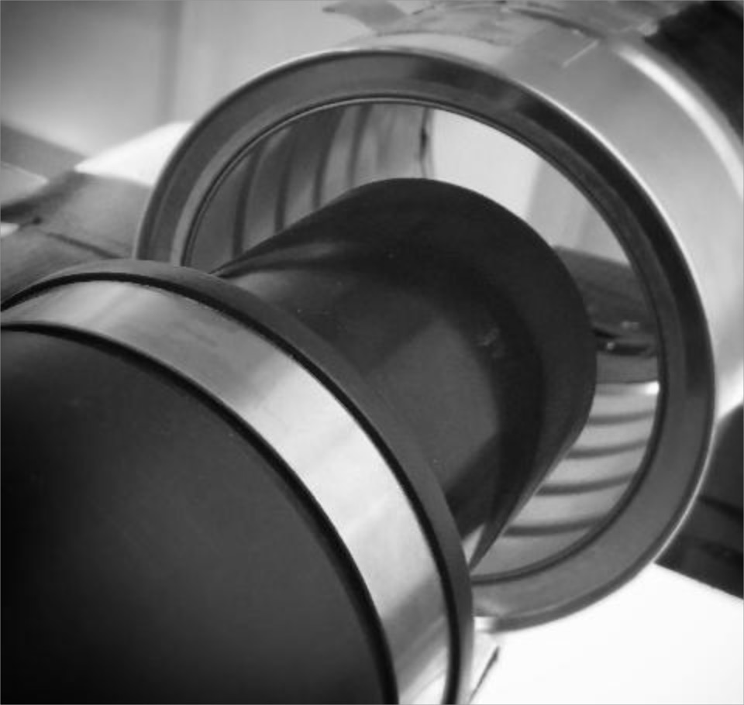
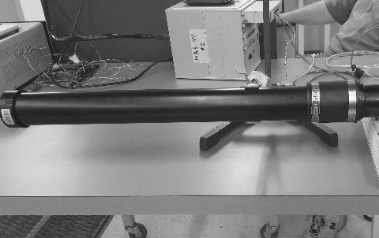
Testing Procedures
Pressurized air entrained the nozzle
where supersonic flow at M > 1 was reached
Using a pitot static tube, total and static
pressures were measured along the x-location
of the nozzle to determine the air velocity
Data collected was used to construct
pressure distribution plots and perform mass flow analysis

Slide 9
Results
Assuming flow expansion occurred without separation, the results allowed for better understanding of static pressure and velocity at the inlet and exit of the ejector
As predicted, the low static pressure at the inlet resulted in an adverse pressure gradient where the secondary flow was forced to entrain the ejector
The results showed an increase in mass flow rate and thrust at the exit

Slide 10
Project Outline
The experimental data provided the basis for understanding compressible air flow as it entrains the ejector and how it contributes to the increase in overall thrust of the rocket engine
The boundary conditions obtained will be used to design a nozzle geometry which prevents flow separation and takes into account compressibility
Ducts with varying cross-sectional geometry are to be tested for further analysis of mass flow behavior at the inlet and outlet
After modifying and improving the design, a hybrid engine will be used to further test various geometry nozzles and establish the basis for future work and flight applications

Slide 11
Thank you!
Special Thanks to:
Dr. Timothy Takahashi
Gaines Gibson
Dr. Bruce Steele

