Slide 1



Aerodynamics of Turbine Blade Cooling Air Feed Rig System: Iris
Researcher: Nicholas Wright
Mentor: Dr. Shigeo Hayashibara
ERAU/NASA Space Grant
Honeywell Sponsored Senior Capstone Project (2014-15)
Arizona Space Grant Consortium Symposium
April 18, 2015

Slide 2
Main Topics
1. Research Problem and Objectives
2. CFD Analysis Approach
3. Half Plane Simulation
4. Half Plane Simulation Results
5. Use of Simulation Results
2

Slide 3
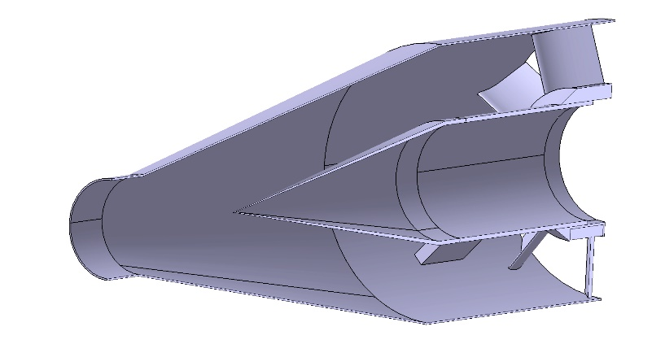
1. Research Problem and Objectives
Research Problem
Turbine rig (Iris) is theoretically designed to minimize pressure loss but it is difficult to
verify this claim with the real rig.
Research Objectives
• Identify total pressure loss regions
in inlet, if any, with CFD models
• Discuss inlet design improvements if necessary
Iris Inlet [Diffuser, Feed Duct, Inlet Guide Vane]
3

Slide 4
2. CFD Analysis Approach
Approach
2D Model -> Half Plane 3D Model -> Full 3D Model
CFD Steps
1. Geometry -> CATIA
2. Mesh -> Pointwise
3. Solver -> ANSYS Fluent
4. Post-Process -> FieldView
5. Iterate if necessary
4

Slide 5
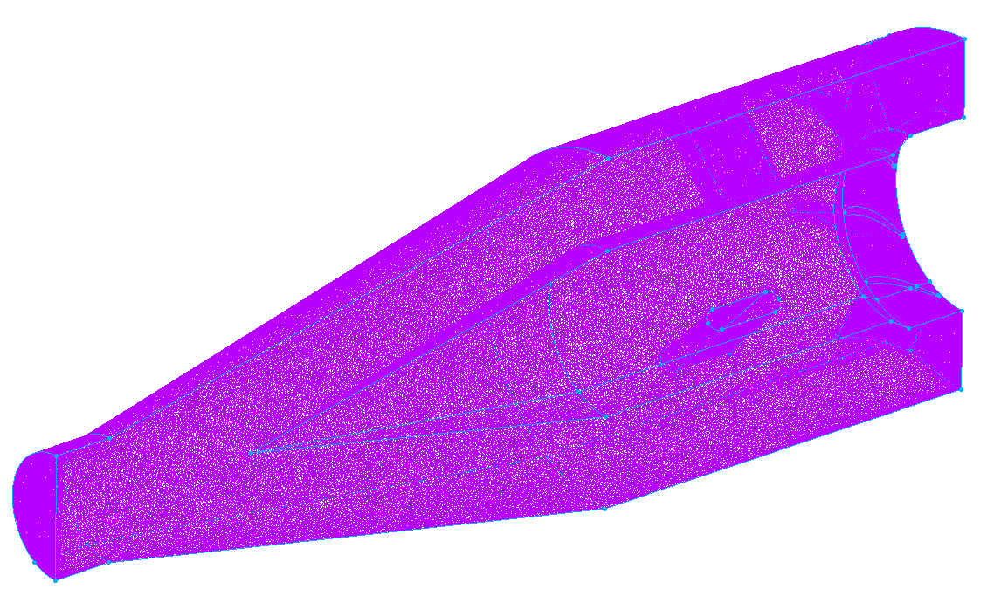
3. Half Plane Simulation
Pointwise Mesh
Fluent Model/Boundary Conditions
• Spalart-Allmaras turbulence model
• Transient time, pressure-based solver
• Mass flow inlet
• Symmetry plane
• Outflow condition on outlet
Mesh Type | # of Points | # of Cells
Unstructured | 1,095,136 | 5,738,755
Mesh of Iris Inlet
5

Slide 6
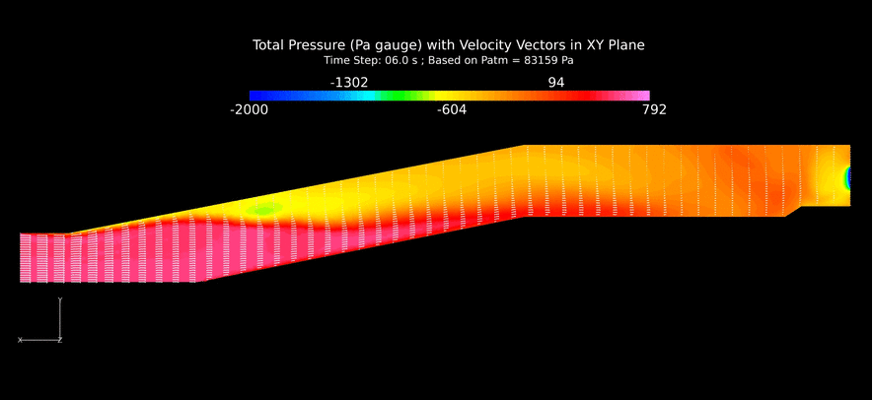
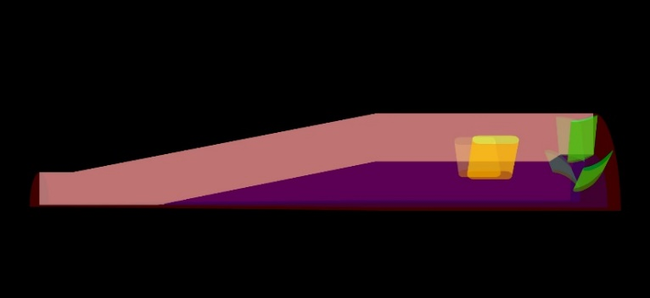
4. Half Plane Simulation Results
Plane of Interest
Pressure Contours/Velocity Vectors of Simulated Air Flow through Center of the Half Plane Model
6

Slide 7
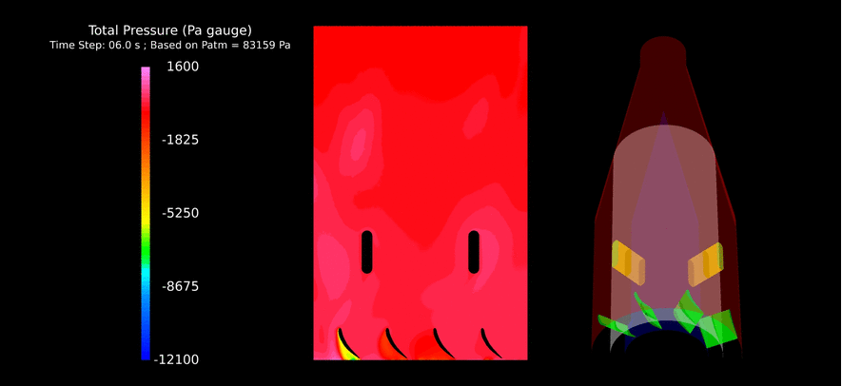
Half Plane Simulation Results
Plane of Interest
Pressure Contours of Simulated Airflow around the Supports and Inlet Guide Vane at the Mean Radius Line of the Blades of the Inlet Guide Vane
7

Slide 8
5. Use of Simulation Results
Half Plane Model is not validated
• Results cannot be used to describe the actual
airflow through the inlet of the turbine rig (Iris)
Use of Half Plane Simulation Results
• Identify potential areas of the inlet (i.e. the
diffuser) that may produce total pressure loss
regions in latter CFD models
8

Slide 9
Thank You
9

