Slide 1
Experimental Study of Shock Wave/Boundary Layer Interaction on Swept and Unswept Wedges
Clark Pederson
University of Arizona
Advisor: Dr. Jesse Little,
Assistant Professor, Department of Aerospace and Mechanical Engineering,
University of Arizona
Arizona Space Grant SYMPOSIUM
April 18th, 2015
Tempe, AZ

Slide 2
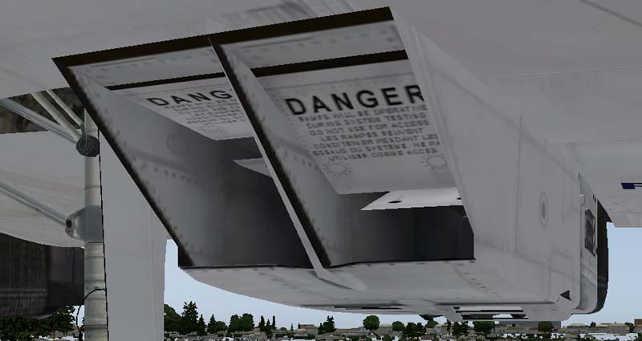
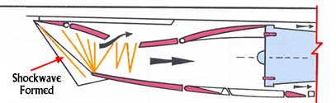
Shock Wave/Boundary Layer Interactions
Also known as SBLI or SWBLI
SBLIs occur anytime there is a fin, inlet, or corner on a supersonic vehicle
  Applies to missiles, rockets, fighter jets, commercial supersonic flight, and more.
SBLIs are highly unsteady
This leads to damaging pressure and temperature fluctuations.
Top Image from flight1.com
Bottom Image from concordesst.com
Notes:
JL: use slide numbers, don’t take up so much space on page with title

Slide 3
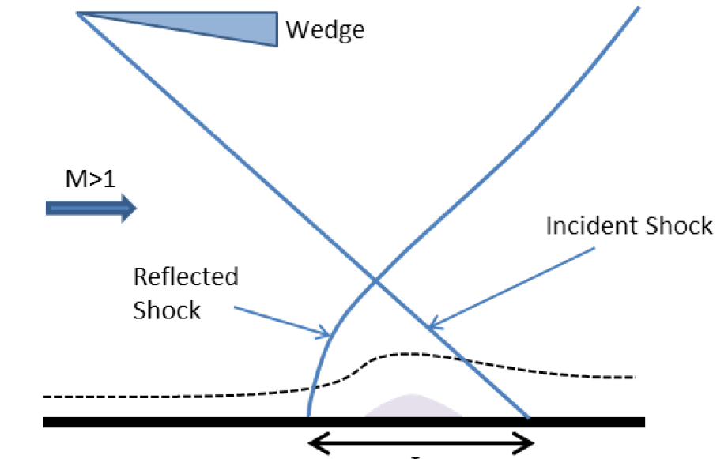
Specific Case Examined: Swept Wedges
Diagram of shock waves
Diagram of sweep angle
y
y
x
x
z
Image from Holden, 1984. Coordinate axis added.
Image from Hainsworth, 2014. Coordinate axis added.
Notes:
JL: schlieren image might be nice, see literature or jared ppt

Slide 4
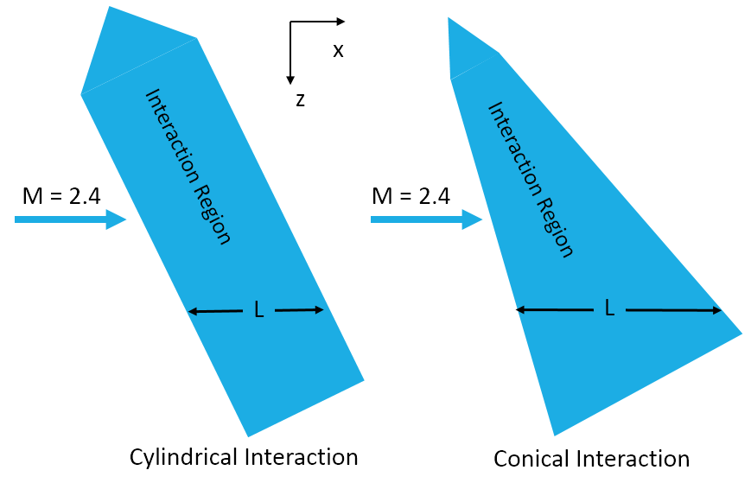
Research Questions
How do the interaction lengths change as the sweep angle changes?
When does the flow separation begin to demonstrate conical behavior?
How much did the wind tunnel affect results?
Image based on Settles 1984
Notes:
JL: will need to explain this

Slide 5
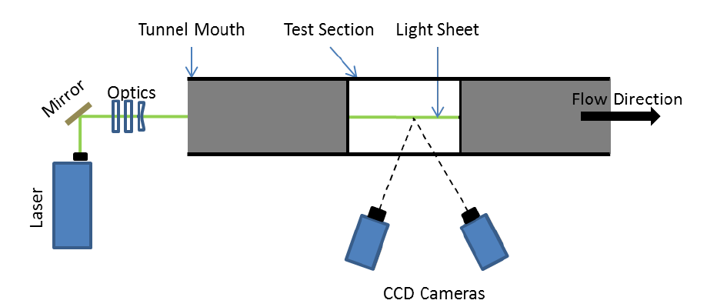
Method Utilized to Analyze SBLI: PIV
x
z
Image from Hainsworth, 2014. Coordinate axis added.

Slide 6
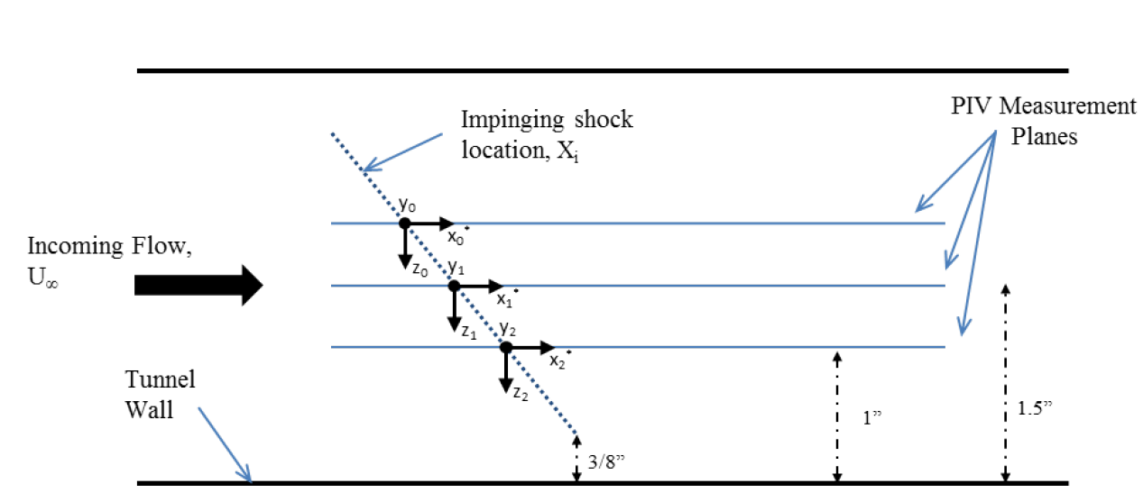
Planes Examined
Image from Hainsworth, 2014

Slide 7
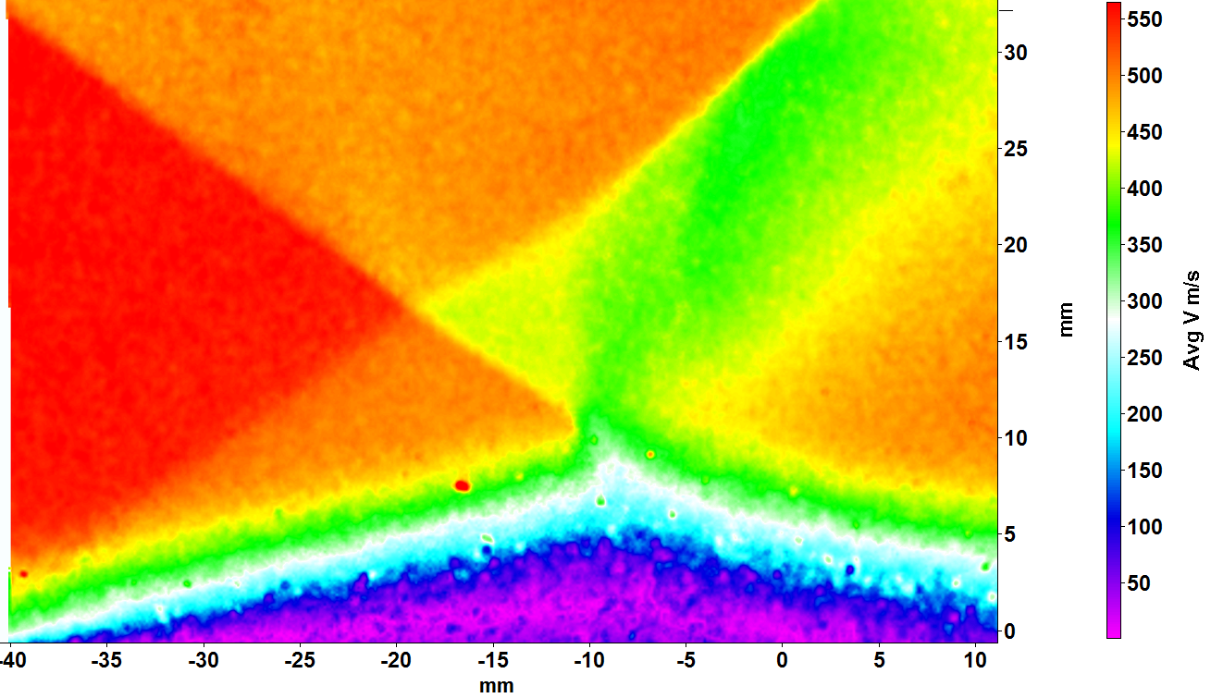
PIV Velocity Data Field
Velocity field was extracted from the PIV data.
The upwards velocity component (V) was utilized to find interaction length
A custom built MATLAB script was used to find the two shock waves
Notes:
JL: I have a good movie for you, but it is too big to email

Slide 8
Previous Experiment vs. Mirrored Experiment
Notes:
Bigger, thicker lines and symbols

Slide 9
Conclusions
Cylindrical behavior seen in previous experiments is not just experimental bias.
While the flat wedge exhibits a uniform interaction length, the 40 degree swept wedge does not.
This helps to better understand 3D (real world) supersonic flows, especially with respect to inlets of engines.
Ongoing work involves the examination of the turbulent characteristics of the flow and boundary layer profiles.

Slide 10
Acknowledgements
My research mentor: Dr. Jesse Little
My research team:
  Jared Hainsworth and Robyn Dawson, especially
Air Force Office of Scientific Research
NASA Space Grant Program
  Susan Brew
  Chandra Holifield

Slide 11
Thank You!

Slide 12
Citations
Clemens, Noel T., and Venkateswaran Narayanaswamy. "Low-frequency unsteadiness of shock wave/turbulent boundary layer interactions." Annual Review of Fluid Mechanics 46 (2014): 469-492.
“Concorde SST : Powerplant.” (n.d.). Retrieved March 31, 2015, from http://www.concordesst.com/powerplant.html
“Flight1.com - Great Aviation Products.” (2014, January 1). Retrieved March 31, 2015.
Hainsworth, J. Experimental Study of Unswept and Swept Oblique Shock-Turbulent Boundary Layer Interactions, (Unpublished masters thesis). University of Arizona, Tucson. 2014
Holden, M. S. “Experimental studies of quasi-two-dimensional and three-dimensional viscous interaction regions induced by skewed-shock and swept-shock boundary layer interactions.” No. CALSPAN-7018-A-2. Arvin/Calspan Advanced Technology Center Buffalo Ny Physical Sciences Dept, 1984.
Settles, G.S. and Teng, H.Y. 1984. “Cylindrical and conical upstream influence regimes of three-dimensional shock/turbulent boundary layer interactions.“ AIAA Journal 22, p. 194-200.

