Slide 1
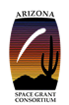
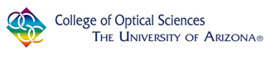
Simulation of Material Characteristics and Laser Performance of Q-Switched Quantum Well Semiconductor Lasers
L. Chardee Allee
2014-2015 NASA Space Grant Symposium
18 April, 2015
Acknowledgements:
Dr. Rolf Binder (UofA)
Dr. Nai-Hang Kwong (UofA)
Dr. Paul Lundquist (Areté)

Slide 2
Outline
Project Motivation
Introduction, quantum well lasers and Q-switching
Simulation framework
Matlab simulation
Conclusion

Slide 3
Project Motivation
High power pulsed lasers have many applications (cutting and drilling, medical uses, measurement purposes such as ranging or LIDAR)
Q-switching typically employed in non-semiconductor lasers
Q-switching not well established for semiconductor lasers
Goal is to explore the possibility of Q-switching in semiconductor lasers, for example, a green gallium nitride laser

Slide 4
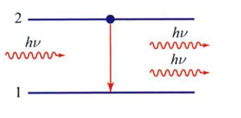
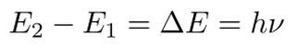
What is a LASER?
Light Amplification by Stimulated Emission of Radiation
From: Saleh, Teich Fundamentals of Photonics (Wiley, 2007) p. 503
ΔE = Band gap energy, usually denoted E_{g}
No energy states exist between E₁ and E₂

Slide 5
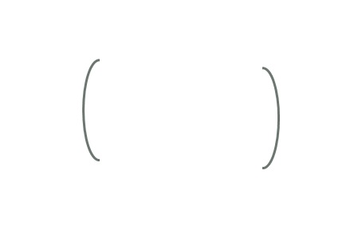
What is a LASER?
What is needed:
Energy source (pump)
Gain medium
Resonator cavity (for example, mirrors)
Energy source (pump)
Resonator cavity
Gain Medium

Slide 6
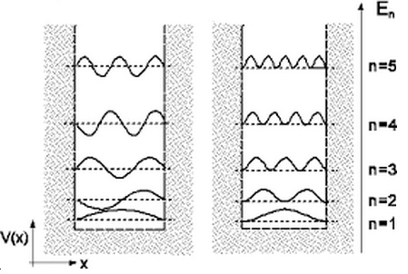
Quantum Well
Potential well with discrete energy values
Wave functions Probability density functions
From: Interaction Potentials, <http://www1017.vu.lt/legacy/pfk/funkc_dariniai/quant_mech/potentials.htm>

Slide 7
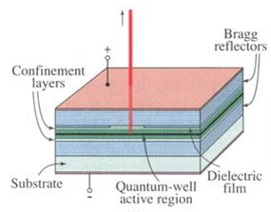
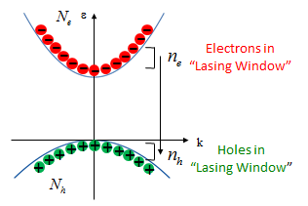
Semiconductor Quantum Well Laser
Gain is within semiconductor material
From: Saleh, Teich Fundamentals of . . Photonics (Wiley, 2007) p. 729
Gain process within the active region

Slide 8
Green Lasers
Frequency doubling is often employed to produce a green laser output
Requires accurate alignment within the laser
Not very robust
Current project looks to create a direct green laser
Easier to build
Very robust

Slide 9
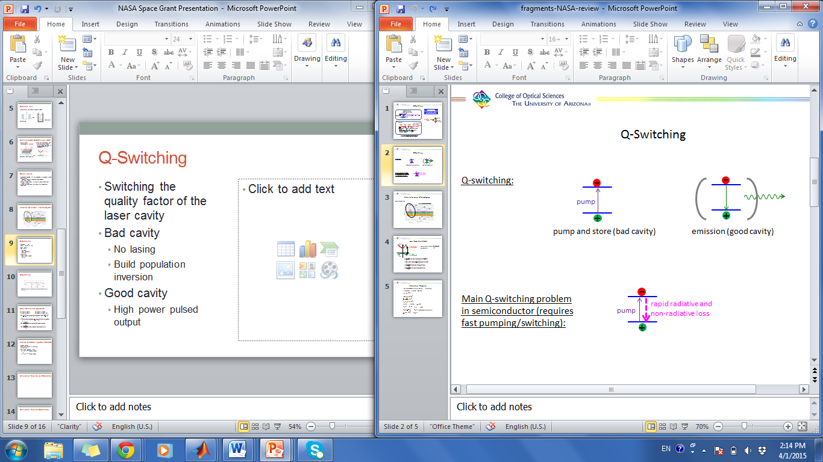
Q-Switching
Switching the quality factor, “Q” of the laser cavity such as changing reflectivity of mirrors
Bad cavity
No lasing
Build population inversion
Good cavity
High power pulsed output

Slide 10
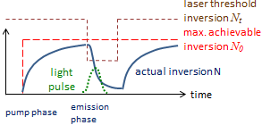

Q-Switching
Difficulty with Q-switching in
semiconductors: Requires fast
pumping and switching
-
rapid radiative and
non-radiative loss
pump
+

Slide 11
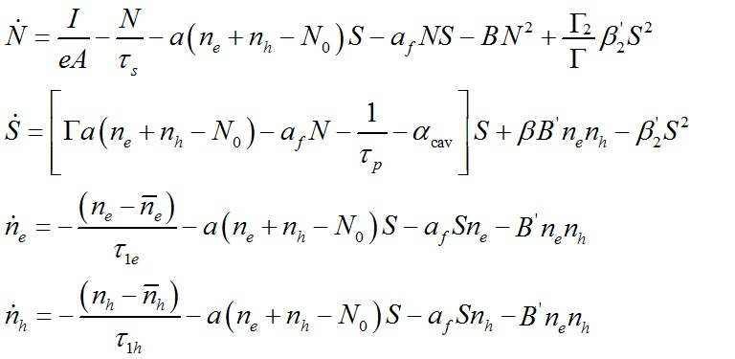

Semiconductor Model
N = Carrier density n_{h}= Density of holes ${ τ}_{p}$ = Photon lifetime
S = Photon density n_{e} = Density of electrons
Laser simulation model based on J. Mork, J. Mark, ‘Time-resolved spectroscopy of semiconductor laser devices: Experiments and modelling’, Proc. SPIE 2399, Physics and Simulation of Optoelectronic Devices III, 146 (June 19, 1995).

Slide 12
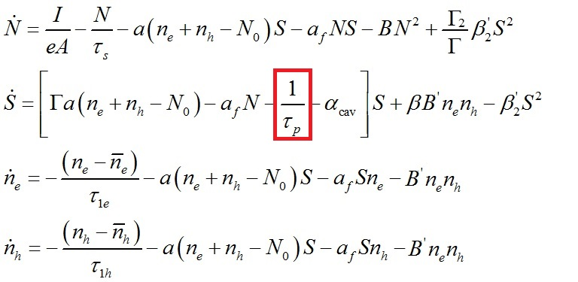

Semiconductor Model
Quantity $\frac{1}{τ_{p}}$ is switched from a large value (bad cavity) to a smaller value (good cavity).

Slide 13
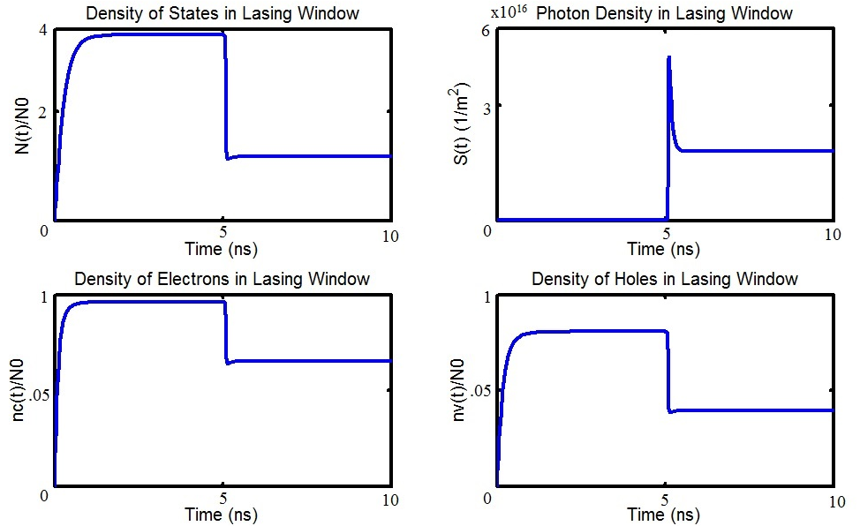
Simulation Results, Q-Switching
Note: Very preliminary results. Further parameter adjustment are needed.

Slide 14
Simulation Results, Q-Switching
Bad Cavity
Laser Pulse
Good Cavity
Switch
Note: Very preliminary results. Further parameter adjustment are needed.

Slide 15
Next Steps
Further adjust laser parameters to make model more realistic
Develop a program to numerically solve Schrodinger’s Equation
Create a better understanding for the behavior of the given quantum well
Further develop model to try and build this laser for testing

Slide 16
Summary
Q-switched lasers are of practical importance
We are trying to explore Q-switching in semiconductor lasers
Utilizing theoretical simulation model for semiconductor laser dynamics
Explored parameter regimes for possible Q-switching

Slide 17
Additional Slides

Slide 18
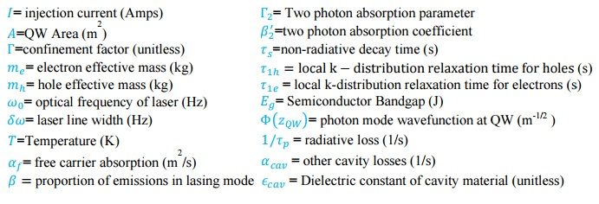
Simulation Parameters

Slide 19
Simulation Parameters

Slide 20
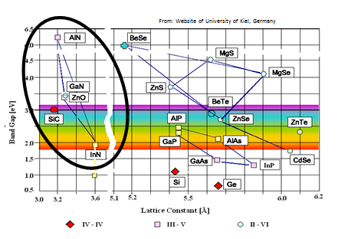
Material Selection: III-Nitride System

