Slide 1
Plasma enhanced atomic layer deposition of ultrathin oxides on graphene
April 18, 2015
Christie J. Trimble, Anna M. Zaniewski, Manpuneet Kaur, and Robert J. Nemanich
Notes:
Introduce self, give background on graphene and project goals.

Slide 2
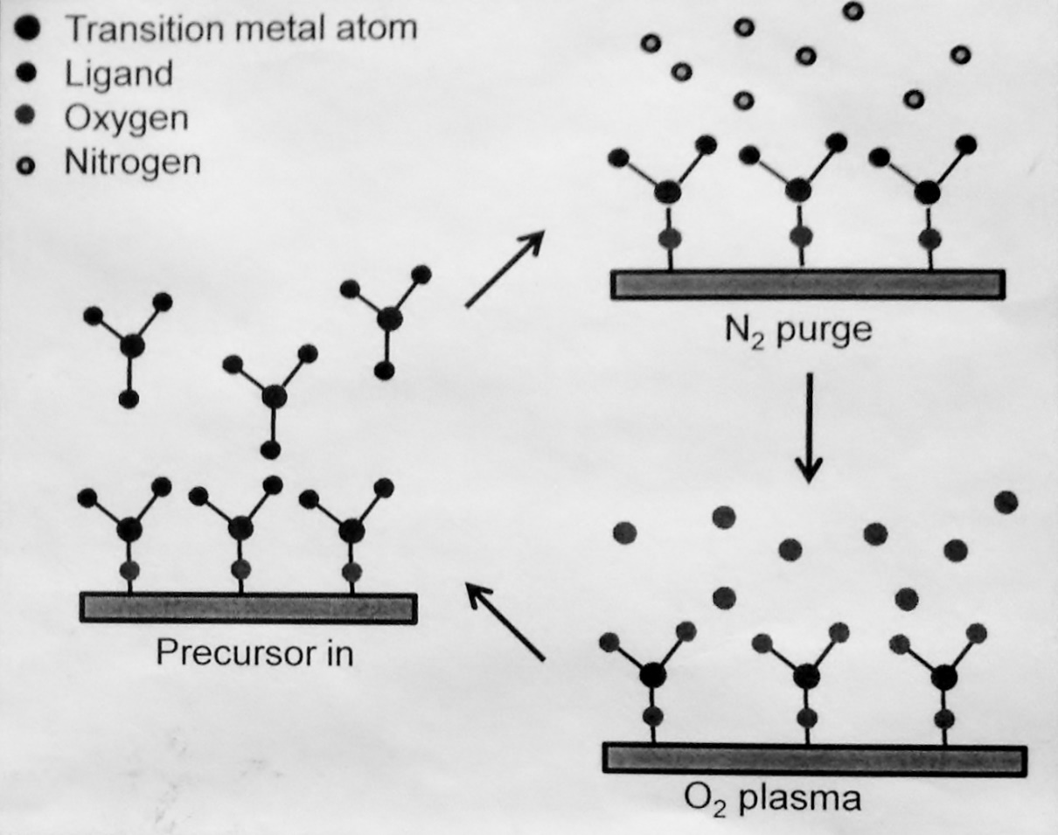

Plasma enhanced atomic layer deposition
Controlled, self terminating
Even coverage
Plasma exposure can damage graphene
Notes:
Explain PEALD and plasma dilemma.

Slide 3
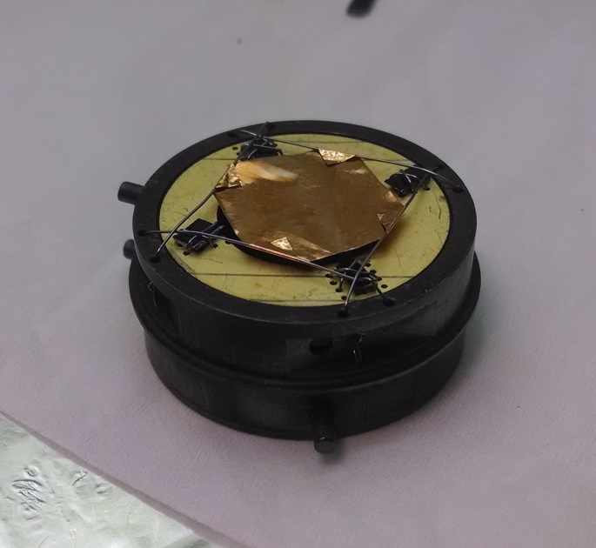
Samples of graphene on copper are suspended above sample holders with spacing created by silicon wafers
ALD is performed such that growth is achieved on front and back sides
Notes:
Explain suspension technique.

Slide 4
XPS results-front
Cu
CuO
Cu
Al
Notes:
Discuss results

Slide 5
XPS results-back
Notes:
Discuss results

Slide 6
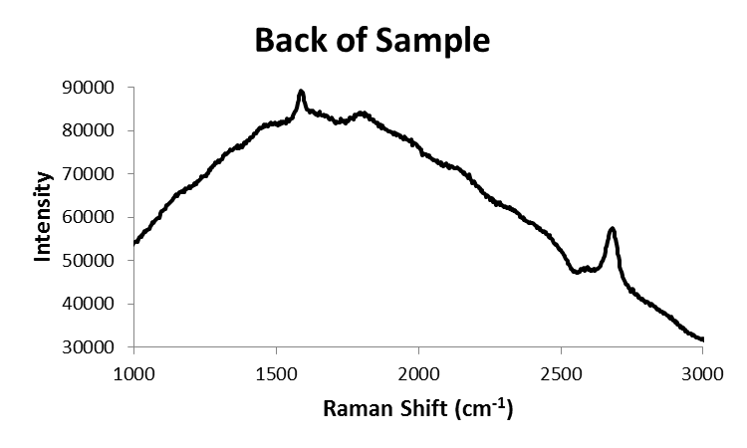
Raman spectroscopy
G
G’
G
G’
D
G’
Plasma induced defects are found on the front side of the sample but are absent on the back
G
Notes:
Discuss results

Slide 7
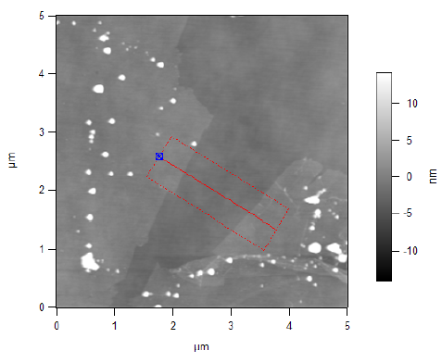
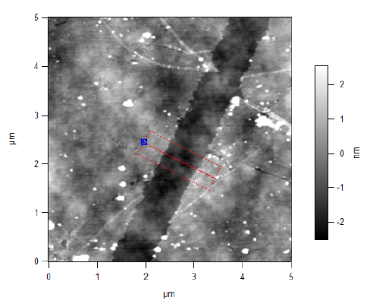
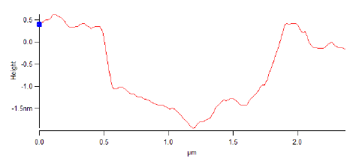
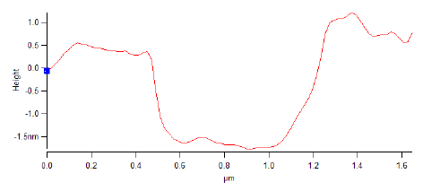
Atomic force microscopy results
front
back
Notes:
AFM results.

Slide 8
Next steps
Optimization of ALD results
Transfer of films to TEM grids for further analysis
Notes:
Next steps.

Slide 9
Acknowledgements
Dr. Robert Nemanich, Dr. Anna Zaniewski, Manpuneet Kaur, and the NSL Group
This work was supported by the National Science Foundation and the ASU/NASA Space Grant Program
Notes:
Thank you.

