Slide 1



Two-Dimensional Patterning of Nanoparticle Thin Films from in situ Microreactors
Jonathan Dwyer
Arizona Space Grant Symposium
April 18, 2015

Slide 2
Why Do We Care
Deposit metal lines in a pattern without etching to make an electronic device
Does not require an applied voltage to the deposition surface
Reduces cost to plate surfaces with thin layer of a metal
Seed layer for 2-D electroplating

Slide 3
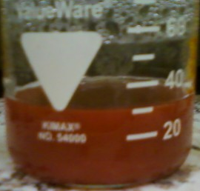
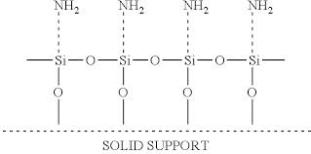
Background Information
Nanoparticle Synthesis
Modified Polyol Method
Deposit thin films using metal nanoparticles
Scanning electron microscope (SEM)
http://patentimages.storage.googleapis.com/US20120187373A1/US20120187373A1-20120726-C00001.png

Slide 4
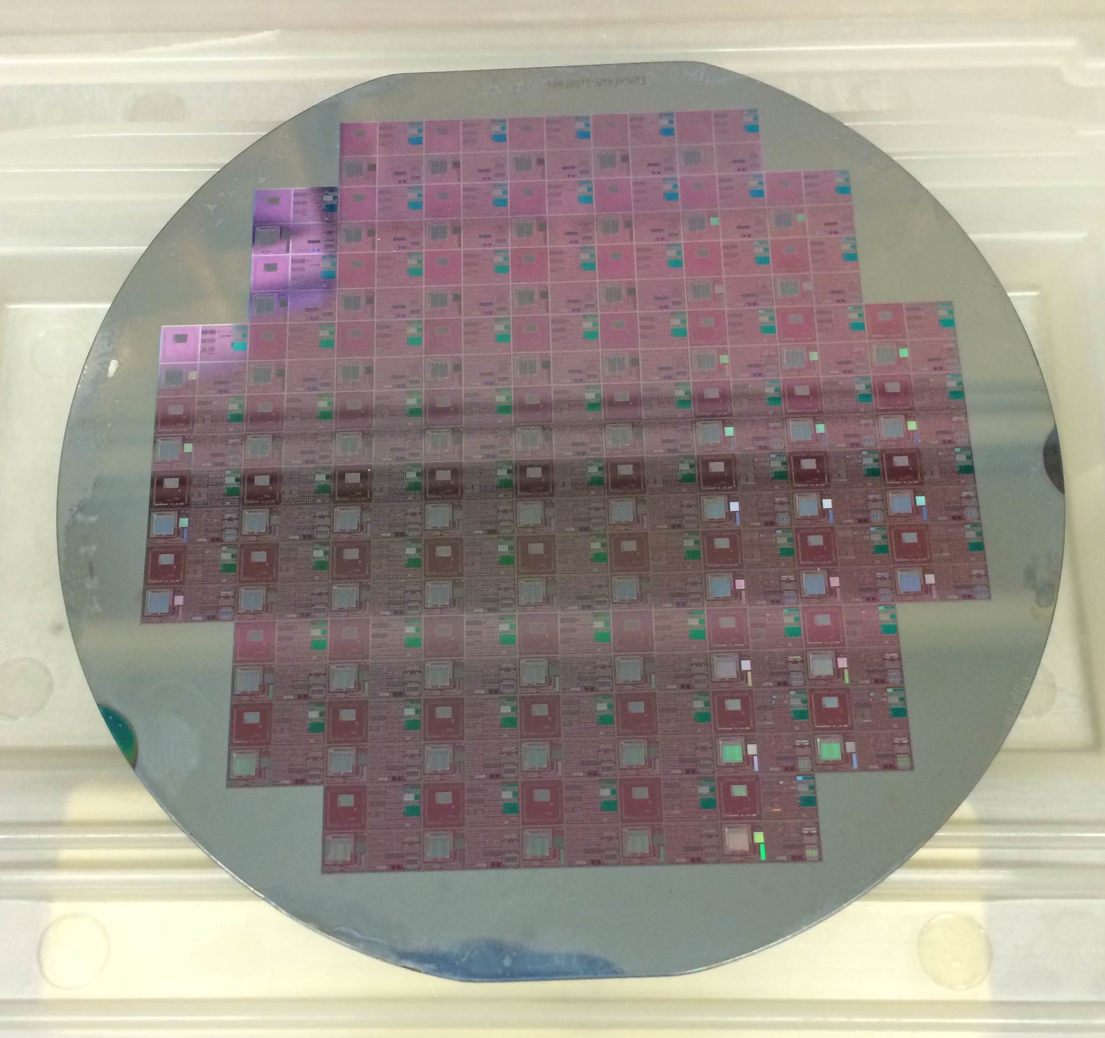
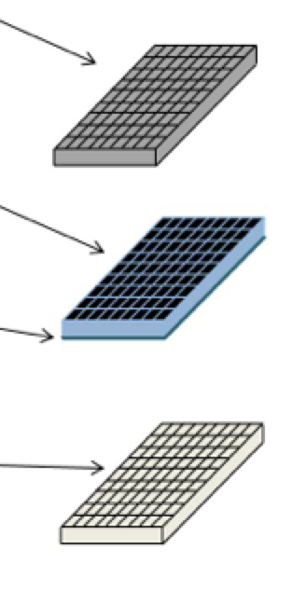
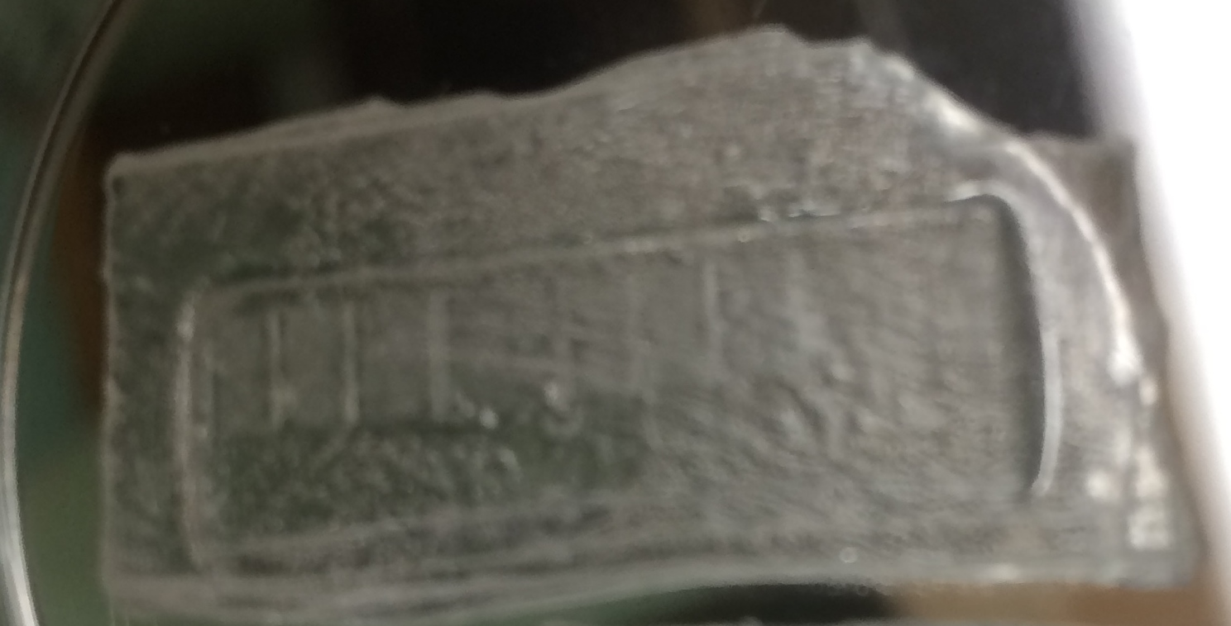
PDMS Microreactor from Si Mold
Patterned Silicon with Microfeatures
Polydimethoxysilane (PDMS)
Polyethylene (PE)

Slide 5
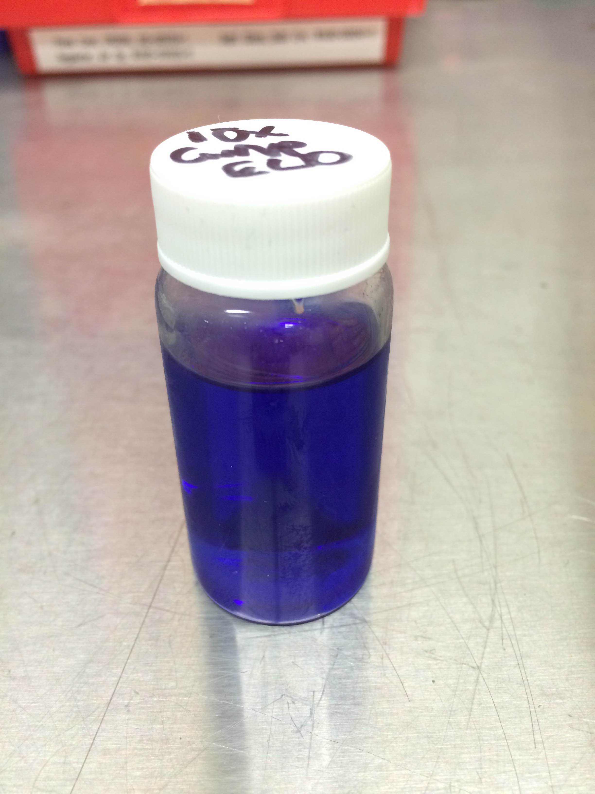
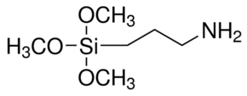
Fabrication
Silicon
Aminopropyltrimethoxisilane (APTMS)
Copper Nanoparticles
PE Mold
Heat
http://www.sigmaaldrich.com/catalog/product/aldrich/281778?lang=en&region=US

Slide 6
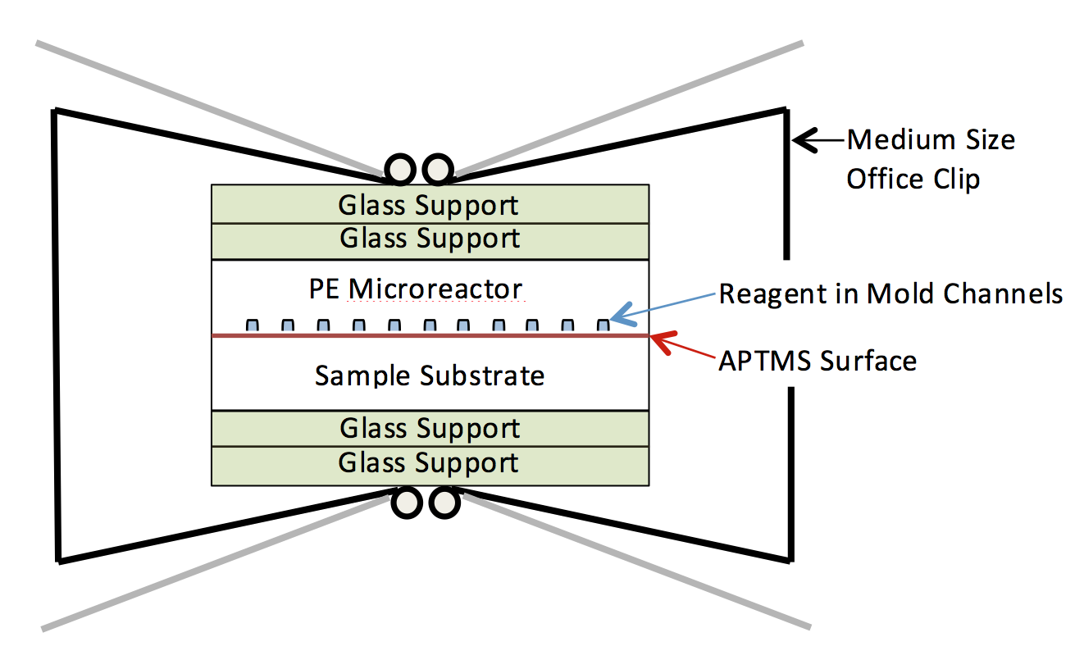
Print Metal with Microreactor

Slide 7
Cu
Nano-particles
PE
PE

Slide 8
Copper
Nano-particles
PE
PE

Slide 9
Project Results
Deposited copper nanoparticle wires in a pattern
10-20 nm thick
micron-scale widths
Useful for seed layer to electroplate onto for thicker film growth
Patent disclosure submitted

Slide 10
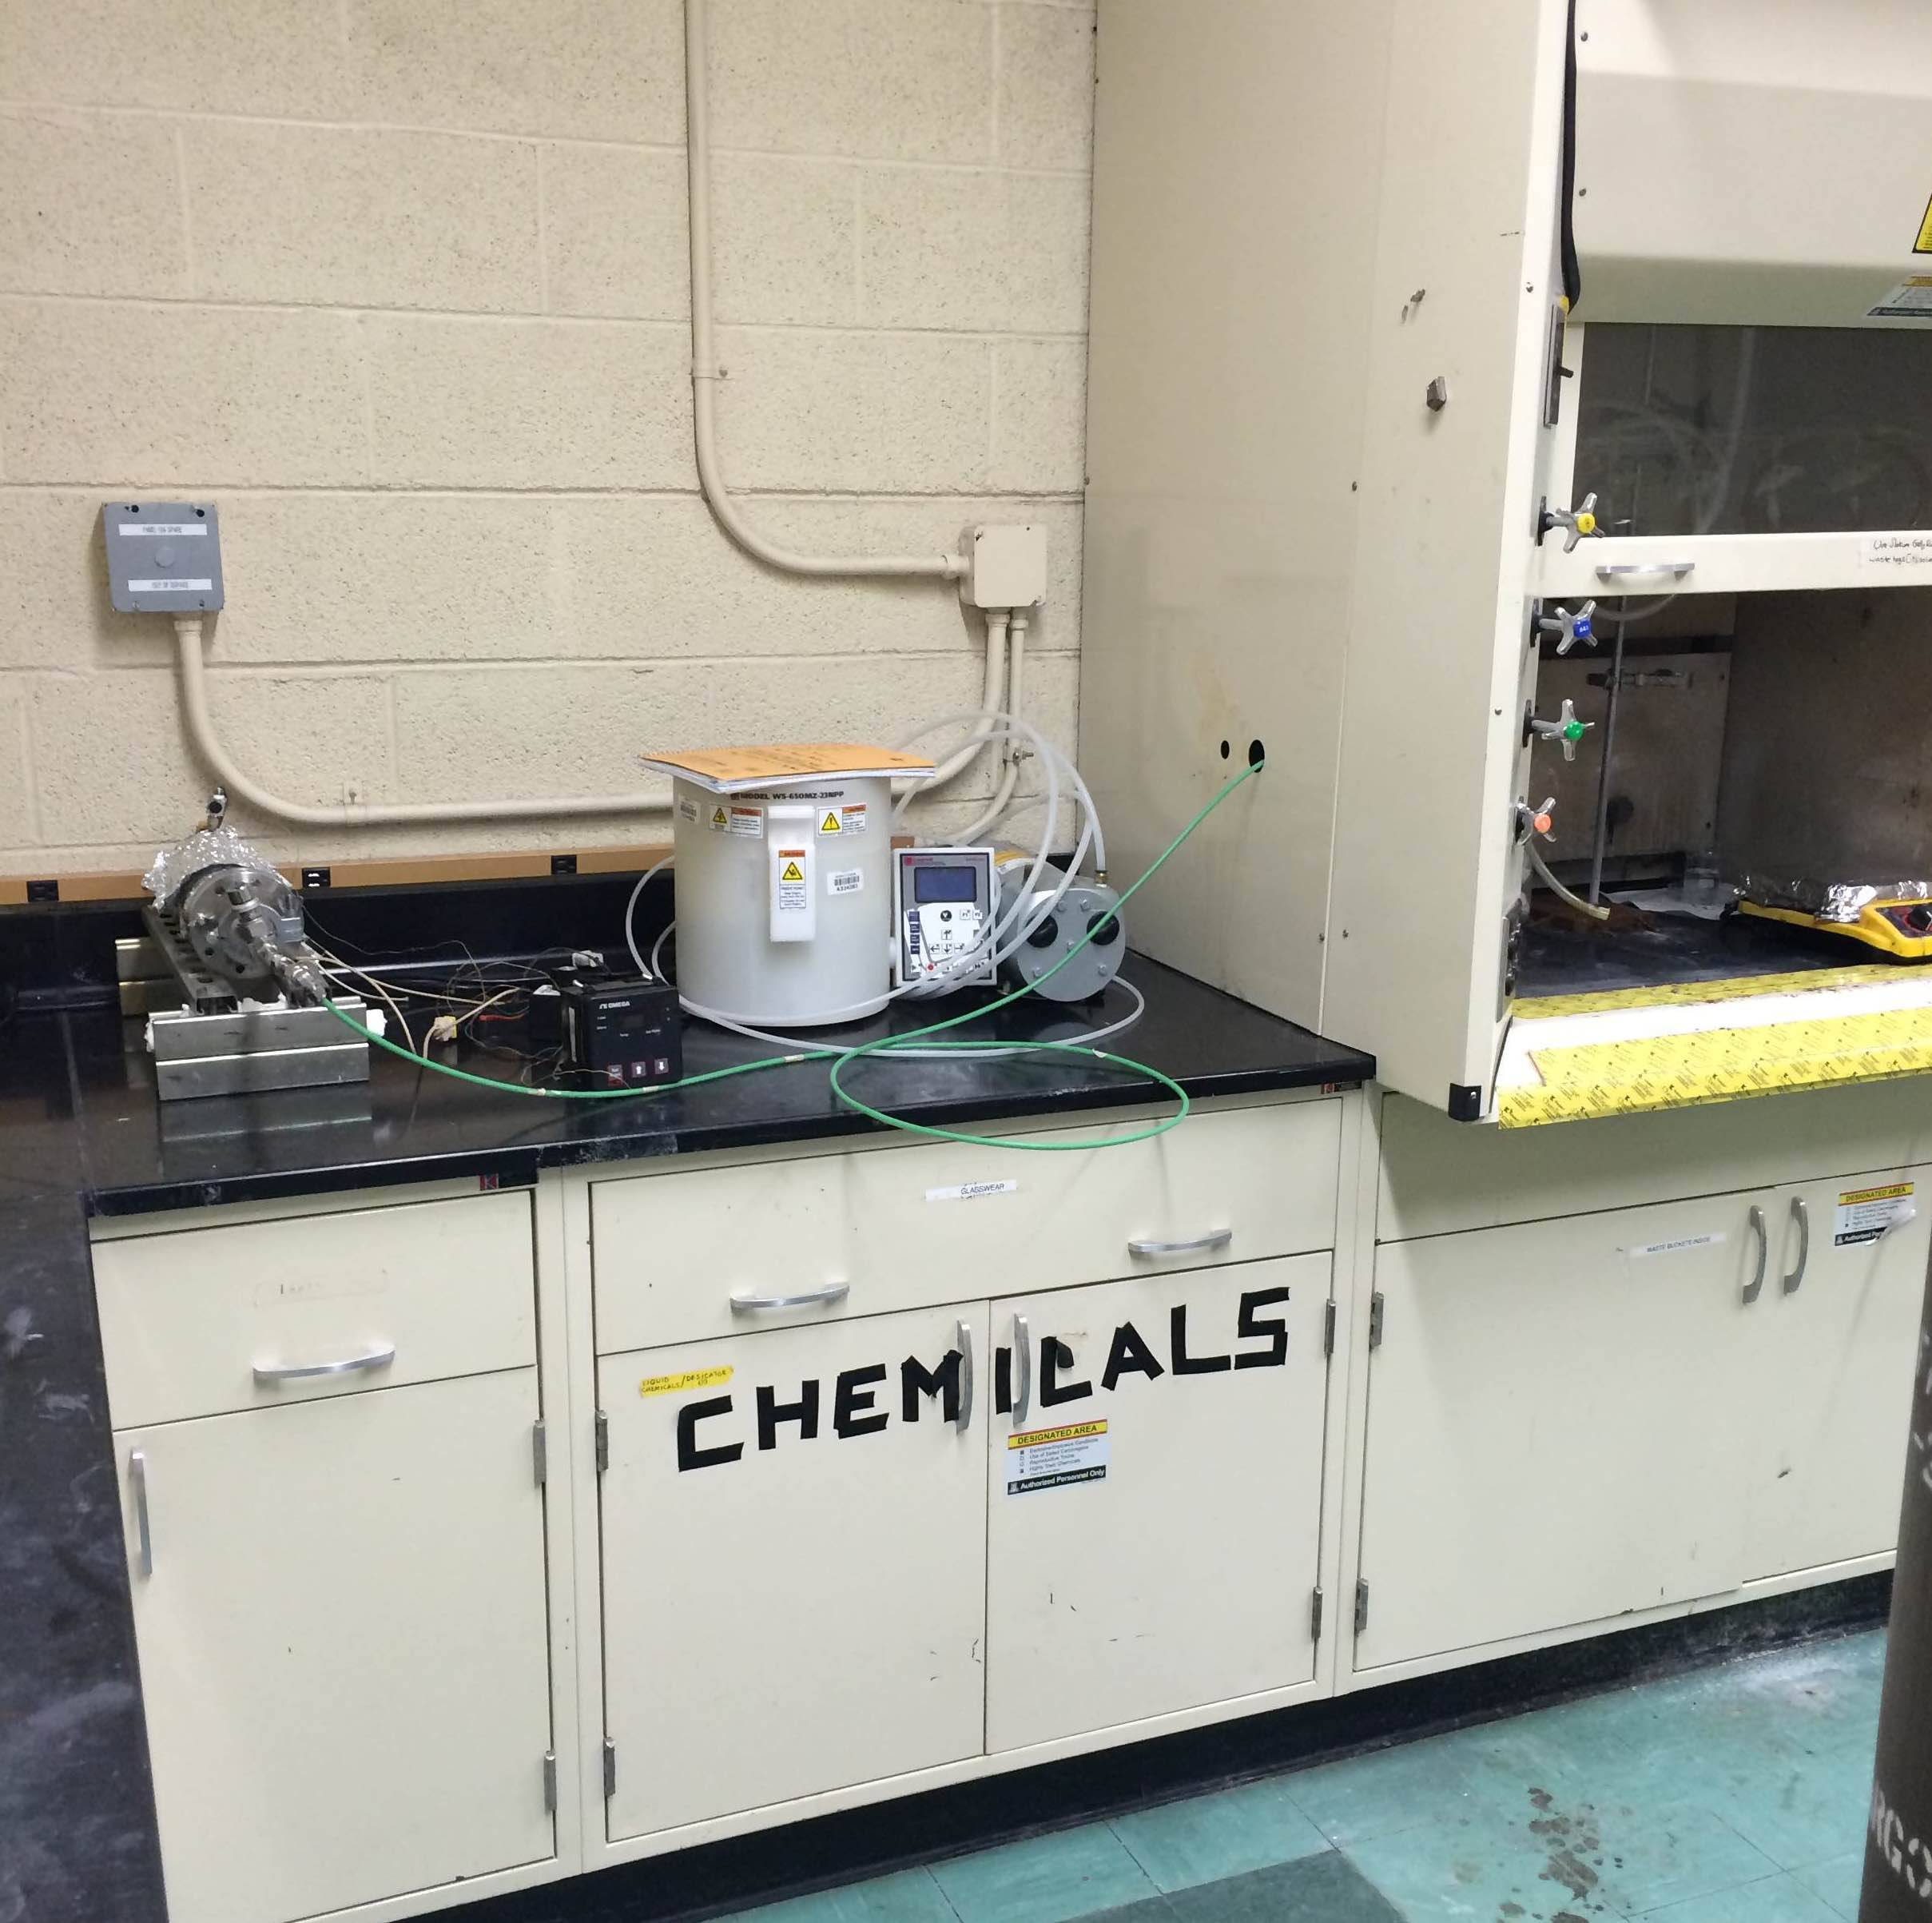
Thank You
NASA Space Grant
Dr. Anthony Muscat
Lance Hubbard

