Slide 1
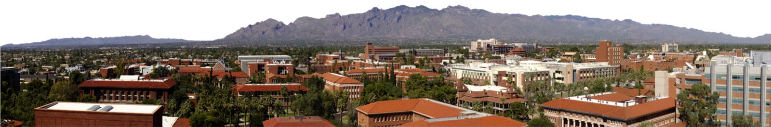


Layer-by-Layer Assembly of Gold Nanoparticles into Monolayers
Daniel Witter
Chemical Engineering
U of A

Slide 2
Objective
Deposit thin film of gold with a desired thickness via layer-by-layer assembly
  Current methods are expensive and slow
  Deposit seed layer for electroplating
    Chemical or physical vapor deposition (CVD and PVD), or other vacuum techniques
Notes:
Primary current method of thin metal films is chemical or physical vapor deposition, both of which are rather costly. Layer by layer assembly would represent a low-cost alternative for the formation of thin metal films. Gold is of interest because it is a highly conductive metal, albeit a rare and expensive one. Thin layers minimize the amount of metal used without sacrificing conductivity. This project focused on the assembly portion of the task at hand.

Slide 3
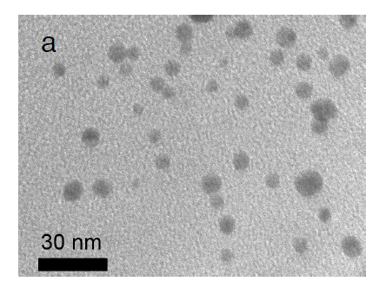
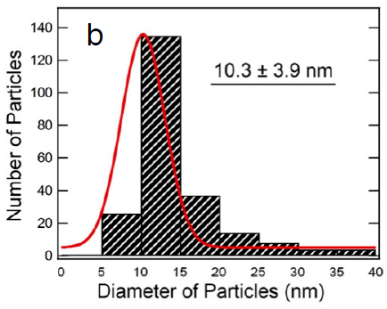
Gold Nanoparticle Characterization
Diameter distribution of Au NP suspension (Jiang, et al)
TEM image of Au NPs (Jiang, et al)
Notes:
Here we have a transmission electron microscopy (TEM) image of gold nanoparticles in solution, as prepared via the Brust process. From this image the plot on the right was generated prior to when I began working on the project, but this shows that the diameter distribution of the nanoparticles formed is relatively monodisperse; the average particle diameter is 10.3 nm, with little variation. A monodisperse solution is preferred for applications and research such as this, as it eliminates some of the variability in testing.

Slide 4
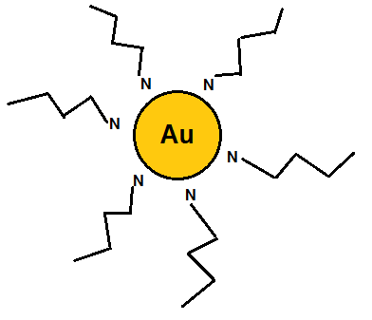
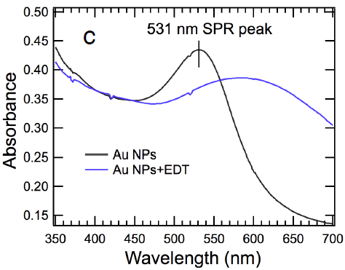
Gold Nanoparticle Characterization
Amine-stabilized gold nanoparticle in solution
UV-vis spectra of Au NP suspension (Jiang, et al)
Notes:
Shown here is a much-simplified sketch of a stabilized gold nanoparticle as it might appear in the suspension, prepared according to the Brust procedure. The particle is surrounded by amine groups that have a slight charge, and thus interact closely with the slightly-charged particle. These bulky amine-terminated compounds prevent the nanoparticles from agglomerating and falling out of solution, effectively stabilizing them for extended periods of time. Suspensions of these particles can be characterized via UV-vis absorbance and looking for specific peaks to indicate the presence of gold. This spectra here from Jiang’s work is one such spectra, and shows the presence of gold nanoparticles.

Slide 5
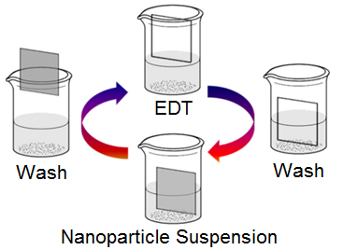
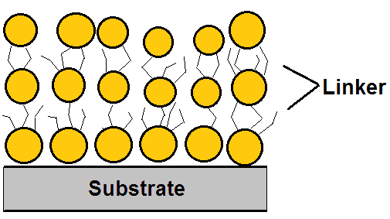
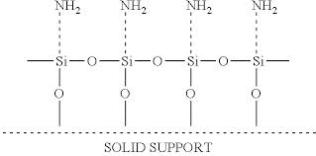

Layer-by-Layer Dipping Procedure
Schematic of cyclical layering process
Substrate, functionalized with amine seed layer, and with linked gold nanoparticle layers
EDT Structure
Notes:
Having prepared our nanoparticle suspension, we begin the most crucial part of the project: the dip procedure. Here we have a picture that details the method of layer. We take whatever our substrate is to be (silicon with various seed layers being of interest) and dip it first in the nanoparticle suspension, then a cyclohexane wash, then in our “linker” solution, which in this case is ethanedithiol, or EDT, the structure of which is shown here. Thiols (the sulfur-hydrogen bond you see) form a relatively strong bond with gold, so we use EDT to act as a sort of double-sided tape to form our layers of nanoparticles. We repeat this cycle as many times as we like, and then sinter the substrate to remove the linker molecules and leave only the gold layers.

Slide 6
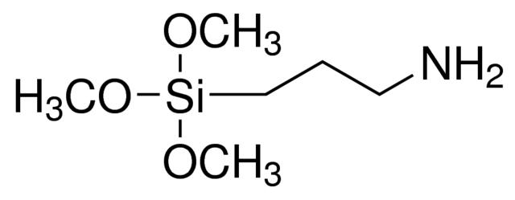
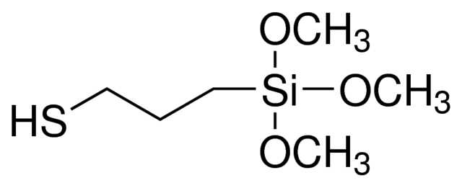
Substrate Selection
Functionalized silicon wafers
  (3-aminopropyl)trimethoxysilane (APTMS)
  (3-mercaptopropyl)trimethoxysilane (MPTMS)
Copper metal
Copper nanoparticles on silicon
CVD copper on silicon
APTMS structure
MPTMS structure
Notes:
Different substrates have different surface chemistries. Silicon wafers functionalized with self-assembled monolayers of APTMS or MPTMS were the original focus, but the project expanded to look at gold-on-copper deposition, given that metals tend to attract each other under these conditions.

Slide 7
SEM Analysis
Scanning Electron Microscopy (SEM)
  Analysis of surface characteristics and morphology
APTMS-functionalized silicon: Cross-section SEM image to determine film thickness
APTMS-functionalized silicon: Top surface SEM image to determine surface coverage
Notes:
Scanning electron microscopy or SEM is the main method of analysis for these samples. Shown here is the same sample, APTMS-functionalized silicon with 8 “dip cycles”, shown from a top-down perspective and a cross-sectional perspective.

Slide 8
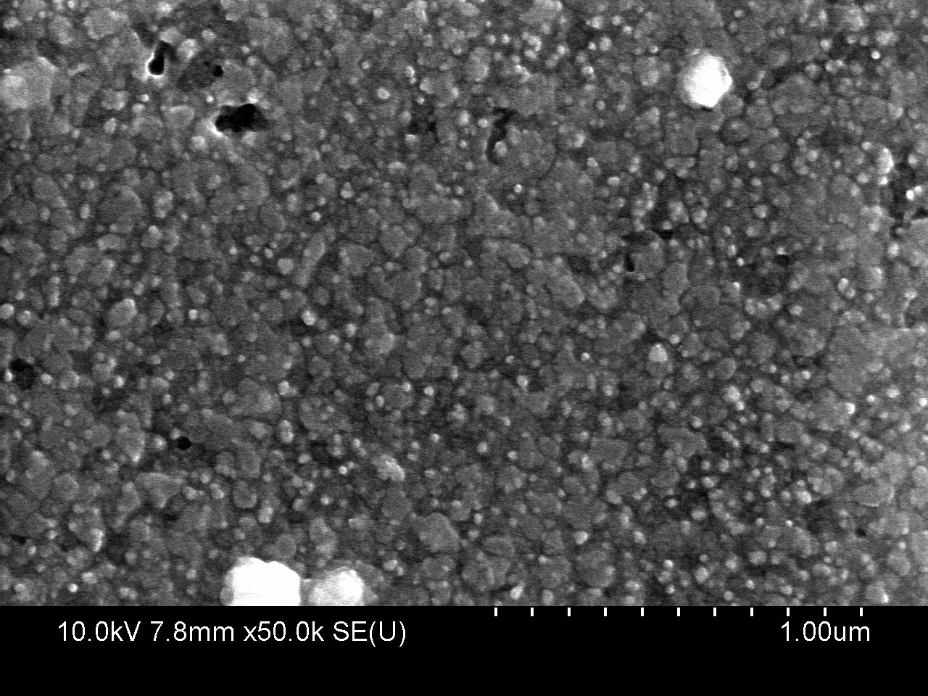
SEM Analysis – CVD Cu
2 cycles; top down
0 cycles; top down
Notes:
0 and 2 cycles of the 8 cycle test. 2 cycles shows the white specks that indicate gold particles, where 0 shows only mechanical defects.

Slide 9
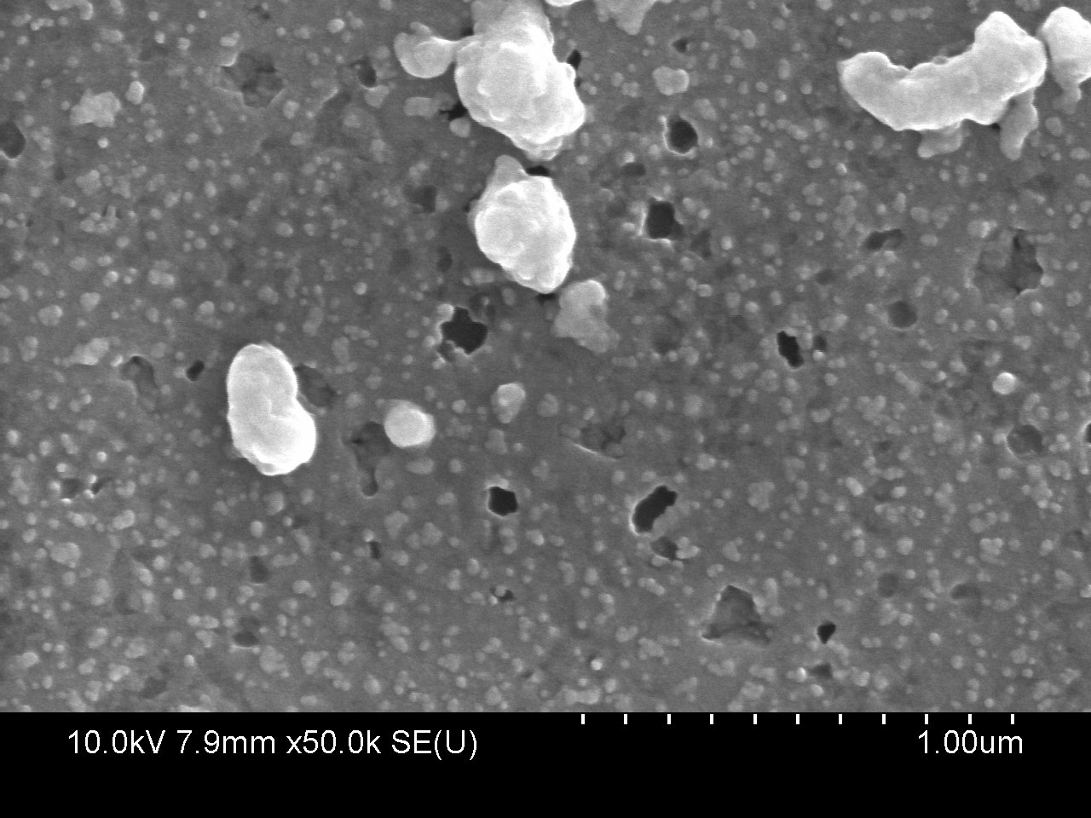
SEM Analysis – CVD Cu
6 cycles, top down
4 cycles, top down
Notes:
Cycles 4 through 6. 6 shows the layers underneath.

Slide 10
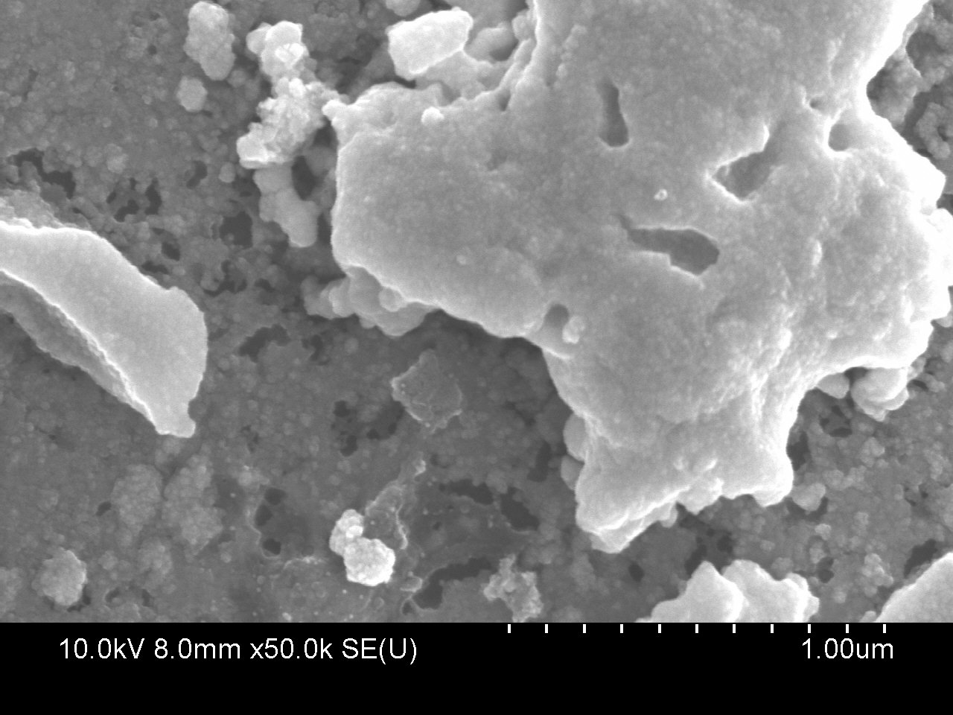
SEM Analysis – CVD Cu
8 cycles, top down
7 cycles, top down
Notes:
Cycles 7 and 8.

Slide 11
Conclusions and Future Work
Demonstrated multilayer film growth
  Control film thickness
Make further changes to process variables
  Sinter temperature and EDT concentration
Inhibit the reaction and increase reaction time
Notes:
Multilayered film growth clearly a possibility. SEM analysis shows that multilayers are forming. There are some issues with uniformity that we’d like to improve, but we’ve shown that on a variety of substrates we can get multilayer growth under these relatively mild process conditions, which is great. A literature search has shown that the sintering temperature and time can have a significant impact on island formation; future work will take a look at optimal process conditions such as sinter temperature and linker molecule concentration. Inhibition of the layering reaction may be of interest, as slowing down the layer formation may enable us to form a more continuous film.

Slide 12

Thank you!
NASA Space Grant
Dr. Anthony Muscat
Lance Hubbard
Jefferson Lee
Charles “Alex” Page

