Slide 1




Arizona NASA Space Grant Statewide Symposium
April 22nd 2023, Phoenix, AZ
Transitional Shock Wave/Boundary Layer
Interactions at Mach 5
Morgan Goz
Advisor: Prof. Jesse Little
Department of Aerospace Engineering
^{University of Arizona}
Acknowledgements:
Dr. Ashish Singh
Office of Naval Research (ONR)
Grant Number: N00014-20-1-2267
Program Manager: Dr. Eric Marineau
Boundary Layer Stability and Transition Lab
(BLST): Prof. Stuart A. Craig

Slide 2
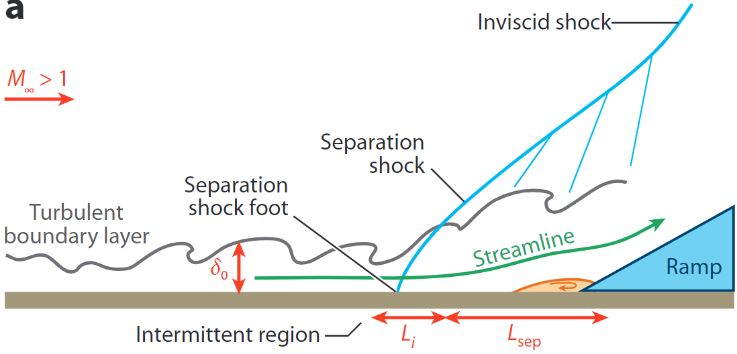
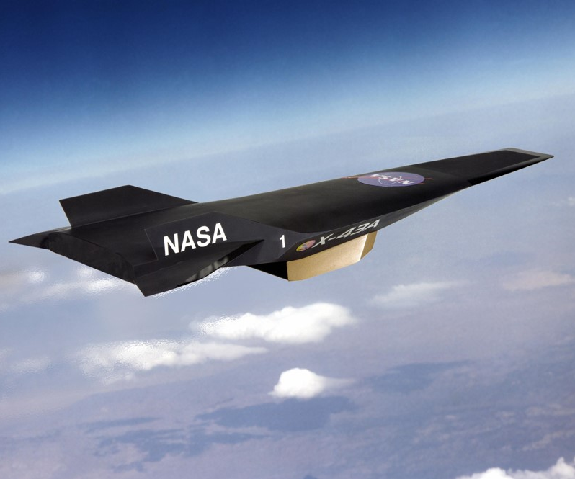
Transitional Shock/Boundary Layer Interactions (SBLIs)
Boundary layer – layer of fluid between surface and freestream
SBLIs have a significant impact on hypersonic systems
Common occurrence in internal and external flow fields
Can lead to system failure
Clemens, N. T., & Narayanaswamy, V. (2014). Low-Frequency Unsteadiness of Shock Wave/Turbulent Boundary Layer Interactions.
Hypersonics – SACD. NASA. (2022).
Notes:
SBLIs occur when a shock wave appears in the boundary layer at high speeds, or over three times the speed of sound. The boundary layer is the layer of fluid between the surface of an object and the freestream, which is the flow upstream of and around a flight vehicle that is unaffected by the passage of aircraft or an object through it. Boundary layer transition occurs when the flow in the boundary layer transitions from laminar, which is uniform and smooth, to turbulent, which is when the flow becomes chaotic and moves irregularly. In this diagram on the left, you can see an SBLI over a compression ramp, with a shock wave present in the area right before flow begins to separate, which is when the boundary layer detaches from the surface due to the change in wall geometry. On the right is NASA’s X-43A Hypersonic Experimental Vehicle, which has some of that ramp-like geometry where the presence of SBLIs would be expected. SBLIs have a significant impact on hypersonic systems, as they are a common occurrence in internal and external flow fields. SBLIs result in flow separation, low frequency unsteadiness, and high surface heat flux, which can lead to system failure.

Slide 3
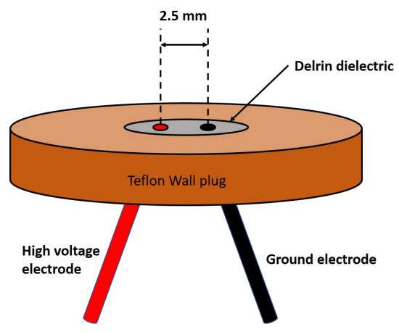
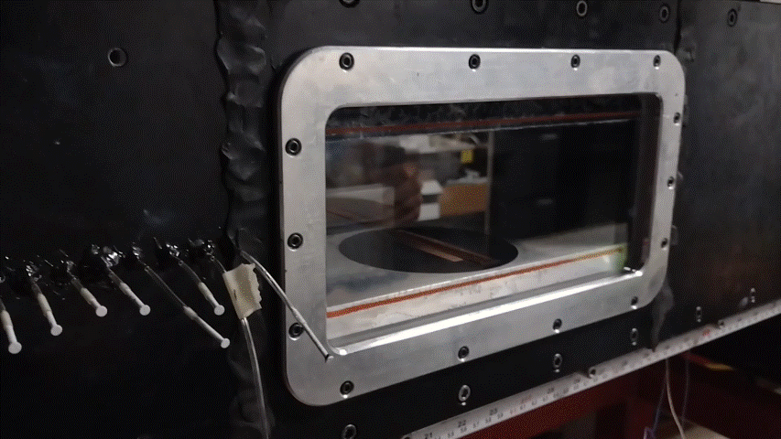
Goals and Methodology
Understanding the relationship between boundary layer transition and SBLIs
Wind tunnel experiments with a flare test article
Localized Arc Filament Plasma Actuators (LAFPAs) allow for active flow control
Singh, A., et al. (2021). Development of Plasma-based Controlled Disturbances for the Study of Boundary Layer Transition and Shock Boundary Layer Interaction.
Notes:
Because SBLIs have such a great impact, the goal of this research is to further our understanding of the relationship between boundary layer transition and transitional SBLIs in order to work towards finding ways to mitigate the effects of SBLIs on hypersonic vehicles. This is done by conducting tests on a flared test article in a wind tunnel. Localized Arc Filament Plasma Actuators (LAFPAs), pictured here, are used as they allow for active flow control, so we can generate disturbances in the flow across the flare. You can see a similar plasma actuator in the video as it generates a plasma discharge.

Slide 4
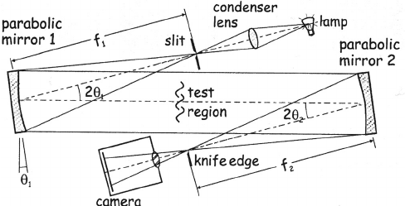
Goals and Methodology
Pressure measurements and z-type schlieren imaging to visualize plasma-generated disturbances and their influence on SBLIs
Travers, N. (2012). Schlieren Z-Type Flow Visualization System.
Notes:
To visualize the instabilities and disturbances generated by the plasma discharge, as well as how they interact with SBLIs, flow field and surface measurements will be employed. Schlieren systems allow for subtle changes in transparent media to be visualized by refraction, reflecting a light into the test section and then to a camera. As the light rays go through the test section, they will bend whenever encountering a change within the air.

Slide 5
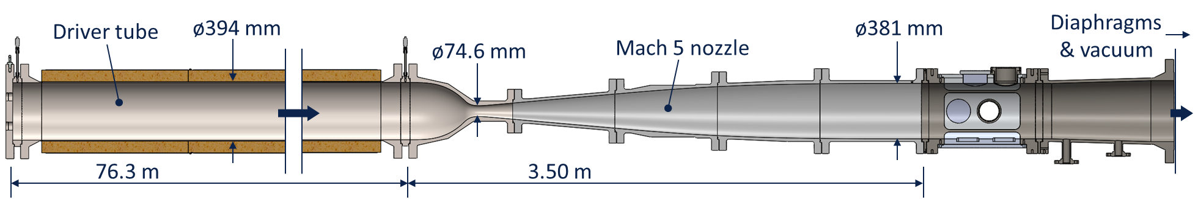
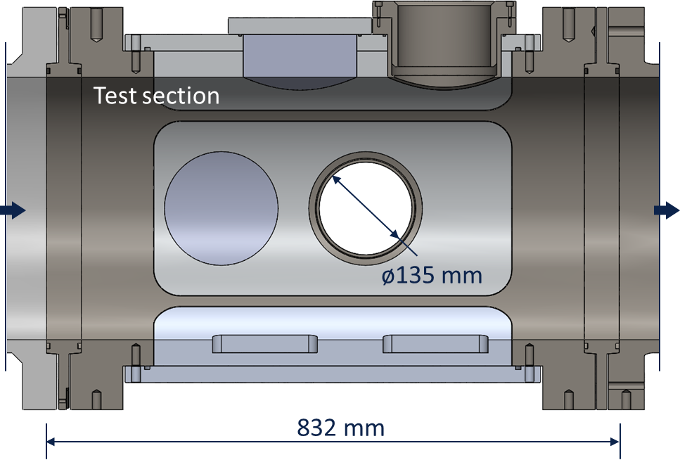
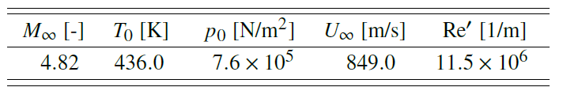
Wind Tunnel Experiments
Singh, A., et al. (2023). Schlieren Visualization of Controlled Disturbances in Mach 5 Flow Over a Hollow Cylinder Flare.
Performed in UArizona Mach 5 Ludwieg Tube (LT5)
Run Conditions – Can closely match flight conditions
Notes:
Experiments were performed in the Mach 5 Ludwieg Tube at the University of Arizona. The wind tunnel is run by pressurizing the driver tube and then bursting a diaphragm, which has a vacuum on the other side. After the diaphragm bursts, the flow accelerates through the nozzle before reaching the test section and then flowing into the vacuum tank. The tunnel is able to closely imitate flight conditions, making it a prime facility to conduct tests at hypersonic speeds that accurately reflect what we would expect to see in real flight.

Slide 6
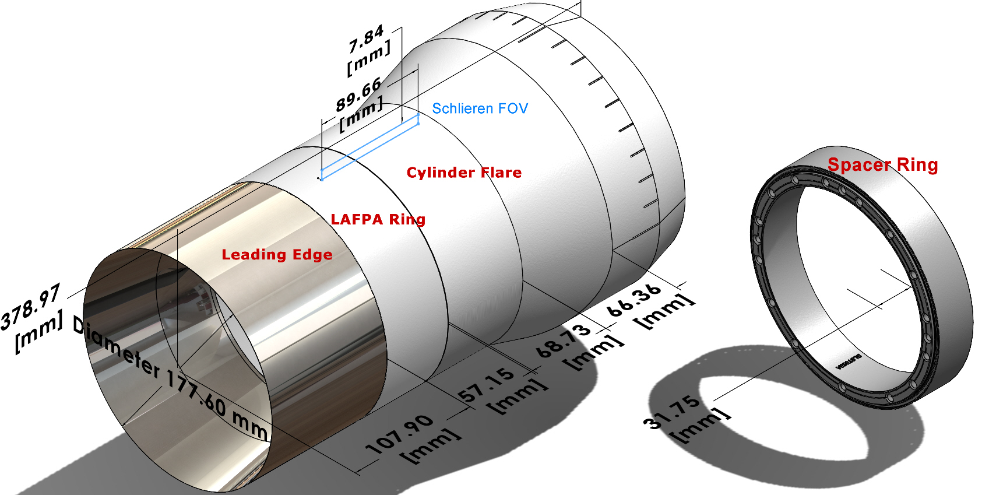
Wind Tunnel Experiments
Hollow cylinder flare model
Plasma actuator
Singh, A., et al. (2023). Schlieren Visualization of Controlled Disturbances in Mach 5 Flow Over a Hollow Cylinder Flare.
Notes:
The test article is a hollow cylinder flare model, as this geometry is commonly seen in flight systems. The flare provides the ramped geometry where the presence of SBLIs is expected. The plasma actuator is situated ahead of the ramp.

Slide 7
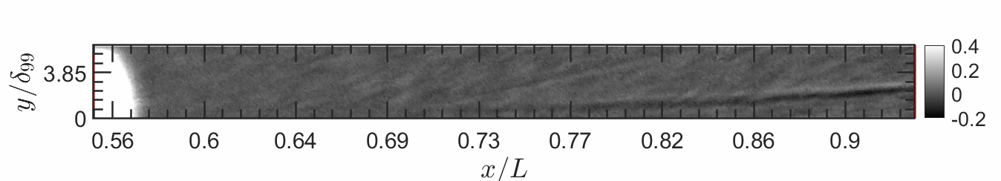
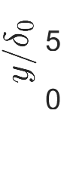
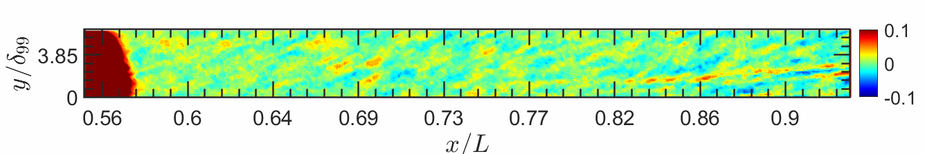
Results
Disturbance field captured with Schlieren imaging
Can see shock as it travels across the boundary layer and detaches
Separation
Actuator Location
Separation
Singh, A., et al. (2023). Schlieren Visualization of Controlled Disturbances in Mach 5 Flow Over a Hollow Cylinder Flare.
Actuator Location
Notes:
The plasma perturbation employed by the plasma actuator to create artificial disturbances over the flare can be seen in the disturbance field captured by Schlieren imaging. It had to be slowed down by about 40,000 times so we could see what’s happening. The top image is the raw footage, whereas the bottom footage was color scaled to see more clearly what’s happening. You can see how the shock forms by separation, and travels along the boundary layer before detaching from the boundary layer, lifting off to the shear layer.

Slide 8
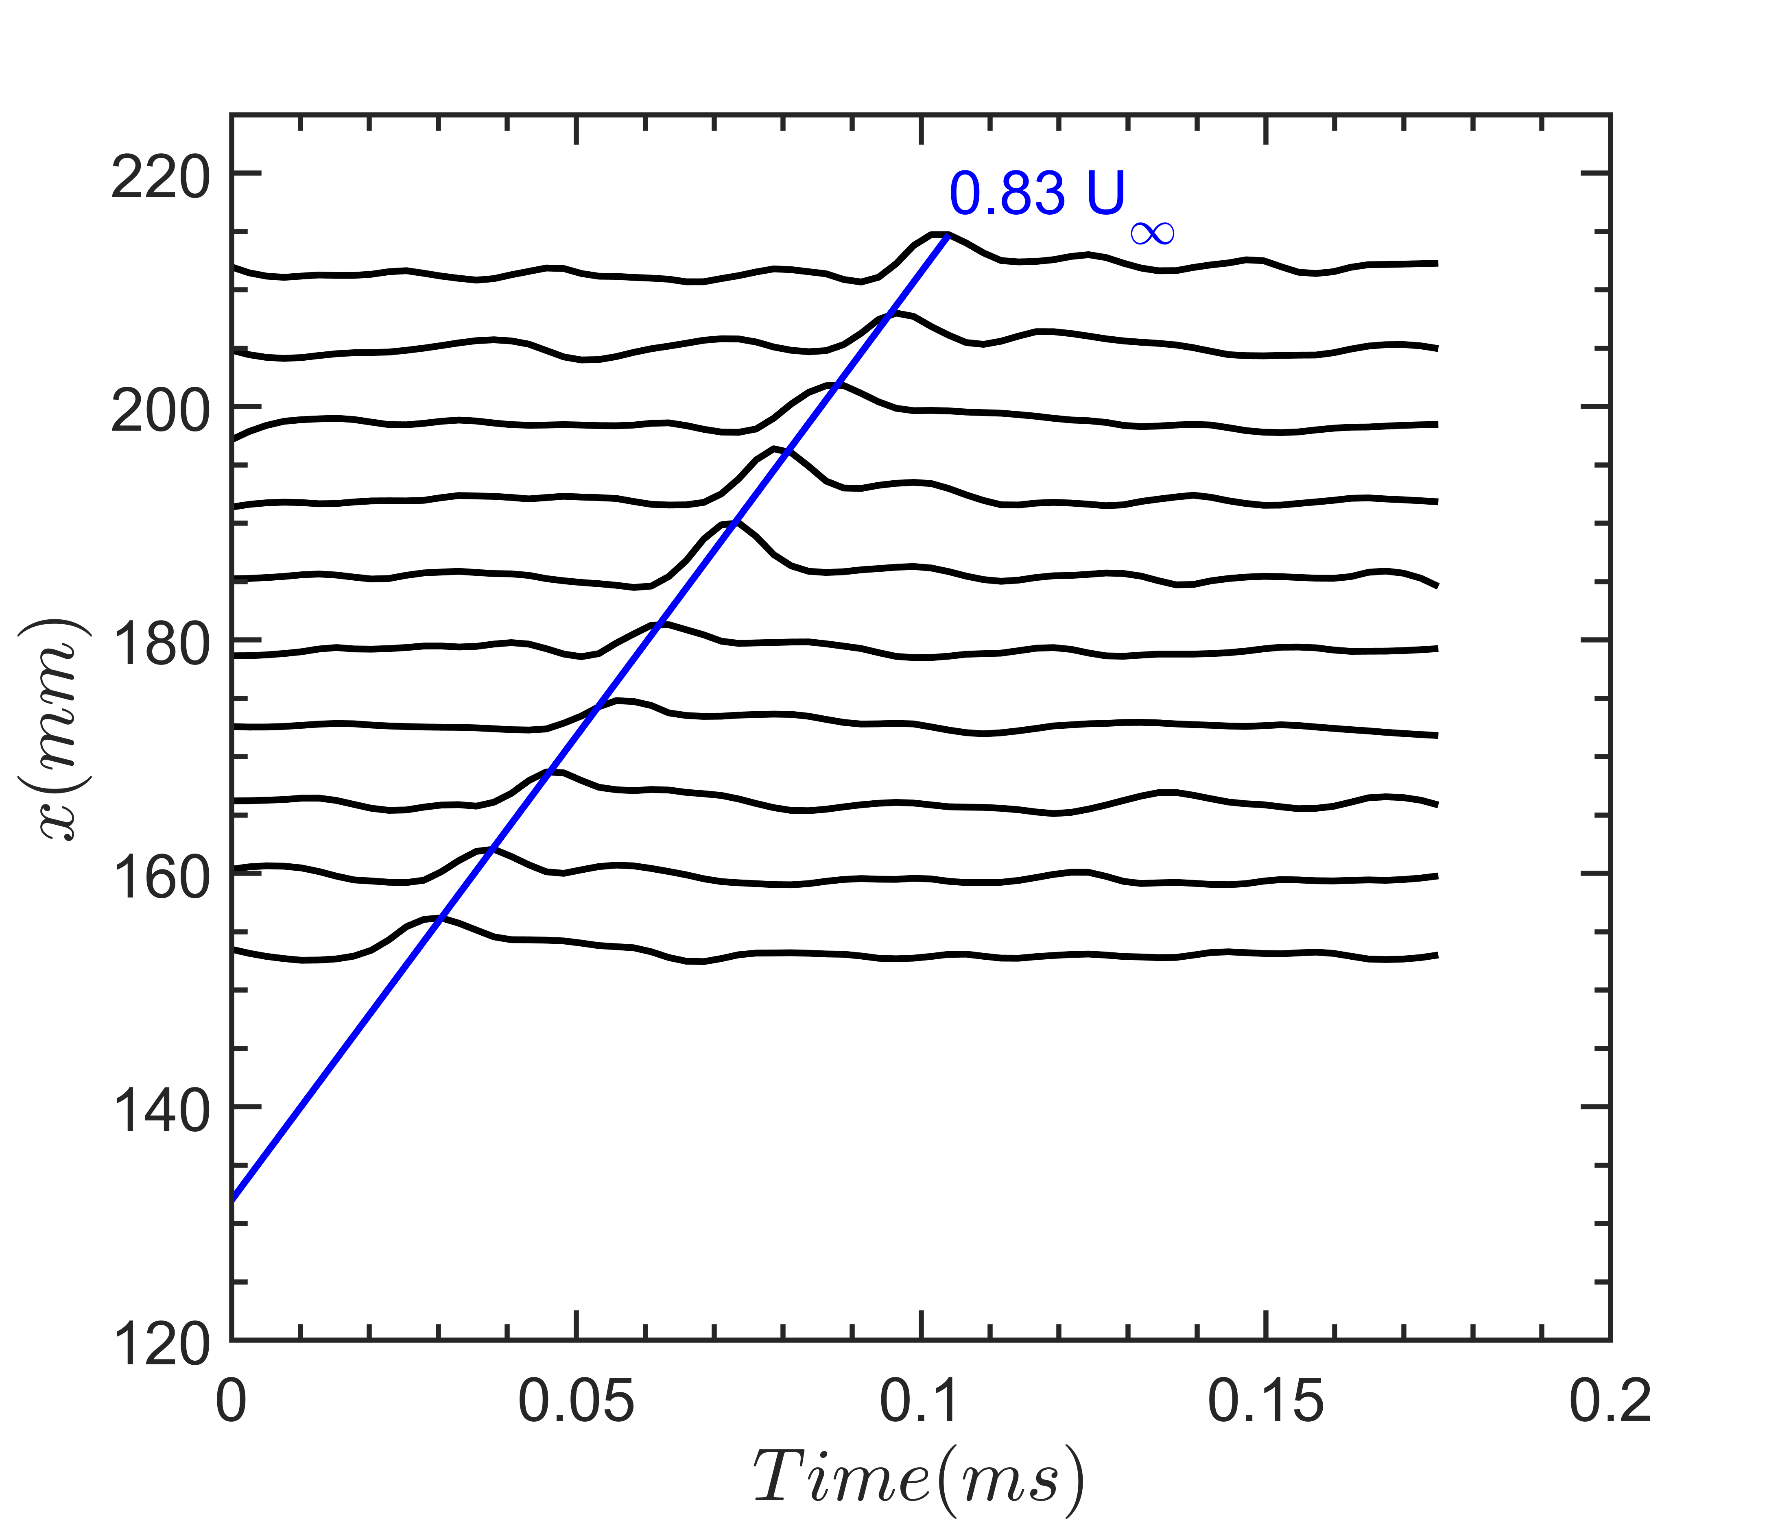
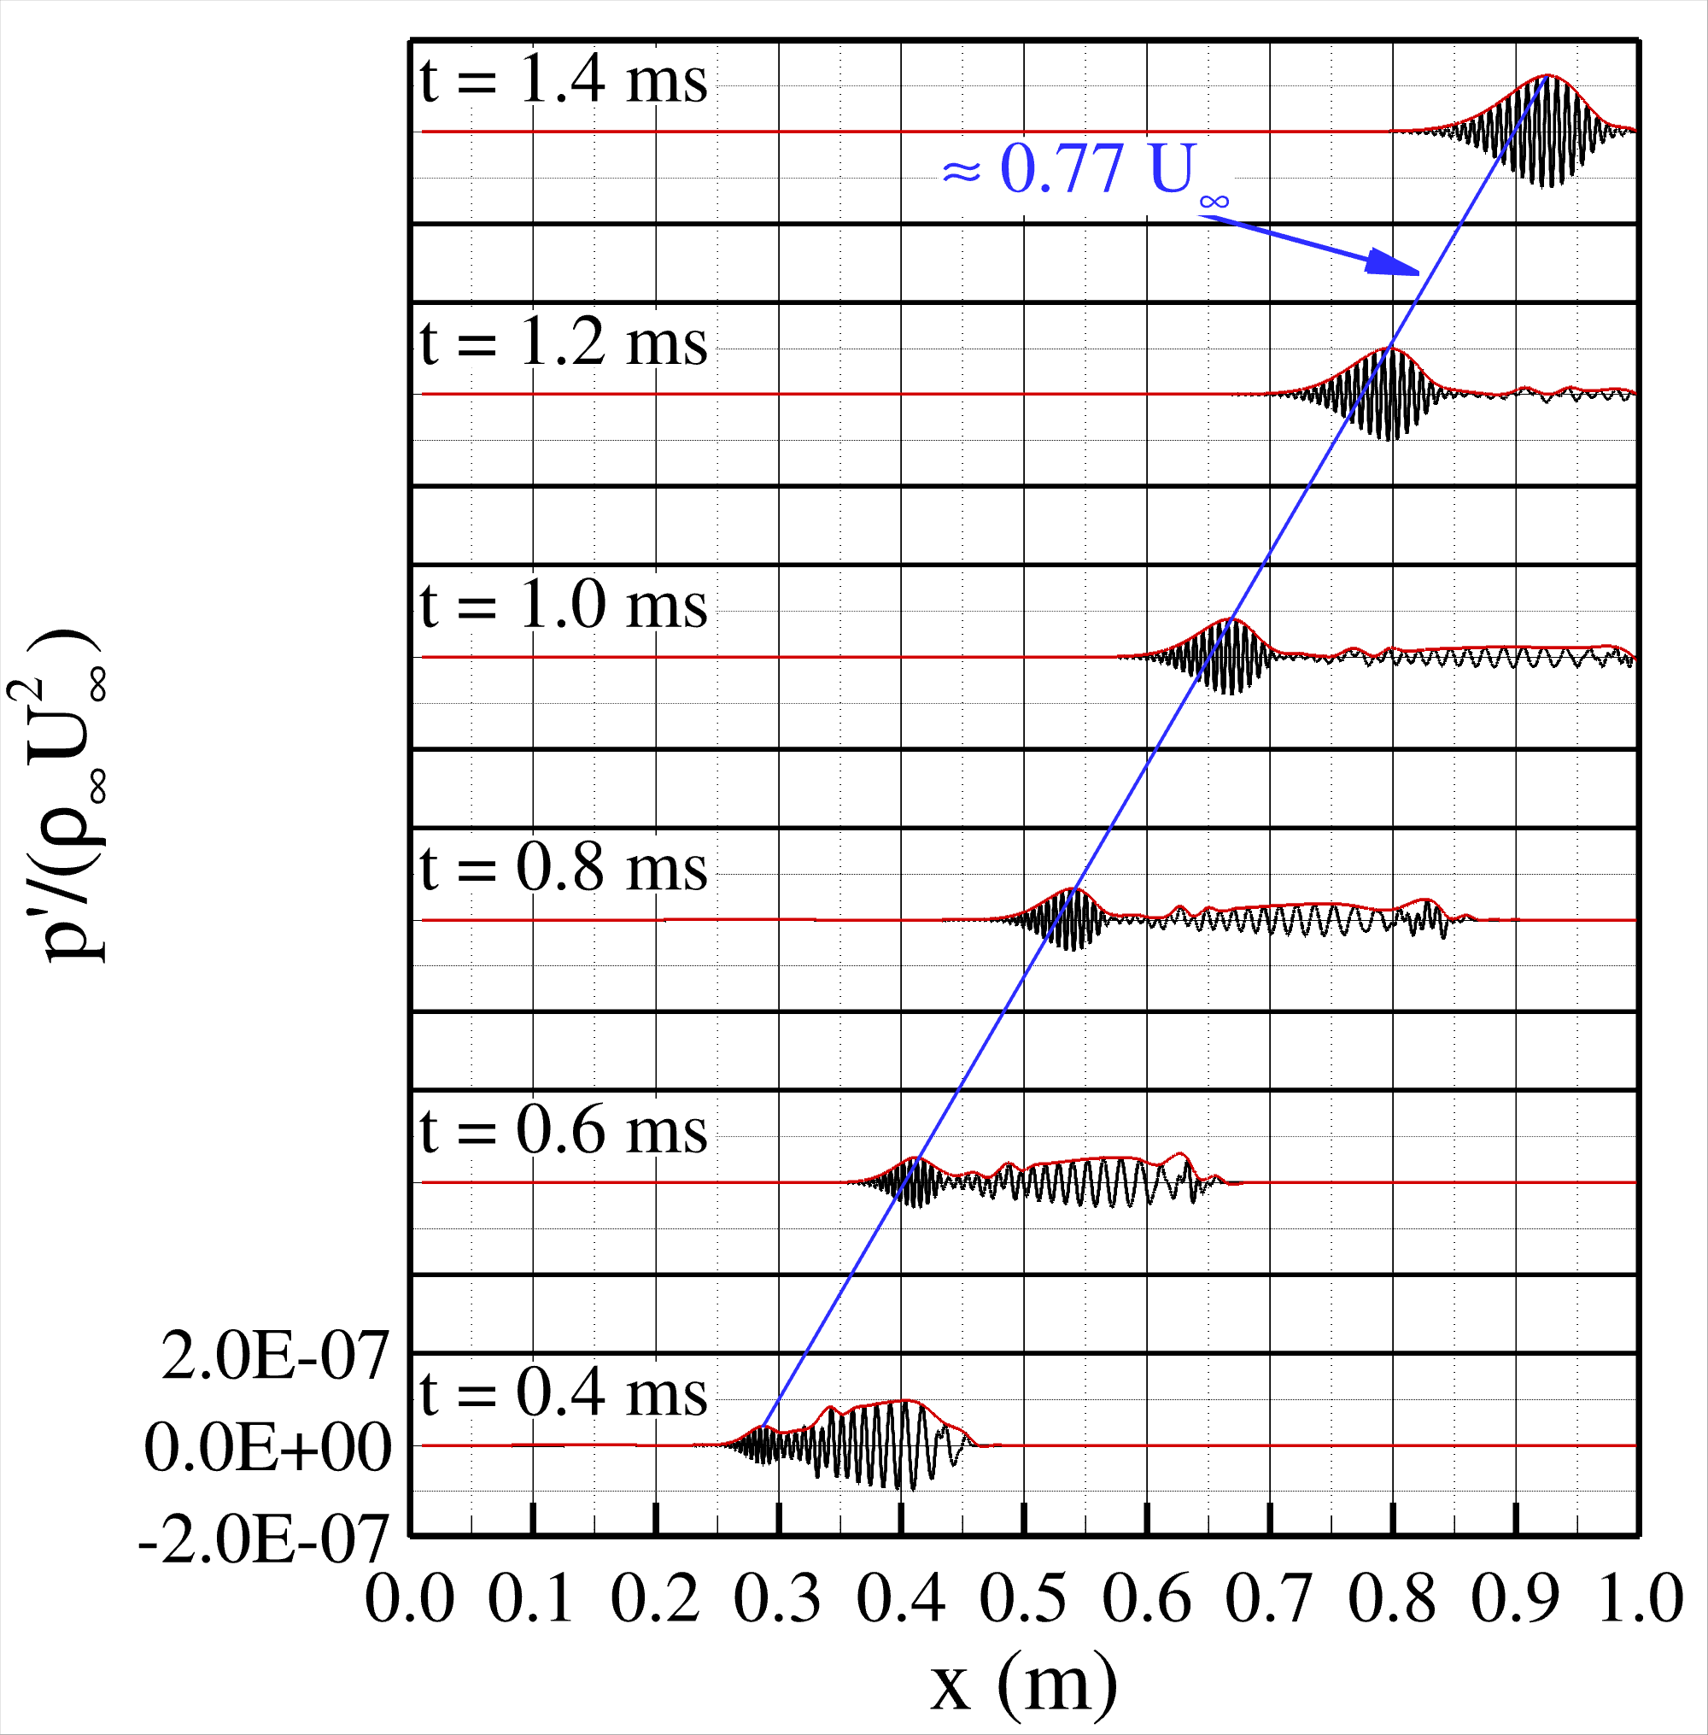
Results
Experimental data closely aligns with computational data at same Reynolds number
Experimental
Computational
Singh, A., et al. (2023). Schlieren Visualization of Controlled Disturbances in Mach 5 Flow Over a Hollow Cylinder Flare.
Notes:
The disturbance field was plotted in order to trace the amplification of the disturbance as it travels into the separated flow region. The black lines on the experimental graph show the flow at each location over time, and they match closely with the red lines on the computational graph to the right. The peak velocity was found to be roughly 0.83 times the freestream velocity, which is consistent with the computational value of 0.77 times the freestream velocity found at the same Reynolds number.

Slide 9
Conclusions
Developed technique to introduce artificial controlled disturbances into boundary layer and can compare to computations
Disturbance propagation from experiments qualitatively match well with computational models
Future Work
Moving forwards, will continue to develop experimental models to further study and understand SBLIs
Notes:
We successfully developed a technique to introduce artificial disturbances into a flow field and visualize SBLIs that we can use to compare to computational models. The disturbance propagation from these specific experiments aligned closely with computational models. Moving forwards, we’re going to continue conducting experiments and improving our methodology in order to study and further understand SBLIs .

Slide 10
Acknowledgements
Arizona NASA Space Grant
Office of Naval Research (ONR) Grant Number: N00014-20-1-2267
Program Manager: Dr. Eric Marineau
Lead PI
Prof. Jesse Little
Laboratory
Boundary Layer Stability & Transition Lab (Prof. Stuart A. Craig)
Postdoc Research Associate
Dr. Ashish Singh
Graduate Students
Alejandro Roskelley Garcia
AME Machine Shop
Dale Drew, Paul Horwath, and Joseph Hartley

Slide 11
Thank you!

