Slide 1


ASU NASA Space Grant Project: Analysis and Optimization of Electric Ducted Fan Nacelle Geometry
Student; Lucas Guaglardi; Mentor: Timothy Takahashi, Professor of Practice – Aerospace Engineering; (SEMTE)

Slide 2
Problem Statement, Objectives/Goals, Introduction
Main problem is that nacelle design for low speed regime vehicles including UAVs is not well understood, so traditional jet engine nacelle designs are not necessarily the best solution.
To learn how the design or nuances of engine nacelles impact overall engine performance.
Nacelles can be thought of as revolved airfoils.
Convergence and divergence in both inlets and nozzle design.
Testing to see effects on various performance parameters.

Slide 3
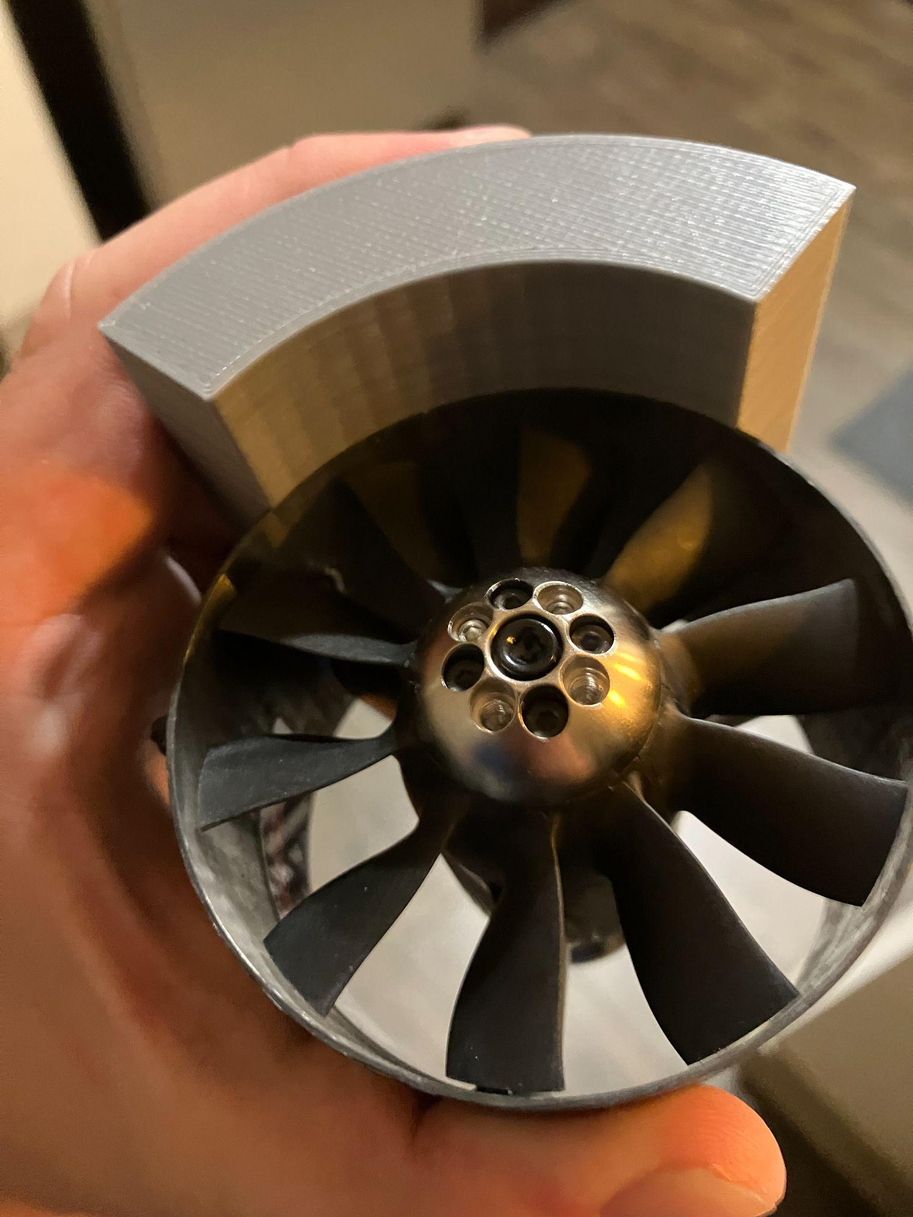
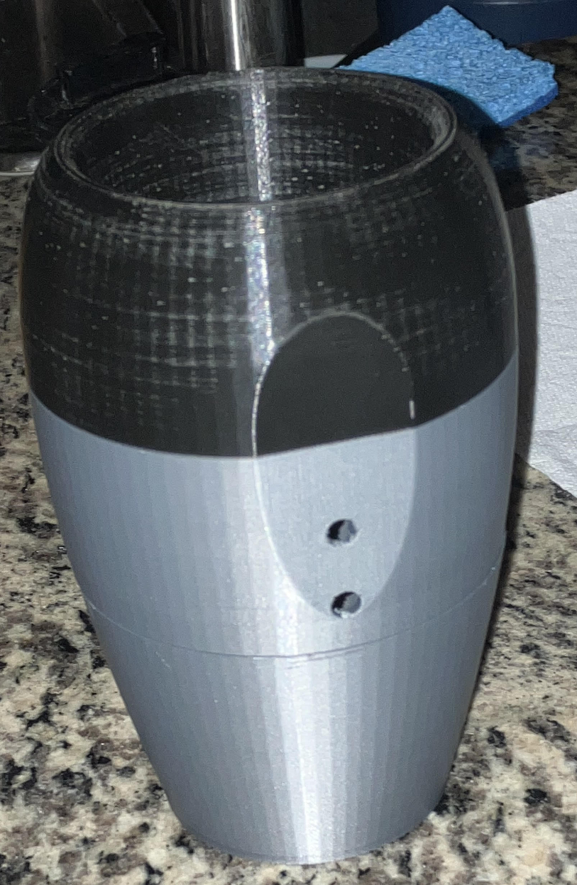
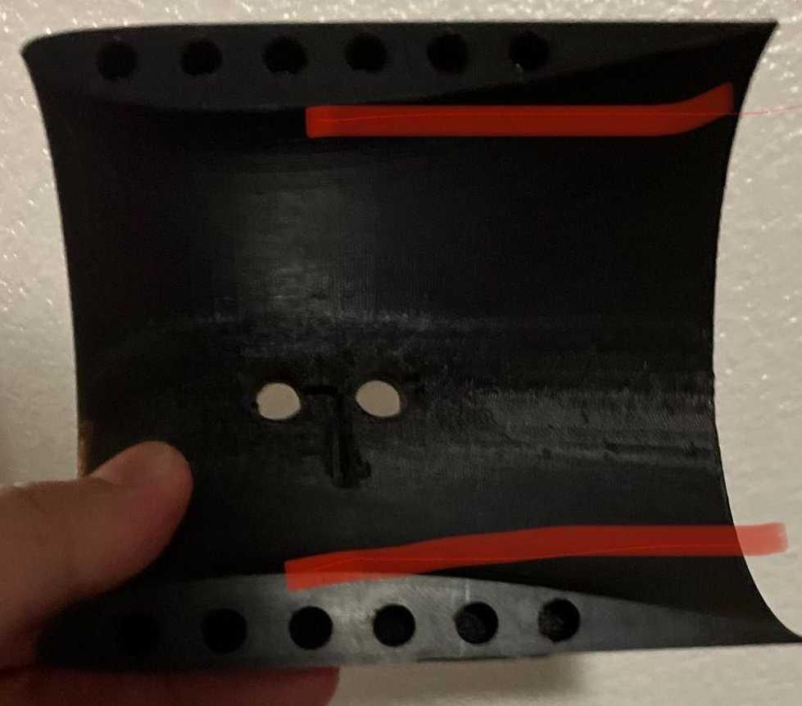
Prototyping Phase
Fig. 1. Clamshell Nacelle Design
Fig. 2. Radius Fitting Test
Fig. 3. Traditional Nacelle Configuration

Slide 4
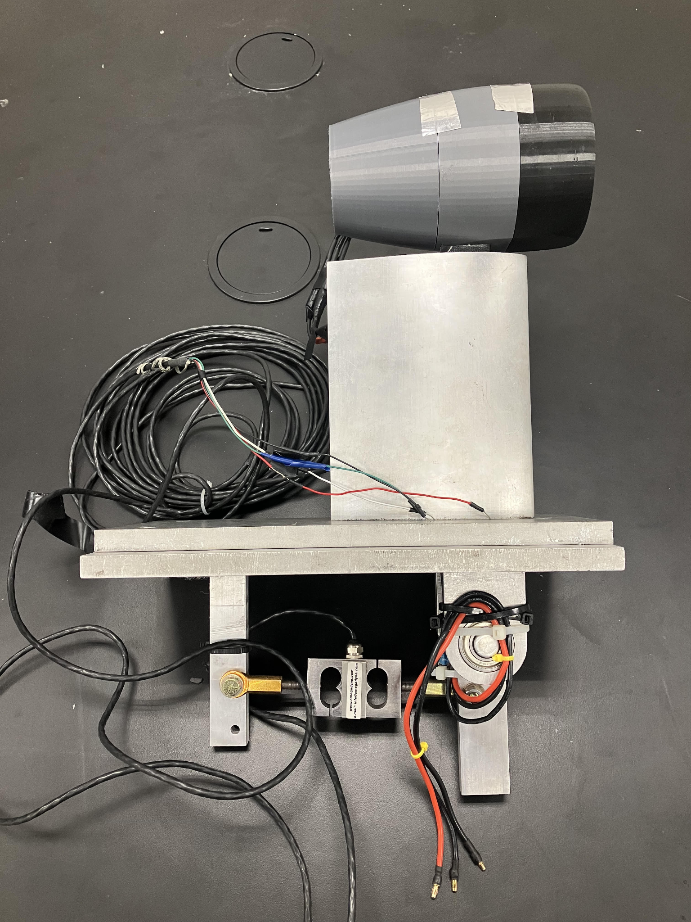
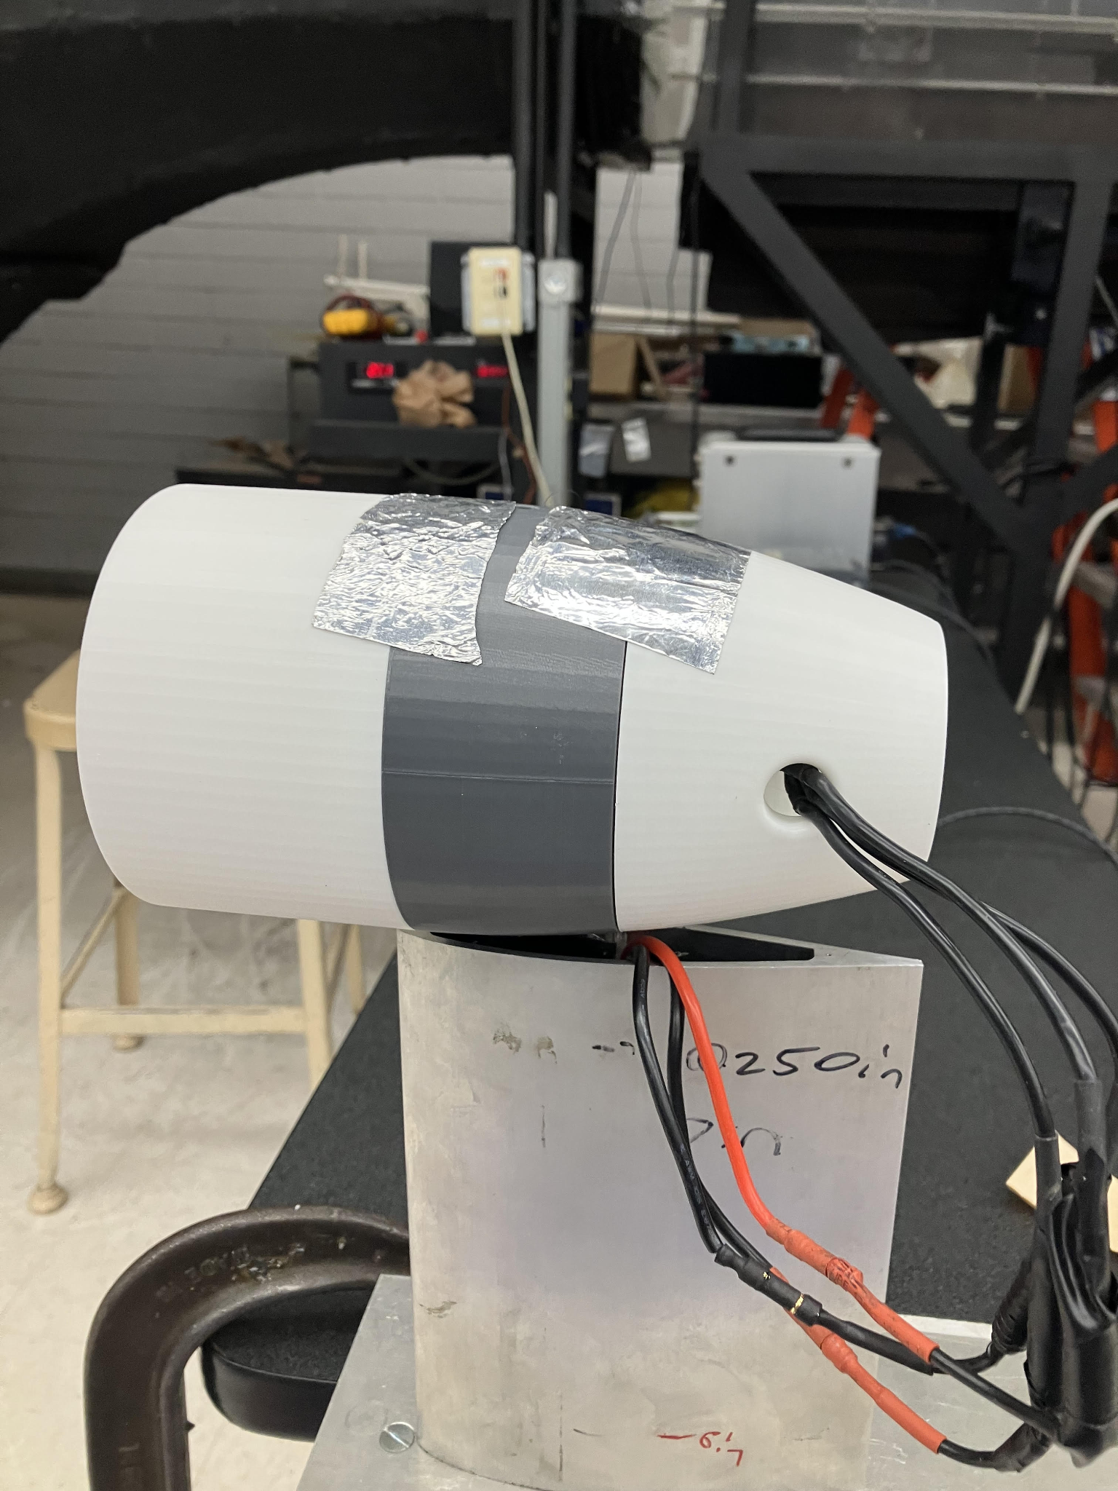
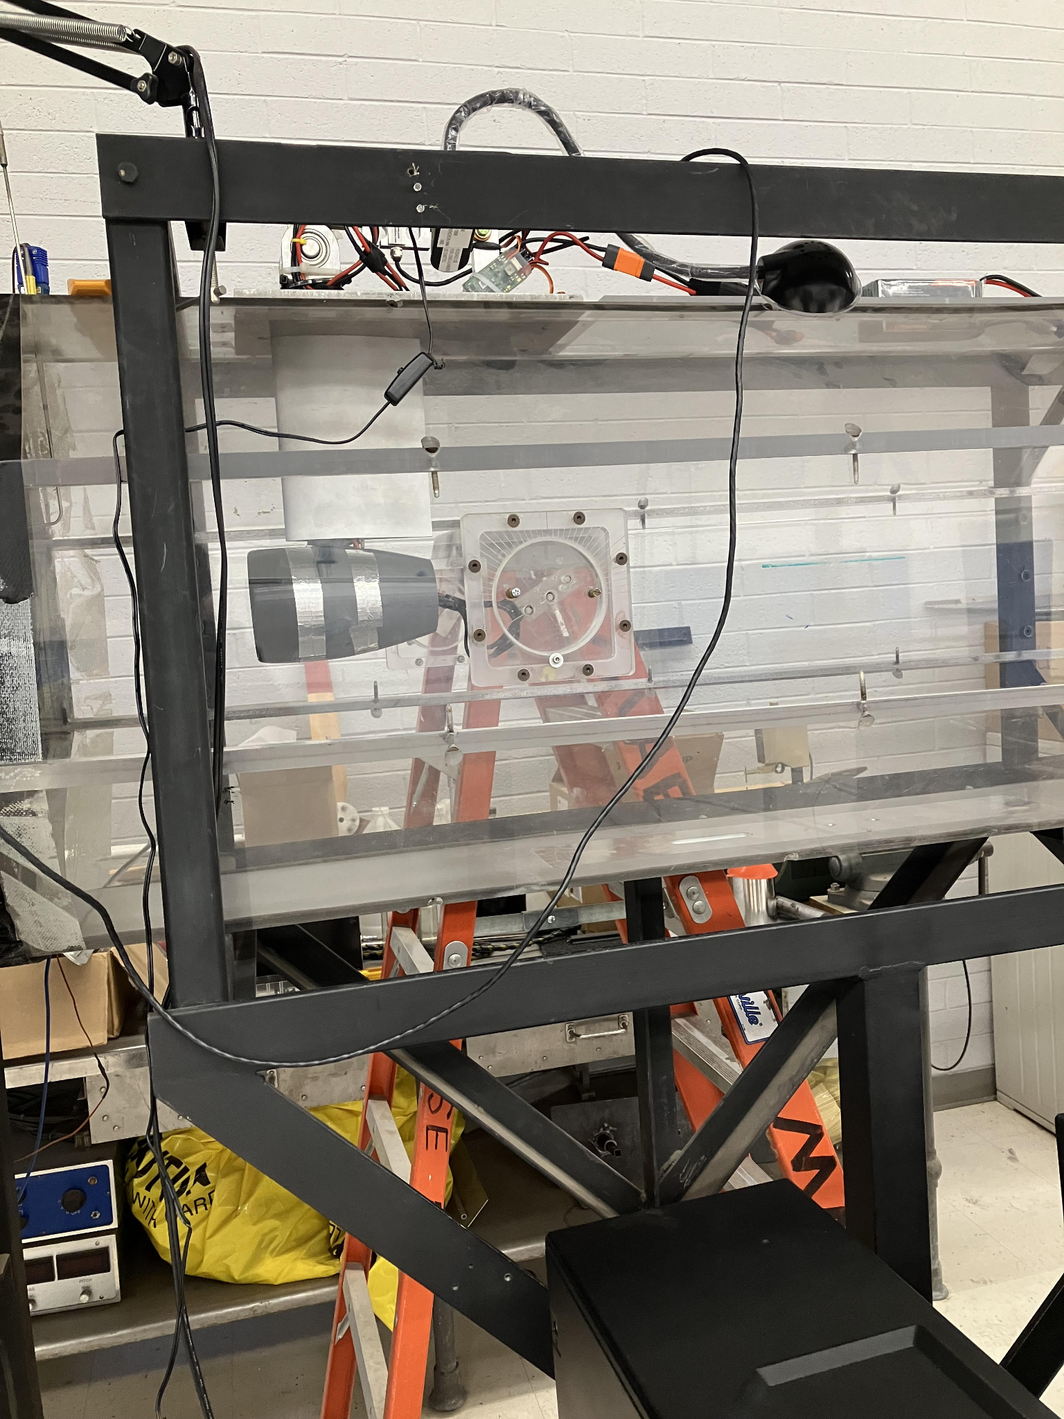
Testing Phase
Fig. 4. Test Stand
Fig. 5. Static Testing Configuration
Fig. 6. Dynamic Testing Configuration

Slide 5
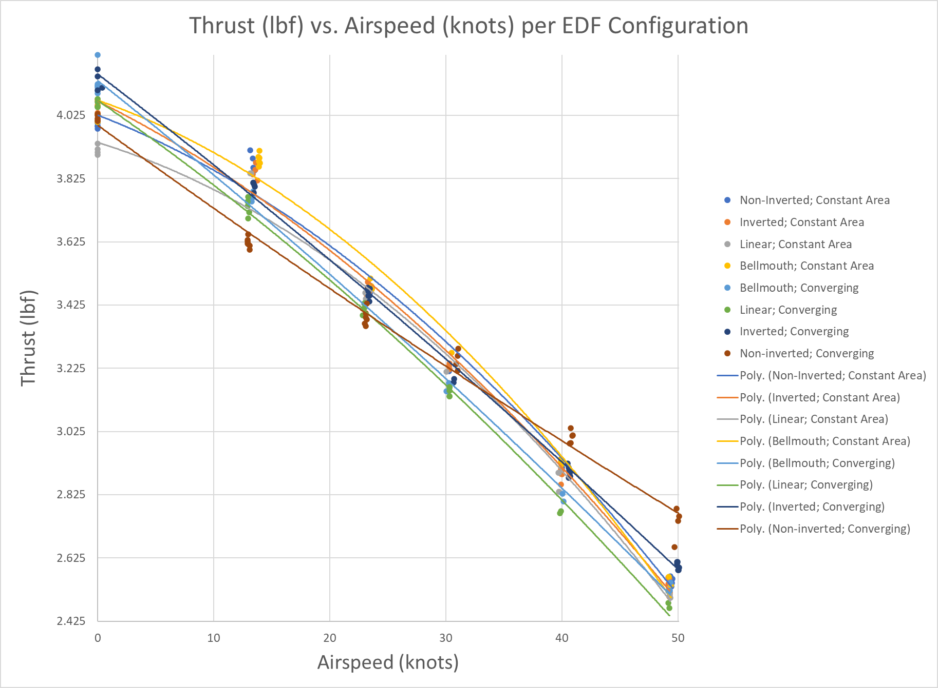
Data Analysis
Takeaway: Most nacelles tend towards similar performance, however depending on the various takeoff requirements of a vehicle the nuance of the nacelle can be adjusted accordingly.
Fig. 7. Thrust Lapse Plot for Various EDF Configurations

Slide 6
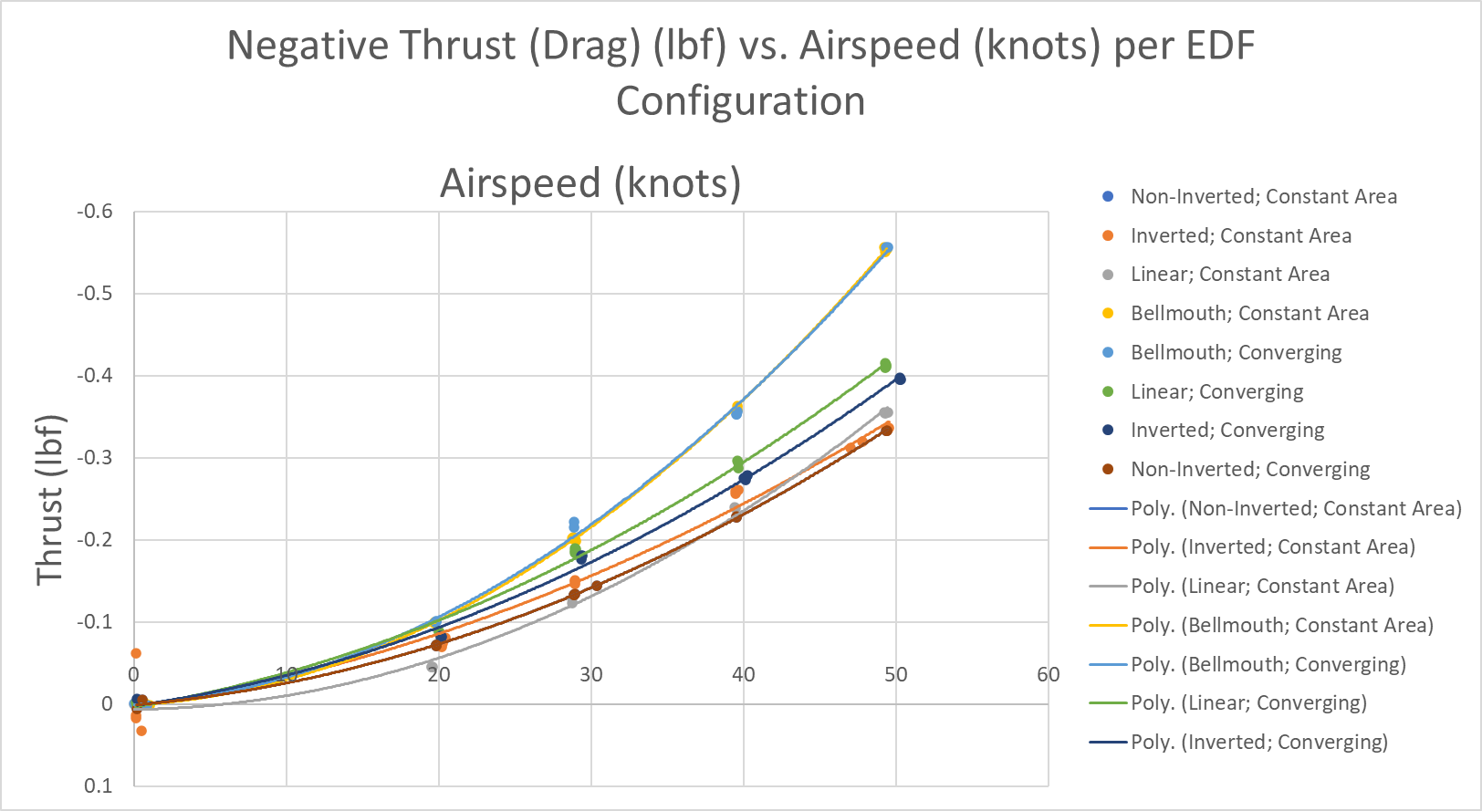
Data Analysis cont.
Fig. 8. Nacelle Drag vs. Airspeed for various EDF Configurations
Takeaway: Bellmouths have large spillover drag.

Slide 7
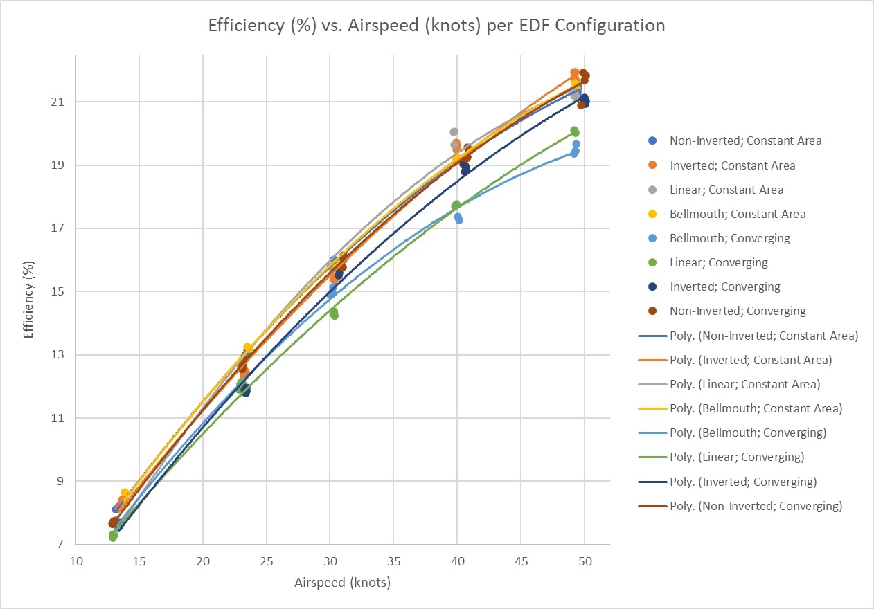
Data Analysis cont.
Takeaway: Efficiency increases with airspeed. Converging inlets tend to have less efficiency.
Fig. 9. Percentage Efficiency vs. Airspeed for various EDF Configurations

Slide 8
Conclusion/Next Steps
In conjunction with time step integration, thrust lapse data can be used to determine takeoff performance and maximum level airspeed.
Typical EDF thrust lapse curves are quadratic in nature.
Converging inlets tend to have slightly more static thrust than constant area inlets.
Bellmouth inlets have the worst spillover drag.
Get pressure scanner to measure pressure gradient of nacelles.
Collect data at higher airspeeds to compare efficiency plots against power versus airspeed.

Slide 9
Acknowledgements\Thank you
NASA Arizona Space Grant Consortium
Dr. Takahashi
Dr. Steele

