Slide 1



Force and Moment Measurements in the Arizona Polysonic Wind Tunnel
NASA Space Grant Undergraduate Research Symposium
April 22, 2023
Nicholas Mammana
Special Acknowledgments:
The University Consortium for Applied Hypersonics
Arizona Research Center for Hypersonics
Mentor: Dr. Jesse Little, UAZ

Slide 2


Project Overview / Motivation
Aero-databases (ADBs) allow for increased efficiency in initial design and computations.
Current ADBs are built using force and moment data from CFD and expensive wind tunnel testing.
These tests tend to have a high-dimensional parameter space without detailed flow physics – hampering the scalability and capability of ABDs.
Goal: Conduct experiments at key configurations of Reynolds number, Mach number, and angle of attack to improve ADBs.
Notes:
Focus on understanding the effects of sweep, which requires full understanding of the unswept interaction as a baseline.

Slide 3
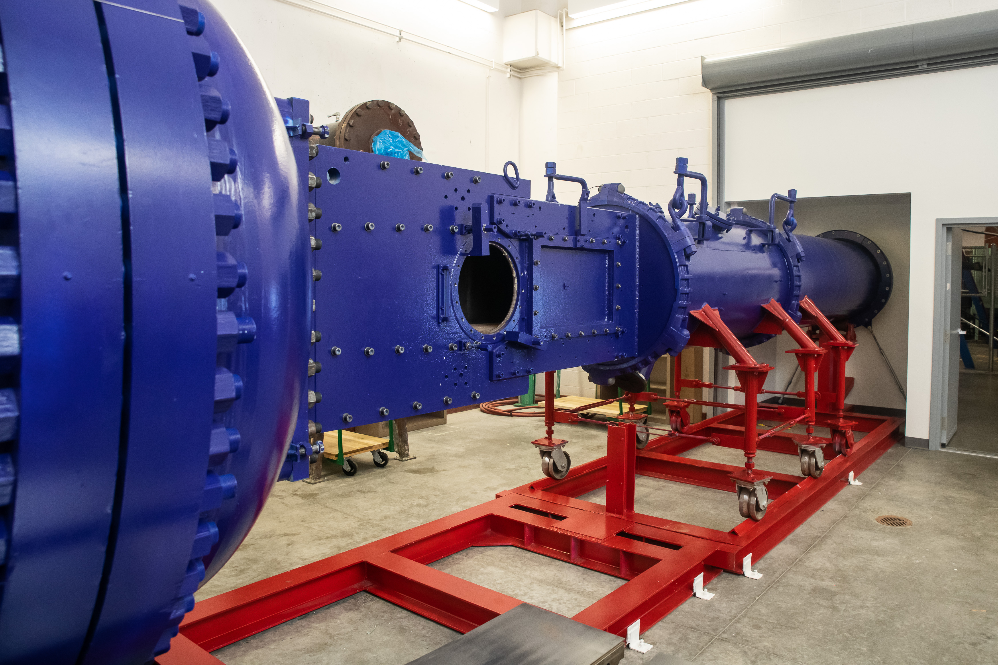
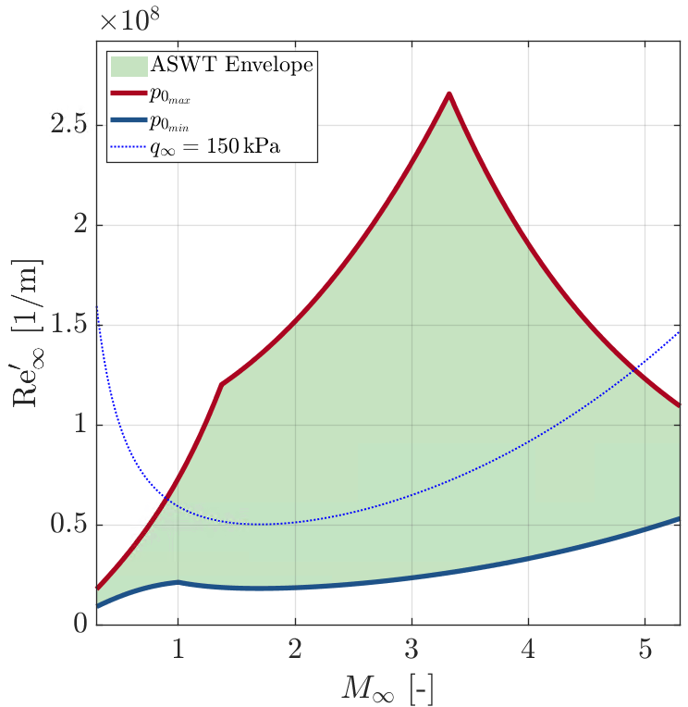
Arizona Polysonic Wind Tunnel
Located at the AME building at UArizona
Polysonic Blowdown Wind Tunnel
Test Section: 15in x 15in x 50in
Current Mach Range: 1.75 - 4
Run Time: 10-25 seconds
Testing Envelope:
The Arizona Polysonic Wind Tunnel
Notes:
Focus on understanding the effects of sweep, which requires full understanding of the unswept interaction as a baseline.

Slide 4
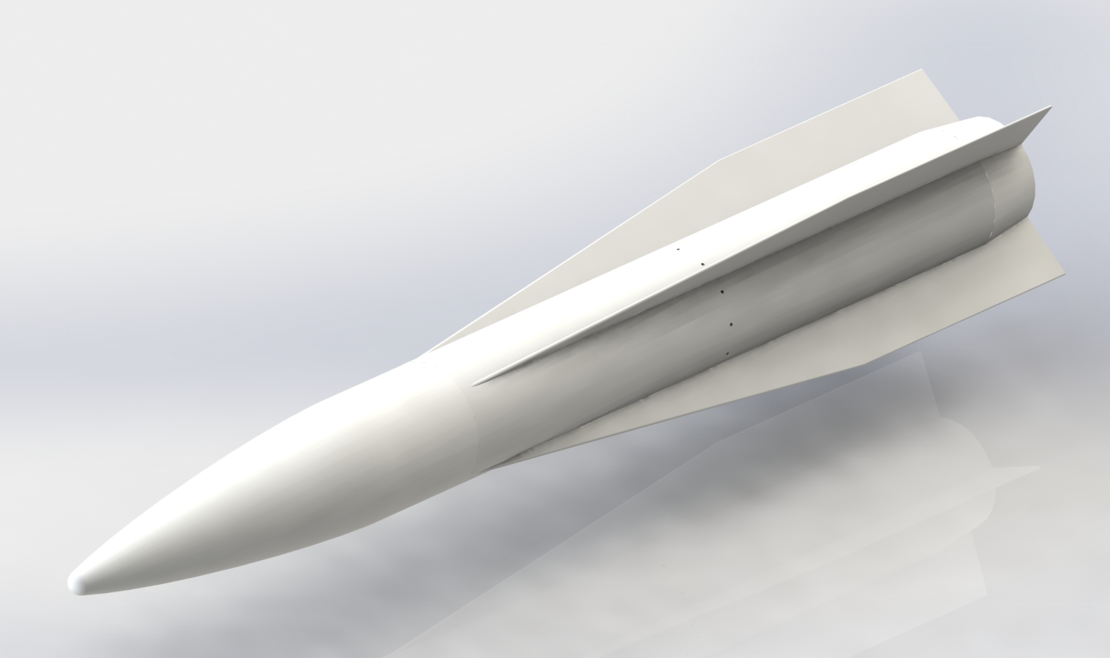
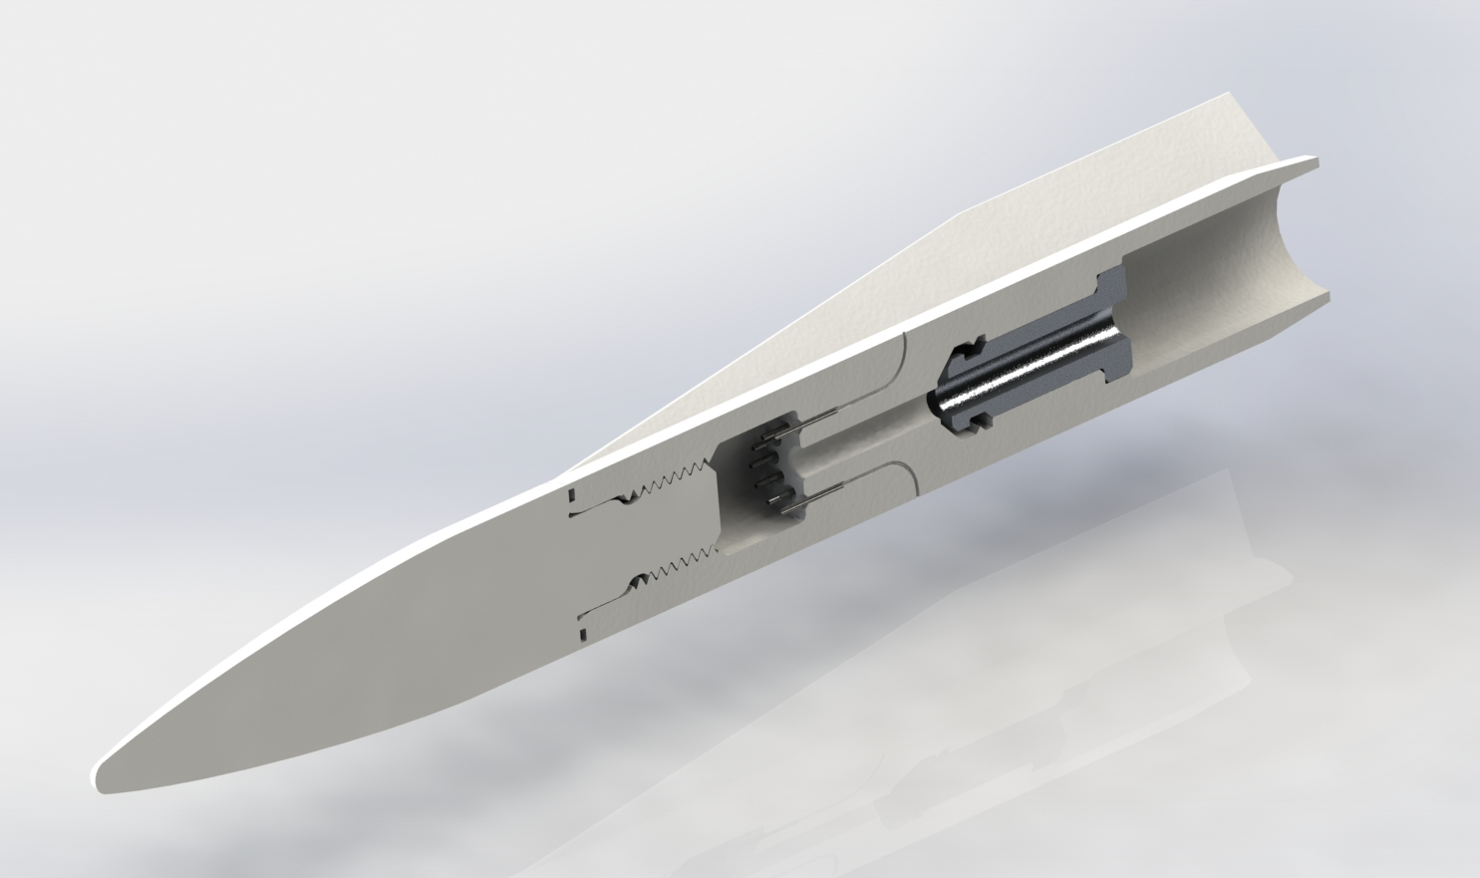
Original Test Article / Model
Laboratory Technology Vehicle (LTV) developed by the Army Research Laboratory (ARL)
Design Constraints
  Model Size
  Model Loads
  Balance Size
  Balance Positioning
  Manufacturability
Notes:
Focus on understanding the effects of sweep, which requires full understanding of the unswept interaction as a baseline.

Slide 5
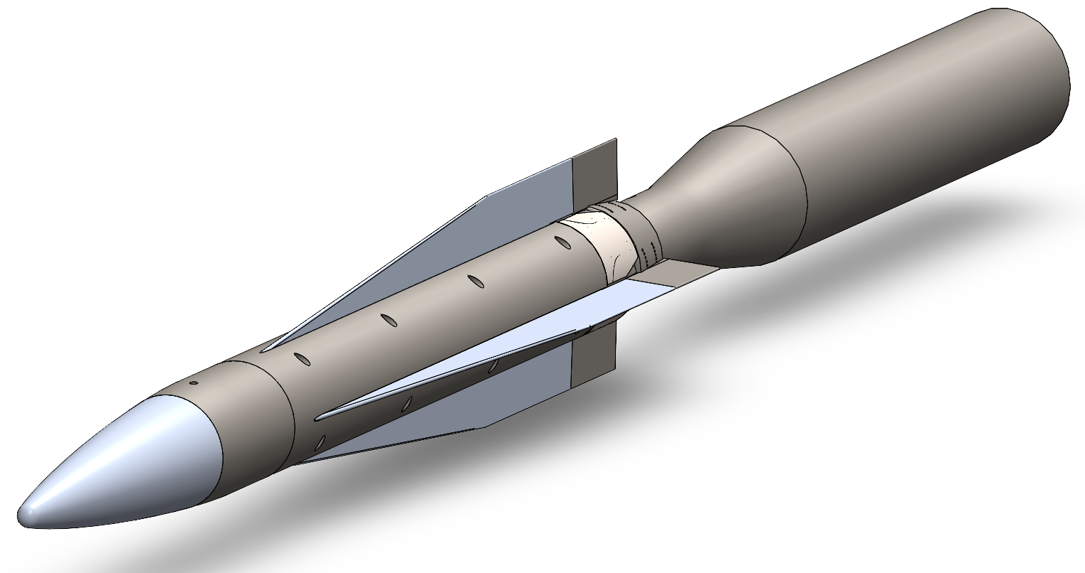
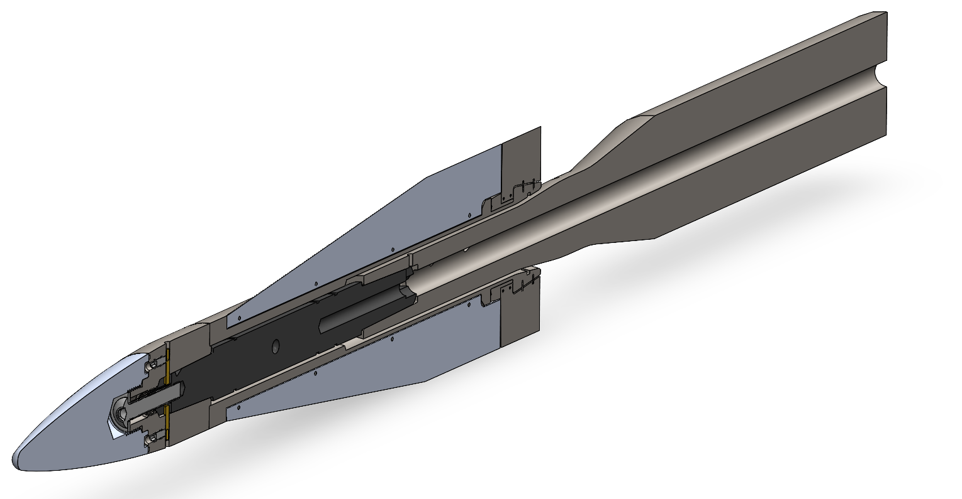
Current Test Article / Model
Diameter: 38.1mm (1.5”)
Length: 381mm (15.0”)
Length to Diameter Ratio: 10:1
Notes:
Focus on understanding the effects of sweep, which requires full understanding of the unswept interaction as a baseline.

Slide 6
Sizing the Force Balance
+N₁
+N₂
+NF
Nmax
spc
+PM
Notes:
Focus on understanding the effects of sweep, which requires full understanding of the unswept interaction as a baseline.

Slide 7
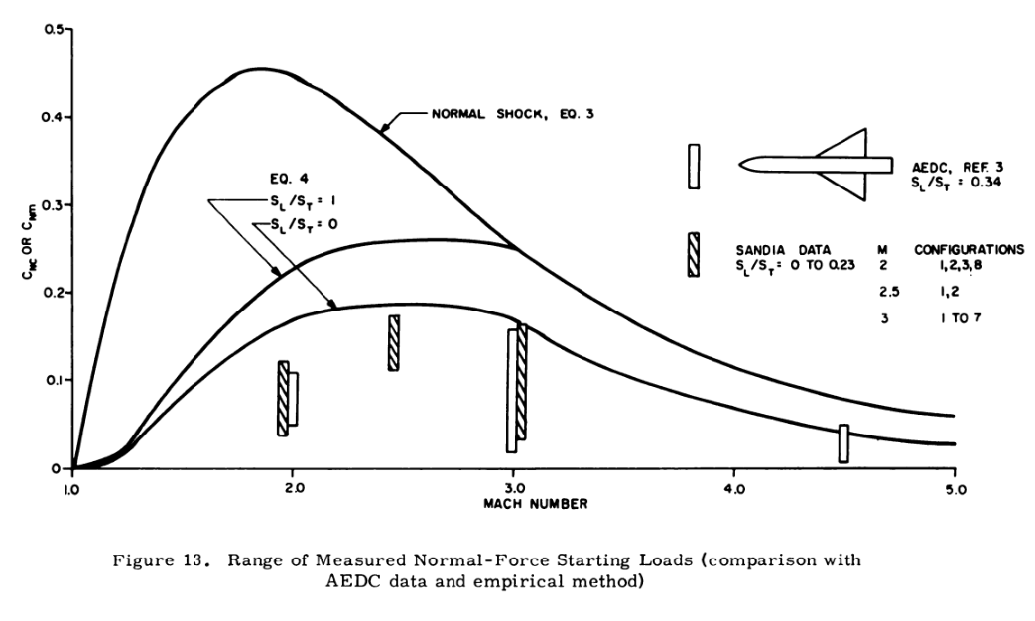
Predicting the Forces on the Model
There are a few options to predicting the forces
  Normal Shock Method
  Normal Shock Method with Numerical Correction (Maydew)
  Conical Shock Method
Maydew (1962)
Notes:
Focus on understanding the effects of sweep, which requires full understanding of the unswept interaction as a baseline.

Slide 8
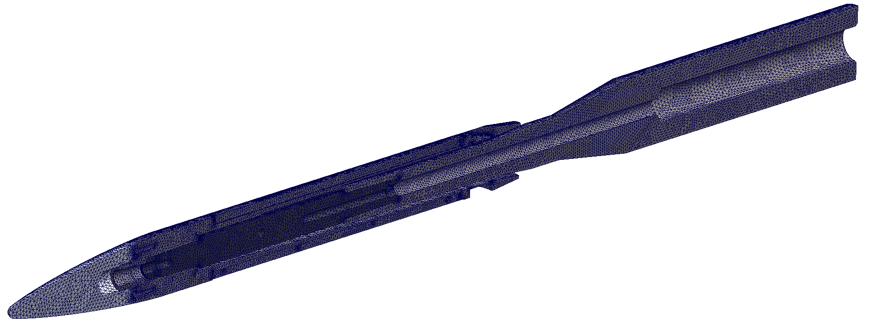
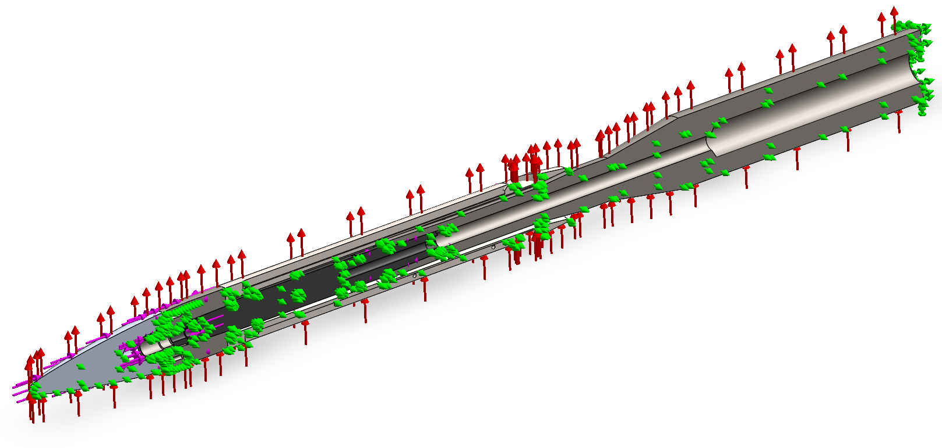
Finite Element Analysis
Starting Load Pressure: 100 kPa
Torque from un-started fins: 150 kPa
Simplified Body
Fixed Sting Base
Notes:
Focus on understanding the effects of sweep, which requires full understanding of the unswept interaction as a baseline.

Slide 9
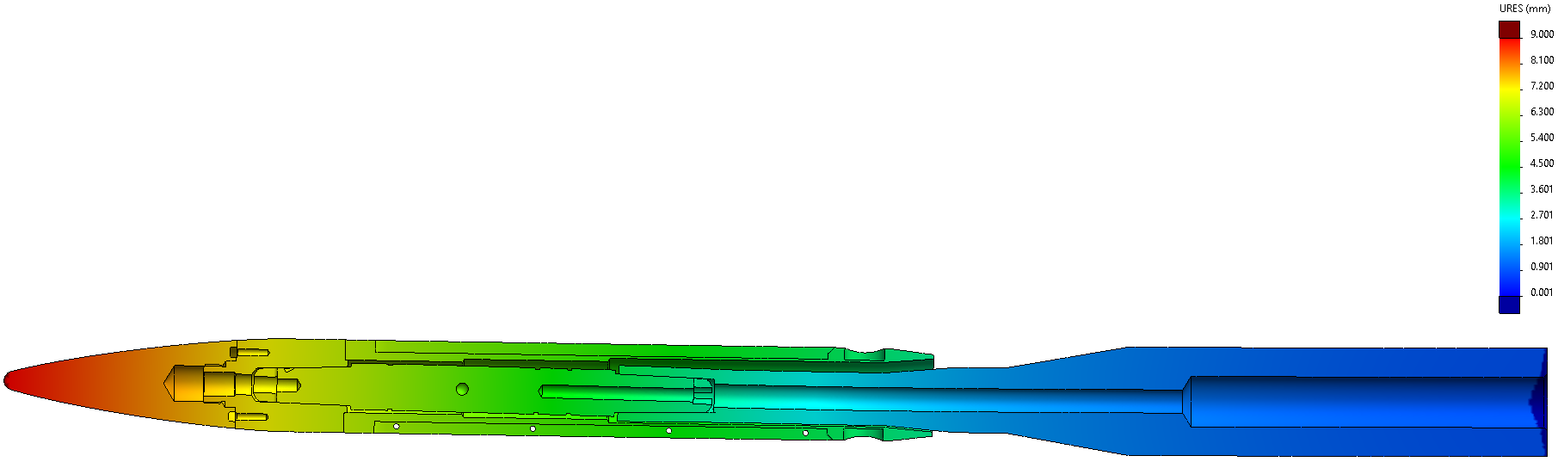
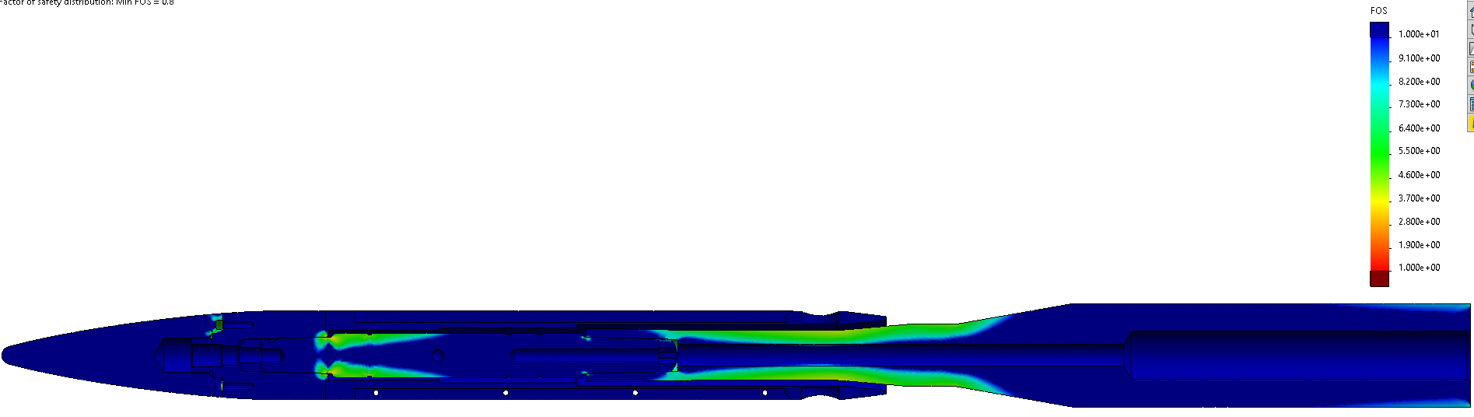
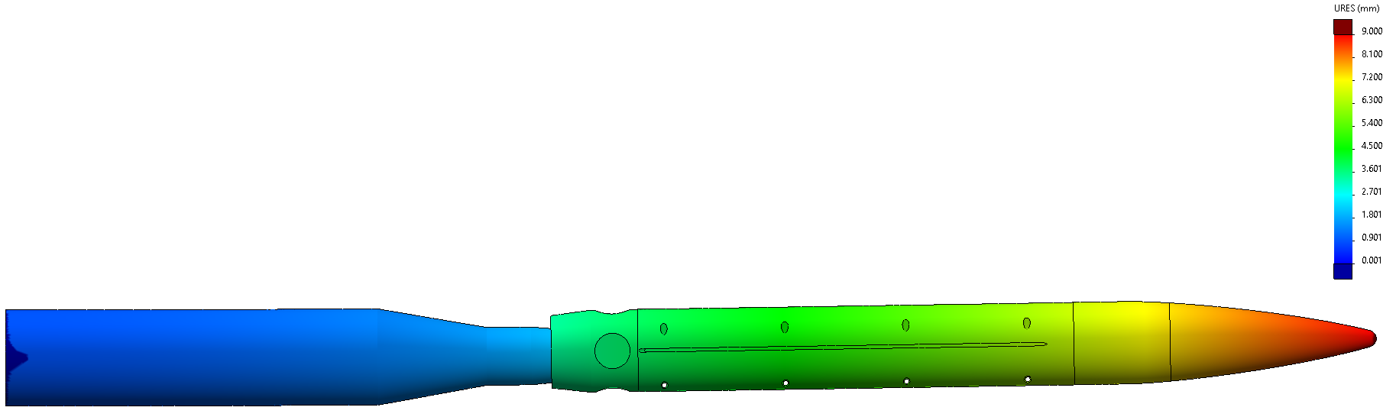
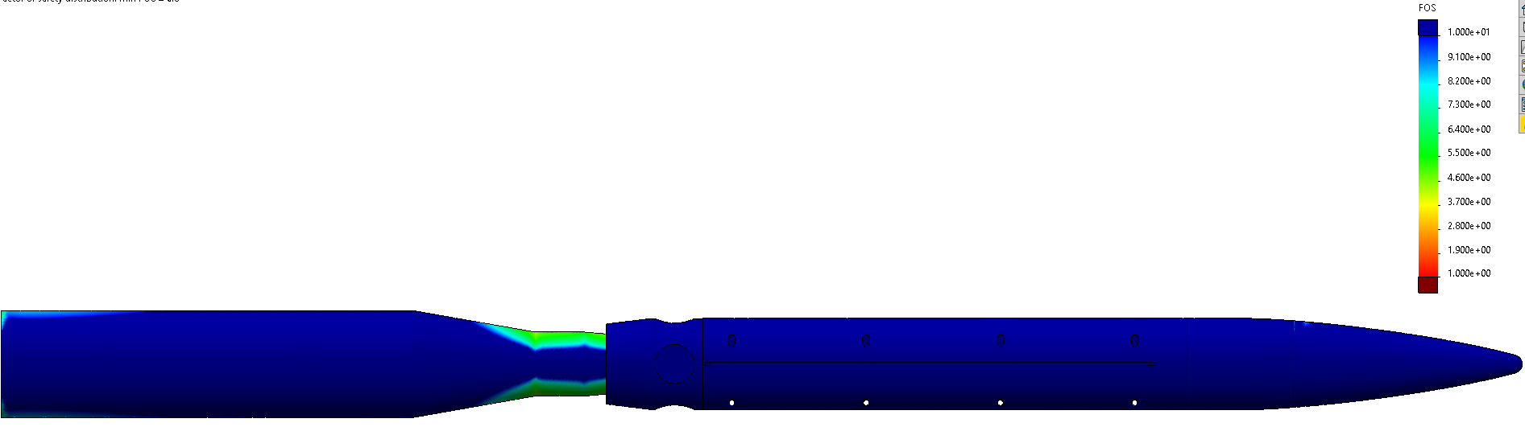
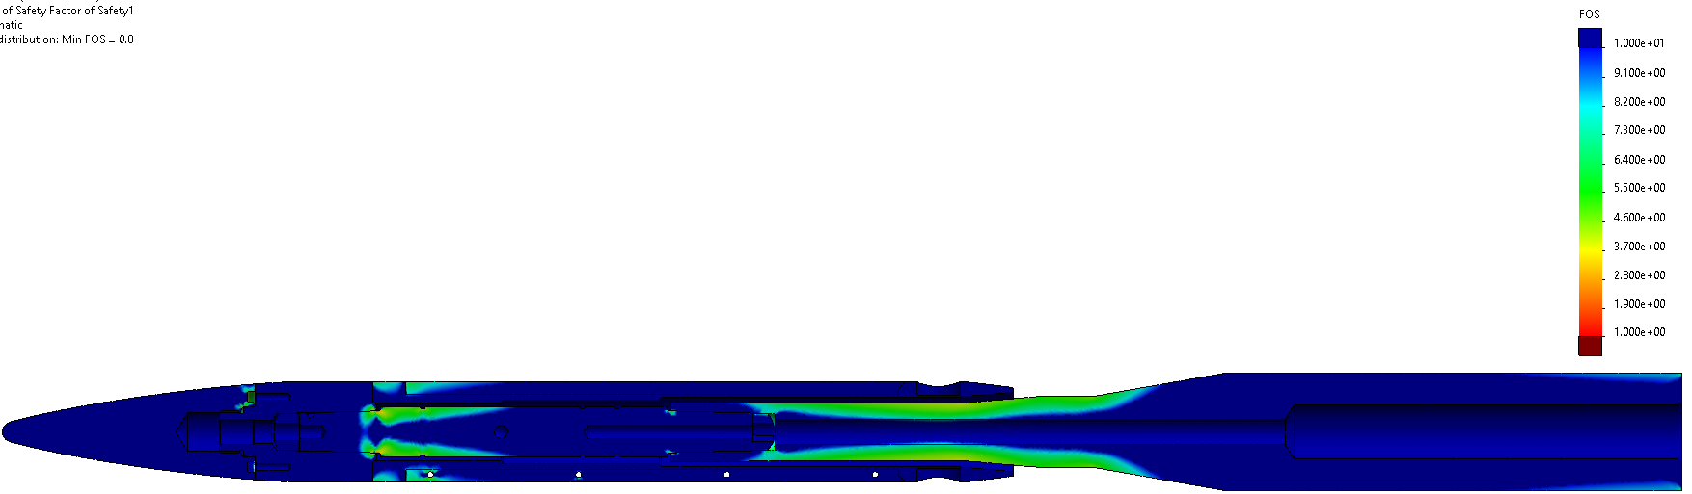
Finite Element Analysis
Section View
Base Assembly (<9 mm)
Side View
Section View
Base Assembly (> 4)
Side View
Notes:
Focus on understanding the effects of sweep, which requires full understanding of the unswept interaction as a baseline.

Slide 10
Initial Model Mount Designs and Considerations
During testing, the model will generate shock waves off its nose.
These shocks are reflected off the walls of the tunnel back into the freestream.
This impacts the sizing of the model as well as the placement of the model within the tunnel.
The model mount must be precise enough to ensure that
  Reflected shocks do not interact with the model’s physics
  The model does not experience a force loading that will damage the sting, mount, model, or balance
Notes:
Focus on understanding the effects of sweep, which requires full understanding of the unswept interaction as a baseline.

Slide 11
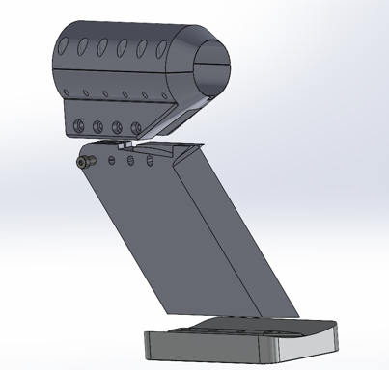
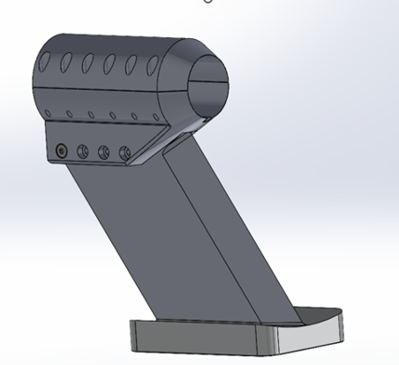
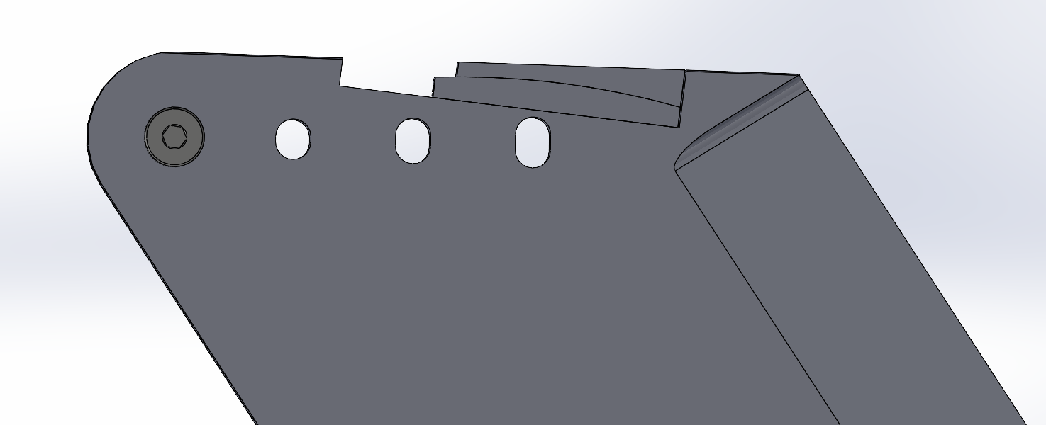
Initial Model Mount Designs and Considerations
Notes:
Focus on understanding the effects of sweep, which requires full understanding of the unswept interaction as a baseline.

Slide 12
Future Work and Testing Plans
Determine the model positioning in the tunnel
Finalize sting-mount interface
Perform testing
Acknowledgments
UArizona-NASA Space Grant
University Consortium for Applied Hypersonics
Army Research Laboratory
Sandia National Labs
CALSPAN
Arizona Research Center for Hypersonics
Dr. James Threadgill
Dr. Ed Marquart
Notes:
Focus on understanding the effects of sweep, which requires full understanding of the unswept interaction as a baseline.

Slide 13
Thank you!

