Slide 1


Preparing for a Successful Symposium Experience
Arizona NASA Space Grant
Statewide Student Research Symposium

Slide 2
Symposium 2026
Held at Arizona State University (ASU) Space Grant
April 17-18, 2026
Friday events: ASU School of Earth and Space Exploration
Keynote Speaker, Graduating Senior Ceremony, Networking
Saturday events: SkySong ASU Scottsdale Innovation Center
Student PowerPoint & Poster presentations all day

Slide 3
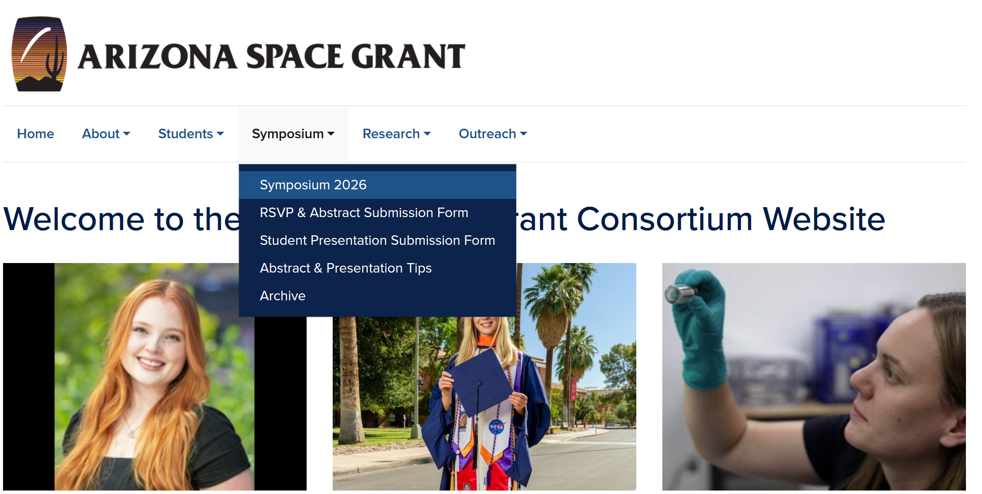
Find Updates on the Space Grant Website
Notes:
https://spacegrant.arizona.edu/symposium

Slide 4
Symposium Due Dates Use the website to submit your files
March 20, 2026: Student Abstracts & All RSVPs
April 3, 2026, Space Grant Intern: Symposium PowerPoints
April 3, 2026: Spring Graduating Seniors, Degree Completion Form
April 10, 2026: ASCEND Program: Symposium Posters & PowerPoints (if applicable)

Slide 5


Submitting an Abstract
Students presenting at the conference:
Select Yes to the question Are you a student presenting at the Symposium?
Select Space Grant Intern or ASCEND Student to get access to the abstract submission drop down.
Everyone must submit their own abstract and RSVP form, even if you are part of a team presentation and sharing 1 team abstract.
Why? Each RSVP form asks for your dietary restrictions, nametag information, etc. so each person must submit their own.
Team presentations can share the same abstract, but each individual team member must submit an RSVP form.

Slide 6
Submitting a PowerPoint
Remember, you are uploading your PowerPoint and Poster presentations to a formal conference with over 150 presenters.
Your Filename should be your: Lastname_Firstname
Individual presenters should submit their own PowerPoint presentation. Team presentations only have to submit one PowerPoint or Poster (only one person from the team needs to submit the document for the whole team).

Slide 7
What to Expect During the Symposium
Starting with your abstracts…

Slide 8
How are the abstracts used?
Symposium organizers use your abstract to place you in a topical session, and to organize the presentation timeline.
They are included in a digital Symposium booklet distributed to all attendees.
They are your first point of contact with the people in your audience. Abstracts are often used for attendees to decide what presentations and posters they want to see. Make your abstract stand out!

Slide 9

Tips for Writing Abstracts
Be concise. Focus only on the major elements (150-word limit)
A science abstract is like a formula – it almost always contains the same elements in the same order.
Begin by capturing the problem / question(s) you have been trying to address as well as your objective(s).
After, you can link the problem to the purpose of your project / research, etc.

Slide 10
Abstract Tips
Next, summarize the methods and activities pursued to address the problem.
Then, summarize your results and accomplishments.
Finally, conclude with interpretations of those results and their significance.
In the case of R&D work, science education, or science writing, conclude with your interpretations of the potential utility and impact the product / activities / articles will have.

Slide 11
Ensuring Quality & Professionalism
Make sure your mentor reads and approves your abstract before it is submitted.
Do not submit your abstract late.
You may not change your abstract after the final submission online.

Slide 12
What to Expect During the Symposium
Now onto the Symposium PowerPoint Presentations…
Note: Some of this content may be applicable for ASCEND poster presentations as well. However, poster design tips and templates can be found at: https://spacegrant.arizona.edu/symposium/abstract-presentation-tips

Slide 13

During your Symposium Presentation
The Session Moderators
Open presentations for each session
Introduce speakers
Keep time
Field questions for you during Q&A
The Presenter (You)
Attend the short plenary talk first thing Saturday morning to receive instructions for the day
Go to your session early & introduce yourself
Sit near the front of the room when it’s close to your presentation time
Participate in the entire session and support other students throughout the Symposium
Notes:
Moderators in the Room
Moderators will introduce you and/or your team and put up your PowerPoint presentation on the projector screen.
All PowerPoints are preloaded onto the computer for your session; no changes may be made after you submit your presentation.
Moderators will sit in the front row and will hold up signs for a 5-, 3-, and 1-minute warning to indicate your time remaining. They will stop you (whether you are done or not) at 9 minutes 20 seconds.
Moderators will help you field questions based on any time that is remaining. If there is no time remaining, they will encourage people to ask you questions during the breaks/lunch.

Slide 14
Presentation Tips
All presentations must be in PowerPoint format.
Note that there will be no audio in the presentation rooms for videos, special slide features, etc.
Do not submit your presentation late and be sure it is complete. You cannot change your presentation after it is submitted.
Individual presenters receive a 10-minute presentation slot broken down as ~7 minutes to present,1-2 minutes for Q&A, and 1-minute to switch to the next presenter.

Slide 15
Presentation: Core Content
The core of your presentation will flow through
Statement of the problem;
Objectives;
Methods / activities / analysis techniques;
Results; and
Interpretations of the results and their significance / use / impact.

Slide 16
Opening Slide
Most presentations use the title slide to state the
Title of presentation
Your name
Your mentor's name / school or industry affiliation, and people who worked with you directly
Name and place of the symposium
Date of the symposium

Slide 17
Logos & Attribution
Somewhere on the edges of the title slide put logos of organizations key to the research (the department, NASA, etc.).
If Space Grant is the primary sponsor / funding you to perform this research, place the Space Grant logo in the bottom corner of all subsequent slides.
Find Logos Here:
https://spacegrant.arizona.edu/about/logos

Slide 18

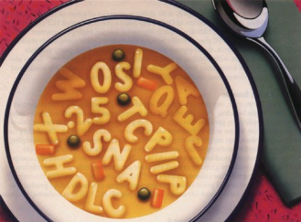
Effectively Communicating
Know your audience. Though scientifically aware, some of your audience may not be versed in the technical terms of your specific topic or discipline.
Audience may include interns, mentors, but also family and friends.
Avoid jargon
Define technical terms
Spell out acronyms
Source: Blogging Innovation

Slide 19
Be Careful Of…
Background Colors
Choose simple backgrounds (white with black text or dark blue with white text).
Text colors: Do not use red. Light text on light background and dark text on dark background should be avoided.
Animations.

Slide 20


Which Font & What Size?
Sans Serif Fonts
These include, among many others, Arial and Tahoma.
Generally, slide titles should be larger (e.g. 40pt), while bullet points can be smaller (32 or 28pt.)

Slide 21

Images
Images are excellent, particularly if they aid comprehension.
Note: It is very important that you credit the source of the image on your slide (usually in smaller font below the image). PowerPoints remain accessible to the public on the Space Grant website.
Source: openscience.org

Slide 22
Closing Slide(s)
Conclusions: generally on the second to last slide
Discuss interpretations and give some insight of future directions.
Then, end with a more detailed acknowledgements slide.
Remember your mentor, any graduate students, the funding agency, the Department, the name of the grant, etc. have all helped you get to this point.

Slide 23
Last Slide
Your final slide should simply say “Thank You” and may include your contact information. This is important to indicate your presentation is complete.
Do not end with a slide reading “Questions?”. You may not have time for questions depending on the length of your presentation. The session moderator will determine this.
Upon completion of your presentation, the Session Moderator will stand up and announce next steps.

Slide 24
How Do I Field Questions?
The moderators in each room will
Ask the audience for questions if there is remaining time
Help field the questions so that you don’t have to scramble to find who asked a question first
Note: do not close your PowerPoint because you may need it to refer to a slide during Q&A
You may want to add slide numbers to aid audience in asking question on slide…

Slide 25
Strong Beginning, Strong Finish
Memorization rarely if ever helps a presentation.
However, having a strong beginning and strong finish can make a world of difference.
These get you rolling, reduce nerves because you are rolling, and help you gracefully off the stage!

Slide 26
Transition Tips
Memorize your introduction and conclusion and identify the transitions you want between slides.
Two complimentary methods work well:
a) plan for the last thing you say on a slide to be the opening for the next slide, and/or
b) place something on the slide (a word in the last bullet or an image) that cues you as to what is coming next.
Good transitions lead to good presentations and are much more effective than rote memorization.

Slide 27
Delivery
Face your audience, not the screen.
Speak loudly and clearly.
Do not read your slides, they should speak for themselves.
Eye contact is very helpful for communication.
Some movement (hand gestures, etc.) is ok, but keep this at a minimum to avoid being distracting.
When directing audience attention to a particular aspect of a slide with a laser pointer, point– but do not distract with the pointer!

Slide 28
Miscellaneous Symposium Items

Slide 29
View our Resources
Review past Symposium presentations and abstracts by visiting our Symposium archive. Abstracts can be found in the digital Symposium booklet. PowerPoints can be found organized by topical session.
https://spacegrant.arizona.edu/students/symposium/archive

Slide 30
Symposium Room Setup
Generally theatre style with an isle down the middle
Each room will have a podium with a mic and laptop for the presenter at the front of the room, as well as a projector screen.
Note that your presentation will be pre-loaded in the presentation room before your arrival. You do not have to bring your presentation or laptop.
Team presentations should consider how to best move around to use the microphone.
There will be a slide advancer for your use.

Slide 31
Being Supportive & Respectful of Others
Use the Symposium to network!
Ask other students questions about their research and stay for the duration of the Symposium to show your support.
If moving from session to session, wait for a break in speakers and leave as quietly as possible.
When entering a new room, wait until you hear clapping/ Q&A, so you don’t interrupt someone’s presentation.
Remember to put your phone on silent for this event.

Slide 32
Have Fun!
We hope that each of you enjoy this experience. Please let us know how we can better help you feel prepared for the Symposium event.

