Slide 1


The Effect of Polymer Film Roughness on the Performance of Polyamide Reverse Osmosis Membranes
Cailen McCloskey
4/2/15
Notes:
California
global water use grown at twice the rate of the population

Slide 2
1. Goals and Objectives 2. Background 3.Methodology 4.Results 5.Recommendations

Slide 3
Goals and Objectives
Synthesize polyamide latex from available monomers: meta-phenylene diamine (MPD) and trimesoyl chloride (TMC)
Make thin film composite membranes using polyamide latex
Compare performance of latex membranes to that of interfacially polymerized membranes

Slide 4
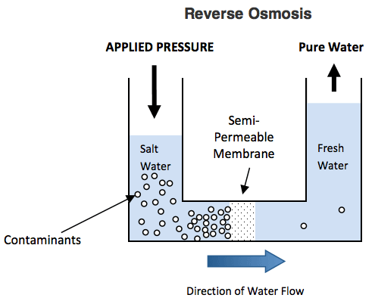
Background
Reverse osmosis is a common water desalination technique
High purity
High cost
Membranes are prone to fouling
Flux=Flow rate/Membrane Area
Rejection=Permeate/Feed
Applications for water
filtration in space

Slide 5

Background
Thin film composite membranes are made of a layer of porous support coated with a thin film of highly selective polymer
Selective Polymer
Porous Support

Slide 6
Interfacial film formation
MPD in water
TMC in solvent
Interfacial reaction
Curing and rinses
Notes:
Two monomer solutions are made, in immiscible solvents.
The support membrane is dipped in each and the polymer film is formed on the surface of the support, at the interface between the two monomer solutions
Additionally, we apply some curing and rinses before the membrane is finished

Slide 7
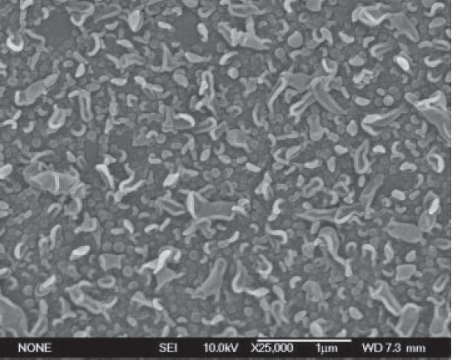
Interfacially polymerized membranes have a characteristic “hill and valley” structure and a very high roughness. For this study, it is believed that this roughness may contribute to fouling.
Feinberg, B. J., Hoek, E. M. V. Interfacial Polymerization. Encyclopedia of Membrane Science and Technology, 2013.
Notes:
As you can see, the I.P. film is very rough.
In order to cast a smoother membrane we decided to make a latex membrane

Slide 8
Latex film formation
Water evaporates off
Particles deform
Notes:
In latex film formation, the polymer has already been formed as beads, which are dispersed in water.
As the water evaporates off, capillary pressure forces the beads together, which eventually deform and coalesce into a smooth film

Slide 9
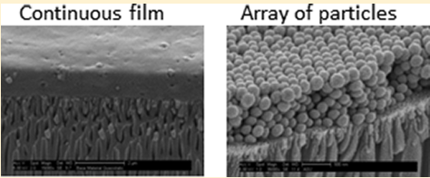
Latex membranes have smoother surfaces due to the deformation of particles into a continuous film.
Khosravi et. al, Latex Barrier Thin Film Formation on Porous Substrates. Langmuir. 13994-14003. 2014.
Notes:
In these pictures, you can see the round particles and the final continuous film

Slide 10
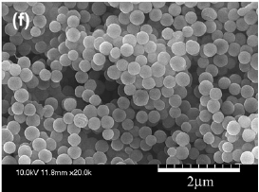
Polyamide latex particles from literature
Yoshioka et. al, Preparation and Characterization of Nanoscale Aromatic Polyamide Particles. Polymer. (48): 2214-2220. 2007.
Notes:
Now polyamide latex has been made before, but to our knowledge has not been made using the monomers we use and made into TFC membranes

Slide 11
Methodology
Based on Yoshioka et al, different combinations of monomers and solvent have been tried.
Water, Pyridine, and Tetrahydrofuran (THF) were chosen as solvents
The particles were tested with scanning electron microscopy (SEM) to determine quality

Slide 12
Results
Very difficult to get uniform, small, rounded particles
40+ batches and more fine tuning needed
Of the three solvents tested, it appears that pyridine is the best
THF makes good particles, but the yield is very small
Particles do not yet form a film

Slide 13
Film formation
Notes:
At first, we were just pouring the solutions into each other, and we had the formation of a film, rather than defined particles

Slide 14
Unreacted monomer, no defined particles
Notes:
We began pipetting the monomers slowly together while stirring them, and eventually purchased burettes to steadily titrate the mixture. This gave us better particles, but the mixtures still weren’t right

Slide 15
2mL water, 2x MPD
Notes:
We also adjusted the ratio of the monomers, however have received the best results from changing the solvents added

Slide 16
Results
Very difficult to get uniform, small, rounded particles
40+ batches and more fine tuning needed
Of the three solvents tested, it appears that pyridine is the best
THF makes good particles, but the yield is very small
Particles do not yet form a film

Slide 17
Results
Very difficult to get uniform, small, rounded particles
40+ batches and more fine tuning needed
Of the three solvents tested, it appears that pyridine is the best
THF makes good particles, but the yield is very small
Particles do not yet form a film

Slide 18
12.5mL Pyridine
Notes:
High yield, good density, disperses fairly well

Slide 19
Results
Very difficult to get uniform, small, rounded particles
40+ batches and more fine tuning needed
Of the three solvents tested, it appears that pyridine is the best
THF makes good particles, but the yield is very small
Particles do not yet form a film

Slide 20
5mL THF
Notes:
¼ or less of the yield of pyridine

Slide 21
Results
Very difficult to get uniform, small, rounded particles
40+ batches and more fine tuning needed
Of the three solvents tested, it appears that pyridine is the best
THF makes good particles, but the yield is very small
Particles do not yet form a membrane film

Slide 22
Non-uniform, no particle deformation, no real “performance”
Notes:
These are all membranes made form the same batch of particles, on different supports and at different concentrations of particles

Slide 23
Compared with 99.4% rejection and flux of ~30um/sec
Notes:
It can be seen here that vs the support, there is a reduction in flux, which is to be expected because of the additional barrier of the added polymer. However, there does not seem to be a clear increase in rejection. From this preliminary data, it appears that the dry membrane may be better for dip coating but more research should be done
All of these results are so far from published I.P.

Slide 24
Recommendations
Cast more batches with pyridine and THF
Potentially mix pyridine and THF
Apply curing process to particles
Dip coating on a dry support seems initially better than on a treated support

Slide 25
Recommendations
Cast more batches with pyridine and THF
Potentially mix pyridine and THF
Apply curing process to particles
Dip coating on a dry support seems initially better than on a treated support

Slide 26
Recommendations
Cast more batches with pyridine and THF
Potentially mix pyridine and THF
Apply curing process to particles
Dip coating on a dry support seems initially better than on a treated support

Slide 27
Recommendations
Cast more batches with pyridine and THF
Potentially mix pyridine and THF
Apply curing process to particles
Dip coating on a dry support seems initially better than on a treated support

Slide 28
Thank you!
To the ASU/NASA Space Grant, Dr. Mary Laura Lind, and the Lind lab

