Slide 1


Developing a Model Organism to Investigate the Evolution of Cellular Differentiation
Baltazar Diaz
Mentor: Richard Michod
CoMentors: Erik Hanschen and Zach Grochau-Wright
University of Arizona

Slide 2
Cellular Differentiation
The evolution of multicellularity has occurred numerous times and this process is not completely understood
Cellular differentiation allows for increase fitness through specialized cells
  Germ and somatic cells
Focusing on early transition of cellular differentiation

Slide 3
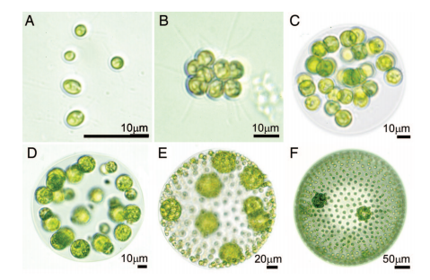
Background
Germ cell: cell involved in replication
Somatic cell: non reproductive cell whose function is hypothesized to be involved in motility and nutrient gathering
Germ cell
Somatic cell
Michod 2007.

Slide 4
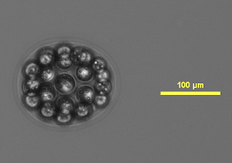
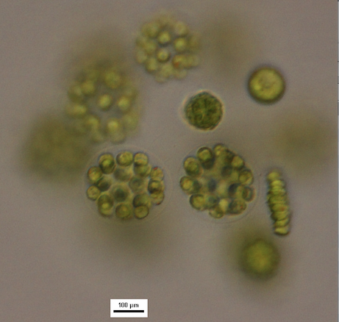
E. illinoisensis
Ranges from 8-32 cells
32 celled colonies had anterior cells reduced in size ( Goldstein 1964)
  Characterized as somatic cells
Somatic cells

Slide 5
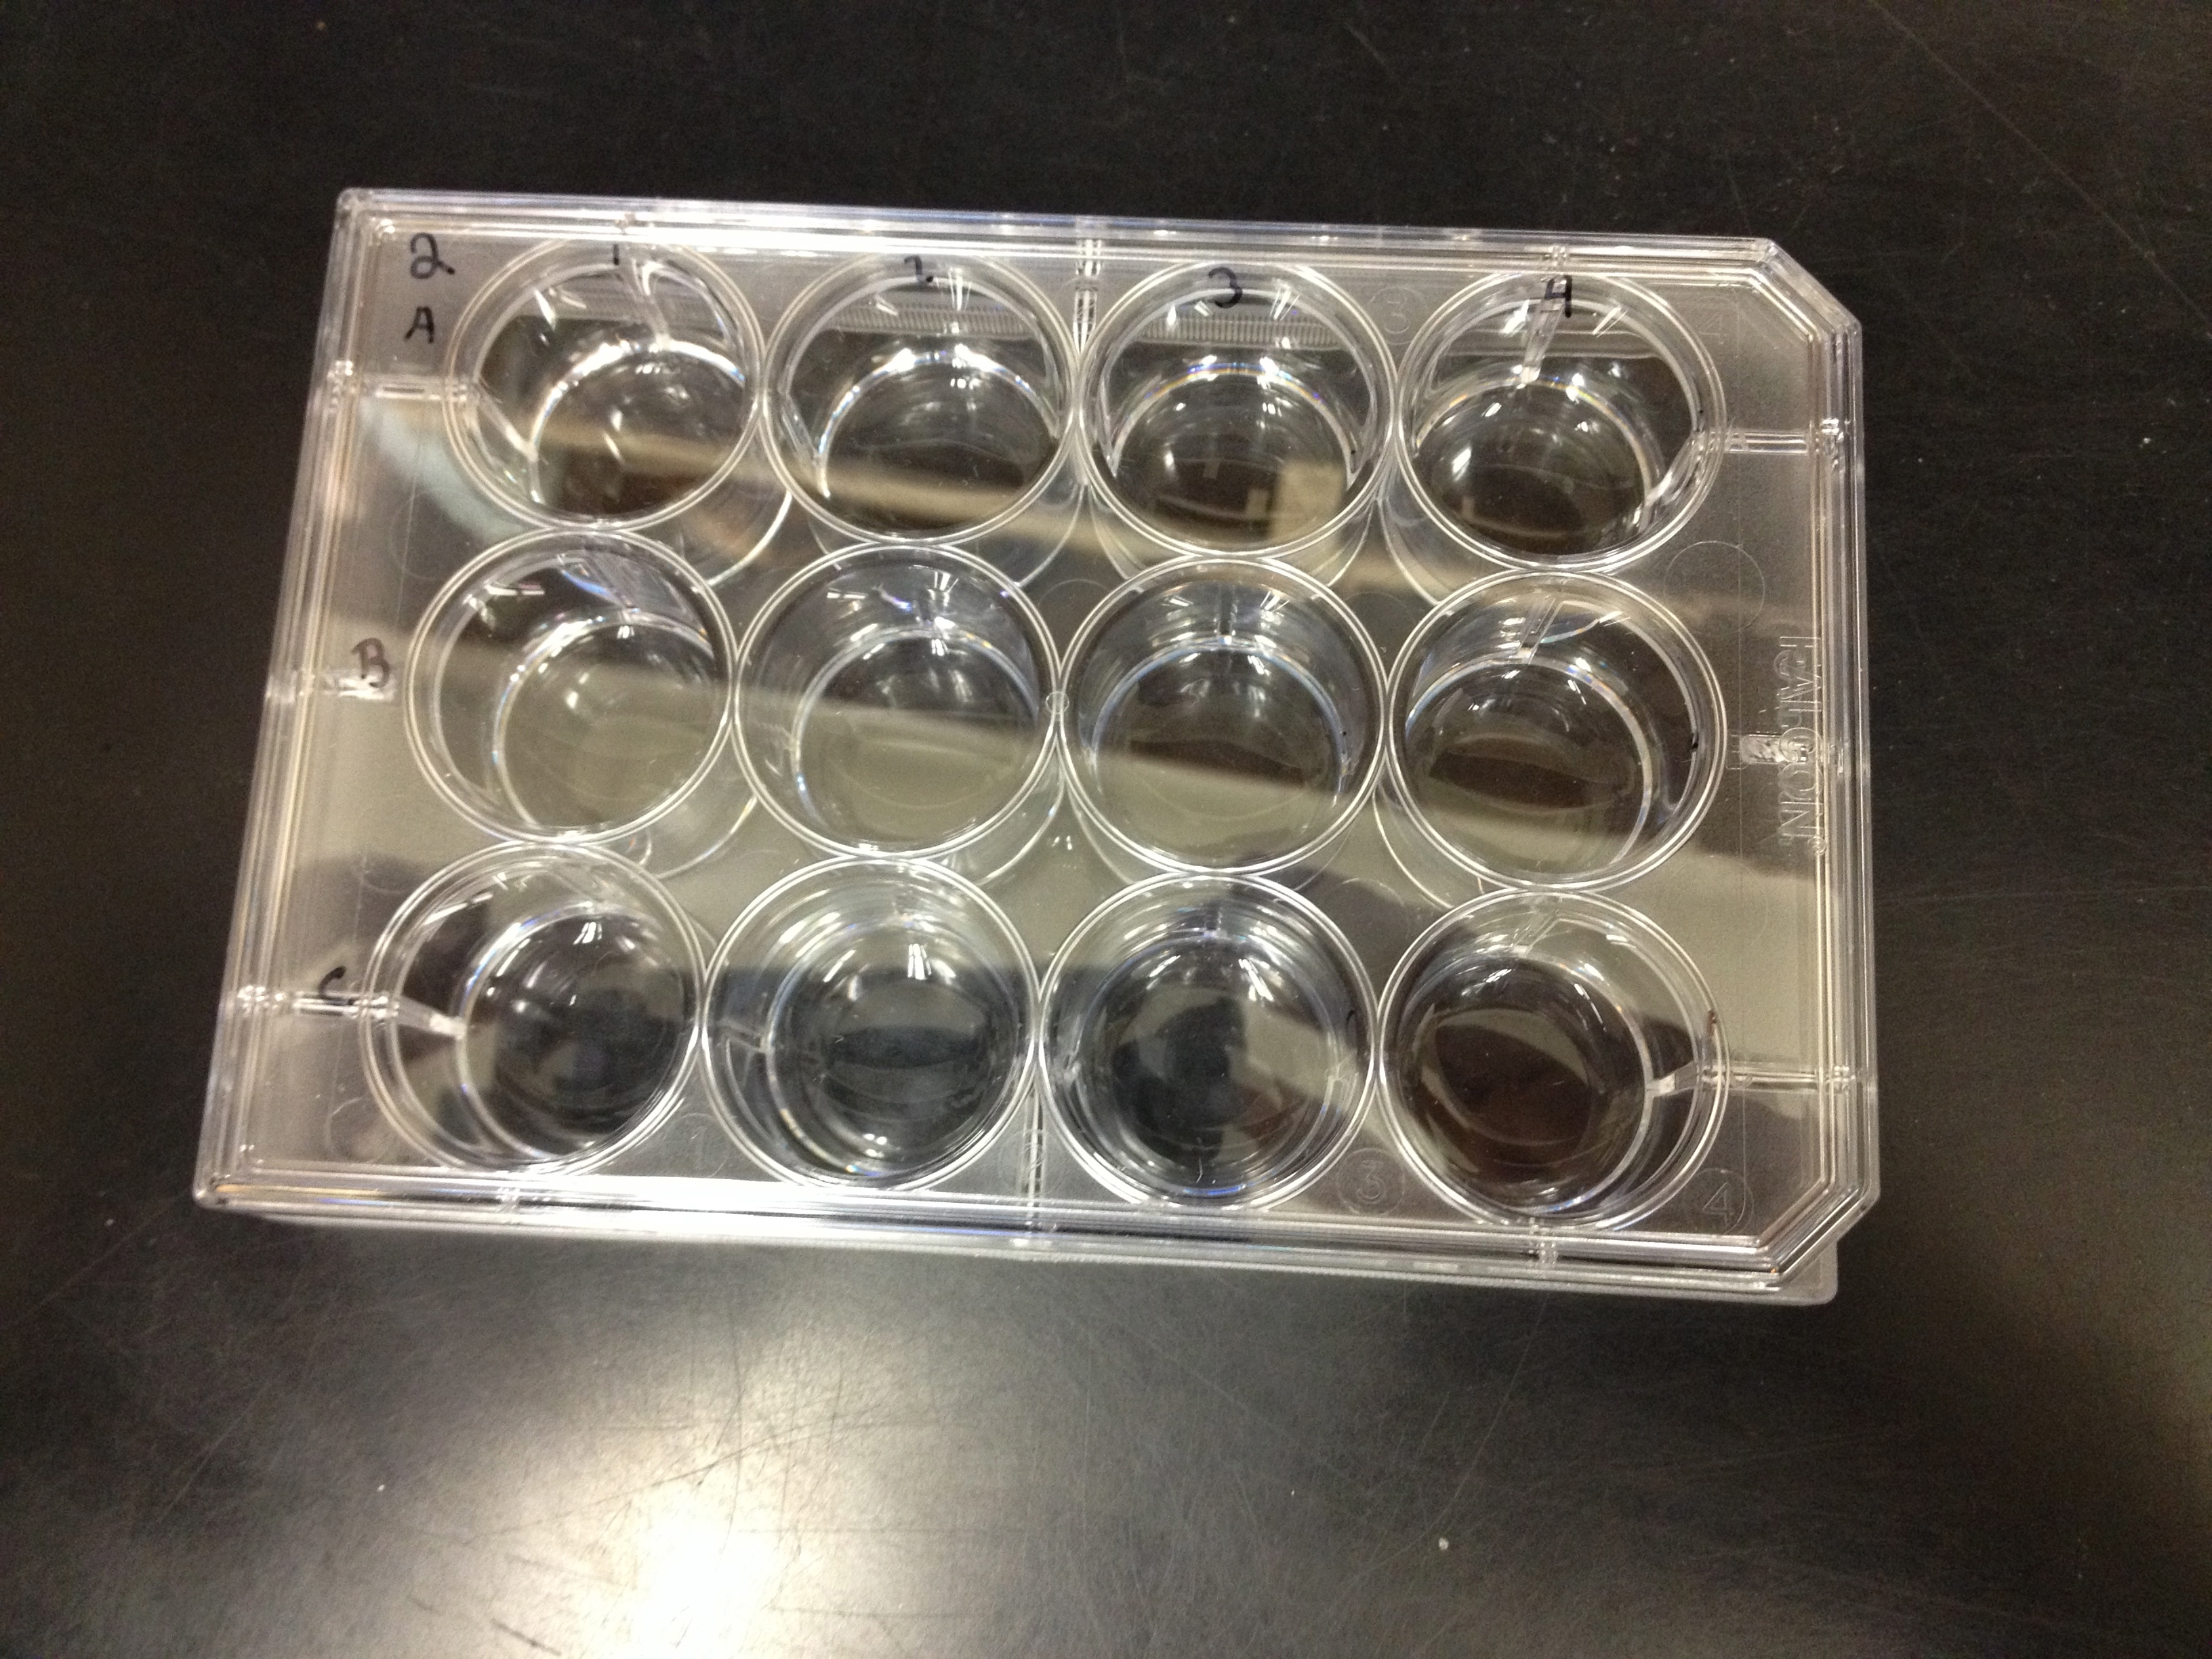
Methods
Grew under different conditions
  1X SVM
  0.25x Phosphate 1x SVM
Isolated after hatching and placed in 12 well plate
  Quantified after replication took place in well

Slide 6
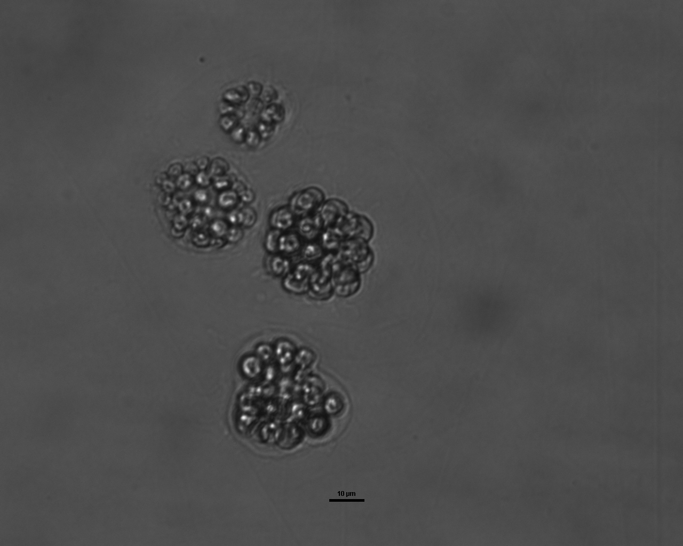
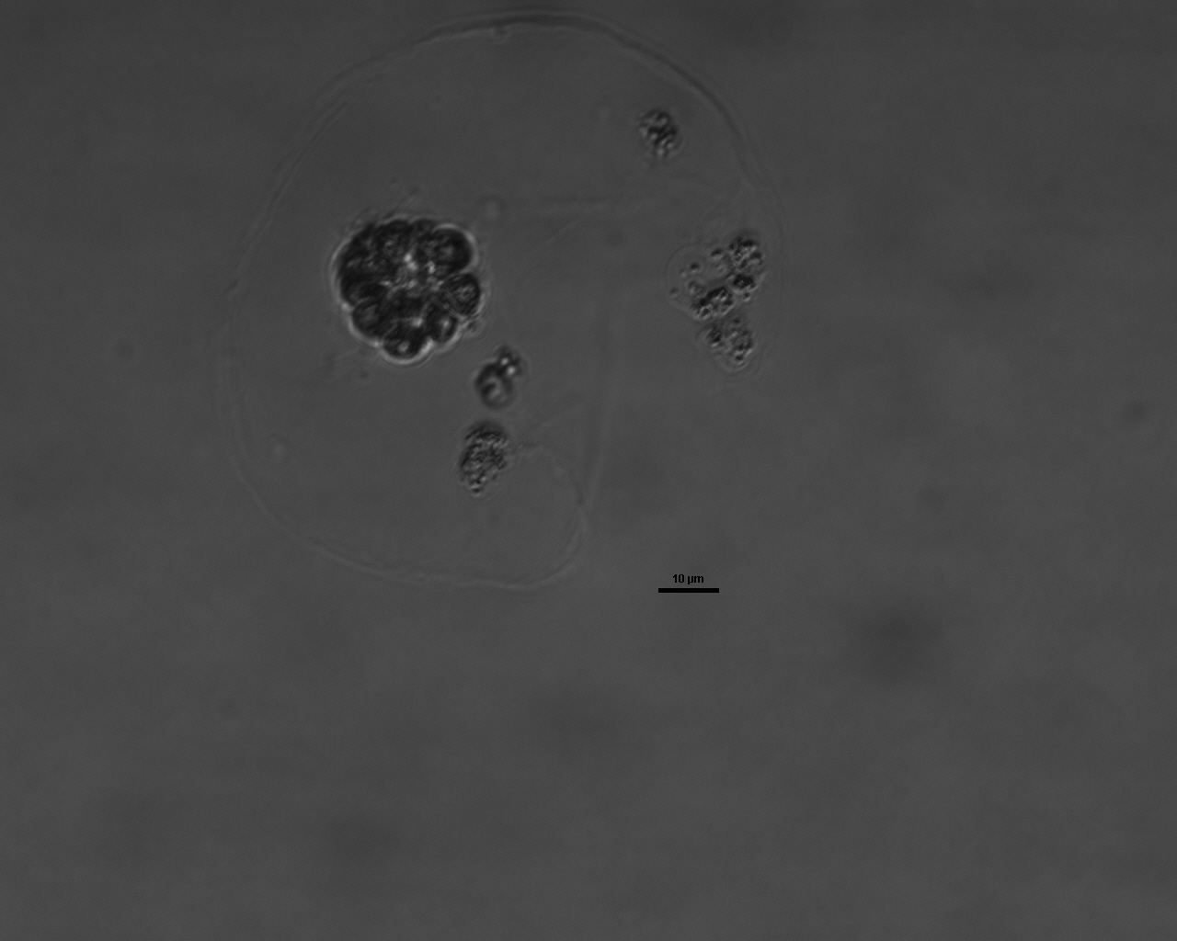
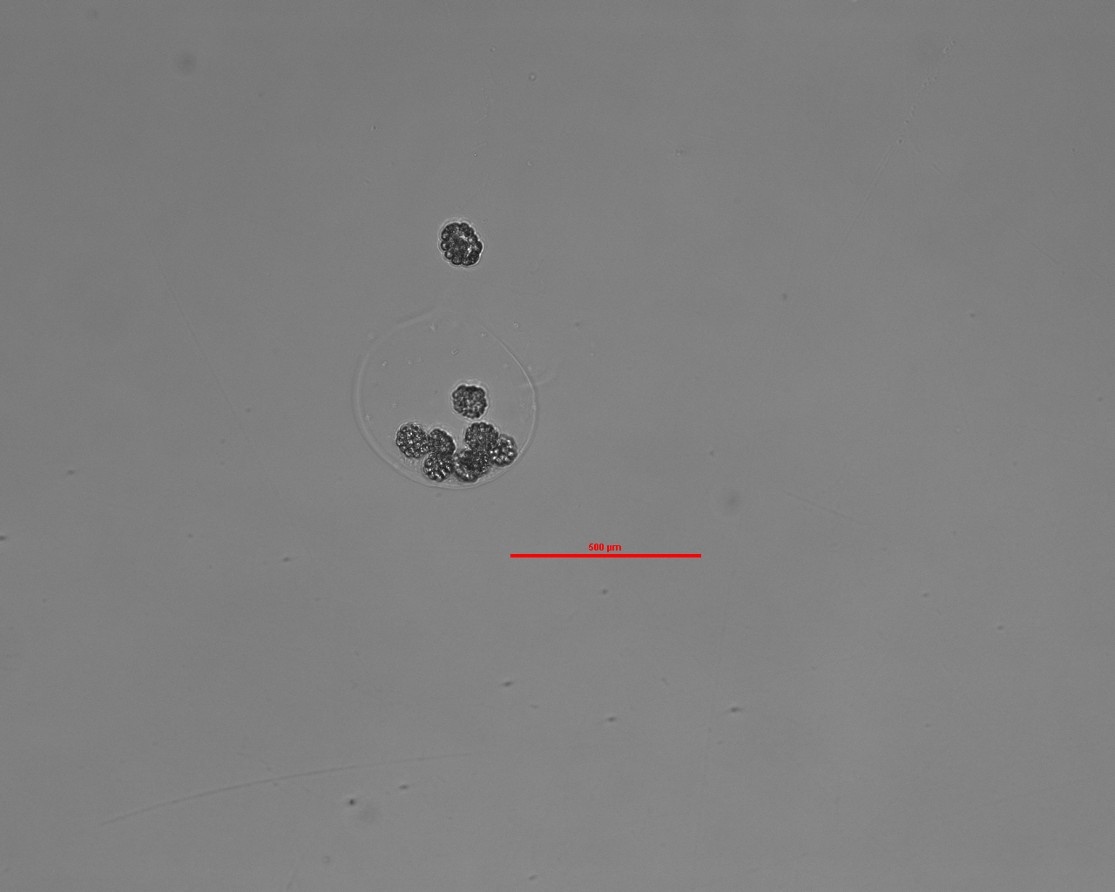
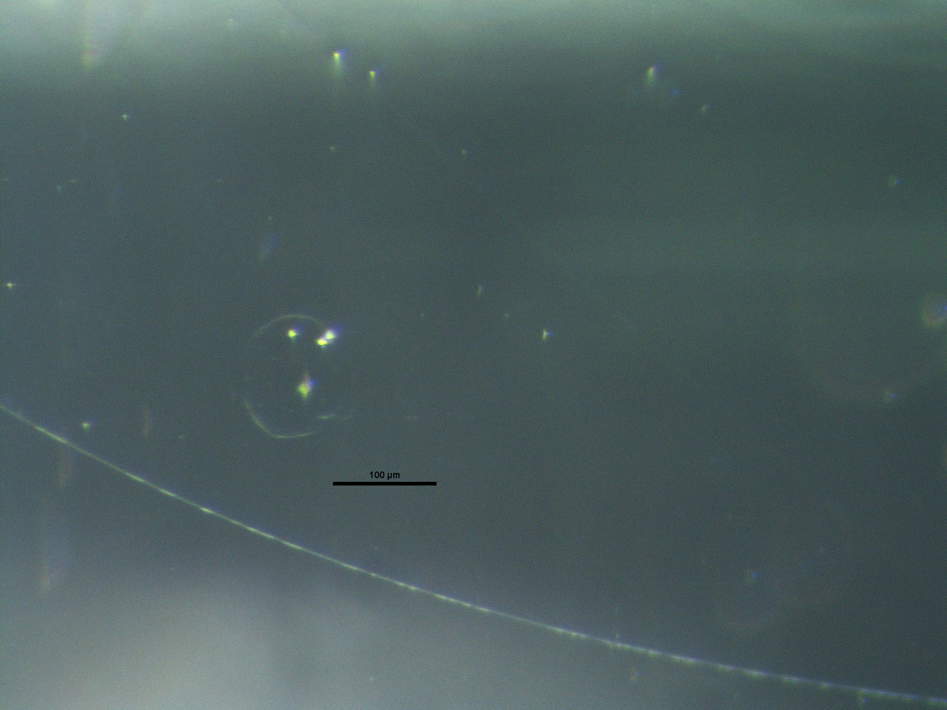
Quantification

Slide 7
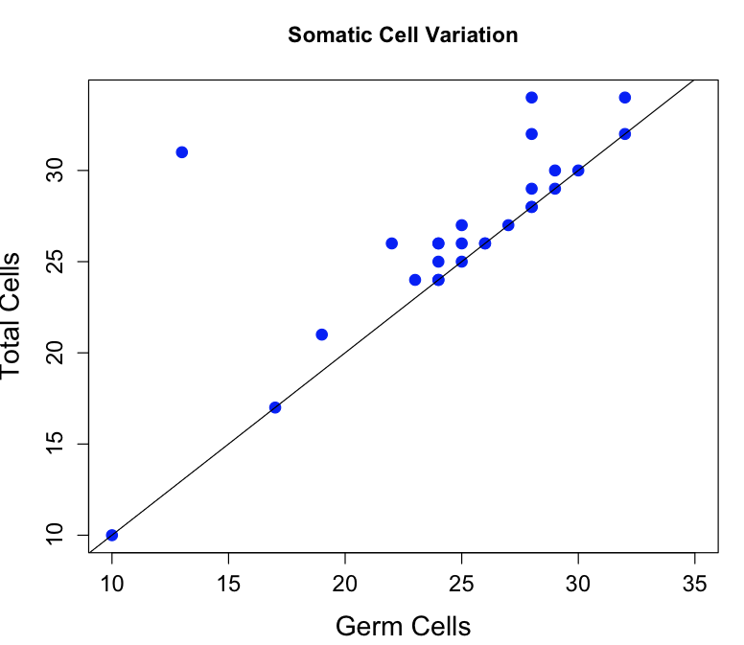
Results

Slide 8
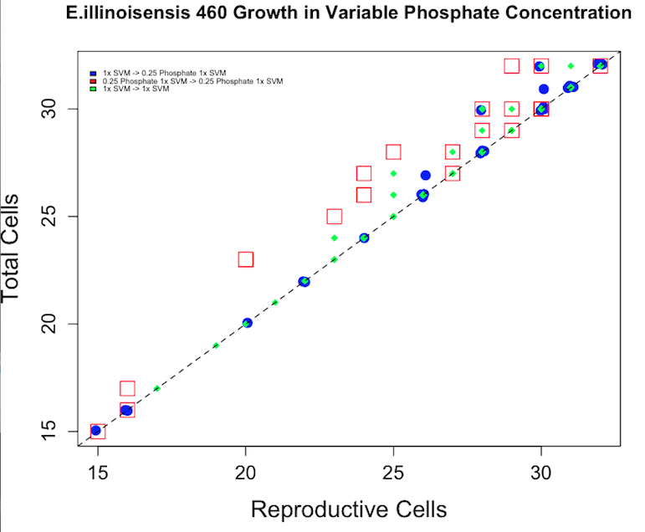
Results

Slide 9
Thanks!

