Slide 1

FPGA for Underwater Communication
Pradyumna (Prad) Kadambi
Mentor: Cody Youngbull
April 13, 2015

Slide 2
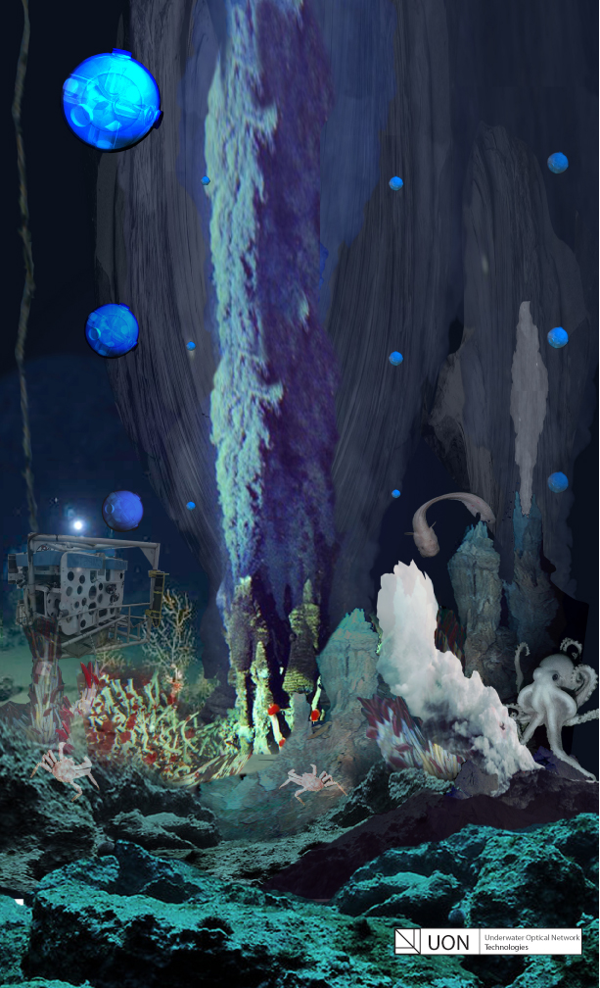
Motivation
Current underwater communication can be slow and cumbersome
Need for environmental/structural monitoring
Oil and Gas
Defense
Goal: Create a robust, high speed underwater communication system
Optical communication

Slide 3
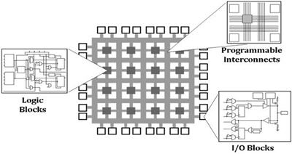
Field Programmable Gate Array (FPGA)
Advantages:
Massively parallel
Immense flexibility
No fixed hardware structure
All algorithms are implemented in hardware!
Disadvantages:
FPGA development can be lengthy
Programming FPGA is more involved than programming a microcontroller
ni.com

Slide 4
System Architecture
Analog front end
Required to detect optical signal
Analog to digital conversion (ADC)
FPGA
Process detected signal
Decode received signal to intelligible letters and numbers
Microcontroller
Interface with communication ports, storage devices
Peripherals
Analog Receiver/ Transmitter
FPGA
(Data Processing)
Microcontroller
Peripherals

Slide 5
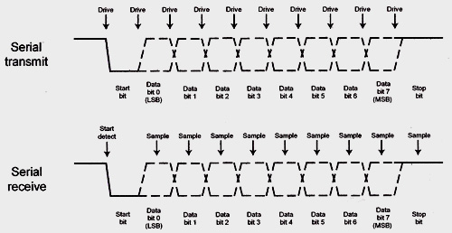
UART
Microcontroller must communicate with FPGA.
Universal Asynchronous Receiver Transmitter (UART)
UART is simple, has low overhead
Only need to transmit “Start bit” and “Stop bit”
One character is sent every 8 bits
embedded.com

Slide 6
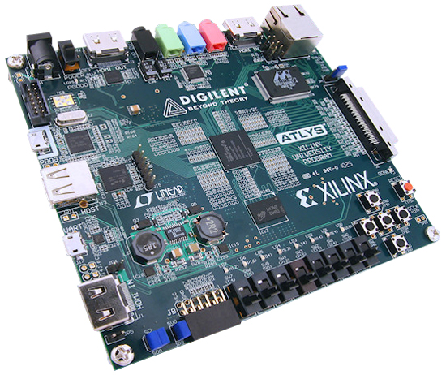
FPGA Design Flow
Model algorithms in Simulink
Simulate and debug algorithms
Convert algorithms to HDL
Hardware Description Language
Simulate and debug HDL
Test/debug hardware
Often hardware will not match simulation
Design is an iterative process
digilentinc.com

Slide 7
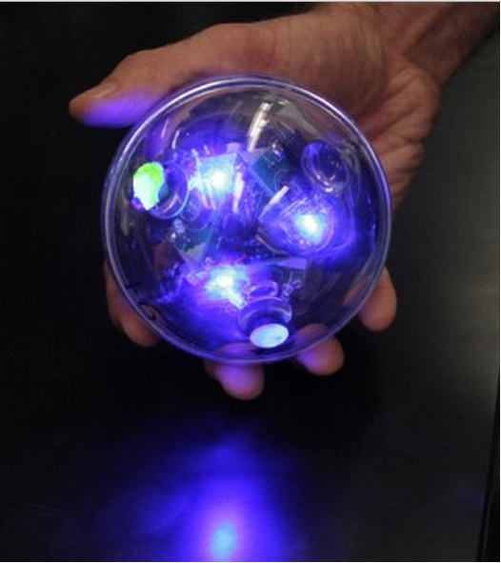
Current Milestones
Fully functional FPGA design
Point to point communication
Sensor integration

Slide 8
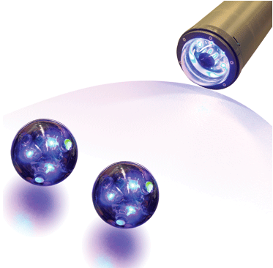
Future Goals
Expand on networked sensing arrays
Another presenter will be addressing this issue
Forward error correction
Improve distance
Improve speed

Slide 9
Thank You!

