Slide 1



Does Exposure to Scratch and Tynker Affect the Attitudes of Teachers toward Computing?
Alexandria Wauneka
Mentor: Dr. Suzanne Westbrook
School of Information: Science, Technology, and Arts (SISTA)
University Of Arizona
Space Grant Symposium, April 18, 2015

Slide 2
Objective
The purpose of this pilot study was to see if exposure to a visual block structured language (such as Scratch or Tynker) affected attitudes of pre-service teachers towards computing and programming
The results of this study could be used to support a larger study of both pre-service and experienced teachers.

Slide 3
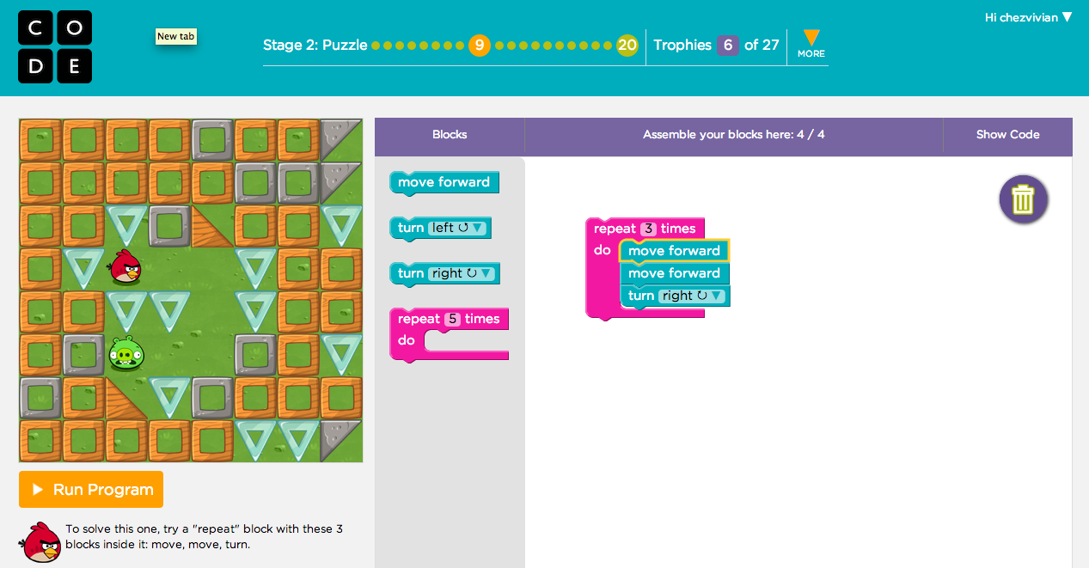
Project overview
1 hour hands-on activity with pre-service teachers at U of A
Introduced Hour of Code activities (code.org)
Gave them one hour to work on Angry Birds exercise on the Hour of Code website
Had them fill out a background, pre and post surveys to understand their comfort in both using and teaching computing
Source: Code.org

Slide 4

Subjects’ backgrounds
U of A Education Students (Pre-service teachers)
Undergraduates - All Juniors
Focus on teaching grades K-8
Only one person had any exposure to programming prior to the activity (website design)
Source: Shutterstock.com

Slide 5
Data and Analysis
I am comfortable working with:
Background Survey to assess general feelings about technology, computers, and math
Used a 5-point scale from 1 (not at all comfortable) to 5 (extremely comfortable)
Technology | Computers | Math
4.3 | 4.5 | 3.5

Slide 6
Data and analysis
I would be comfortable talking with my students about:
Pre-service teachers did a identical pre and post surveys to assess their comfort in talking with their students about computer science, computer programming, and the role of computing
Used a 5-point scale from 1 (not at all comfortable) to 5 (extremely comfortable)

Slide 7
Data and analysis
I would like to learn more about:
They also answered questions in the pre and post survey about their interest in learning more about computing and programming.
Used a 5-point scale from 1 (no way!) to 5 (absolutely!)

Slide 8
conclusion
In this one hour activity:
  Noticeable improvement (from 2.7 to 4.2) in their perceived comfort level in talking to their students about computer programming.
  Improvement in perceived level of comfort in talking to their students about computer science (from 3 to 3.8) as well as the role of computing to other disciplines (from 3.3 to 4) even though these weren’t discussed in the activity.
  Also improvement (from 4.2 to 4.7) in their desire to learn more about programming.
A larger study would be more definitive about the value on students and teachers of including programming activities in K-8 teachers’ education

Slide 9
Acknowledgements
I would like to thank:
  Dr. Suzanne Westbrook, Mentor
  Susan Brew, Space Grant Manager
  The pre-service teachers who participated in the activity
  NASA Space Grant Program

Slide 10



Thank You

