Slide 1
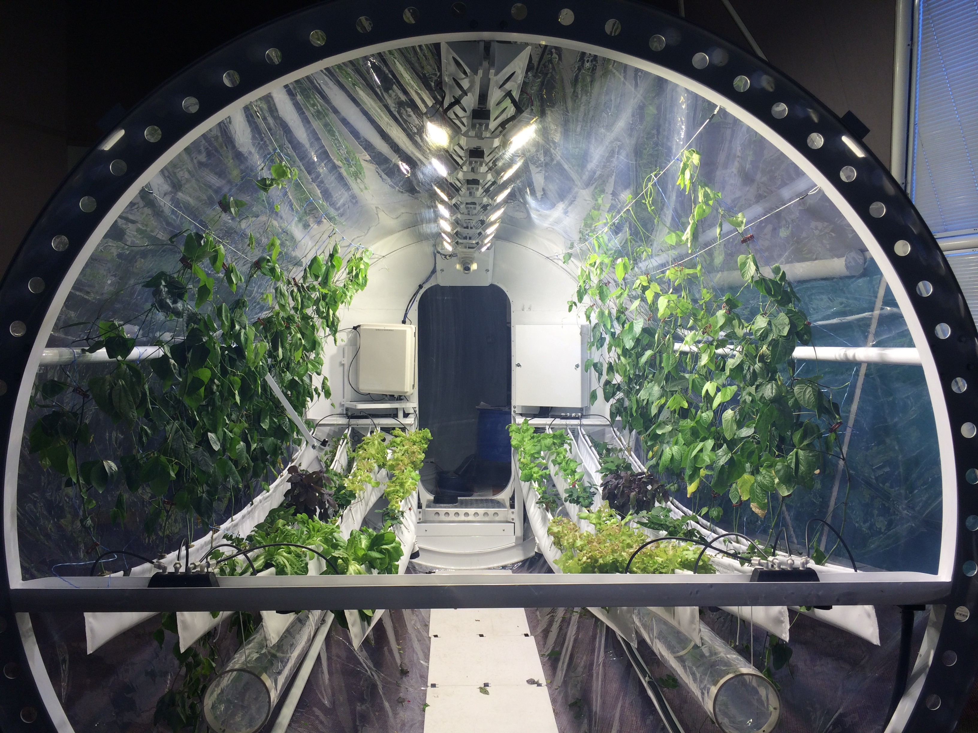



The Lunar Greenhouse: Outreach and Teaching Module(LGH-OTM) Development and Documentation
Erica Hernandez, Dr. Giacomelli
Controlled Environment Agriculture Center
University of Arizona NASA Space Grant
April 18, 2015

Slide 2


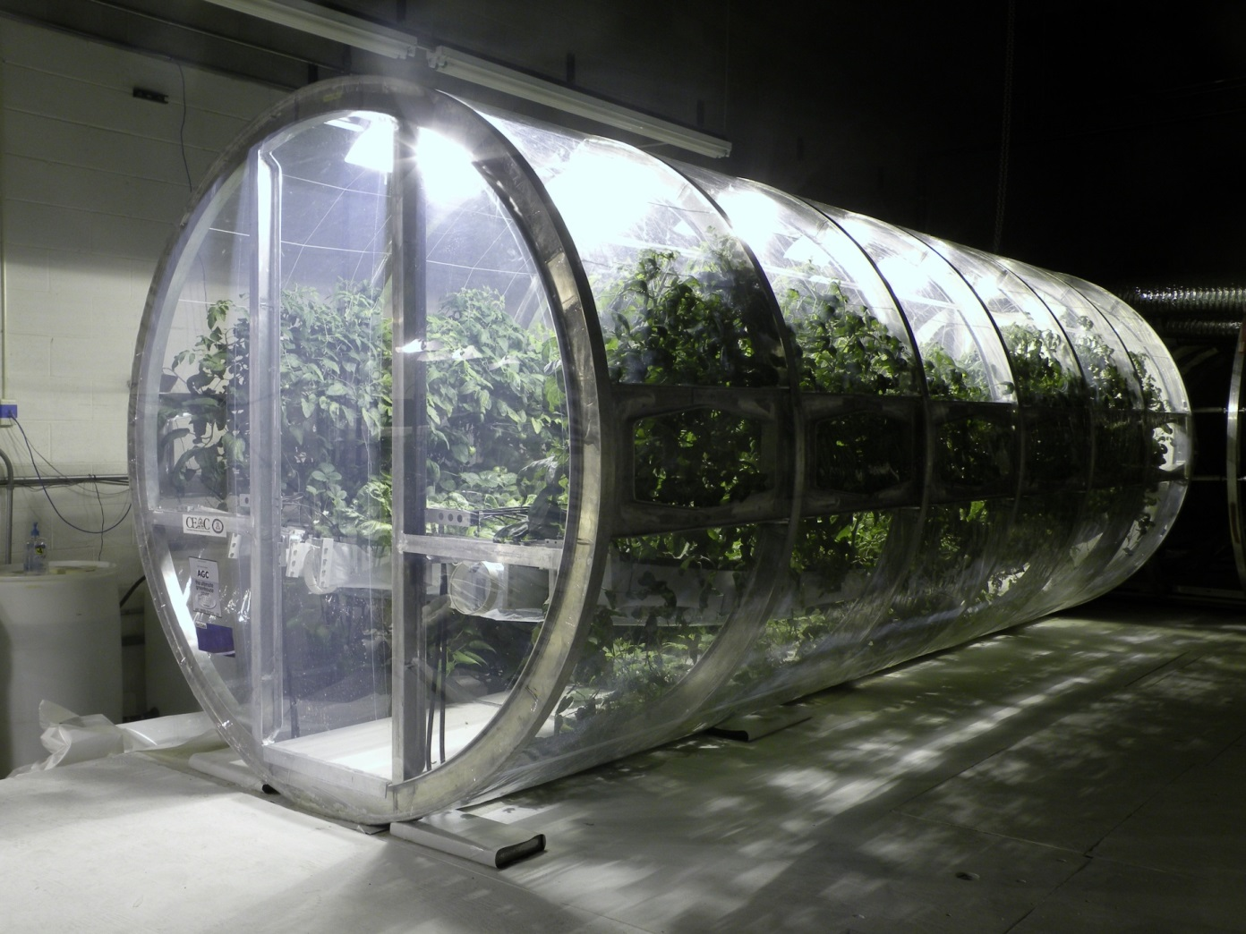
Lunar Greenhouse Outreach and Teaching Module at Biosphere 2
Erica Hernandez, Connor D. Osgood, Neal H. Barto, Dr. Gene Giacomelli, Phil Saddler
¹Plant Sciences UArizona, ² Sus. Plant Sys, UArizona, ³CEAC Staff Engineer, ⁴CEAC Director, ⁵Sadler Machine Co.
What is the Lunar Greenhouse?
BLSS: Bioregenerative Life Support System
Hydroponic crop production
Produces oxygen, water, calories
Lamps
Crops
Air / Water Circulation
Notes:
The LGH is supported by the Ralph Steckler Space Exploration Grant from NASA. It is designed as a bioregenerative life support system, using a living biological system (the crops) to produce fresh water, fresh air, and nutritional calories for one astronaut on an mission to the moon or Mars. Plants are grown inside the chamber in a hydroponically based system (cable culture hydroponics), and supported with artificial lighting, HVAC, and nutrient / water delivery system.

Slide 3
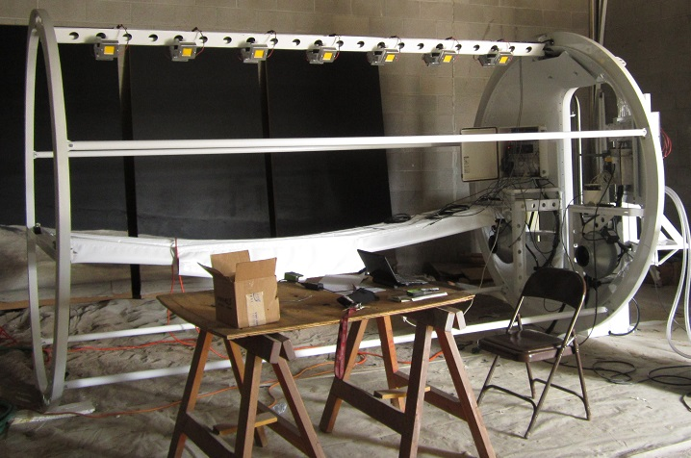
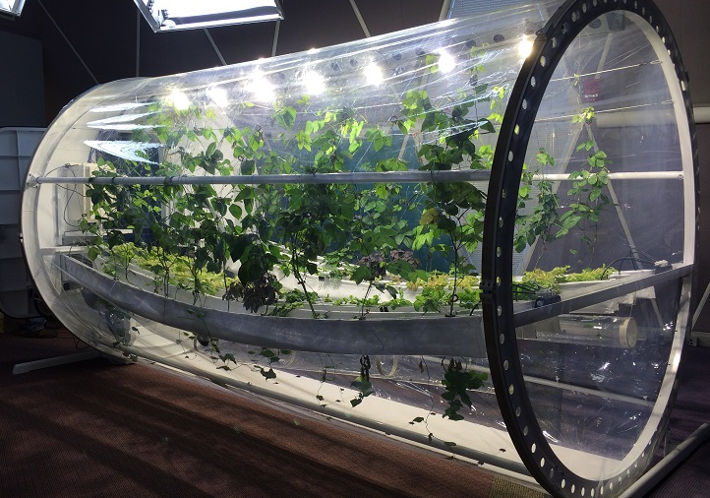
Lunar Greenhouse Outreach and Teaching Module at Biosphere 2
Erica Hernandez, Connor D. Osgood, Neal H. Barto, Dr. Gene Giacomelli, Phil Saddler
¹Plant Sciences UArizona, ² Sus. Plant Sys, UArizona, ³CEAC Staff Engineer, ⁴CEAC Director, ⁵Sadler Machine Co.
What is the LGH – OTM?
Demonstrating LGH-Outreach and Teaching Module at Biosphere2
Developing remote monitoring and control strategies
Documentation of procedures, problem solving, systems components, and other details
Training of B2 personnel for on-site maintenance
Testing potential cultivars of various crop species
Educating the public on realities of space agriculture and its application here on earth
Notes:
The OTM demonstrates the main processes and concepts behind the lunar greenhouse project. Its purpose is to education the public. Housing the OTM at B2 gives us a platform from which to reach the large number of people that visit B2. With this eye on public reception, we investigate and test out new and visually striking cultivars of our selected crops. In order to operate the OTM effectively, we trained a number of on-site staff to ensure trained personnel are on site at all times. A heavy focus is put on developing remote monitoring and control strategies, and we use a number of different technologies to accomplish this goal.

Slide 4
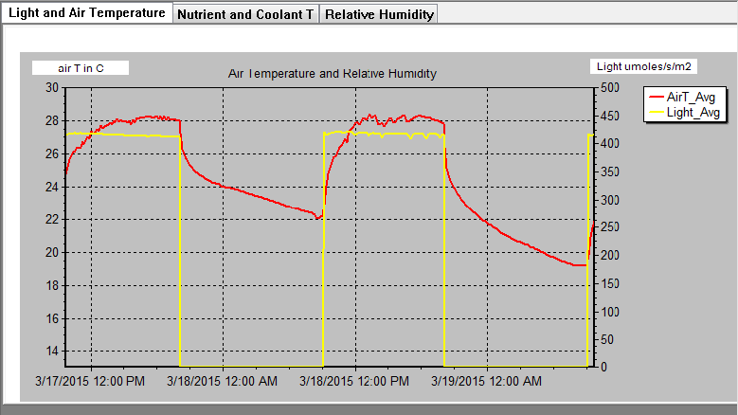
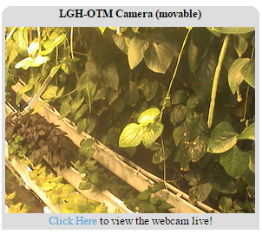
Lunar Greenhouse Outreach and Teaching Module at Biosphere 2
Erica Hernandez, Connor D. Osgood, Neal H. Barto, Dr. Gene Giacomelli, Phil Sadler
¹Plant Sciences UArizona, ² Sus. Plant Sys, UArizona, ³CEAC Staff Engineer, ⁴CEAC Director, ⁵Sadler Machine Co.
Remote Monitoring
Array of sensors monitors environment
Laptop accessible to offsite personnel
Visual displays of data over time
Public access to webcam: auto tour
Private access: controllable
Remote Control
Data logger programmed with control logic
Equipment turned on / off automatically or manually through data logger access
LGH at CEALive - http://cealive.arizona.edu/lunargreenhouse/
Notes:
The brain of the LGH-OTM: The CR1000 data logger. A number of sensors are hooked up to the data logger; they are calibrated before installation, and data about environmental condition is continually recorded even when workers are not there to take measurements. This data is available to off-site personnel through an attached laptop workers are able to log into. Graph: example data. Daily environmental reports are generated by workers and sent out to all members of the project team. A movable webcam sits inside the chamber, allowing workers to do a limited visual inspection and connect environmental data to real time images of the chamber.

Slide 5
Lunar Greenhouse Outreach and Teaching Module at Biosphere 2
Erica Hernandez, Connor D. Osgood, Neal H. Barto, Dr. Gene Giacomelli, Phil Sadler
¹Plant Sciences UArizona, ² Sus. Plant Sys, UArizona, ³CEAC Staff Engineer, ⁴CEAC Director, ⁵Sadler Machine Co.
Example Environmental Report
Remote Monitoring Team Development
Generation of daily reports
Email based, listserv
Data accessed through LogMeIn remote desktop software.
Discussion of problems that have arisen, upcoming schedule changes
Summary of environmental conditions inside the chamber
  Temperatures, light levels, humidity
Environmental Reporting for the LGH-OTM 3/15/15 -- 3/16/15:
Air temperatures min & max were 20.7 C and 28.0 C.
The LED’s were shut down at 8:00 pm last night. Light intensity started at ~412 µMol m-2 s-1 but gradually decreased to 406 by the end of the day.
The nutrient solution water temperature ranged from a low yesterday morning of 22.2 C to a high of 25.4 C.
LED coolant water temperatures ranged from 21.1 C to >40.0 C at the end of yesterday's photoperiod.
The relative humidity ranged from minimum of 30.4% during the photoperiod, and a maximum of 86.9% during the dark period.
Current Situation Analysis Report:
No unusual observations.
Higher minimum air T (and slightly higher nutrient solution T) likely due to warming outside climate.
Decrease in light intensity across photoperiod seems nominal at worst.
Notes:
The brain of the LGH-OTM: The CR1000 data logger. A number of sensors are hooked up to the data logger; they are calibrated before installation, and data about environmental condition is continually recorded even when workers are not there to take measurements. This data is available to off-site personnel through an attached laptop workers are able to log into. Graph: example data. Daily environmental reports are generated by workers and sent out to all members of the project team. A movable webcam sits inside the chamber, allowing workers to do a limited visual inspection and connect environmental data to real time images of the chamber.

Slide 6
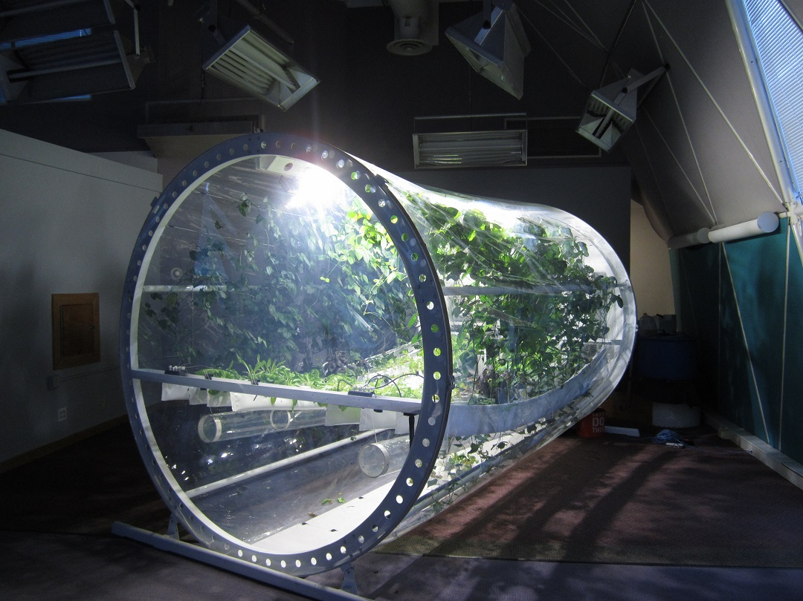
Lunar Greenhouse Outreach and Teaching Module at Biosphere 2
Erica Hernandez, Connor D. Osgood, Neal H. Barto, Dr. Gene Giacomelli, Phil Sadler
¹Plant Sciences UArizona, ² Sus. Plant Sys, UArizona, ³CEAC Staff Engineer, ⁴CEAC Director, ⁵Sadler Machine Co.
Lettuce, Strawberry, and Basil on inner rows
8 ft
Sweet Potato and Cowpea on outer rows
LGH at CEALive - http://cealive.arizona.edu/lunargreenhouse/
Notes:
The LGH-OTM is about 8 ft tall and about 12 ft long and cylindrical in shape. All the plant support systems are hydroponically based and contained in a suspended envelope (“cable culture”) system. The crops that currently reside in the chamber are sweet potatoes and cowpeas on the outer rows, with sweet potatoes, strawberries, and basil on the inner row. The outer rows are intended to contain vining crops that will grow up and down the sides of the chamber, while the more compact lettuce and strawberry crops remain mostly in their spaces in the inner envelopes.

Slide 7
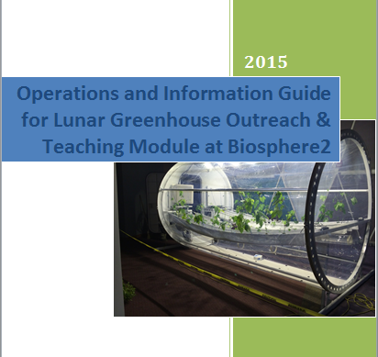
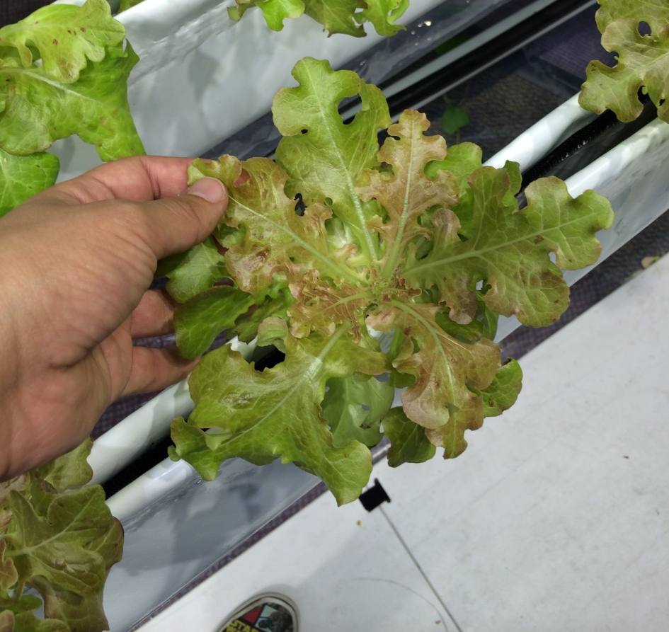
Lunar Greenhouse Outreach and Teaching Module at Biosphere 2
Erica Hernandez, Connor D. Osgood, Neal H. Barto, Dr. Gene Giacomelli, Phil Sadler
¹Plant Sciences UArizona, ² Sus. Plant Sys, UArizona, ³CEAC Staff Engineer, ⁴CEAC Director, ⁵Sadler Machine Co.
Personal Objectives
Daily reports sent out to LGH-OTM listserv detailing environmental conditions, demonstrating remote monitoring capabilities
Developing user manual and information guide
Seedling preparation
Notes:
My personal role in the project has several aspects. Long term, I work to document the equipment and protocols of the chamber and any problem solving strategies we develop. Short term, I help keep the team updated on a day to day basis with the environmental summary reports, as well as maintain a steady stream of seedlings to support our weekly harvest efforts.

Slide 8
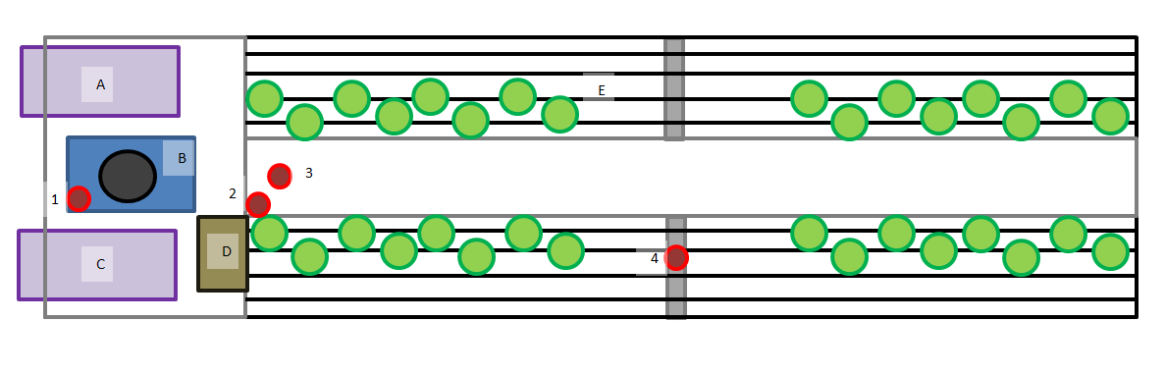
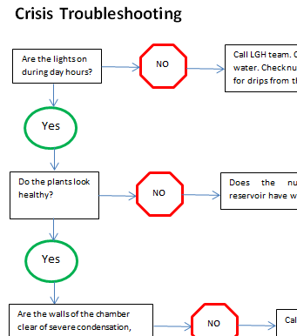
Lunar Greenhouse Outreach and Teaching Module at Biosphere 2
Erica Hernandez, Connor D. Osgood, Neal H. Barto, Dr. Gene Giacomelli, Phil Sadler
¹Plant Sciences UArizona, ² Sus. Plant Sys, UArizona, ³CEAC Staff Engineer, ⁴CEAC Director, ⁵Sadler Machine Co.
Simple map of sensors and hardware components.
Troubleshooting
A variety of possible problems are discussed in an easy to read flow chart.
Daily routine and important checks are described for operators.
Notes:
My personal role in the project has several aspects. Long term, I work to document the equipment and protocols of the chamber and any problem solving strategies we develop. Short term, I help keep the team updated on a day to day basis with the environmental summary reports, as well as maintain a steady stream of seedlings to support our weekly harvest efforts.

Slide 9
Lunar Greenhouse Outreach and Teaching Module at Biosphere 2
Erica Hernandez, Connor D. Osgood, Neal H. Barto, Dr. Gene Giacomelli, Phil Sadler
¹Plant Sciences UArizona, ² Sus. Plant Sys, UArizona, ³CEAC Staff Engineer, ⁴CEAC Director, ⁵Sadler Machine Co.
Thank You!
Acknowledgements
Dr. Gene Giacomelli
Phil Sadler
Connor Osgood
Neal H Barto
Susan Brew

