Slide 1



Design and Implementation of a Focused Laser Differential Interferometer for Hypersonic Boundary Layer Transition Measurements
Jackson Barger
Mentored by Dr. Alex Craig and John Flood
University of Arizona

Slide 2
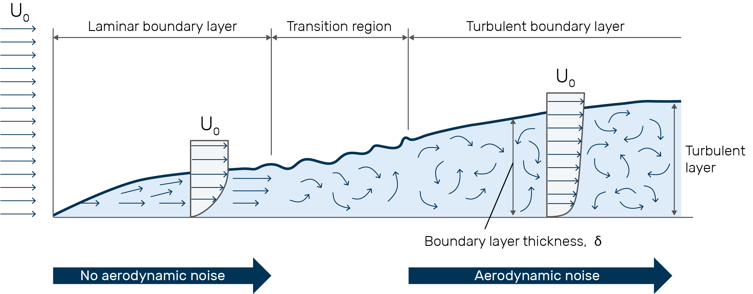
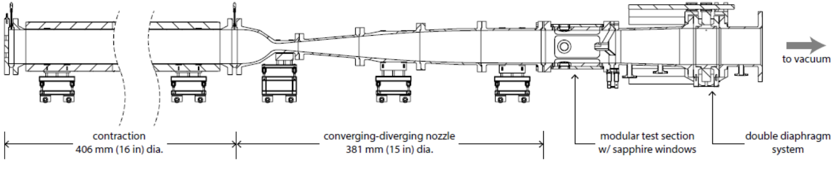
Boundary Layer Transition
Laminar vs Turbulent Boundary Layers
Flow Instabilities
Thermal heating and Shear Forces
Structural failure
Hypersonic Flight (M>5)
Mach 5 Ludwieg Tube (LT5)
Grasacoustics.com
Flood, J. et al (2023)

Slide 3
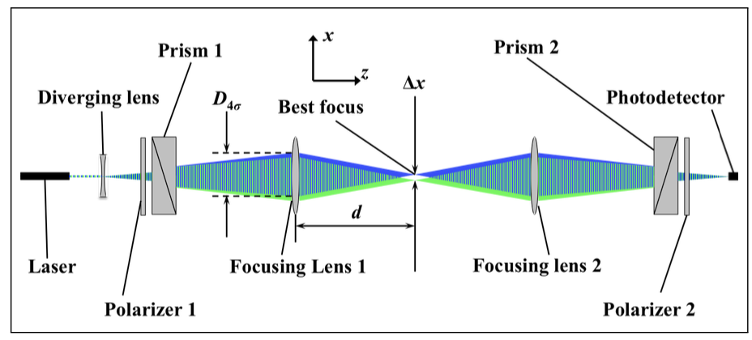
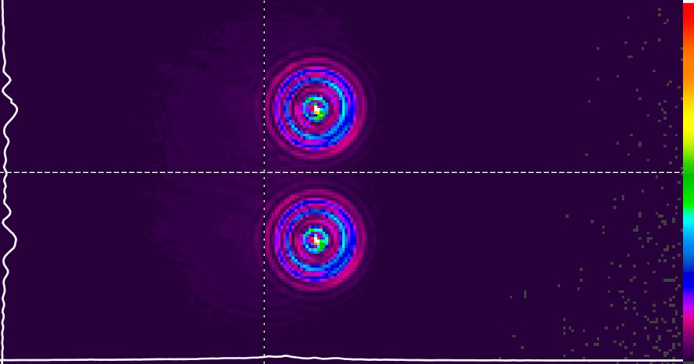
Focused Laser Differential Interferometry (FLDI)
FLDI is a non-intrusive laser-based optical measurement system
Insensitive to density gradients outside the focused region
Expand, Polarize, Split, Focus
Can calculate density gradients to categorize flow instabilities
Phase difference between signals
Gladstone-Dale Relationship
Schmidt, Applied Optics 2015

Slide 4
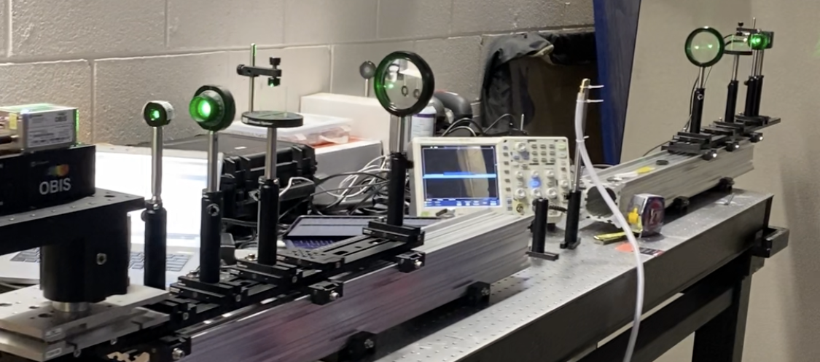
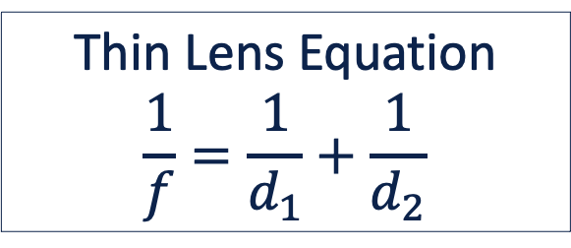
Design
Thin Lens Equation and Lens Geometry
Lens Spacing
Physical Tunnel Constraints
Parts
100mW 532nm Laser, -6mm focal length plano-concave lens, linear polarizer, 2-arcminute Wollaston Prism, 300mm focal length achromatic lens
d₁
d₂
Thin Lens Equation
$$\frac{1}{f}=\frac{1}{d_{1}}+\frac{1}{d_{2}}$$

Slide 5
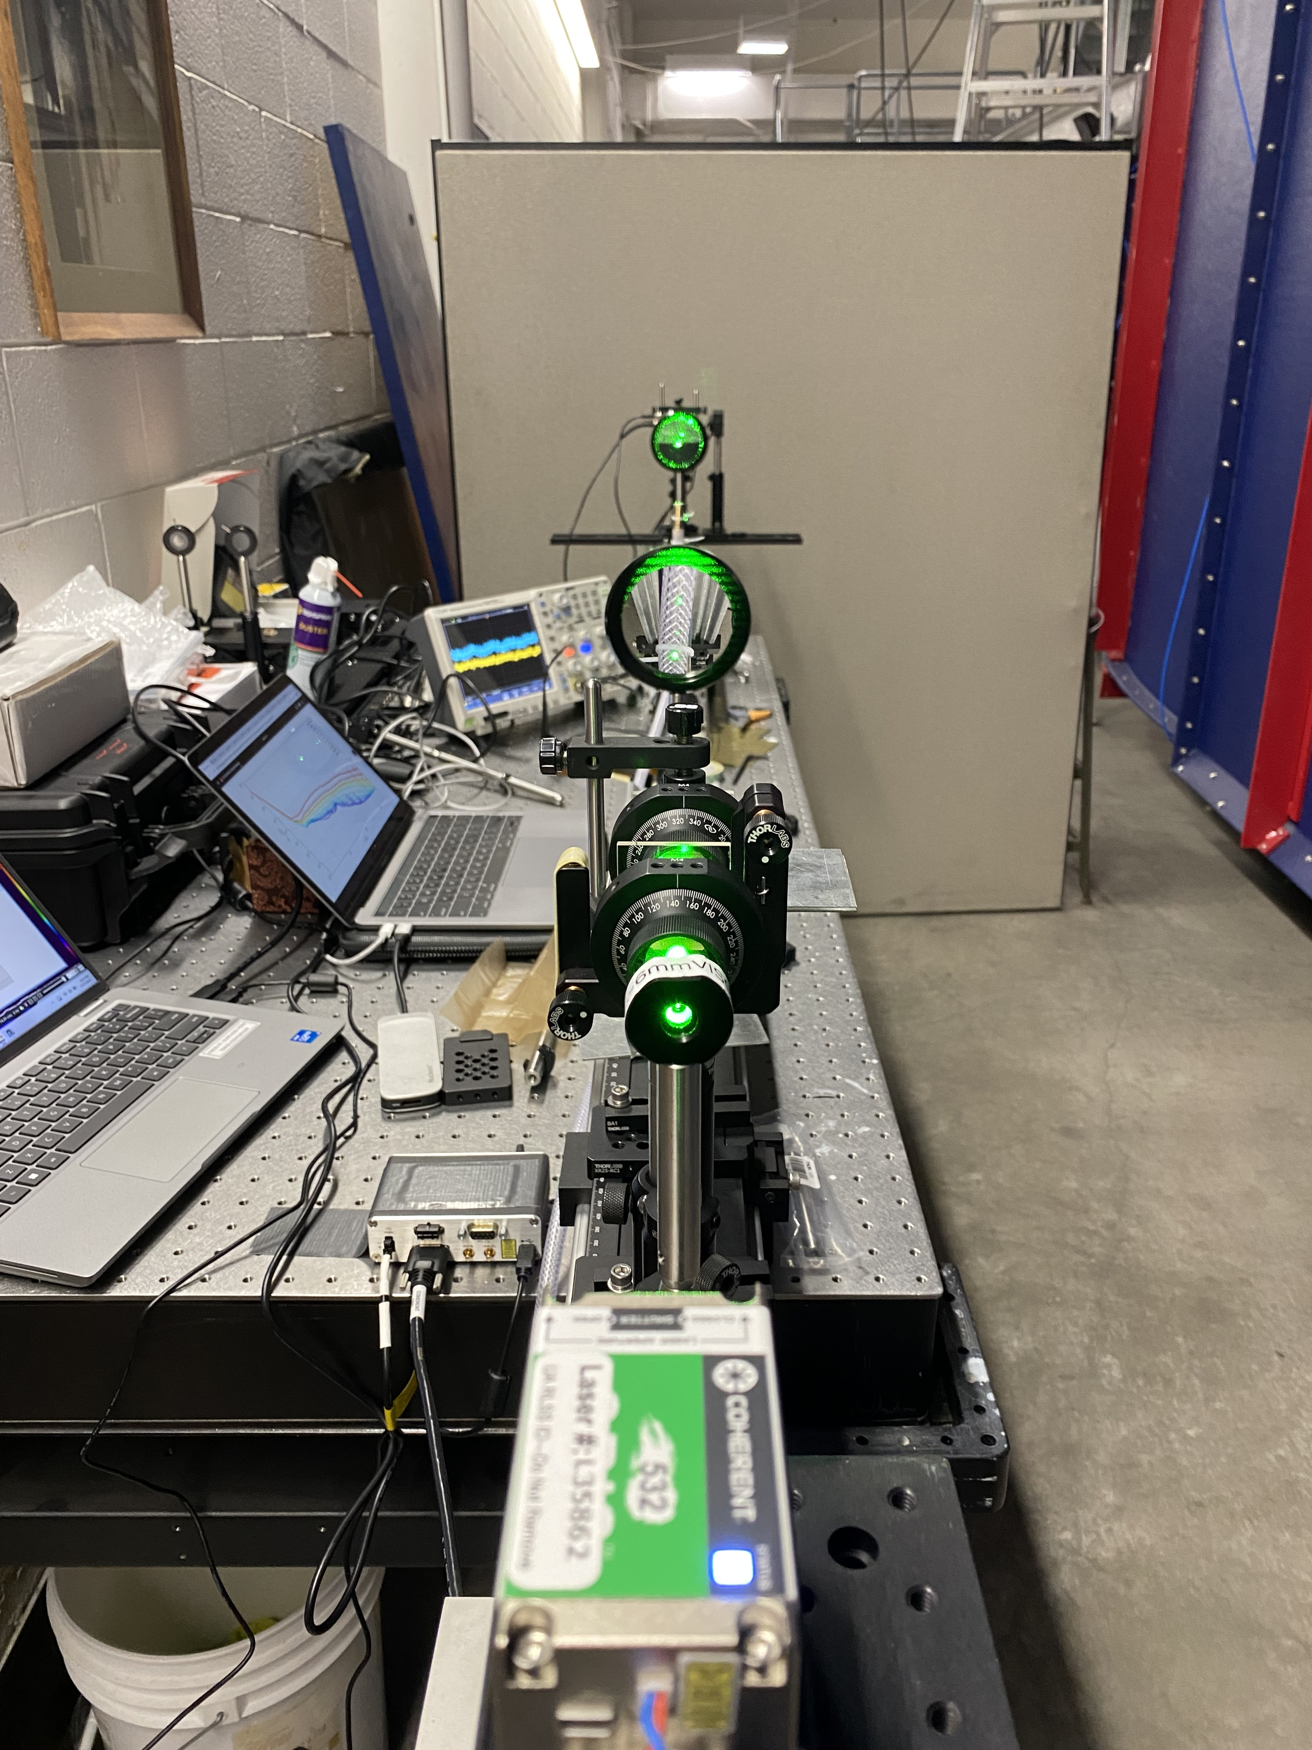
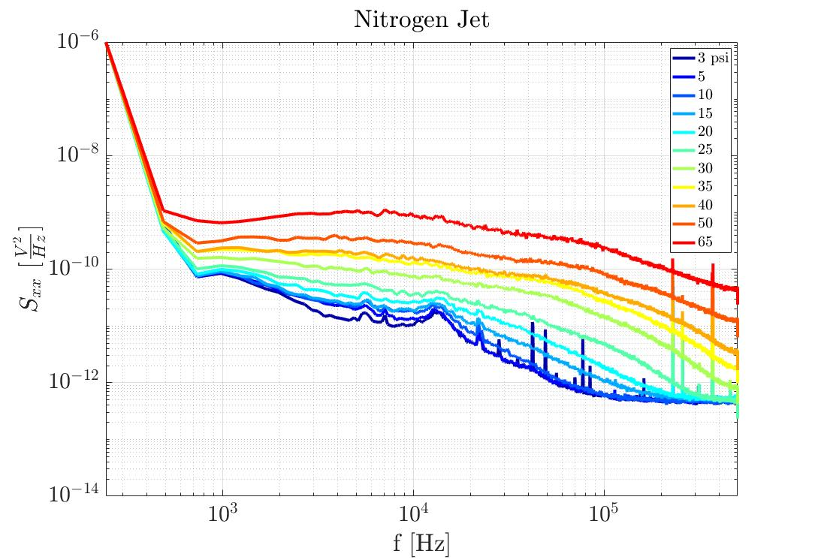
Benchtop Testing
Built, calibrated, and validated on benchtop
Nitrogen jet
Changed Reynold’s number of a nitrogen jet to observe laminar to turbulent jet transition

Slide 6
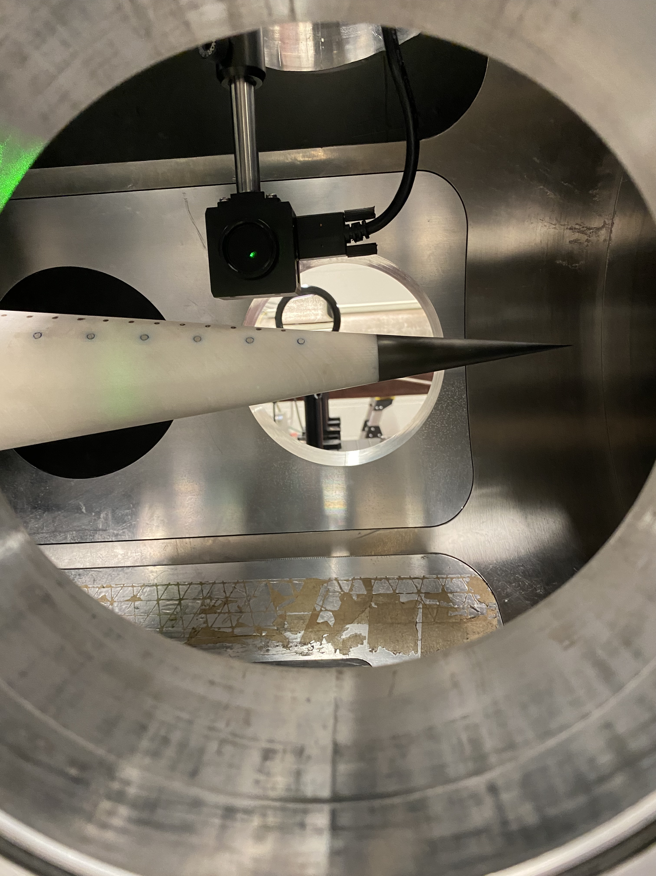
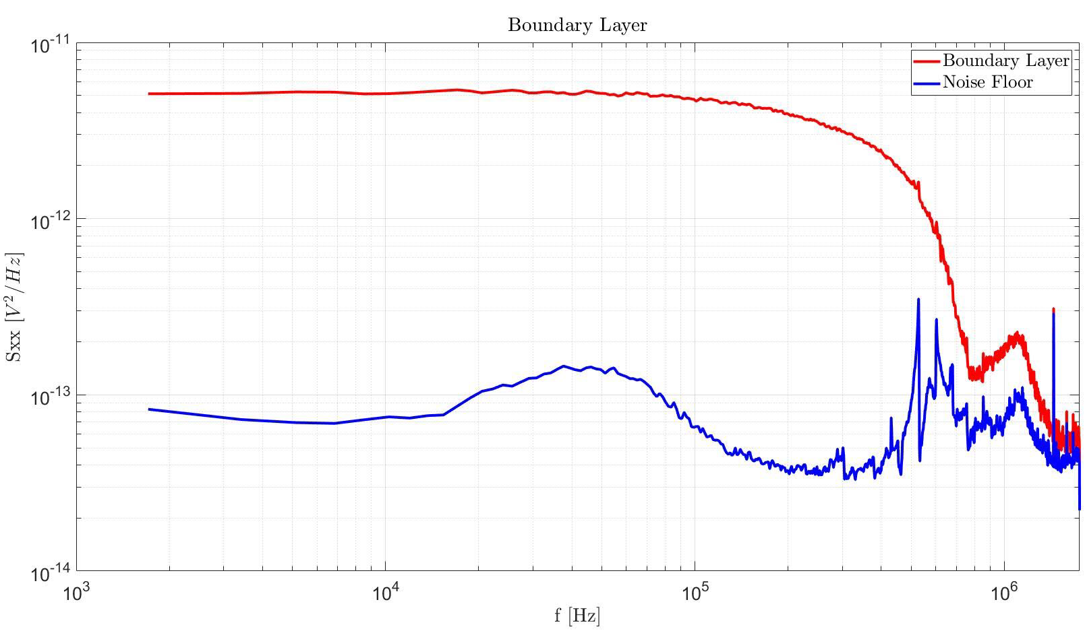
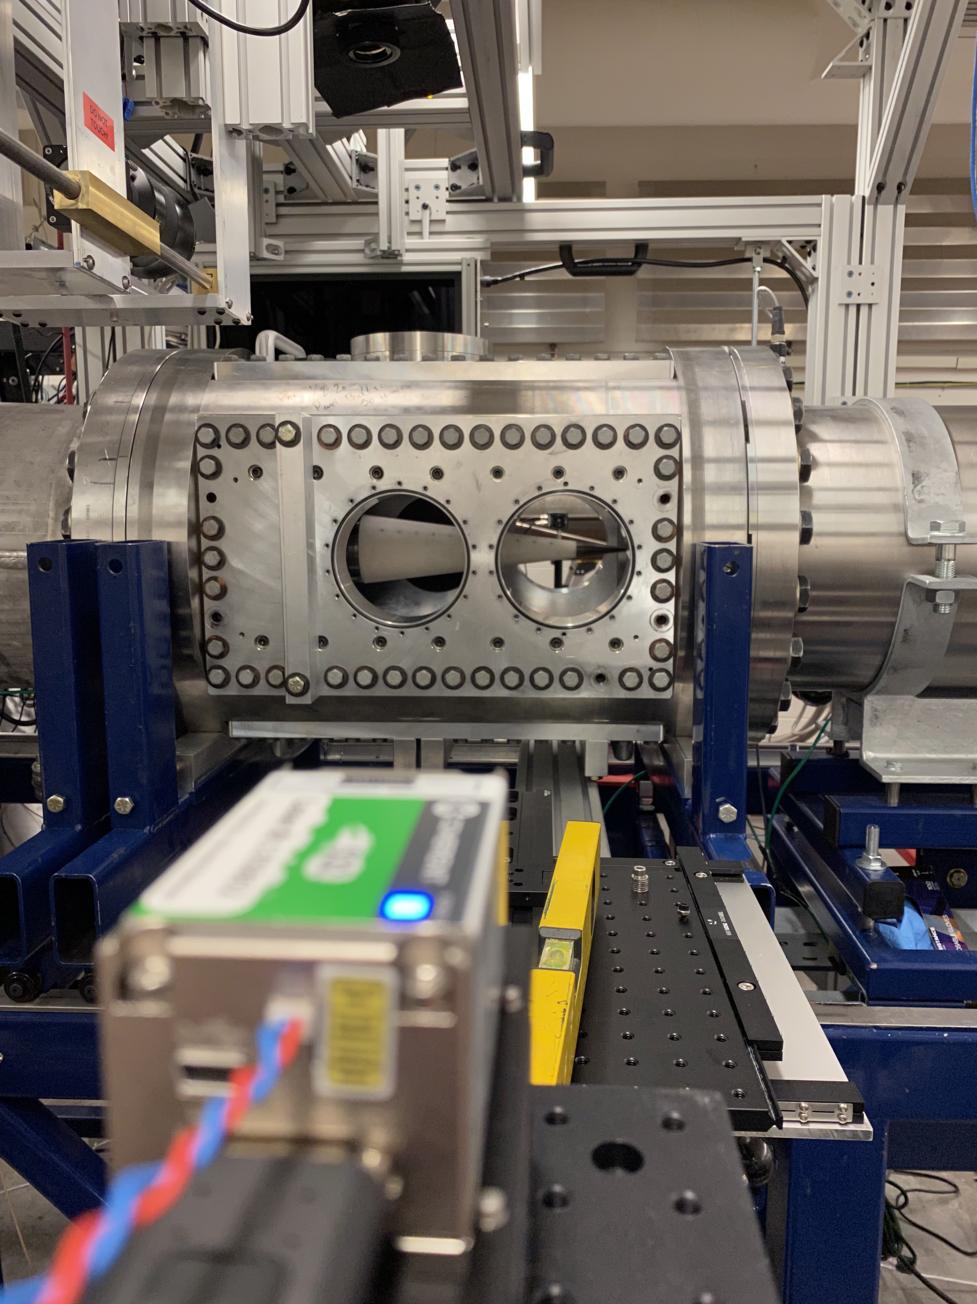
Wind Tunnel Testing
Hypersonic wind tunnel test at Mach 5
7-degree cone with sharp tip
Measured boundary layer spectra

Slide 7
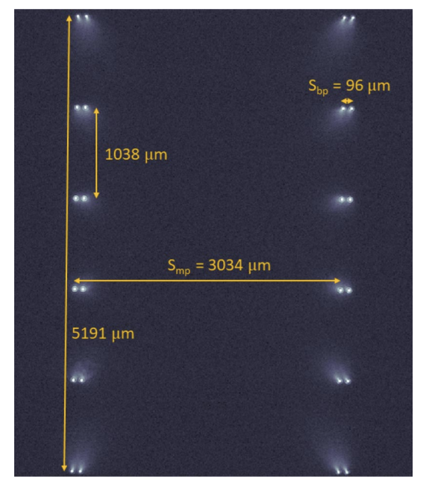
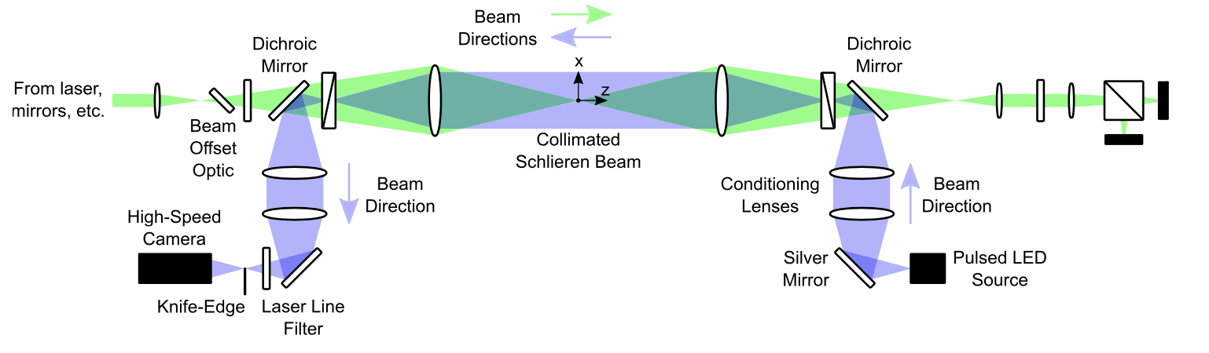
Conclusions and Future Applications
Developed cutting-edge diagnostic for BLST lab
Successfully measured laminar-turbulent jet transition and measured boundary layer in wind tunnel test
Investigate Two Point and Multi-Point FLDI
Integrate with Schlieren
Bathel et al 2021
Davenport et al 2023

Slide 8
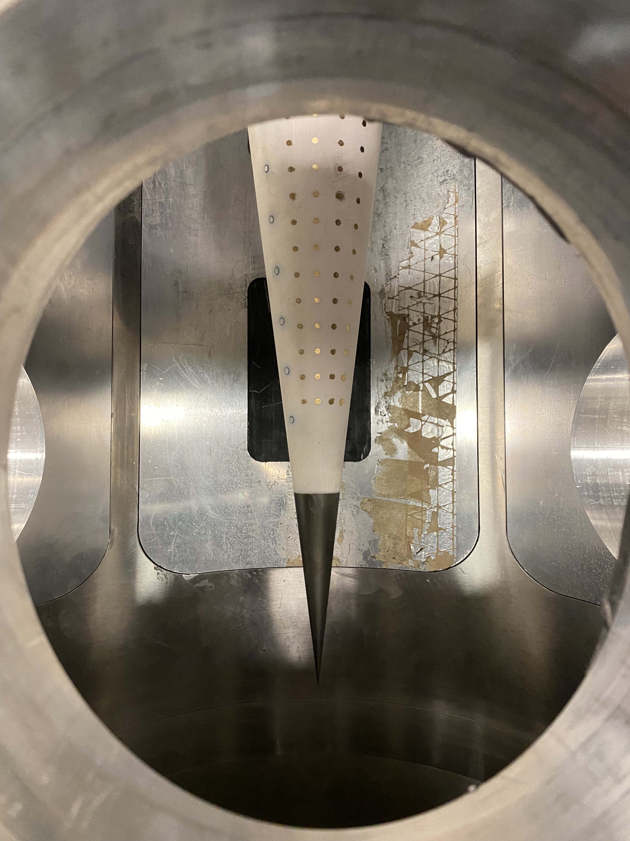
Acknowledgements
NASA Space Grant
My mentor, Dr. Alex Craig and everyone else in the Boundary-Layer Stability and Transition Laboratory
Office of Naval Research

Slide 9
Thank You

