Slide 1


Numerical Investigation of Hypersonic Boundary-Layer Transition for an Ogive Geometry
Samantha Stevens, Christoph Hader, Hermann F. Fasel
University of Arizona
Acknowledgements:
Support: Arizona NASA Space Grant
Compute time: DoD HPCMP, UA HPC
Notes:
Welcome to the talk on our numerical investigation of Hypersonic Boundary-Layer Transition for an Ogive Geometry. Before I begin, I would like to acknowledge the support from Arizona NASA Space Grant Consortium and the compute time provided by the DOD and the UAHPC

Slide 2
Outline
Background
Results
Summary
Notes:
I’d like to start with a brief introduction about what we will be addressing in this presentation.

Slide 3
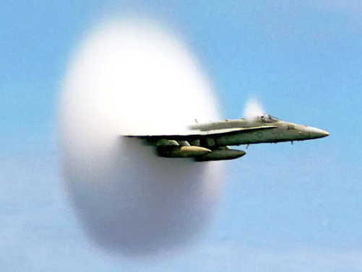
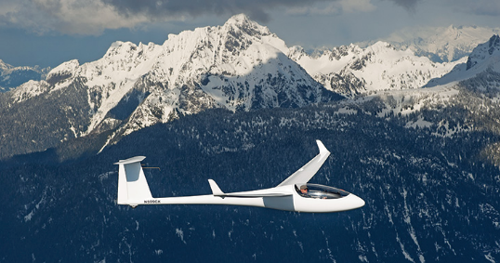
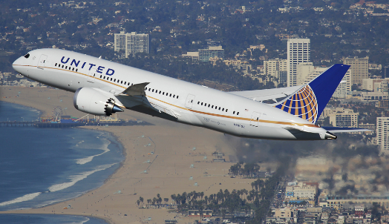
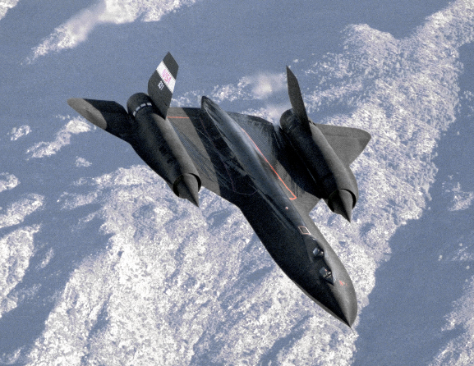
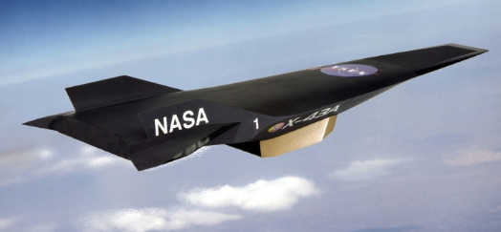
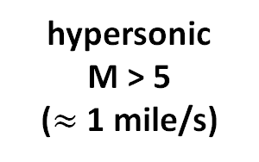
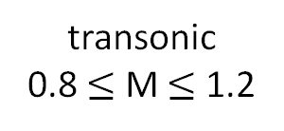

Background: What is hypersonics?
M = 1
“sound barrier”
Mach number (M = ${\text{U}}_{∞}$/${\text{c}}_{∞}$)
subsonic
M < 1
transonic
0.8 $≤$ M $≤$ 1.2
supersonic
M > 1
hypersonic
M > 5
($≈$ 1 mile/s)
Tucson to Phoenix in < 2 min
Notes:
What is a mach number – it is a ratio between the local flow velocity and the local speed of sound
Divisions of a mach number – the general division of hypersonic speeds is at Mach 5
When an aircraft reaches mach 1 or the speed of sound is referred to as breaking the sound barrier.
Across the shockwave produced when you break the sound barrier, the flow properties all change a lot

Slide 4
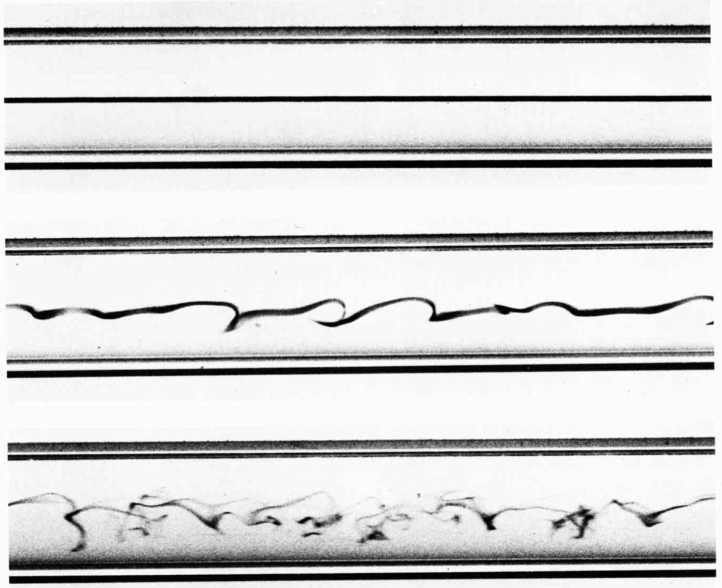



Background: What is laminar-turbulent transition?
laminar flow
“smooth”/ “ordered”
U$∞$
dye
transitional flow
U$∞$
turbulent flow
“chaotic”/random fluctuations
U$∞$
Repetition of Reynolds’ dye experiment. An Album of Fluid Motion, Van Dyke
Reynolds, O. 1883 “On the experimental investigation of the circumstances which determine whether the motion of water shall be direct or sinuous, and the law of resistance in parallel channels” Phil. Trans. R. Soc. 174 935–82
Notes:
fully developed pipe flow

Slide 5
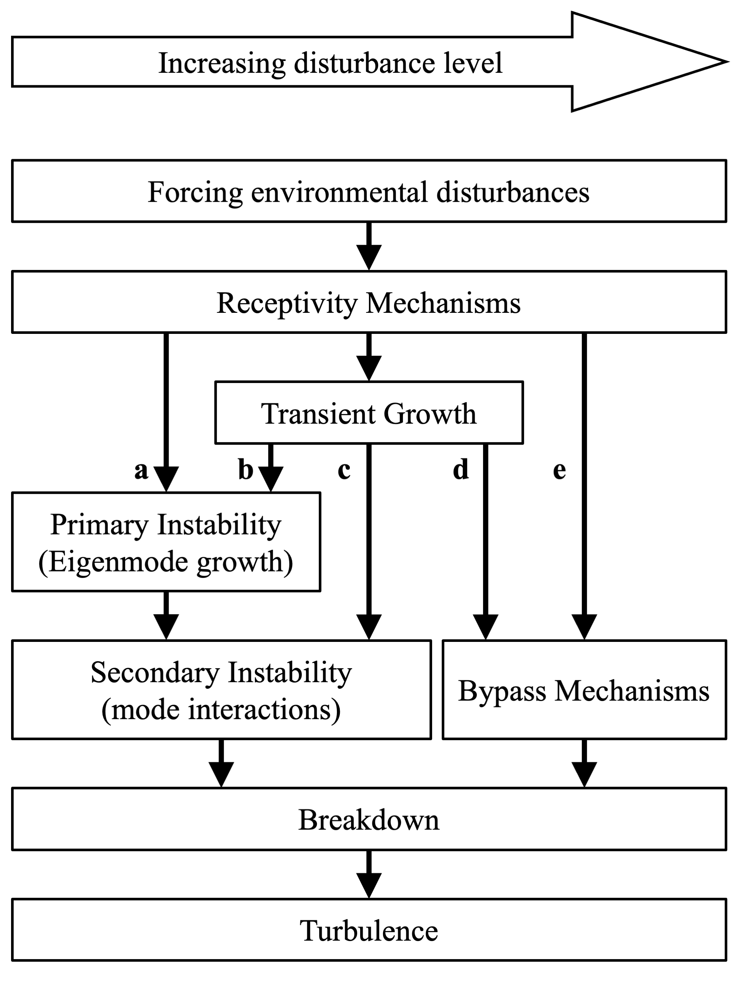
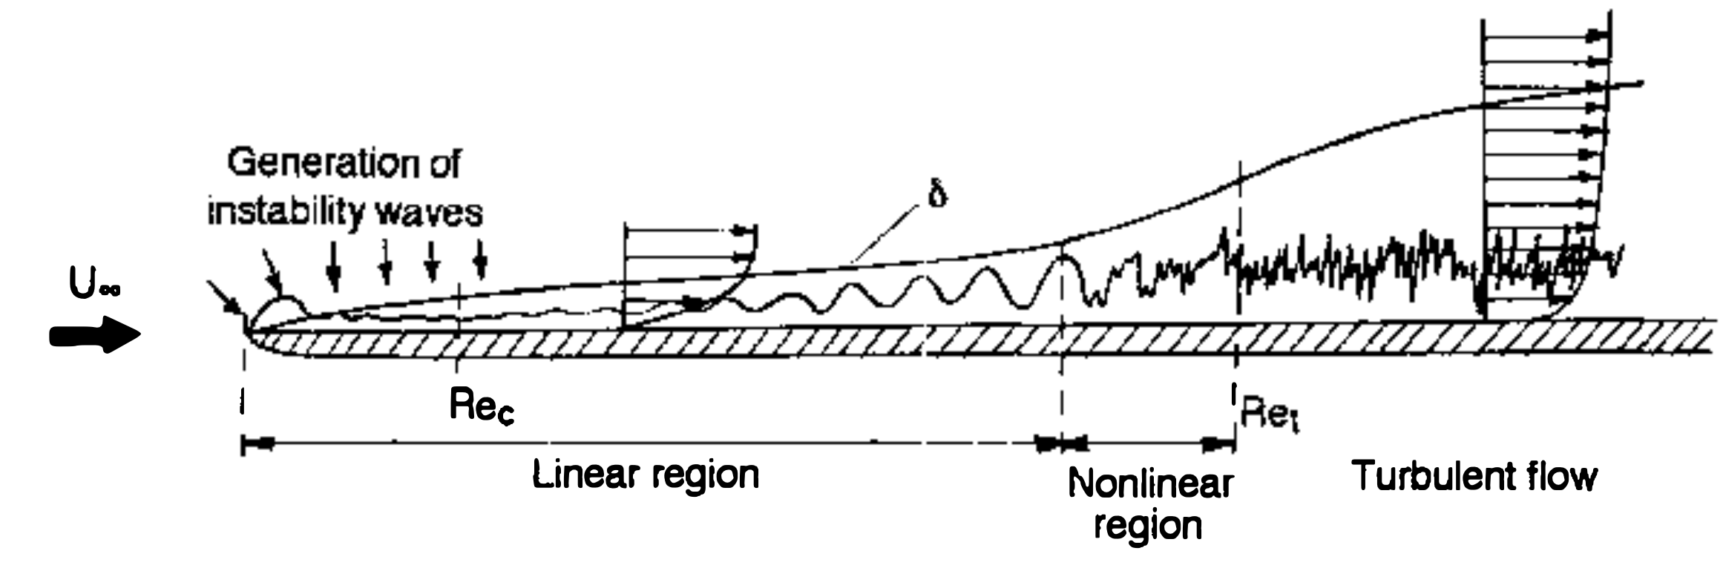
Background: What is laminar-turbulent transition?
Roadmap to transition (according to Morkovin, 1969) => paths to transition
Separate paths to transition into various “stages” (no sharp divide, continuous progression)
Kachanov, Y. S. (1994). Physical mechanisms of laminar-boundary-layer transition. Annual review of fluid mechanics, 26(1), 411-482.
Notes:
See what the stages of laminar to turbulent transition are on the schematic
Then explain that the path that we followed to get our results follows this leg of the diagram (click to highlight the path)

Slide 6

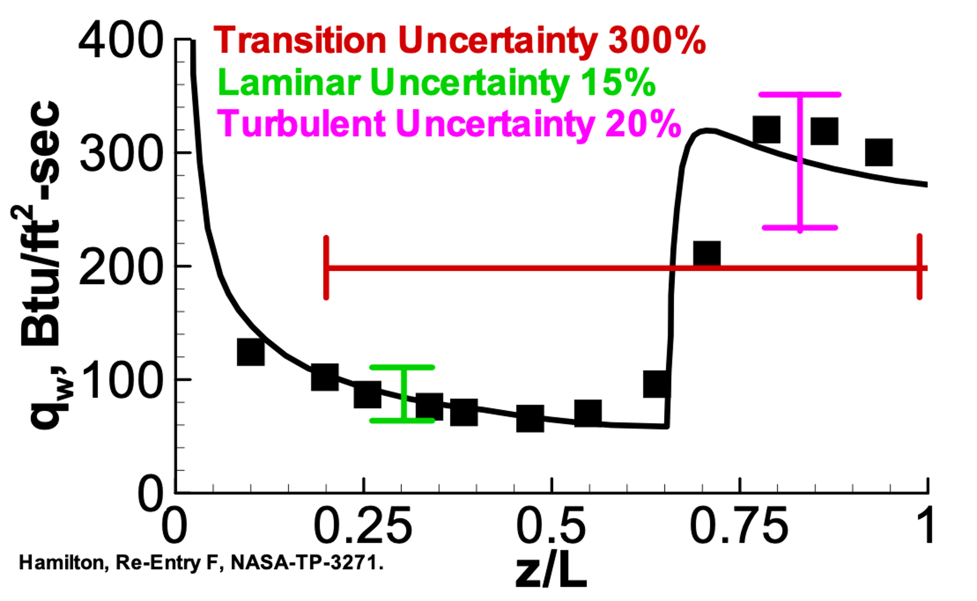
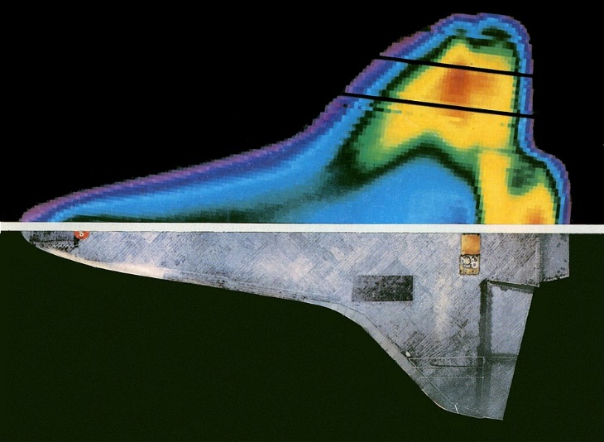
Background: Why is transition important?
Significant increase in skin-friction and heat transfer in turbulent flow
Major impact on design and performance (e.g. thermal protection requirement, aerodynamic drag, control authority)
z/L
0
1
Large uncertainty on where transition occurs and what heat flux levels are
  Transition dominated by nonlinear processes => complex and nonunique
  Lack of understanding on what exactly causes transition
Notes:
signal of an accelerometar embedded in the surface
Transition = huge impact on design and thermal protection performance
Graoh from re-entry flight of heat transfter over downstram distance (z)

Slide 7
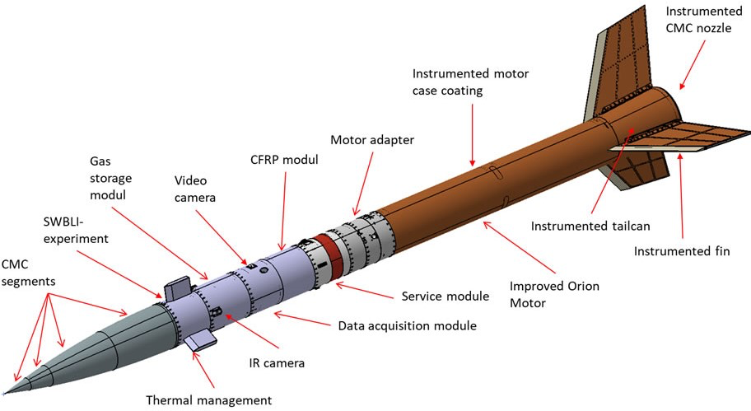
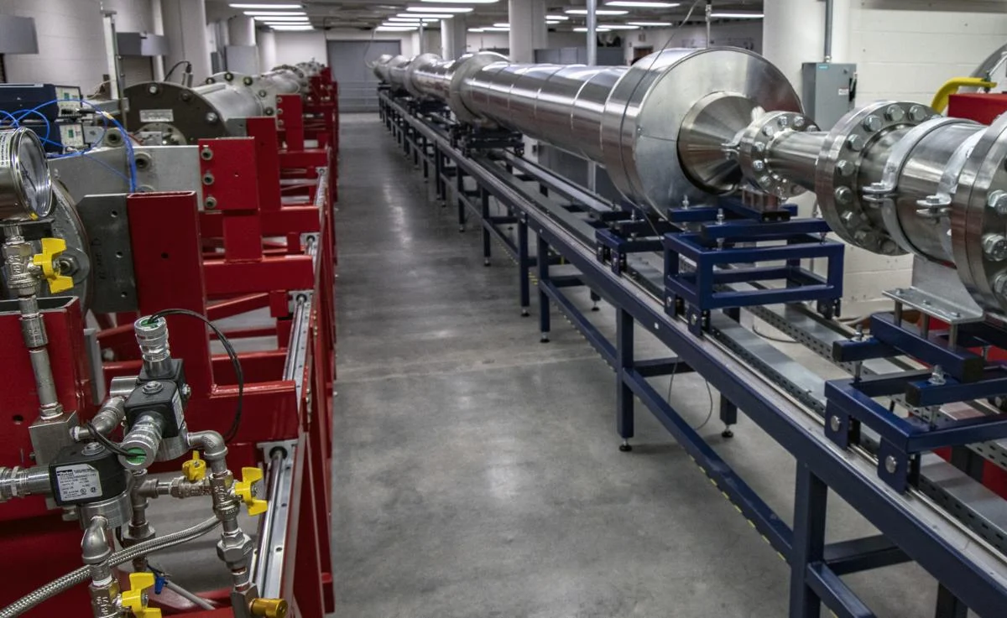
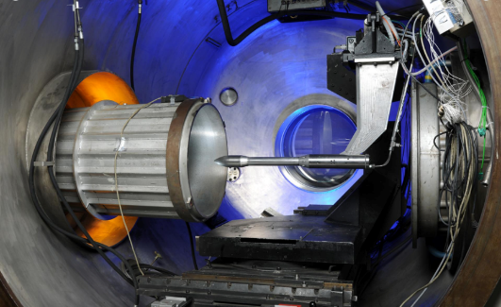
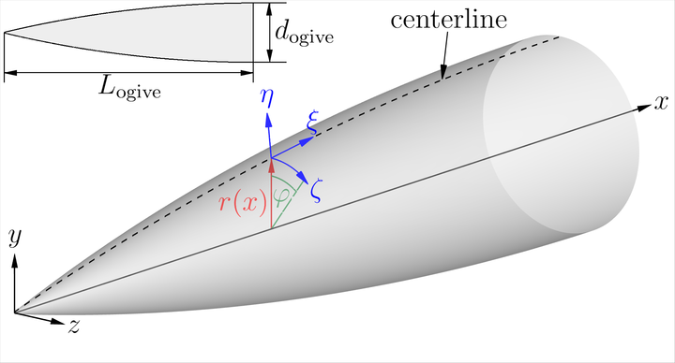
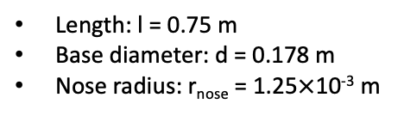
Background: What we do
STORT: Key Technologies for High-Speed Return Flights of Launcher Stages
STORT project: Collaborative effort between University of Arizona and DLR Cologne involving wind tunnel experiments, flight experiments and simulations
Here: Focus on transition on ogive forebody
STORT Flight
Wind Tunnel Experiments
University of Arizona (LT-5)
German Aerospace Center (H2K)
Simulations (DNS)
Length: l = 0.75 m
Base diameter: d = 0.178 m
Nose radius: r_{nose} = 1.25$×$10⁻³ m
Notes:
what nonlinear mechanisms dominate the boundary-layer transition process for Mach 10
not all relevant parameters of flight conditions can be matched in ground-based wind tunnel experiments.

Slide 8
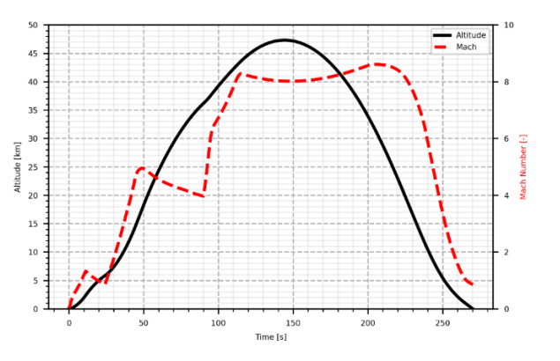
Flow Conditions
Flight experiment:
Wide range of Mach and Reynolds numbers along flight trajectory (Gülhan et al. 2022)
M = 7.0
M = 5.3
Wind tunnel experiments:
Hypersonic wind tunnel (M = 5.3, M = 7) at the German Aerospace Center (Cologne): H2K - completed
Mach 5 wind tunnel (Ludwieg Tube) at the University of Arizona: LT-5 - planned
Simulations:
Carry out numerical investigations for H2K wind tunnel conditions
Gülhan, A., Hargarten, D. A., Zurkaulen, M., Klingenberg, F., Siebe, F., & Reimer, T. (2022). Objectives and Achievements of the Hypersonic Flight Experiment STORT. 73rd International Astronautical Congress (IAC), Paris, France, 18-22 September 2022.
Notes:
Focusing on h2k conditions because those ones are already finished

Slide 9
Outline
Background
Results
Summary
Notes:
I’d like to start with a brief introduction about what we will be addressing in this presentation.

Slide 10
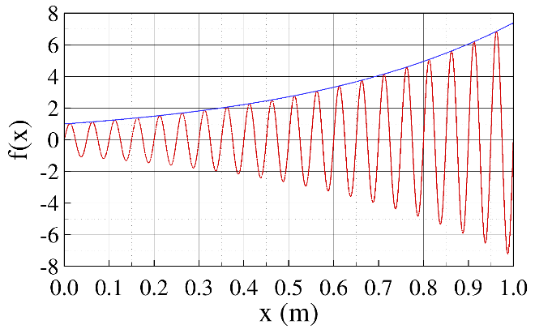
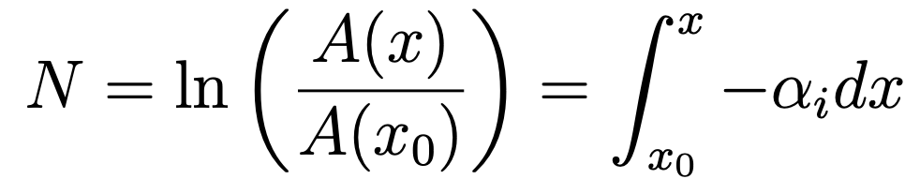
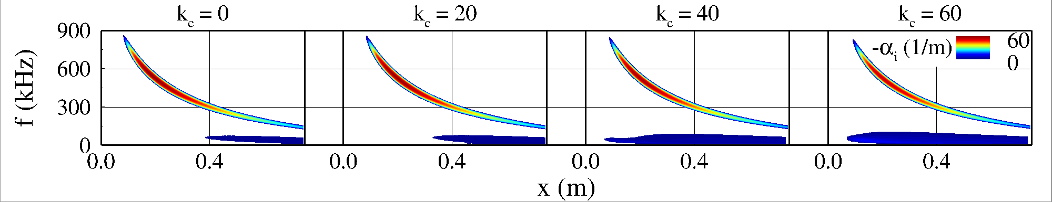
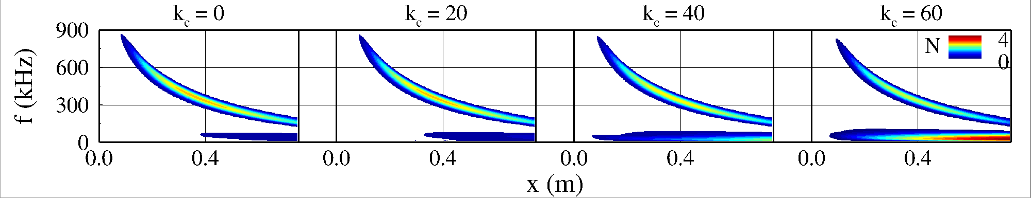
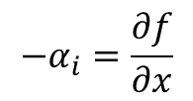
Linear Stability Theory: M = 5.3, Re₁ = 17.9$×$10⁶ 1/m
growth rate = slope of amplitude development
N-factor:
$$−α_{i}=\frac{∂f}{∂x}$$
2nd mode (higher frequencies)
1st mode (lower frequencies)
Notes:
Second mode instability starts out the strongest, but it quixkly dies as the wave packet moves downstream
First mode instability grows bigger as the wave packet travels downstream until it hits its largest and then begins decaying
We decided to focus on the first mode being the dominant mode for triggering transition, so we took the wave number to focus on based on where the largest/most saturated first mode instability packet/banana is.

Slide 11
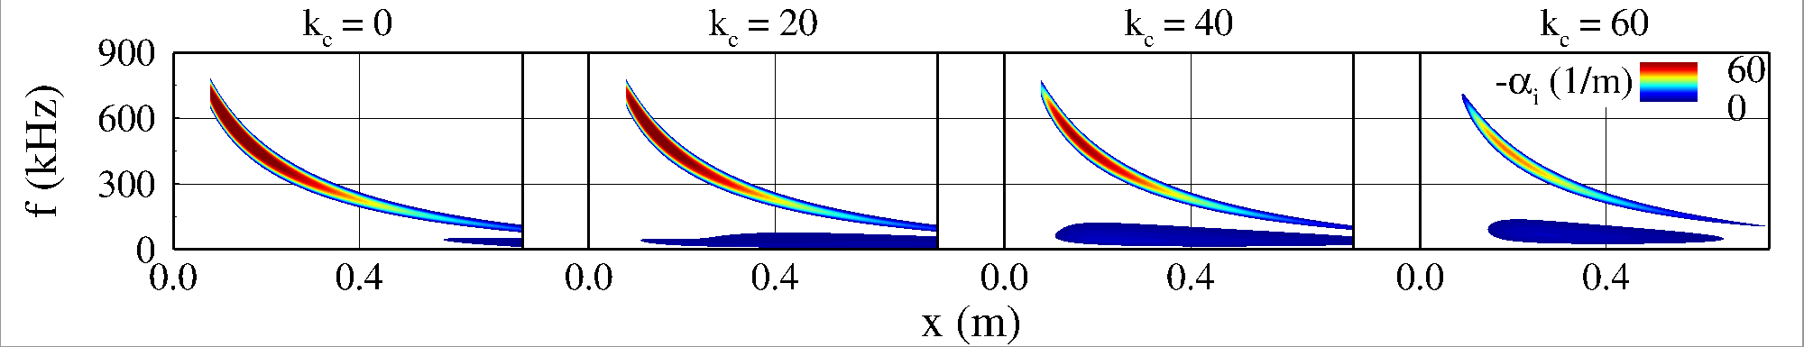
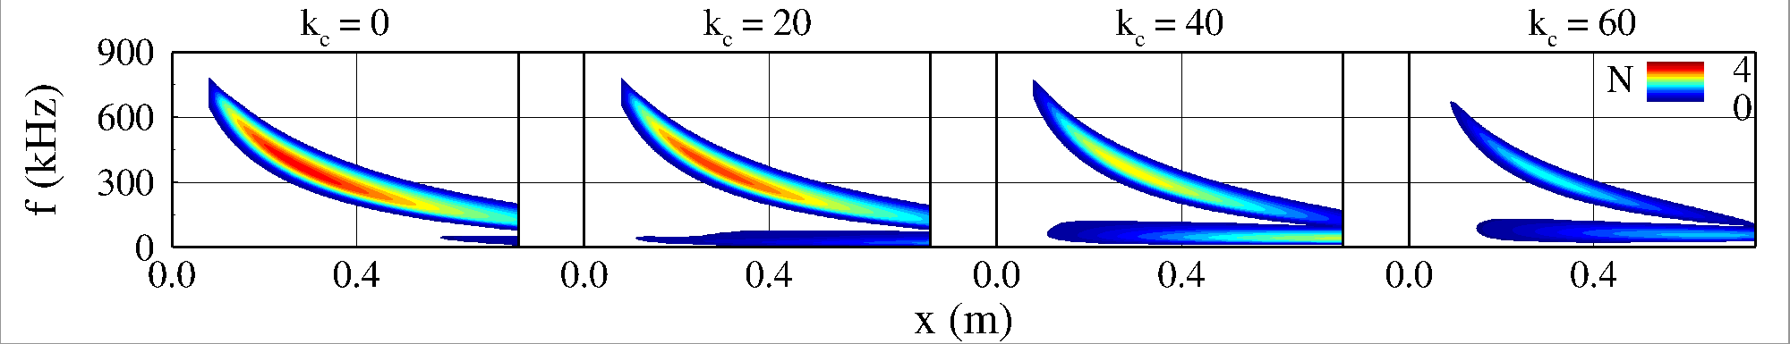
Linear Stability Theory: M = 7.0, Re₁ = 13.1$×$10⁶ 1/m
Frequency and wavenumber content of tunnel noise not known => is transition dominated by 1st or 2nd mode or possible 1st mode 2nd mode interaction?
Transition dominated by 2nd mode possible (see Meersman, Hader & Fasel, 2022)
Can (lower frequency) oblique 1st mode waves also lead to transition?
Meersman, J. A., Hader, C., & Fasel, H. F. (2022). Numerical Investigation of Hypersonic Boundary-Layer Transition for an Ogive Cone. In AIAA SciTech 2022 Forum (AIAA 2022-0946).
Notes:
Make sure to append other subdomain to complete banana
Need to change grid lines to be same for all of them – smoother switch
→ line spacing and y-grid number increment

Slide 12
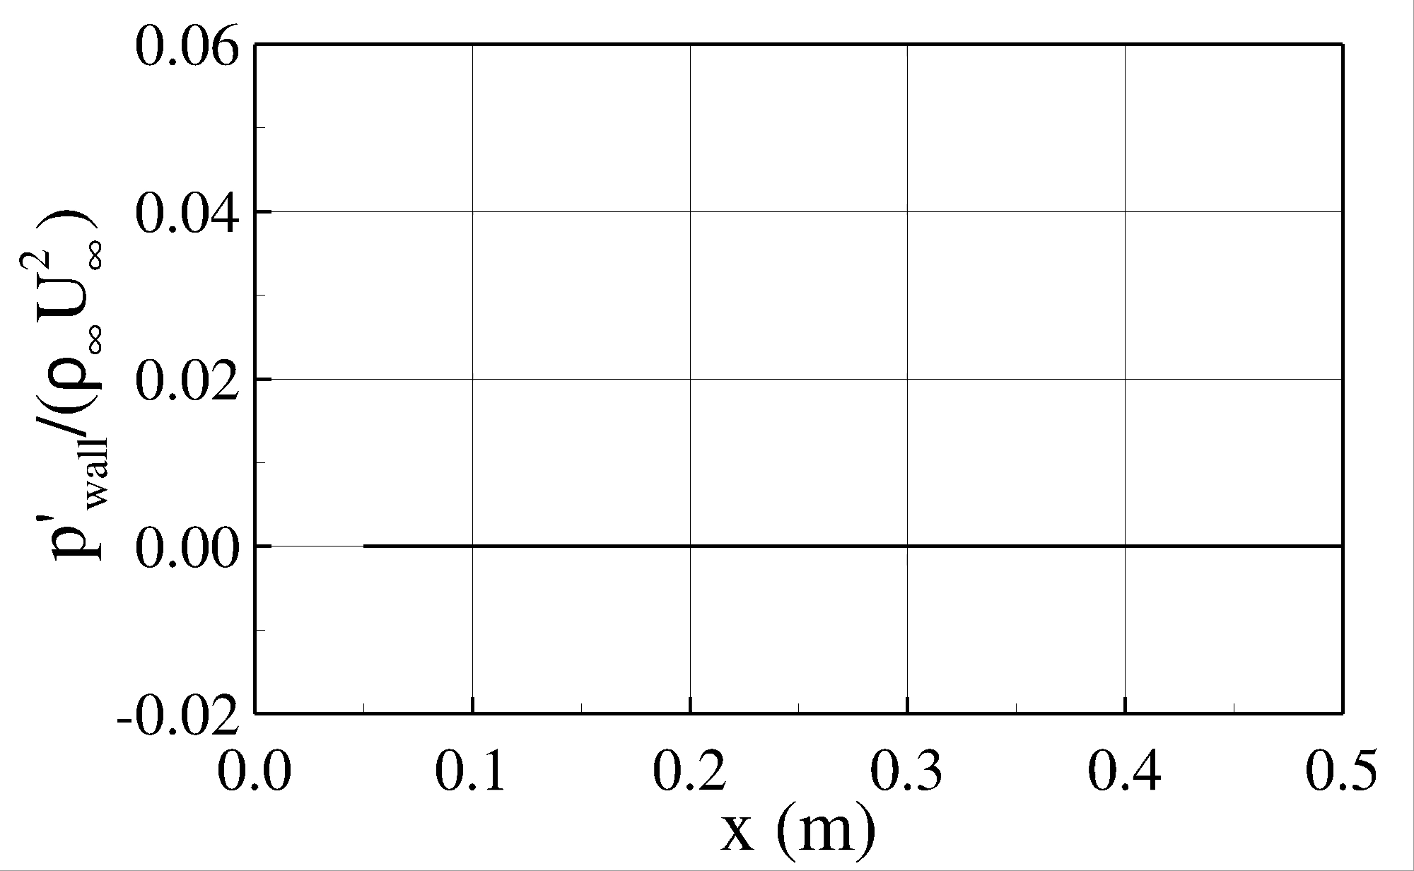
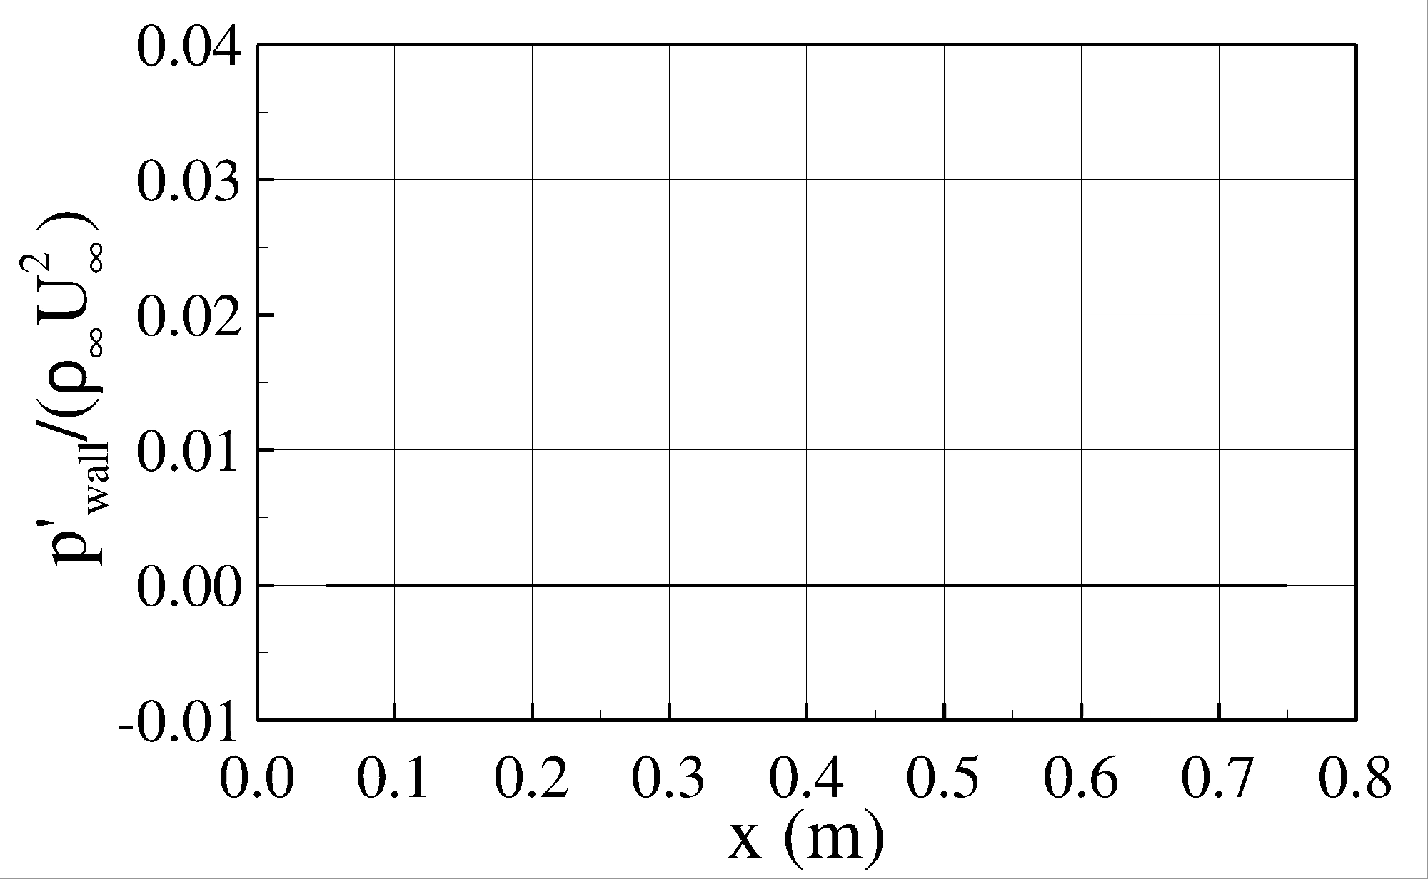
Oblique Disturbance Waves: Nonlinear Development
Can disturbances identified with LST lead to nonlinear development?
Select frequency and wavenumber from Linear Stability Theory (LST) results
M = 5.3
M = 7.0
Nonlinear Development
Transition due to 1st mode possible => run higher-resolved simulation
Notes:
spatio-temporal development of the wave packet → plotting the instantaneous pressure disturbance contours on the surface of the cone.
the amplitude levels are given in the legend, and the forcing hole location is marked with a black sphere, and the time instant at which the wave packet is plotted is given here
We can see that a small wave packet immediately forms downstream of the forcing location.

Slide 13
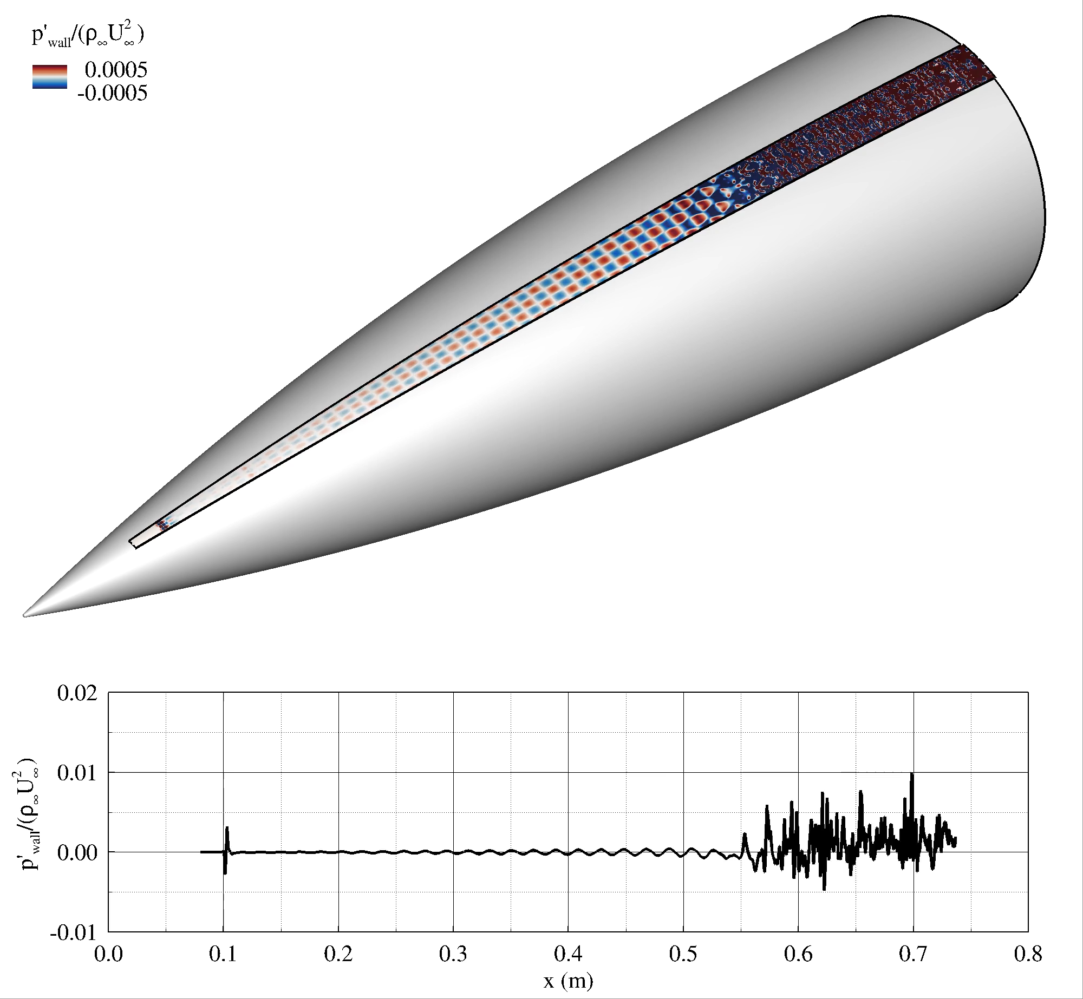
Oblique Breakdown Simulation
Notes:
Developments of streaks further down are indicative of the flow reaching the transition stages
The departure of oblique breakdown line from the laminar line on the heat flux graph indicates that the flow is departing from the linear behavior, telling us that it is going/tending towards transition

Slide 14
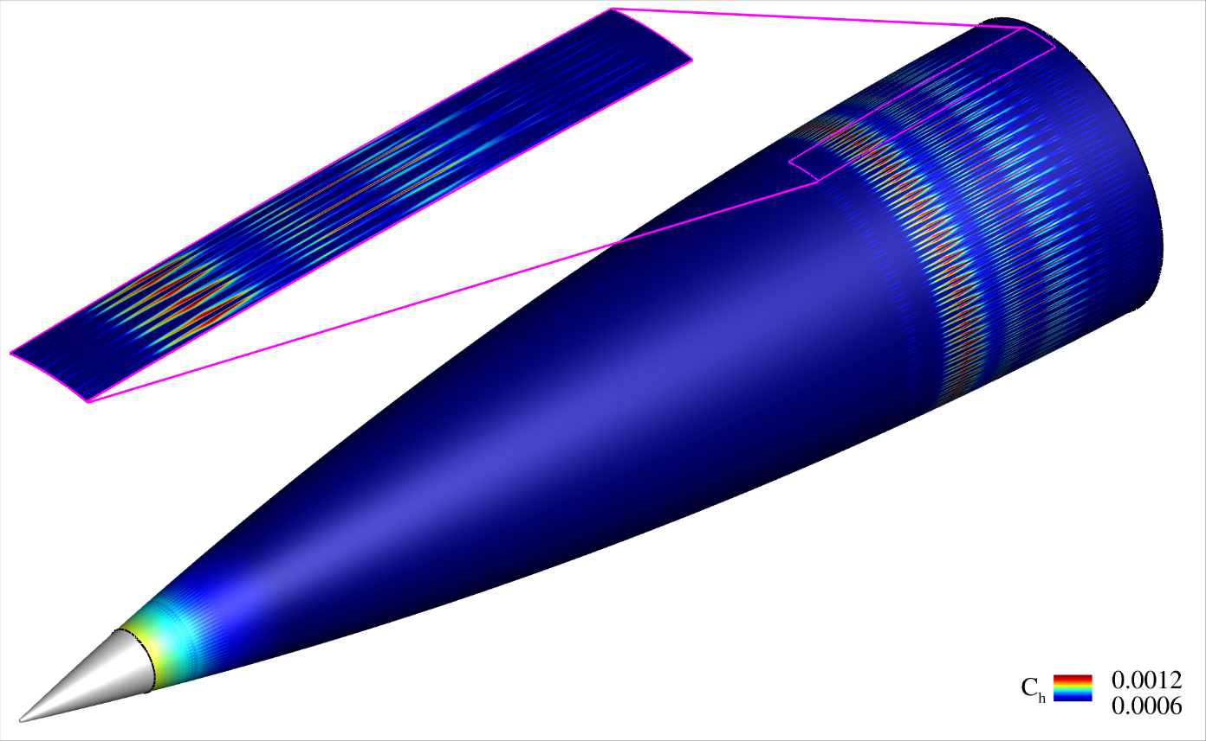
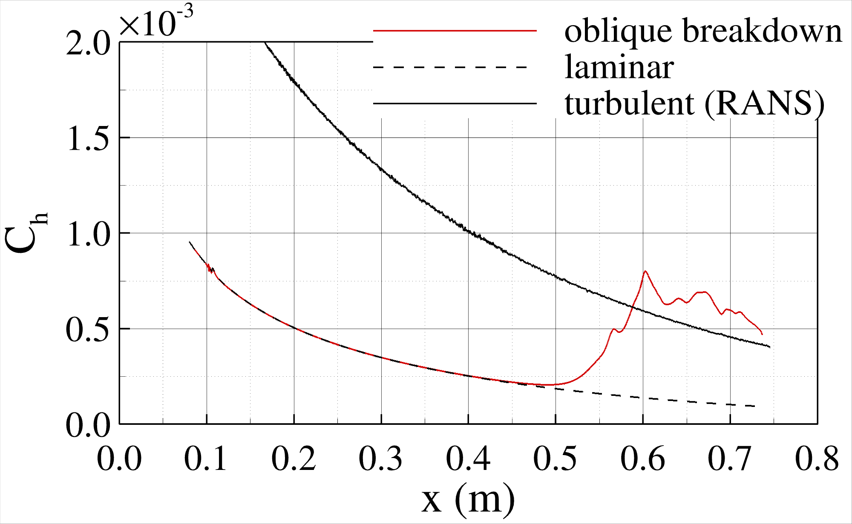
Oblique Breakdown Simulation
Turbulence?
Transition Onset
Notes:
Developments of streaks further down are indicative of the flow reaching the transition stages
The departure of oblique breakdown line from the laminar line on the heat flux graph indicates that the flow is departing from the linear behavior, telling us that it is going/tending towards transition

Slide 15
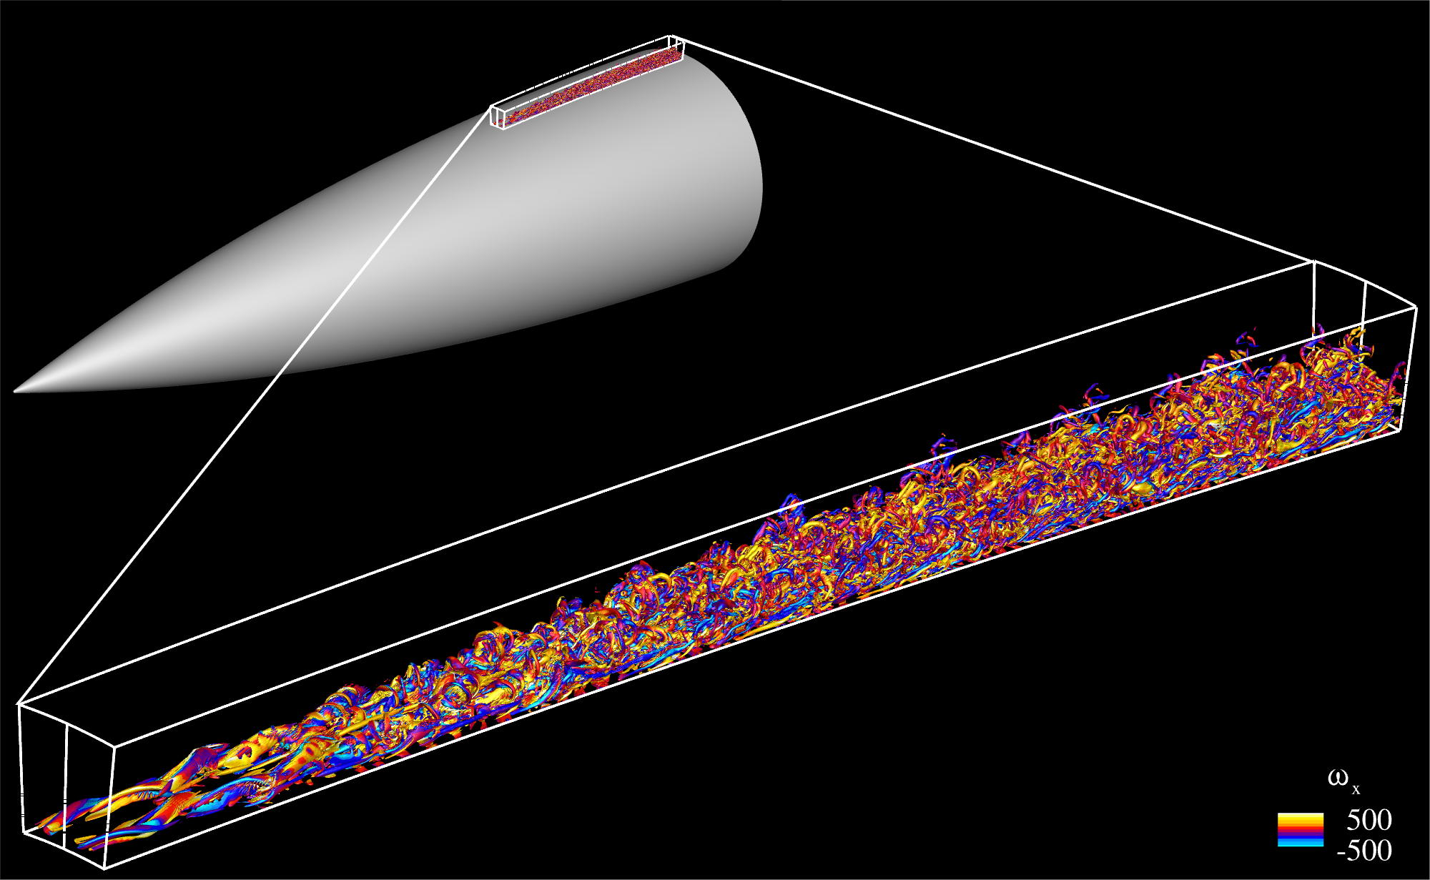
Oblique Breakdown Simulation
Q-vortex identification criterion to visualize development of small-scale structures indicative of boundary-layer transition
Q = 10000 iso-surfaces colored by streamwise vorticity
Notes:
Development of small scales towards the end of the computational area indicates that the boundary-layer is starting to transition

Slide 16
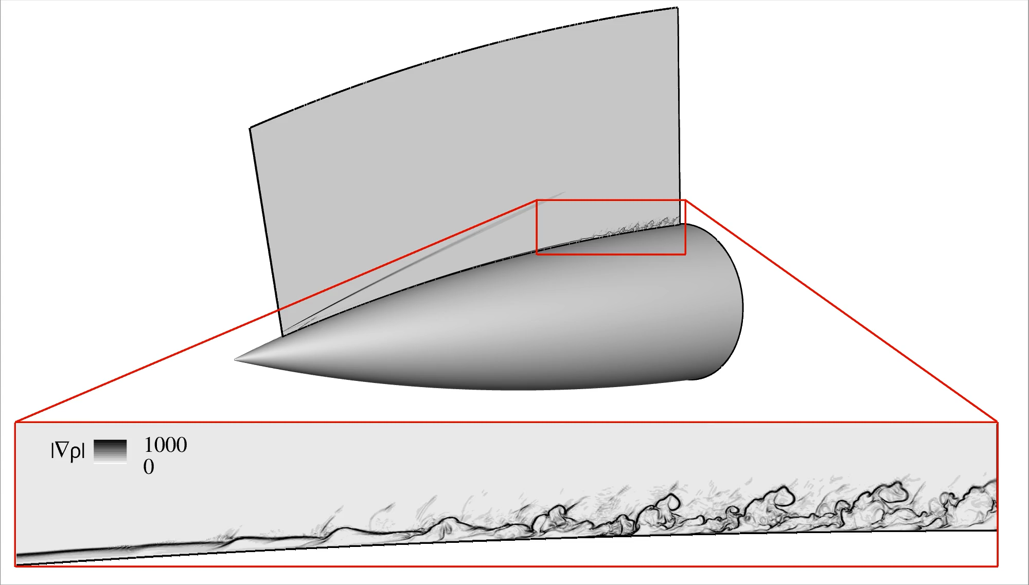
Oblique Breakdown Simulation
Simulated “Schlieren” to emulate visualization technique used in wind tunnel experiments
Notes:
Schlieren is a technique that uses how light bends around density changes in a fluid to visualize the flow over an object in wind tunnel experiments, so this is a way to more directly compare visually/qualitatively to the wind tunnel results.
Through this density-based flow visualization technique, you are able to track and visualize the changes in pressure, temperature, and shockwaves in the air flowing over the surface of a model

Slide 17
Outline
Background
Results
Summary & Outlook
Notes:
I’d like to start with a brief introduction about what we will be addressing in this presentation.

Slide 18

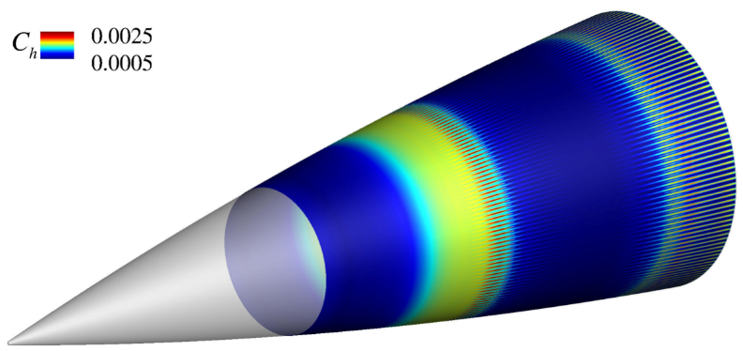
Summary & Outlook
Summary:
Found dominant primary (linear) instabilities for wind tunnel conditions (M = 5.3, M = 7)
Found that so-called “first mode oblique breakdown” is nonlinear mechanism that can lead to rapid (over short distance) laminar-turbulent boundary-layer transition
“first-mode oblique breakdown”
(M = 7)
“second-mode fundamental breakdown”
(M = 7)
Meersman, Hader & Fasel (2022)
Outlook/open questions:
Possible 1st/2nd mode interactions leading to transition?
Dominant nonlinear mechanism in a “noisy” tunnel environment (modeled by broadband random forcing)?
Which nonlinear breakdown mechanisms are possible for M = 5.3 (1st mode/2nd mode dominated, possible 1st mode/ 2nd mode interaction)?
Are dominant nonlinear mechanisms changing for flight conditions?

Slide 19
Thank You
Acknowledgements:
Support: Arizona NASA Space Grant
Compute time: DoD HPCMP, UA HPC
Notes:
Welcome to the talk on our numerical investigation of the nonlinear transition stages for a sharp cone at Mach 10. Before I begin, I would like to acknowledge the support from the ONR with Dr. Eric Marneau serving as the program manager, and the compute time provided by the DoD and the UAHPC.

