Slide 1
Tips for Creating Your Abstracts & Presentations
Preparing for the
Annual Arizona NASA Space Grant Consortium Symposium

Slide 2
Symposium Due Dates
March 19th, 2021
Symposium Abstracts & Student RSVPs
April 2nd, 2021
Symposium PowerPoints (Interns)
April 5th, 2021
Spring Graduating Seniors, Degree Completion Form
April 9th , 2021
Symposium PowerPoints (ASCEND Scholars)
April 10th, 2021
Mentor & Guest RSVPs (you do not need to RSVP for your mentor)
April 17th, 2021
Symposium!

Slide 3
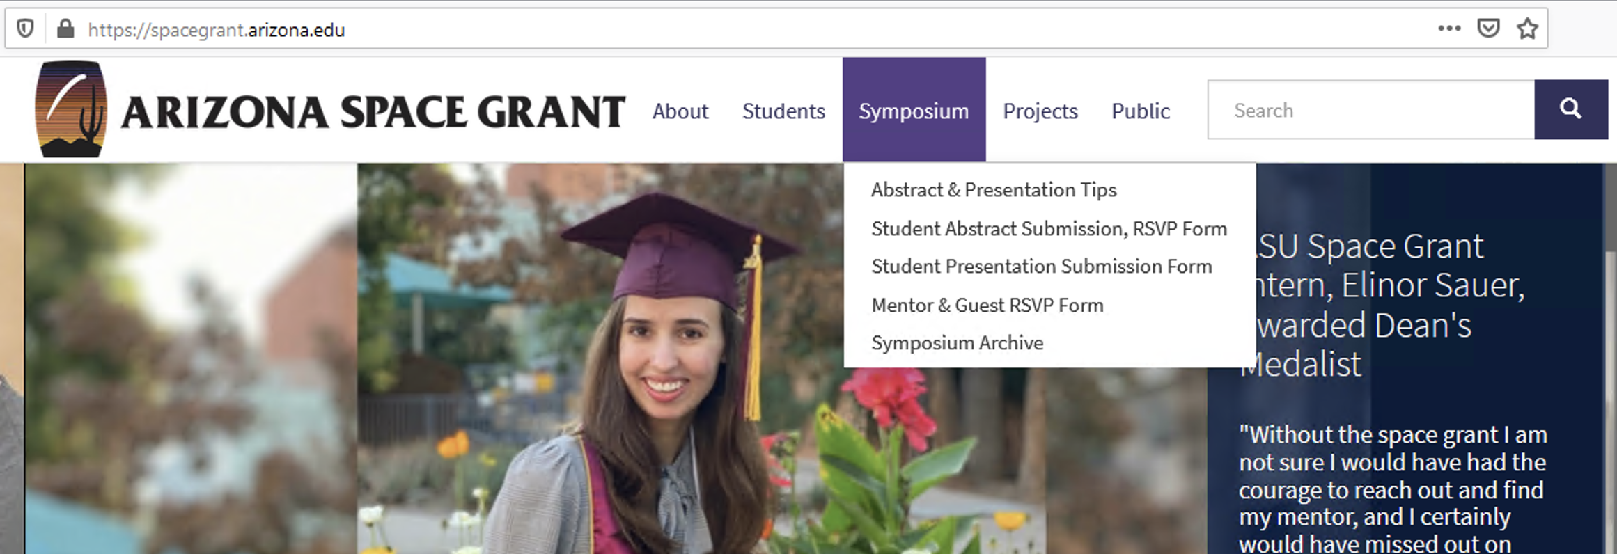
Find Updates on the Space Grant Website
The website will have the latest Symposium information,
dates, deadlines, and forms!

Slide 4
Use the Website to Submit Your Files
Submit abstracts and RSVPs here: https://sgsymposium.lpl.arizona.edu/abstract-rsvp-form
Submit PowerPoints here: https://spacegrant.arizona.edu/students/symposium/presentation.

Slide 5
Submitting an Abstract
Abstracts and RSVPs are due by students presenting at the conference on March 19th, no exceptions.
This is a professional conference and deadlines will not be extended.
Each individual should submit their own RSVP and Abstract form, regardless if you are part of a team presentation and sharing 1 team abstract.
Team presentations can share an abstract and do not have to create unique abstracts for each person on the team.

Slide 6
Submitting an Abstract
Students presenting at the conference:
Select “yes” to the question: “Are you currently part of the Arizona Space Grant Consortium.”
Select “undergraduate research intern” or “ASCEND Team Member” to have access to submitting an abstract.

Slide 7
Submitting a PowerPoint
Remember, you are uploading your PowerPoint presentation to a formal conference with over 100 presenters.
Your Filename should be: Lastname_Firstname
Individual presenters should submit their own PowerPoint presentation. Team presentations only have to submit one PowerPoint (only one person from the team needs to submit the PowerPoint for the whole team).

Slide 8
What to Expect During the Symposium
Starting with the Symposium Presentations…

Slide 9
During your Symposium Presentation
The Moderators
Open presentations via their Zoom “shared screen”
Introduce speakers
Keep time
Click the “next slide” for you
Field questions for you during Q&A
The Presenter (You!)
Attend the Keynote address and closing
Go to your session early & introduce yourself in the chat box
Participate in the entire session and support others

Slide 10
Presentation Tips
All presentations (no exceptions) must be in PowerPoint format.
File size matters– compress images in PowerPoint.
Do not submit your presentation late, and be sure it is complete. You cannot change your presentation after it is submitted.
Presentations are ~7 minutes long with 1-2 minutes for questions afterwards.

Slide 11
Presentation: Core Content
The core of your presentation will flow through
Statement of the problem;
Objectives;
Methods/activities/analysis techniques;
Results; and
Interpretations of the results and their significance/use/impact.

Slide 12
Opening Slide
Most presentations use the title slide to begin:
Title of presentation
Your name
Your mentor's name / school or industry affiliation, and people who worked with you directly
Name of the symposium
Date

Slide 13
Logos & Attribution
Somewhere on the edges of the title slide put logos of organizations key to the research (the department, NASA, etc.).
If Space Grant is the primary sponsor / funding you to perform this research, place the Space Grant logo in the bottom corner of all subsequent slides.
Find Logos Here:
https://spacegrant.arizona.edu/about/logos

Slide 14
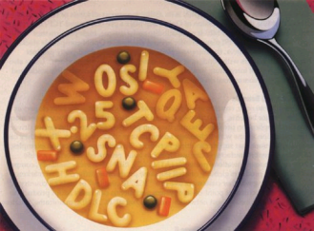
Effectively Communicating
Though scientifically aware, some of your audience may not necessarily be versed in the technical terms of your specific topic or discipline.
Define technical terms
Spell out acronyms
Avoid jargon
Source: Blogging Innovation

Slide 15
Be Careful Of…
Background Colors
Choose simple backgrounds (white with black text or dark blue with white text).
Text colors: Do not use red. Light text on light background and dark text on dark background should be avoided.
Animations.

Slide 16
Which Font & What Size?
Sans Serif Fonts
These include, among many others, Arial and Tahoma.
Generally, slide titles should be larger (e.g. 40pt), while bullets can be smaller 32 or 28pt.

Slide 17
Images
Images are excellent, particularly if they aid comprehension.
NOTE: It is very important that you credit the source of the image on your slide (usually in smaller font below the image).
Source: openscience.org

Slide 18
Closing Slide(s)
Conclusions: generally the second to last slide
Discuss interpretations and give some insight of future directions.
End with a more detailed Acknowledgements Slide.
Remember your mentor, any graduate students, the funding agency, the Department, the name of the grant, etc. have all helped you get to this point.
A final slide for questions should be a simple “Thank You”

Slide 19
How Do I Field Questions?
The moderators will
Asks the audience for questions if there is remaining time
Field the questions for you so that you don’t have to scramble to find who asked a question first

Slide 20
Strong Beginning, Strong Finish
Memorization rarely if ever helps a presentation.
However, having a strong beginning and strong finish can make a world of difference.
These get you rolling, reduce nerves because you are rolling, and help you gracefully off the stage!

Slide 21
Transition Tips
Memorize ONLY your introduction and conclusion…and identify the transitions you want between slides.
Two complimentary methods work well:
a) plan for the last thing you say on a slide to be the opening for the next slide, and/or
b) place something on the slide (a word in the last bullet or an image) that cues you as to what is coming next.
Good transitions lead to good presentations and are much more effective than rote memorization.

Slide 22
Delivery
Turn on your camera, if able.
Do not read your slides, they should speak for themselves.
Eye contact is very helpful for communication.
Even though this is a virtual presentation, look into the camera and not away.
Some movement (hand gestures, etc.) is ok, but keep this at a minimum (too much can be distracting).
Keep background noise to a minimum if able and speak loudly and clearly.

Slide 23
Tips for Writing Abstracts
Be concise. Focus only on the major elements (150 word max. limit)
A science abstract is like a formula – it almost always contains the same elements in the same order.
Begin by capturing the problem / question(s) you have been trying to address as well as your objective(s).
After, you can link the problem to the purpose of your project/research, etc.

Slide 24
Abstract Tips
Next, summarize the methods and activities pursued to address the problem.
Then, summarize your results and accomplishments.
Finally, conclude with interpretations of those results and their significance.
In the case of R&D work, science education, or science writing, conclude with your interpretations of the potential utility and impact the product, activities, and/or articles will have.

Slide 25
Ensuring Quality & Professionalism
Make sure your mentor reads and approves your abstract before it is submitted!
Do not submit your abstract late.
You may not change your abstract after the final submission online.

