Slide 1
Preparing for a Successful Symposium Experience
Arizona NASA Space Grant
Statewide Student Research Symposium

Slide 2
Symposium 2025
Hosted by Arizona State University (ASU) Space Grant
April 18-19, 2025
Friday events: ASU School of Earth and Space Exploration
Keynote speaker, Graduating Senior Ceremony, Networking
Saturday events: SkySong ASU Scottsdale Innovation Center
Presentations all day

Slide 3
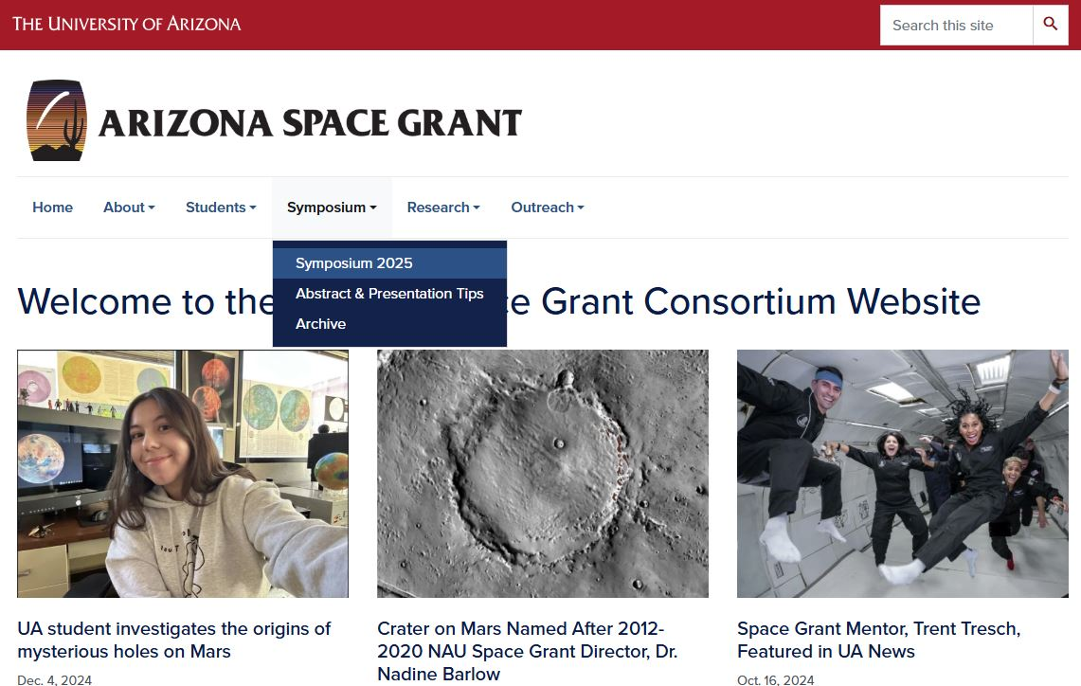
Find Updates on the Space Grant Website

Slide 4
Symposium Due Dates Use the website to submit your files
March 21, 2025: Student Abstracts & All RSVPs
April 4, 2025: Intern Program: Symposium PowerPoints
April 4, 2025: Spring Graduating Seniors, Degree Completion Form
April 11, 2025: ASCEND Program: Symposium Posters & PowerPoints (if applicable)

Slide 5
Submitting an Abstract
Students presenting at the conference:
Select Yes to the question Are you a student presenting at the Symposium?
Select Space Grant Intern or ASCEND Student to get access to the abstract submission drop down.
Everyone must submit their own abstract and RSVP form, even if you are part of a team presentation and sharing 1 team abstract.
Why? Each RSVP form asks for your dietary restrictions, nametag information, etc. so each person must submit their own.
Team presentations can share the same abstract, but each individual team member must submit an RSVP form.

Slide 6
Submitting a PowerPoint
Remember, you are uploading your PowerPoint and Poster presentations to a formal conference with over 150 presenters.
Your Filename should be: Lastname_Firstname
Individual presenters should submit their own PowerPoint presentation. Team presentations only have to submit one PowerPoint or Poster (only one person from the team needs to submit the document for the whole team).

Slide 7
What to Expect During the Symposium
Starting with the Symposium Presentations…

Slide 8
During your Symposium Presentation
The Session Moderators
Open presentations for each session
Introduce speakers
Keep time
Field questions for you during Q&A
The Presenter (You)
Attend the short plenary talk first thing Saturday morning to receive instructions for the day
Go to your session early & introduce yourself
Sit near the front of the room when it’s close to your presentation time
Participate in the entire session and support other students throughout the Symposium
Notes:
Moderators in the Room
Moderators will introduce you and/or your team and put up your PowerPoint presentation on the projector screen.
All PowerPoints are preloaded onto the computer for your session; no changes may be made after you submit your presentation.
Moderators will sit in the front row and will hold up signs for a 5-, 3-, and 1-minute warning to indicate your time remaining. They will stop you (whether you are done or not) at 9 minutes 20 seconds.
Moderators will help you field questions based on any time that is remaining. If there is no time remaining, they will encourage people to ask you questions during the breaks/lunch.

Slide 9
Presentation Tips
All presentations must be in PowerPoint format.
File size matters– compress your images in PowerPoint.
Note that there will be no audio in the presentation rooms for videos, special slide features, etc.
Do not submit your presentation late and be sure it is complete. You cannot change your presentation after it is submitted.
Individual presenters receive a 10-minute presentation slot broken down as ~7 minutes to present,1-2 minutes for Q&A, and 1-minute to switch to the next presenter.

Slide 10
Presentation: Core Content
The core of your presentation will flow through
Statement of the problem;
Objectives;
Methods / activities / analysis techniques;
Results; and
Interpretations of the results and their significance / use / impact.

Slide 11
Opening Slide
Most presentations use the title slide to state the
Title of presentation
Your name
Your mentor's name / school or industry affiliation, and people who worked with you directly
Name and place of the symposium
Date of the symposium

Slide 12
Logos & Attribution
Somewhere on the edges of the title slide put logos of organizations key to the research (the department, NASA, etc.).
If Space Grant is the primary sponsor / funding you to perform this research, place the Space Grant logo in the bottom corner of all subsequent slides.
Find Logos Here:
https://spacegrant.arizona.edu/about/logos

Slide 13
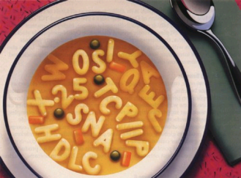
Effectively Communicating
Though scientifically aware, some of your audience may not be versed in the technical terms of your specific topic or discipline.
Define technical terms
Spell out acronyms
Avoid jargon
Source: Blogging Innovation

Slide 14
Be Careful Of…
Background Colors
Choose simple backgrounds (white with black text or dark blue with white text).
Text colors: Do not use red. Light text on light background and dark text on dark background should be avoided.
Animations.

Slide 15
Which Font & What Size?
Sans Serif Fonts
These include, among many others, Arial and Tahoma.
Generally, slide titles should be larger (e.g. 40pt), while bullet points can be smaller (32 or 28pt.)

Slide 16
Images
Images are excellent, particularly if they aid comprehension.
Note: It is very important that you credit the source of the image on your slide (usually in smaller font below the image). PowerPoints remain accessible to the public on the Space Grant website.
Source: openscience.org

Slide 17
Closing Slide(s)
Conclusions: generally on the second to last slide
Discuss interpretations and give some insight of future directions.
Then, end with a more detailed acknowledgements slide.
Remember your mentor, any graduate students, the funding agency, the Department, the name of the grant, etc. have all helped you get to this point.

Slide 18
Last Slide
Your final slide should simply say “Thank You”. This is important to indicate your presentation is complete.
Do not end with a slide reading “Questions?”. You may not have time for questions depending on the length of your presentation. The session moderator will determine this.
Upon completion of your presentation, the Session Moderator will stand up and announce next steps.

Slide 19
How Do I Field Questions?
The moderators in each room will
Ask the audience for questions if there is remaining time
Field the questions for you so that you don’t have to scramble to find who asked a question first
Note: do not close your PowerPoint because you may need it to refer to a slide during Q&A

Slide 20
Strong Beginning, Strong Finish
Memorization rarely if ever helps a presentation.
However, having a strong beginning and strong finish can make a world of difference.
These get you rolling, reduce nerves because you are rolling, and help you gracefully off the stage!

Slide 21
Transition Tips
Memorize your introduction and conclusion and identify the transitions you want between slides.
Two complimentary methods work well:
a) plan for the last thing you say on a slide to be the opening for the next slide, and/or
b) place something on the slide (a word in the last bullet or an image) that cues you as to what is coming next.
Good transitions lead to good presentations and are much more effective than rote memorization.

Slide 22
Delivery
Face your audience, not the screen.
Speak loudly and clearly.
Do not read your slides, they should speak for themselves.
Eye contact is very helpful for communication.
Some movement (hand gestures, etc.) is ok, but keep this at a minimum because too much can be distracting. You will also need to remain near the mic, so avoid walking around.
When directing audience attention to a particular aspect of a slide with a laser pointer, point– but do not distract with the pointer!

Slide 23
What to Expect During the Symposium
Moving onto the abstracts…

Slide 24
How are the abstracts used?
Symposium organizers use your abstract to place you in a topical session, and to organize the presentation timeline.
They are included in a digital Symposium booklet distributed to all attendees.
They are your first point of contact with the people in your audience. Abstracts are often used for attendees to decide what presentations and posters they want to see. Make your abstract stand out!

Slide 25
Tips for Writing Abstracts
Be concise. Focus only on the major elements (150-word limit)
A science abstract is like a formula – it almost always contains the same elements in the same order.
Begin by capturing the problem / question(s) you have been trying to address as well as your objective(s).
After, you can link the problem to the purpose of your project / research, etc.

Slide 26
Abstract Tips
Next, summarize the methods and activities pursued to address the problem.
Then, summarize your results and accomplishments.
Finally, conclude with interpretations of those results and their significance.
In the case of R&D work, science education, or science writing, conclude with your interpretations of the potential utility and impact the product / activities / articles will have.

Slide 27
Ensuring Quality & Professionalism
Make sure your mentor reads and approves your abstract before it is submitted.
Do not submit your abstract late.
You may not change your abstract after the final submission online.

Slide 28
Miscellaneous Symposium Items

Slide 29
View our Resources
Review past Symposium presentations and abstracts by visiting our Symposium archive. Abstracts can be found in the digital Symposium booklet. PowerPoints can be found organized by topical session.
https://spacegrant.arizona.edu/students/symposium/archive

Slide 30
Symposium Room Setup
Theatre style with an isle down the middle so that you can get to the podium to present.
Each room will have a podium with a mic and laptop for the presenter at the front of the room, as well as a projector screen.
Note that your presentation will be pre-loaded onto the presentation screen by the moderator. You do not have to do this or bring your own laptop.
Use the microphone available in the room so that everyone can hear you. Those that may be hearing impaired will appreciate your use of the microphone.
Team presentations should consider how to best move around to use the microphone.
There will be a slide advancer for your use.

Slide 31
Being Supportive & Respectful of Others
Use the Symposium to network with other students and mentors.
Ask other students questions about their research and stay for the duration of the Symposium to show your support.
If moving from room to room, wait until the end of a person’s presentation and exit quietly out the back. Do not let the door slam.
When entering a new room, wait until you hear clapping/ Q&A before entering a room, so you don’t interrupt someone’s presentation.
Remember to put your phone on silent for this event.
Give each presenter your undivided attention by minimizing the use of mobile devices as much as possible during their presentation. Consider only using when necessary.

Slide 32
Have Fun!
We hope that each of you enjoy this experience. Please let us know how we can better help you feel prepared for the Symposium event.

