Slide 1
Tips for Creating Your Abstracts & Presentations
On the road to the 29th Annual Arizona Space Grant Consortium Symposium
Chandra Holifield Collins, UA/NASA Space Grant
March 2-3, 2020

Slide 2
Symposium Due Dates
http://spacegrant.arizona.edu/students/symposium
March 17th, 2020
Symposium Abstracts and Student RSVPs
March 27th, 2020
Mentor RSVPs (you do not need to RSVP for your mentor)
April 3rd, 2020
Symposium PowerPoints
April 6th, 2020
Graduating Students, Degree Completion Form
April 17th, 2020
Symposium Banquet
April 18th, 2020
Symposium
Notes:
2018 Statewide Symposium Announcements
Date & Time Announced!
The Symposium Banquet will be held at the Sheraton Tucson Hotel & Suites in Tucson, AZ. The Banquet typically begins at 6:00pm with a meet and greet. Dinner typically served at 7:00pm. This year's speaker is TBD. This year's Statewide Symposium will also be held at the Sheraton Tucson Hotel & Suites in Tucson, AZ typically from 8:30am to approximately 4:00pm.
Information
For more information, please visit The University of Arizona’s Space Grant Symposium information page.
Symposium Banquet (Friday, April 13)
The Friday night Space Grant Banquet will be held at the Sheraton Tucson Hotel & Suites at 5151 E Grant Rd, Tucson, AZ 85712. The banquet will begin at 6:00pm. Nice business dress is in order.
Symposium (Saturday, April 13)
The Saturday Space Grant Symposium will be held at the Sheraton Tucson Hotel & Suites at 5151 E Grant Rd, Tucson, AZ 85712. The symposium will begin at 8:30am.

Slide 3
Symposium Due Dates
http://spacegrant.arizona.edu/students/symposium
March 17th, 2020
Symposium Abstracts and Student RSVPs
April 6th, 2020
Graduating Students, Degree Completion Form
April 8th, 2020
ASCEND Poster PDFs
April 10th, 2020
ASCEND PowerPoints
April 17th, 2020
Symposium Banquet
April 18th, 2020
Symposium
Notes:
2018 Statewide Symposium Announcements
Date & Time Announced!
The Symposium Banquet will be held at the Sheraton Tucson Hotel & Suites in Tucson, AZ. The Banquet typically begins at 6:00pm with a meet and greet. Dinner typically served at 7:00pm. This year's speaker is TBD. This year's Statewide Symposium will also be held at the Sheraton Tucson Hotel & Suites in Tucson, AZ typically from 8:30am to approximately 4:00pm.
Information
For more information, please visit The University of Arizona’s Space Grant Symposium information page.
Symposium Banquet (Friday, April 13)
The Friday night Space Grant Banquet will be held at the Sheraton Tucson Hotel & Suites at 5151 E Grant Rd, Tucson, AZ 85712. The banquet will begin at 6:00pm. Nice business dress is in order.
Symposium (Saturday, April 13)
The Saturday Space Grant Symposium will be held at the Sheraton Tucson Hotel & Suites at 5151 E Grant Rd, Tucson, AZ 85712. The symposium will begin at 8:30am.

Slide 4
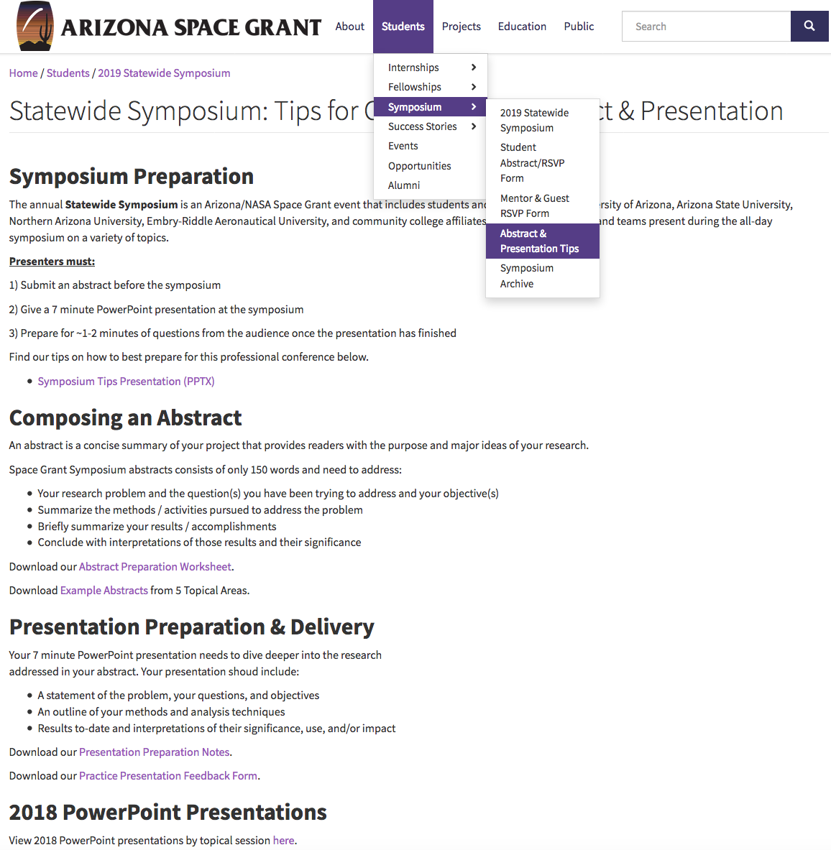
The Website is Your Friend ☺

Slide 5
Use the Website to Submit Your Files
Remember, you are uploading your files (the abstract and PowerPoint presentation) to a formal conference.
Your Filename should be:
Lastname_Firstname_abstract.docx
Lastname_Firstname_presentation.pptx

Slide 6
What to Expect During the Symposium
Starting with the Symposium Presentations…

Slide 7
During your Symposium Presentation
The Moderator
Opens presentations
Introduces speakers
Keeps time
Fields questions for you
The Presenter (You!)
Attend the short plenary talk first thing in the morning to receive instructions
Go to your session early & introduce yourself
Sit in front
Participate in the entire session*
*Space Grant exception: to see the talk of a close friend in another session. BUT -- be polite and when you are not speaking next, sit near the exit.

Slide 8
Presentation Tips
All presentations (no exceptions) must be in PowerPoint format.
File size matters– compress images in PowerPoint.
Do not submit your presentation late, and be sure it is complete. You cannot change your presentation after it is submitted.
Presentations are 7 minutes long with 1-2 minutes for questions afterwards.

Slide 9
Presentation: Core Content
The core of your presentation will flow through
Statement of the problem;
Objectives;
Methods/activities/analysis techniques;
Results; and
Interpretations of the results and their significance/use/impact.

Slide 10
Opening Slide
Most presentations use the title slide to begin:
Title
Your name
Your mentor's name / affiliation, and people who worked with you directly
Name/place of the symposium
Date

Slide 11
Logos & Attribution
Somewhere on the edges of the title slide put logos of organizations key to the research (the department, NASA, etc.).
If Space Grant is the primary sponsor / funding you to perform this research, place the Space Grant logo in the bottom corner of all subsequent slides.
https://spacegrant.arizona.edu/about/logos

Slide 12
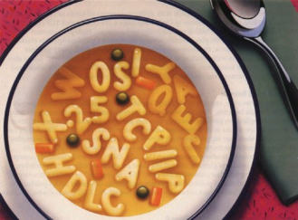
Effectively Communicating
Though scientifically aware, some of your audience may not necessarily be versed in the technical terms of your specific topic or discipline.
Define technical terms
Spell out acronyms
Avoid jargon
Source: Blogging Innovation

Slide 13
Be Careful Of…
Background Colors
Choose simple backgrounds (white with black text or dark blue with white text).
Text colors: Do not use red. Light text on light background and dark text on dark background should be avoided.
Animations.

Slide 14
Which Font & What Size?
Sans Serif Fonts
These include, among many others, Arial and Tahoma.
Generally, slide titles should be larger (e.g. 40pt), while bullets can be smaller 32 or 28pt.

Slide 15
Images
Images are excellent, particularly if they aid comprehension.
NOTE: It is very important that you credit the source of the image on your slide (usually in smaller font below the image).
Source: openscience.org

Slide 16
Closing Slide(s)
Conclusions: generally the second to last slide
Discuss interpretations and give some insight of future directions.
End with a more detailed Acknowledgements Slide.
Remember your mentor, any graduate students, the funding agency, the Department, the name of the grant, etc. have all helped you get to this point.
A final slide for questions should be a simple “Thank You”

Slide 17
How Do I Field Questions?
Remember, the moderator will a) asks the audience for questions and b) fields the questions for you …and then you answer them.
Do NOT close your PowerPoint because you may need it to help you answer a question!

Slide 18
Strong Beginning, Strong Finish
Memorization rarely if ever helps a presentation.
However, having a strong beginning and strong finish can make a world of difference.
These get you rolling, reduce nerves because you are rolling, and help you gracefully off the stage!

Slide 19
Transition
Memorize ONLY your introduction and conclusion…and identify the transitions you want between slides.
Two complimentary methods work well:
a) plan for the last thing you say on a slide to be the opening for the next slide, and/or
b) place something on the slide (a word in the last bullet or an image) that cues you as to what is coming next.
Good transitions lead to good presentations and are much more effective than rote memorization.

Slide 20
Delivery
Face your audience, not the screen.
Do not read your slides, they should speak for themselves.
Eye contact is very helpful for communication.
Some movement (walking, gestures, etc.) is ok, but be kept this at a minimum (too much can be distracting).
When directing audience attention to a particular aspect of a slide with a laser pointer, point– but do not distract with the pointer!

Slide 21
Tips for Writing Abstracts
Be concise. Focus only on the major elements (150 word max. limit)
A science abstract is like a formula – it almost always contains the same elements in the same order.
Begin by capturing the problem / question(s) you have been trying to address as well as your objective(s).
After, you can link the problem to the purpose of your project/research, etc.

Slide 22
Abstract Tips
Next, summarize the methods / activities pursued to address the problem.
Then, summarize your results / accomplishments.
Finally, conclude with interpretations of those results and their significance.
In the case of R&D work, science education, or science writing, conclude with your interpretations of the potential utility and impact the product / activities / articles will have.

Slide 23
Ensuring Quality & Professionalism
Make sure your mentor reads and approves your abstract before it is submitted!
DO NOT submit your abstract late.
You may NOT change your abstract after the final submission online.

