Slide 1
CONTROL SYSTEMS PART 1
Atmospheric Profiling &
Microcontrollers
Created by Maxx Mudd
Notes:
Welcome to the Control System Part 1 Presentation. This is the first part of a two-part section on control systems.
Within these slides are some files that you can reference while understanding programming concepts. Please download and open them for use during the slides.
Please note that these files are designed to be run on your Arduinos and viewed in the serial monitor, where they will print the results of the operations included in the code. To view them, simply upload the code to your Arduino and open the serial monitor.
Also, the workshop will continue next week, so the final build of this workshop will be improved upon. Please keep it built as is or remember to assemble it before the next workshop. Enjoy the slides!

Slide 2
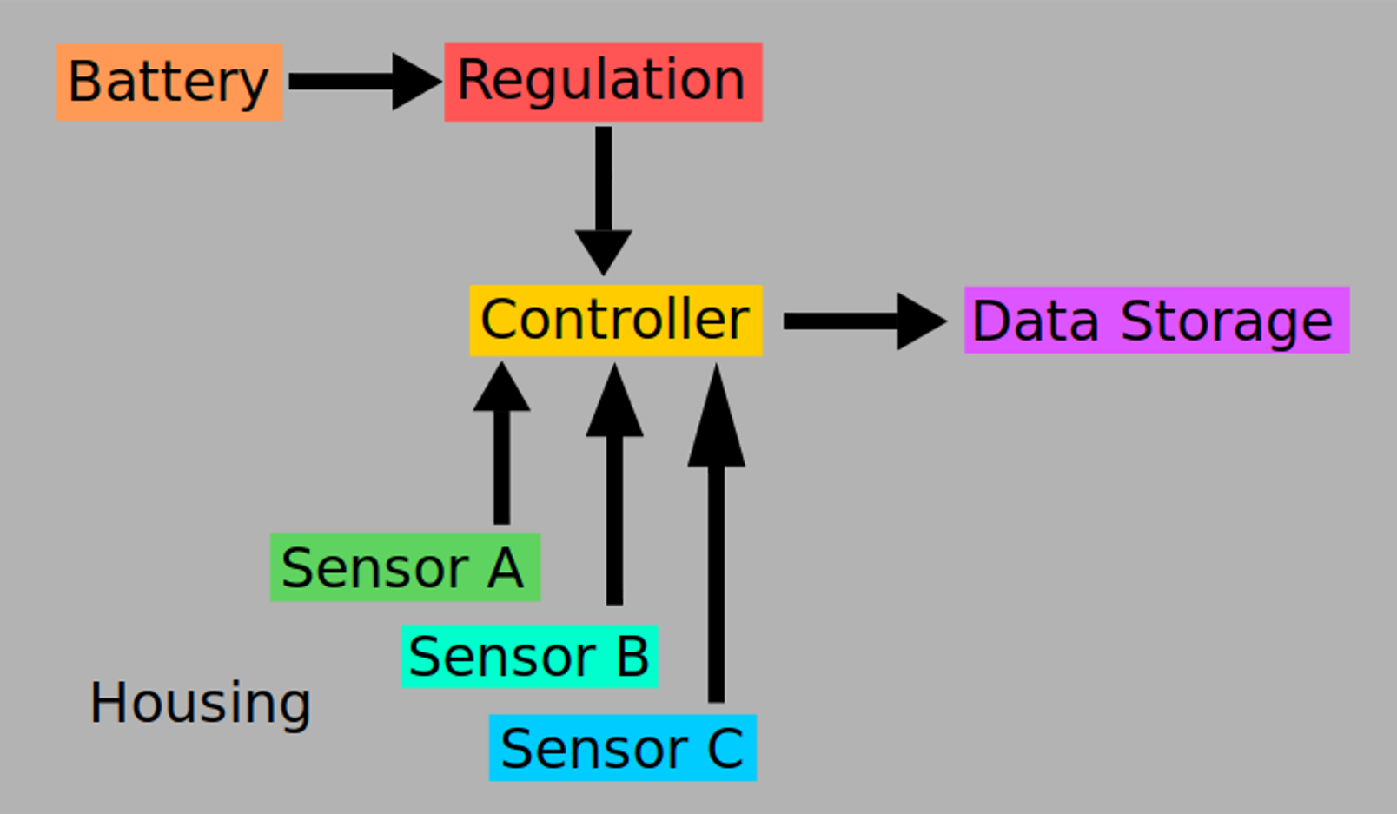
WHAT IS A CONTROL SYSTEM?
Control systems manage the behavior of other devices
A microcontroller unit, also called MCU, is the controller
Your control system will be the center that requests and manages data
Arduino is a base platform for a control system
Notes:
In the context of ASCEND, the control system will be the group of devices that gathers and saves atmospheric data during the flight. This diagram shows the basic structure of what an average control system will look like.
The control system is centered around a microcontroller unit (MCU, microcontroller, controller) that is like the command center for the system. Your systems will have regulated power input going into the microcontroller, with connected sensors sending data upon request to the microcontroller’s onboard memory. Your code that you will design from the ground up will be the instructions the microcontroller follows to handle this data and eventually store it to an SD card.
Arduinos are a common platform used by high-altitude ballooners. It is the most widely supported platform for projects of this nature with a wealth of information available online as well as an active community providing tutorials of all skill levels.

Slide 3
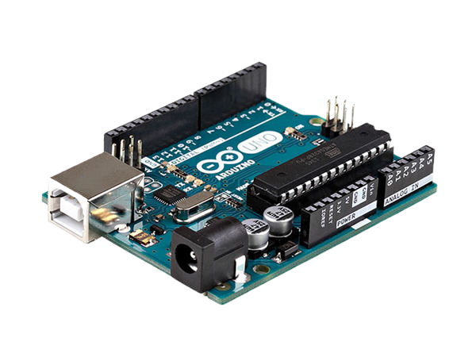
WHAT IS ARDUINO?
Platform that simplifies tinkering with electronics
Requires a microcontroller to work
Provides enhanced connectivity to the microcontroller
Notes:
Arduino is a platform that simplifies tinkering with electronics. Arduinos bridge the gap between electrical engineering concepts and software development. This open-source device has played an important role in the “maker” movement.
Notice the keyword platform here. An Arduino board does not function on its own, it is a circuit board with preassembled components used to provide enhanced connectivity to the microcontroller. When purchased, they always come with an installed MCU.
The microcontroller sits in the IC socket on the Arduino board. The connections made through the pins connect to protective components or expand the inputs and outputs of the device.

Slide 4
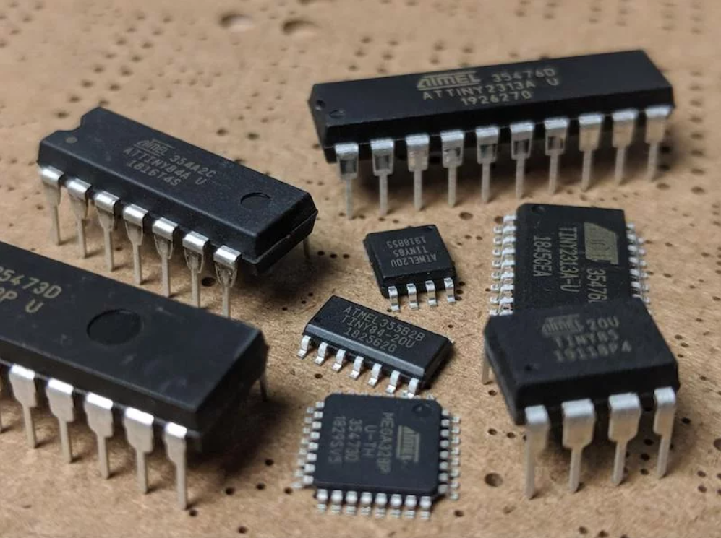
WHAT IS A MICROCONTROLLER?
Manages information, calculations, and logic
Integrated circuit with processor, memory, I/O all in one unit
Puts the “smart” in circuits
No operating system or GUI
Controlled by code, interacts through electrical signals
Notes:
The microcontroller is responsible for managing information, performing calculations, and making decisions using computer logic. It is an integrated circuit with a processor, memory, and I/O (inputs and outputs) all in one unit.
Microcontrollers put the “smart” in your circuits. Up until now, the circuits from the previous workshop operated purely on regulated voltage, distributed across the board to supply different components. When incorporating a microcontroller, the possibilities of what can be done expand tremendously. For example, a circuit could benefit from storing information such as user presets, connecting a sensor that supplements the function of the device, and much more.
Microcontrollers don’t have an operating system like your typical computer, nor do they have a GUI (graphical user interface). To interact with your microcontroller, you will write instructions using code that will be uploaded and stored to the on-board memory. When the microcontroller is powered on, it will follow these instructions on a continuous loop. All events take place in the form of electricity flowing to and from the microcontroller’s pins.

Slide 5
HOW MICROCONTROLLERS WORK
Microcontroller – The Brain
Manages information
Executes instructions
Inputs – Listener
Listens for information
Outputs – Communicator
Sends information, responds
Continuous Loop
Runs repeatedly while powered
Microcontroller
Continuous Loop
Notes:
To understand how the microcontroller works, use this simple analogy to understand the process of how a microcontroller functions.
You can first think of the microcontroller as the brains of the operation. It manages information (data) and executes instructions (code). The inputs are like ears, always listening for information that may come in. The outputs are like the voice of the microcontroller and are ready to communicate when needed.
This state of readiness is always on when the microcontroller is powered and will continue to run instructions in a loop until power is lost.

Slide 6
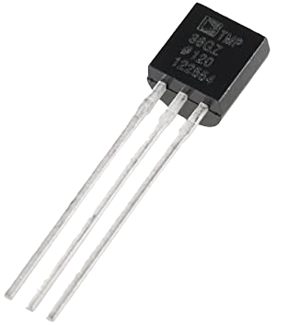
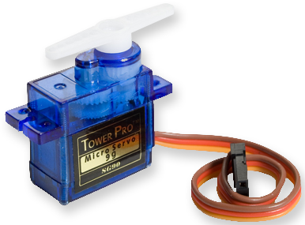
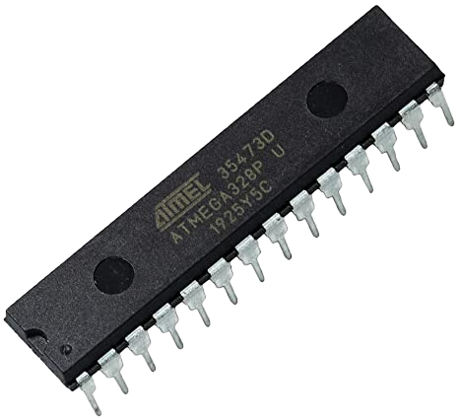
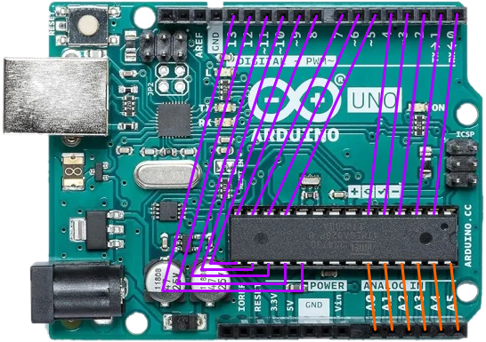
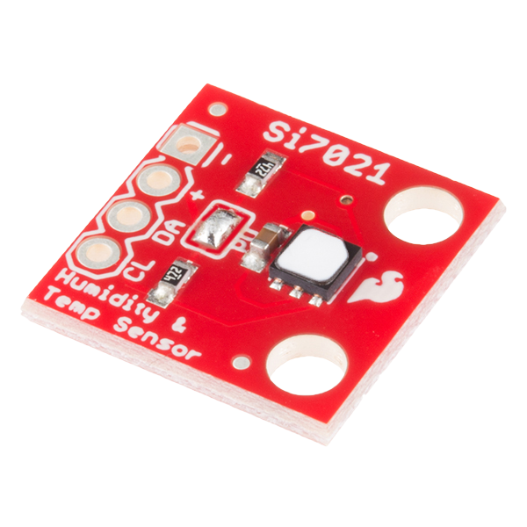
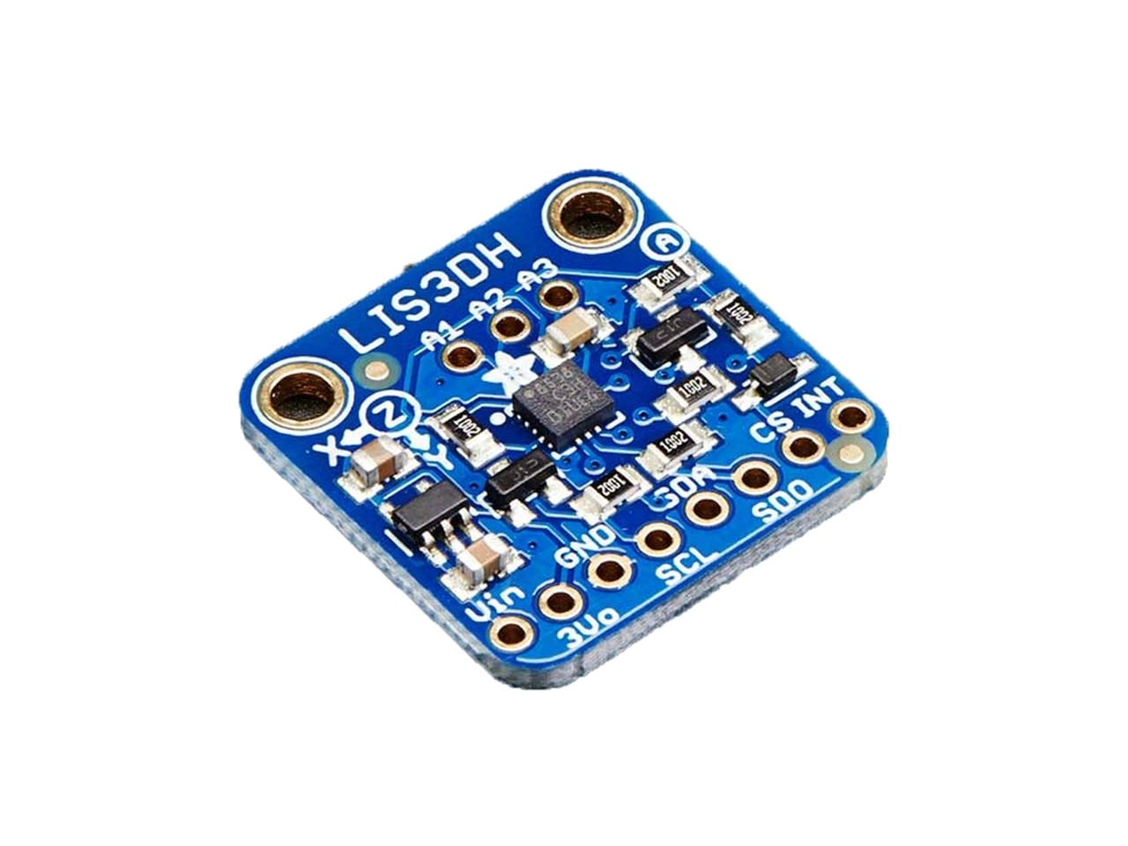
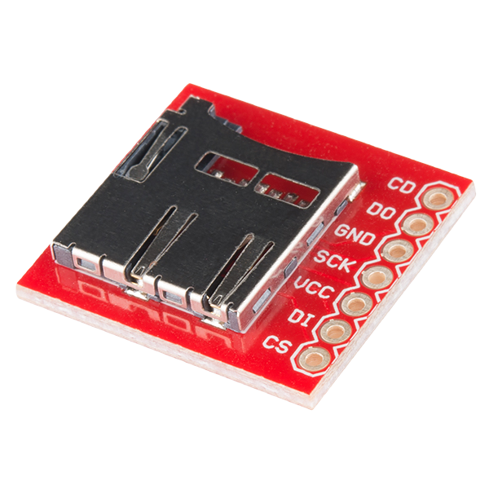
ARDUINO PLATFORM
Notes:
To reinforce the concepts we have talked about, this image represents how these devices work with each other.
On the left, the microcontroller is seated in within the Arduino’s connected IC socket. The colored lines represent the routing to each of the microcontroller’s pins.
On the right, we have a group of modules and sensors that are included in your kits. Through the combination of the code on your microcontrollers and the capabilities of the devices you connect, you can create something specific to your needs.
You will have total control over the Arduino design including the coded procedures as well as the devices you want to connect.

Slide 7
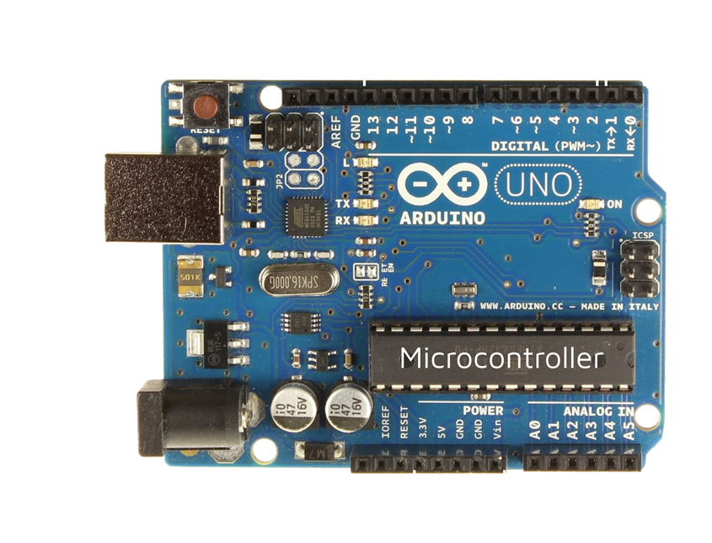
ARDUINO UNO
Notes:
This is a preview of the Arduino Uno’s notable components.
Starting from the bottom right we have the Analog I/O. It is technically capable of both input as well as output, but for now just think of it as an analog input. These pins can convert analog signals such as voltage into a digitally quantifiable value through analog-to-digital conversion. These quantities can then be stored in variables within your programs. These pins will be useful when taking readings from analog sensors.
Next is the power header, which is meant for distributing power to your devices. Included are pins for distributing both 5V and 3.3V depending on your needs, two ground connections, and a Vin pin for connecting external power through a jumper wire.
The barrel connector is a common DC adapter port that allows you to connect battery packs or even a wall adapter. This can be useful in its own way for some projects.
The USB port is going to be the source of power for use in this workshop and the serve as the primary connection method for uploading code to the microcontroller.
The top left is a physical reset button that reboots the Arduino board. This is useful if your Arduino ever becomes frozen, or if you need to view how your program operates from the very beginning. This button will not wipe the memory on your microcontroller; it will only reboot the device.
The digital I/O section runs from pins 2 through 13. These pins will be your main method of connecting devices, as well as the two unlabeled pins to the far left (SCL/SDA). These pins are capable of both input and output. When used as an output, the digital pins can send power to a device and be controlled using code. This is useful for things such as powering LEDs on when conditions are met. These pins can also be used to power devices that draw less than 40mA of current. When used as inputs, the pins can interpret information in binary form, such as ON and OFF. They are also able to read if something is sending a signal or not.
Finally, the top right corner is the serial I/O. This section deserves mentioning because it has a specific purpose of transmitting data in series, one byte at a time. There are devices that utilize this method of communication, but you likely won’t have to use it in the learning stages. Just be aware that pins 0 and 1 are reserved for serial, so do not use them as digital pins.

Slide 8
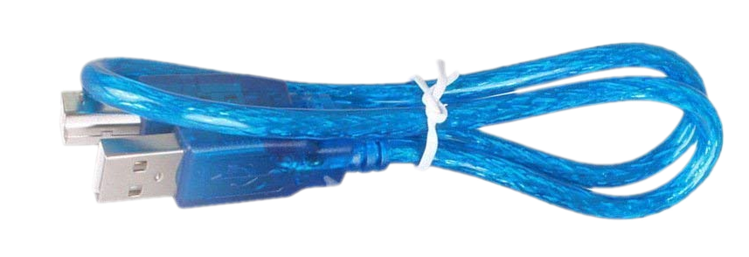
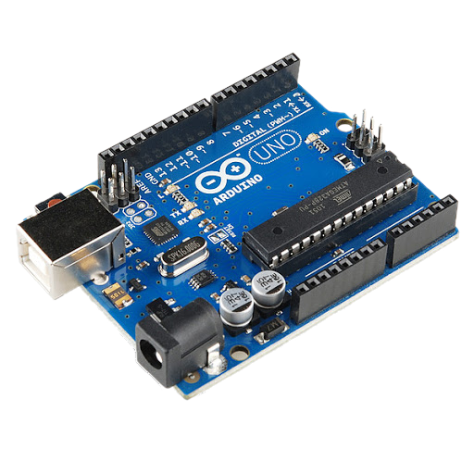
ACTIVITY: UPLOADING SKETCHES
Materials
Arduino Uno
USB Cable
Arduino IDE
Setup
Plug in your Arduino via USB
Open Arduino IDE
Notes:
Plug in your Arduino Uno using the included USB cable, and open the Arduino IDE.

Slide 9
CONNECTING ARDUINO
Please open Arduino IDE as the first step.
Under File, then Preferences, enable these two options
Line numbers: For quick referencing
Code folding: Collapse sections of code
Notes:
Before proceeding, please enable both line numbers and code folding for your Arduino IDE interface. Click the File menu in the top left corner and select Preferences. Within preferences, make sure display line numbers and enable cold folding are checked.
Line numbers make navigation through code much easier by letting you use numbers to reference different pieces of code. This is useful when working with others or simply remembering where events take place.
Code folding allows you to collapse sections of code that you no longer need to view. This will free up space in your IDE while also preventing you from making accidental changes to code that is finalized. If you fold your code by clicking on the minimize button next to the line numbers, you will notice that the line numbers are still intact and does not become offset by collapse code.

Slide 10
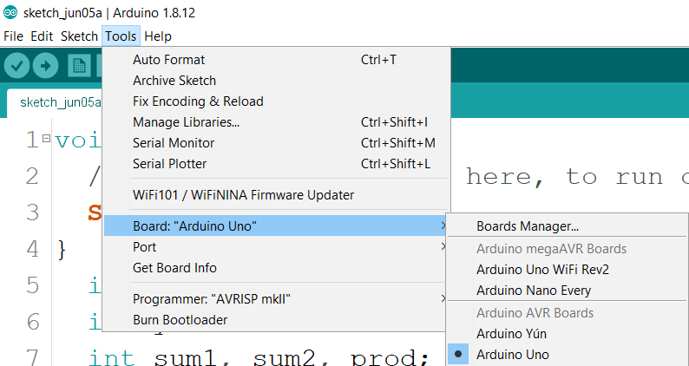
CONNECTING ARDUINO
Notes:
Ensure that your Arduino is connected to your computer by navigating to the Tools menu, then down to Board, and make sure Arduino Uno is selected in the list.

Slide 11
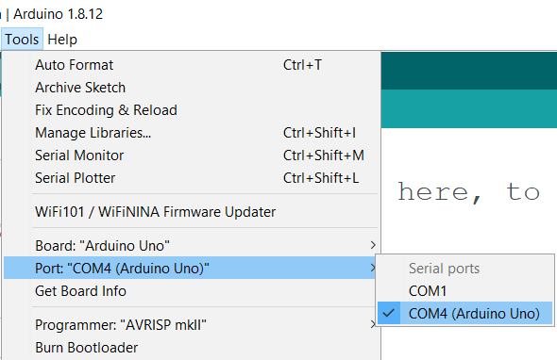
CONNECTING ARDUINO
Windows
COM__ (Arduino Uno)
Mac
/dev/tty.usbserial____
/dev/tty.usbmodem____
Linux
/dev/_____
/dev/usb____
Notes:
Next, click Tools again and select the Port menu. Here you will need to select your Arduino device.
On Windows, you will see the Arduino Uno name in parentheses if it is properly connected. On other platforms, you may see several options to choose from.
To identify your device, disconnect your Arduino Uno from the USB port. Go back into the Tools menu, then go to Port, and make note of the available choices there.
Back out of the menu and plug in your Arduino Uno again. Go back to the Port menu and select the newest device on the list. This will be your Arduino Uno.

Slide 12
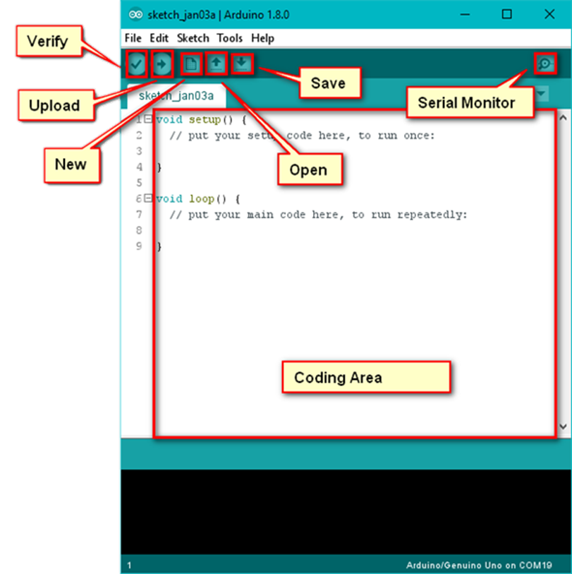
ARDUINO IDE
Verify
Error check only
Upload
Send code to Arduino
Code runs on completion
Serial Monitor
Window for viewing output from Arduino
Console
View status when verifying and uploading
General error messages
Notes:
The Arduino IDE, which stands for integrated environment, is the development suite that you will use to write code for your control system. Arduino IDE is not the only option for coding these systems, but it a simple all in one solution for learning to work with Arduinos.
On the top left corner we have the check mark button called verify, which will check your code for any errors.
Next to that is the upload button which has an arrow on it. When you have written some code and are ready to see how it works on your device, you can click this button to begin the upload process. This feature will first check for any errors in your code. If your code is good to go, it will be uploaded to your microcontroller’s memory and begin running the program immediately.
In the top right we have the serial monitor, which we will go into a little bit later in the slides. The serial monitor is meant for viewing text and is useful for viewing what your device is doing behind the scenes.
At the bottom of the coding window, we have the console, which is the area where important messages about your programs as well as errors will appear for you to view.

Slide 13
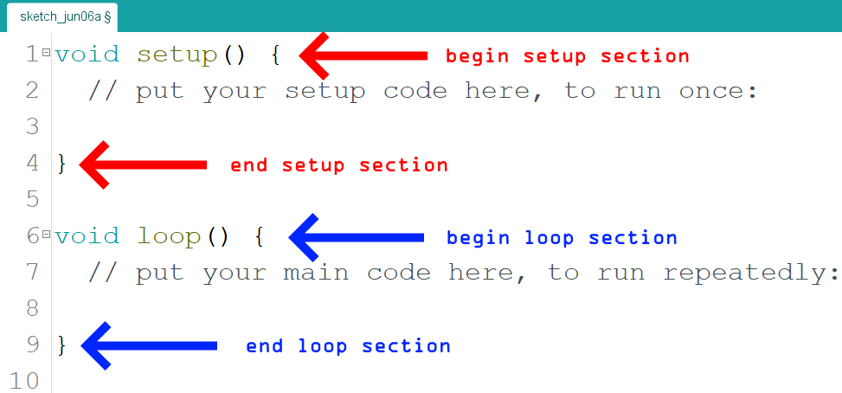
ARDUINO SKETCHES
void setup()
Code that runs before the main program, preparation steps
void loop()
Main section of the program
Runs repeatedly until power loss
Curly braces “hug” blocks of
code. Remember to work inside of them*
Notes:
When viewing this image, I want you to notice the curly braces next to setup() and loop(). These curly braces wrap your code and indicate what is called a code block. The opening brace begins the code block, and the closing brace ends it. When learning to code, try to keep your code within these curly braces. There are exceptions you can learn about later, but in the beginning recognize that there will be errors if you type in between blocks.
Anything that happens within a block, for the most part, is not visible within other blocks. When you are coding, the things you do in setup are not accessible in loop, for example.
Notice within the code window you will see double slashes followed by some descriptive text. The // command is the single line comment command. When using double slashes, the rest of the line will be formatted for commenting. This is an important part of helping not only yourself remember what you have done but also others who may pick up where you left off. Get in the habit of providing code, and view the other examples within these slides as a reference to know how to do it.
The setup method, which is made up of the code block is the method that always runs once before your main program begins. The setup method runs once and is indicated in the code comment inside of the curly braces. This is a preparatory step that runs to make sure your device is ready to do what it needs to do.
Once the setup method is complete, it proceeds down to the next section of code, which is loop. Loop does exactly what it sounds like: it runs in a continuous loop over and over. Your code will be designed to take advantage of the fact that microcontrollers want to run a single program on repeat as long as they can, until power is lost. Since we will be working with high-altitude balloons that will be out of reach for 3 hours during their journey, we want the control systems onboard to gather as much data as possible without needing to be intervened with.
These two methods are the foundation of coding with Arduinos and are the default methods when creating new files.

Slide 14
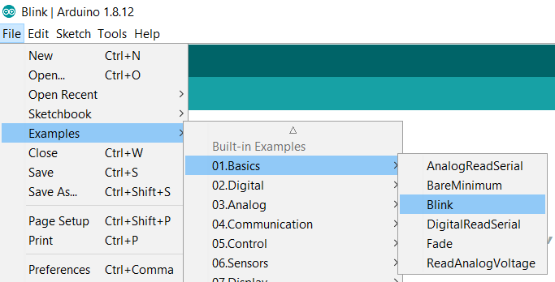
ACTIVITY: UPLOADING SKETCHES
Open the File menu, scroll down to Examples, then 01.Basics, then select Blink.
Examples
Premade sketches that demo Arduino’s abilities
Useful when learning how to code
Module manufacturers will have examples, which we will discuss later
Notes:
We are now going to go through the process of uploading your first sketch (program) to your Arduino Uno using Arduino IDE. Please open the file menu, and drop down to examples, then click on Blink.
You should be prompted with a sketch filled with a bunch of text. At the top of the Blink sketch you will see a wall of grey text. This is part of a comment block. Just as you can have code blocks, you can have comment blocks, and they are useful when needing to write large sections of comments within your code files. It is a programming standard to have a section at the top of your code that includes things such as the code author, program name, description of what it does, detailed descriptions of how it works or how to set it up, the changelog, and some useful links for the user. The commenting within Arduino examples are a good way to learn how your code should be properly commented.
A quick note on examples: this section is loaded with code demos of the various things you can do with your Arduinos. Examples are some of the commonly used or most useful tools you can reference when learning to design your programs. When buying sensors that you will use for your payload, they will come with something called a library. Libraries are premade software packages by the manufacturer that you must include into your projects to utilize their functions. Libraries will include the commands (sometimes called functions or methods) needed to request data from your sensors as well as other features.
When a library is installed, it will almost always include some example files that demonstrate how to call upon these methods in your own code. They will show up in this menu and are a great way to learn how to use your devices.

Slide 15
Notes:
This example is a good way to get introduced into how the coding process works. You can see that our setup and loop methods are here again, except they now have some instructions written in each of them.
Starting from setup, recall that we identified this method as being a block that runs once before the main program, and is a preparatory step to setup the device. The comments will guide you in understanding exactly what is happening here so read them first.
When using your Arduinos, the pins can either receive information as input, or send out information as output. You must set the mode of each pin you want to use to be either input or output before you can use them. In this example, the pinMode command is being used to do this. Next to the pinMode command is a set of parentheses with some words in them, separated by a comma.
When invoking (using, calling) a command such as pinMode, they will sometimes require information that is necessary for them to work properly. These pieces of information are called arguments. In this command, pinMode has two requirements for arguments in order to work. Order matters when including arguments. The first argument must be the target pin, and the second one will be the desired pin state(INPUT/OUTPUT). If you visit Arduino.cc they have a documentation library full of information on how to use each command, and this is how you will find what each one does or requires to work. pinMode in this case will prepare the LED_BUILTIN pin to be used as an output.
As you can see by glancing at each line of code, they are all ended with a semicolon. This is the termination symbol, which tells the compiler that you are finished with the statement. Compilers need to know when you are done with an instruction, so always remember that each command you use will need to be ended with a semicolon.
In the loop method, we see 4 commands. Now that you have used the pinMode to prepare your pin for output, you can now use the write functions within Arduino. digitalWrite is a command that also requires two arguments and is used to send power in a state of HIGH, which is the Arduino term for ON, or LOW, which is the term for OFF. In this statement, digitalWrite is telling the LED_BUILTIN pin to turn on.
The next line uses the delay method, which has a single argument. Delay will pause the code and delay the next action from taking place for an amount of time in milliseconds. Viewing the comment to the right of this statement you can see that this method is delaying the program by one second, which is also 1000 milliseconds. Once the timer is complete, the next line of code executes.
In the last two steps, we see that the process is repeated, except the digitalWrite command turns the LED_BUILTIN pin off, or LOW. Delay is once again called upon and we have reached the end of the block.
Loop is designed to continue over and over until power is lost, so after the last statement in loop is executed, it will move back to the top of the block and repeat the statements over again. By now you have probably deduced that this program will continuously blink an LED at one second intervals, and this is true!

Slide 16
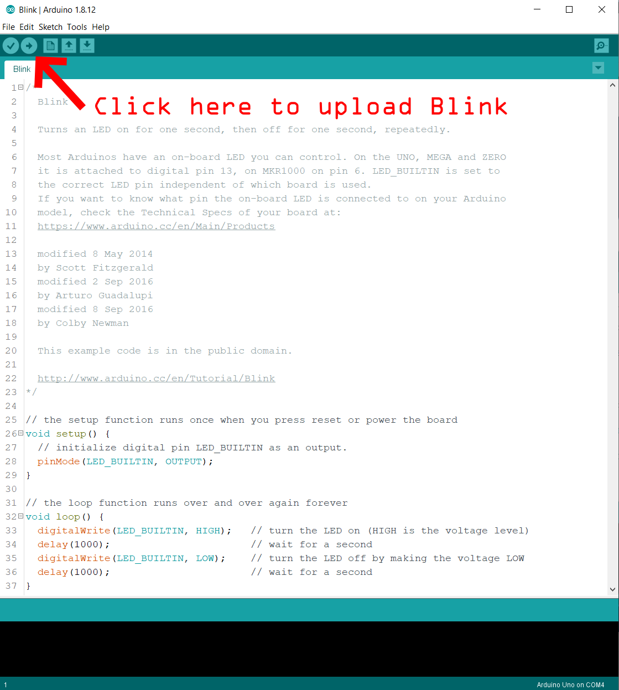
ACTIVITY: UPLOADING SKETCHES
Compilers translate your written code to a language that is better suited for its destination.
Arduino programming language is a simplification of C/C++
Notes:
When you are ready to see the result, click the upload button in the top bar to see your code upload, compile, and be sent to your Arduino Uno.
When your code is being processed to be sent to the microcontroller, it is being “compiled” by the compiler. Compilers translate code that is easy for humans to understand into a language that is easier for machines to understand, such as binary. This makes our lives easier by letting us program in high-level languages instead of learning how to read zeros and ones in series.
Arduino uses a simplified version of C and C++, while including its own unique methods and utilities specially for working with these devices. Many of the things you can do in either language you can do in the Arduino language, but you must be aware that these devices have a very limited amount of storage space for programs, and an even more limited amount of RAM available. To give you an idea of this, the ATMEGA328p microcontroller on your Uno board has 32Kb of storage space for programs with 2Kb of RAM available. This is so small that some commands or data types can be incredibly expensive in using available space. We will go over this in the next workshop a bit during data management.
Once your code has uploaded, you will notice that the orange LED on your board blinking at one second intervals. Congratulations on uploading your first sketch and interpreting your first program.

Slide 17
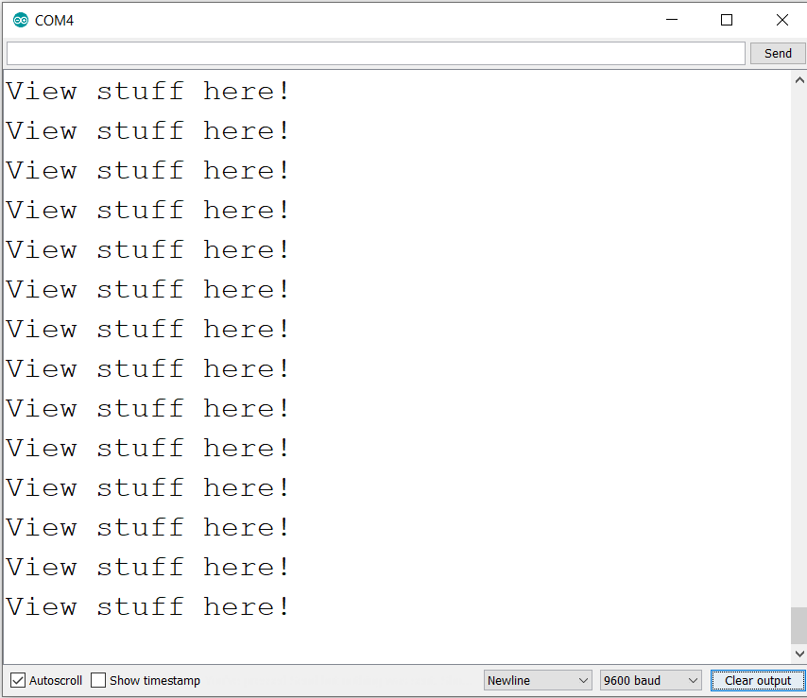
CODING: SERIAL MONITOR
Serial Monitor
Used for printing text, viewing outputs, etc
Must include Serial.begin(9600); to use
Notes:
Earlier the serial monitor was briefly mentioned. This is the window that will allow you to view text prints that hold information about your device. Within your code, you will have to create these print statements as needed to view the current state of some values such as sensor readings, number of iterations, time, and more.
Make note of the image on the left. Notice a few things about this image:
This is a statement that is required to use the serial monitor. It belongs in setup and must be included or else all print commands will run but they won’t show up in the serial monitor. If you are ever going to need to view output from the device through prints, you must include this statement within the setup method.
This statement has a capital S in Serial. In most programming languages, their method of calling upon commands or using variables is case sensitive, meaning that they are sensitive to the way you type things based on upper- or lower-case usage. For example, if you were to type serial.begin(9600); the compiler would have no idea what you are referencing. This is because the S and s are two completely different things in the world of programming, as are all other letters and symbols. Respect the casing of statements as you will encounter errors if you don’t.
The 9600 is a number that you should use as a default. Don’t worry too much about it, just know that it is standard in the Arduino community to keep it at 9600. If you are interested in knowing, this is what is called a baud rate, which is like a transfer rate of communication. Some devices use higher baud rates to transmit more information in a shorter time frame, while others do not. For now, keep this setting at 9600.

Slide 18
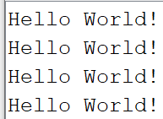
CODING: PRINTING TEXT
Serial.println
Serial.print
Notes:
To print to the serial monitor, you will be using the commands println and print.
When using these commands, you will begin by including Serial at the beginning of the statement. This is telling the compiler that you are attempting to access a method within the Serial library, which is meant for sending information to the serial monitor. You use the dot accessor indicated by the period symbol to use some of the tools that the Serial library has. By calling the command through Serial, you can now use it. The argument for print or println is going to be either text you want to print to the serial monitor, which should be enclosed in double quotes, or you can simply put a piece of data in there such as a variable or number (we will get to variables in the next slides).
Println and print are quite similar except for one important difference. When calling on println, which stands for print line, this command will print the argument within parentheses and then move the cursor to the next line before moving to the next command. This means that the next print will begin on the next line. Print differs in that it does not move to the next line but leaves the cursor in position immediately after the past print. This means that there is no space inserted for you, so you must be mindful when using this. View both previews to get a better understanding.
Combining both print and println statements give you full control of your printing abilities, which will come in handy when you print to SD card files instead of the serial. You can use print to create a label such as “temperature: “, and the next print can be the information you are trying to view, making things easier to read and keeping things organized.

Slide 19
EXAMPLE: PRINTING TEXT
FOR REFERENCE
PRINTING.INO
printing.ino
Learn to use the serial monitor
Print vs println
Formatting tips
Notes:
This file will demonstrate two forms of looping: the for loop and the while loop. Within this program, a timer will keep track of both the system uptime as well as the time to complete each loop. The time in milliseconds will be displayed in the serial monitor, along with the output from each loop.

Slide 20
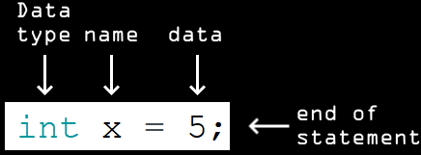
CODING: STORING DATA
Variable
Holds data of a specified type in memory
Syntax
Proper structure and usage of language
Statement
A step in the list of coded instructions
Ends with a semicolon
Notes:
The most important part of using a control system will be to collect data about the atmosphere. When your connected devices are ready to gather a reading, the information must go somewhere to be handled by the microcontroller. The process of handling data begins with creating data of the proper type to store and pass this information onto a storage device.
When working with data, you must create what are called variables, which you can think of just like variables in algebra. When working with an equation such as 5 = x + 3, we can solve for x to find that x = 2. You can now refer to x in other equations knowing that it holds the value of 2.
This is also true in programming, except you can create variables with custom names such as myNumber or count. There are many data types available to use for specific situations. When creating variables, the programming language requires you to use proper syntax, which is the appropriate form for communicating with the compiler. The syntax for creating a variable is seen in the image. Let’s break it down:
You will start by declaring the type of information you want to store. In the next slide we will go over the most common data types, but you will need to declare the appropriate data type for what you are trying to store. In this case, we will be creating an integer (whole number) variable called x, and we will be giving it value using the assignment operator =, followed by the value or data that you want to store. As usual, you end this statement with a semicolon.

Slide 21
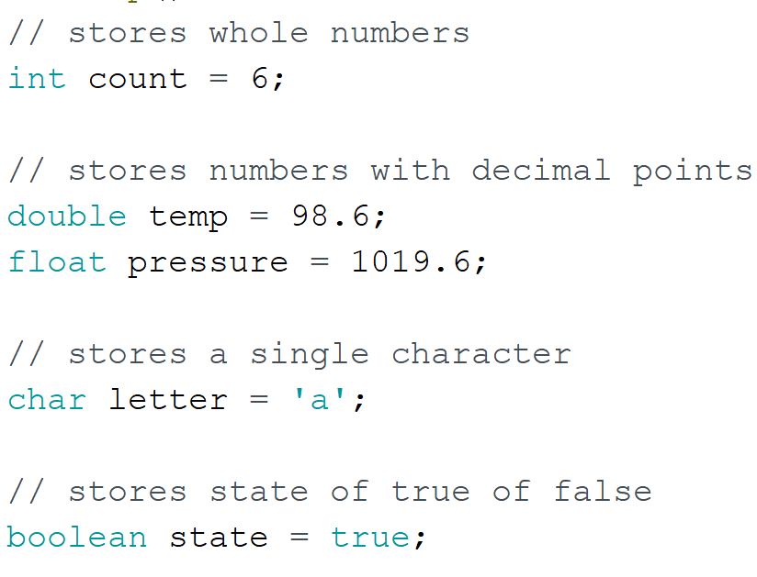
CODING: COMMON DATA TYPES
Notes:
This image shows some of the common data types that you will work with. There are more data types than this, but these are proven the be the least expensive when consuming your Arduino’s program storage and RAM.
At the top we declare an integer called count, which will be assigned the value of six. Recall that integers only store whole numbers.
Both a double and a float are declared, and their purposes are to store data that include fractions of numbers. In Arduino, doubles and floats are the exact same thing and take of the same amount of space, so choose one you would like to work with. In other languages this is not the case, but feel free to pick one based on preference in this context.
Char, short for character, store letters, symbols, or numbers.
Booleans are the foundation of computer logic. A Boolean is a data type that stores either true or false and allows you to execute commands based on conditions. If is an incredibly important part of programming and we will address it in detail coming up.

Slide 22
EXAMPLE: DATA OPERATIONS
FOR REFERENCE
DATAOPS.INO
dataOps.ino
Work with creating variables
Calculations using variables
Shorthand tricks for working number
Print formatting and working with data types
Notes:
This file will demonstrate two forms of looping: the for loop and the while loop. Within this program, a timer will keep track of both the system uptime as well as the time to complete each loop. The time in milliseconds will be displayed in the serial monitor, along with the output from each loop.

Slide 23
ACTIVITY: DATA AND PRINTING
Create new file, save as workshop.ino
DIY data ops and printing
Use other sketches for reference
Notes:
As a quick exercise, view the previously mentioned sketches as a reference and begin doing some of your own coding. Create some variables, do some calculations, and print to the serial monitor.

Slide 24
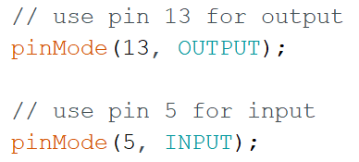
CODING: PIN MODES
pinMode()
Requires target pin and state as arguments
Send (OUTPUT)
Receive (INPUT)
Required to use digital pins
Use in setup
Allows digital and analog read/write options
Notes:
You were introduced to the pinMode() earlier in the slides when interpreting the steps of the Blink example. Recall that pinMode is required to use pins within your programs. Once you have set a pin’s state and it is ready for use, you will have access to functions within the pin family for working with other components.

Slide 25
CODING: PIN FUNCTIONS
digitalWrite()
Send output
HIGH = ON
LOW = OFF
Send power to something (40mA max)
digitalRead()
Read input
Read HIGH/LOW
Check if something is on
Notes:
There are two commands for working with digital signals: digitalWrite() and digitalRead().
digitalWrite() requires two arguments as seen earlier and will output a HIGH or LOW signal (recall this means ON or OFF). This is useful when implemented to send power to an LED or in some cases to power a device on under specific conditions. Keep in mind that if you use a digital pin as a source of power, the device cannot draw more current than 40mA.
digitalRead() will check the pin included in its argument to gather input that may be going through it. This is useful if you need to know whether something is powered on.

Slide 26
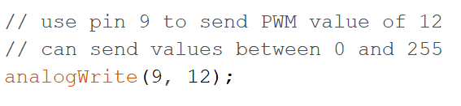
CODING: PIN FUNCTIONS
analogWrite()
Output a PWM signal
Value between 0-255
PWM is digital recreation of analog signals
analogRead()
Read analog input
Value between 0-1023
Required to read analog sensors/voltage
Notes:
analogWrite and analogRead are two methods of the pin family that are for analog signals.
analogWrite is something you won’t be using much for now, but it allows a digital device to recreate an analog signal using pulse-width modulation, or PWM. Since digital communications are output using square waves (ON or OFF), it is difficult to recreate the natural form of an analog signal. The only option is using PWM to send a signal that can be interpreted as analog. This is possible by controlling the width of these pulses.
analogRead will be something you will use when taking readings from analog sensors. This command is specifically for the analog pin section. Notice in the image on the bottom that the analogRead method is reading pin 0 and is assigning the value of that reading to the posPosition variable. When reading from pins, you must store the information somewhere, since they are returning data.

Slide 27
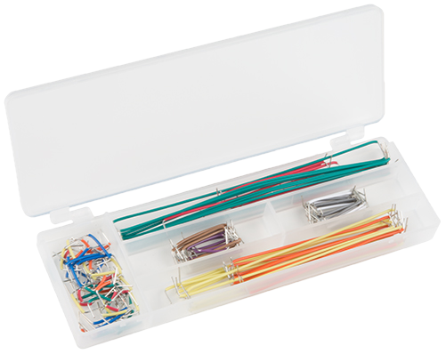
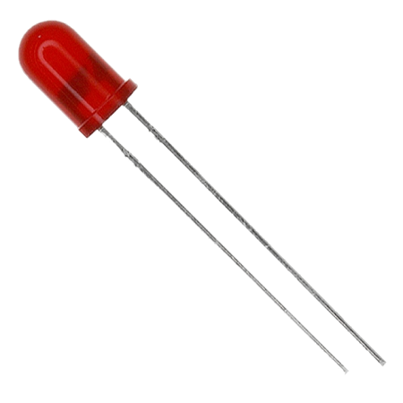
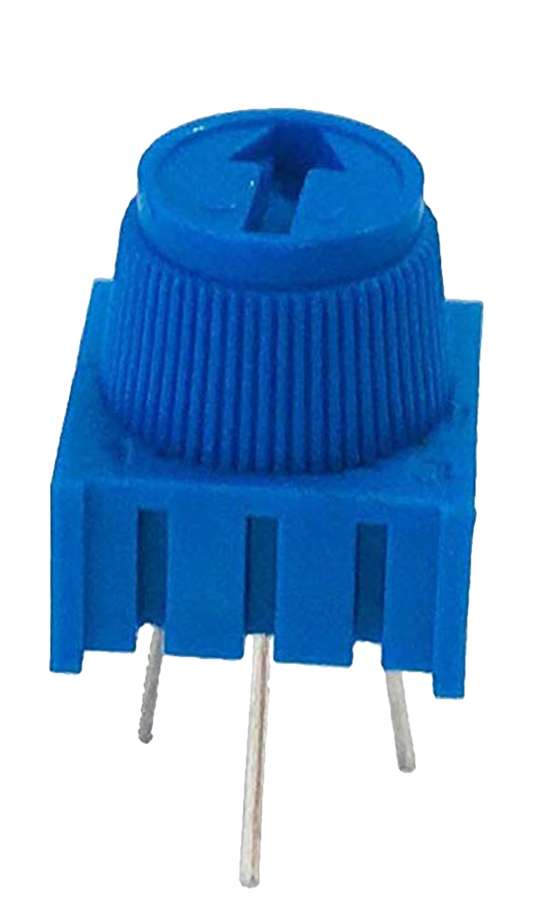
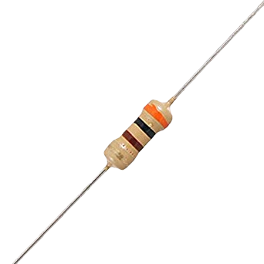
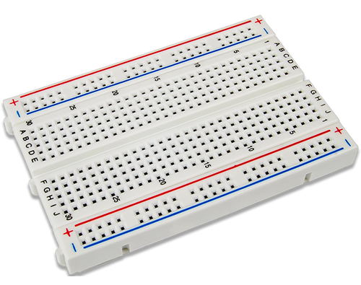
ACTIVITY: POTENTIOMETER LED
Structure
VOUT voltage goes into analog pin A0
potPosition will store the voltage value as a number
potPosition will control the blink interval
LED will blink on and off based on potPosition
Creating and storing data, analogRead, delay, digitalWrite,
Notes:
For the next activity, you will assemble a circuit that will show you components in a circuit can be controlled using code. You will need the items on screen before you continue.
View the structure of the code before proceeding, as it will help you piece together the steps you will review within the code example.

Slide 28
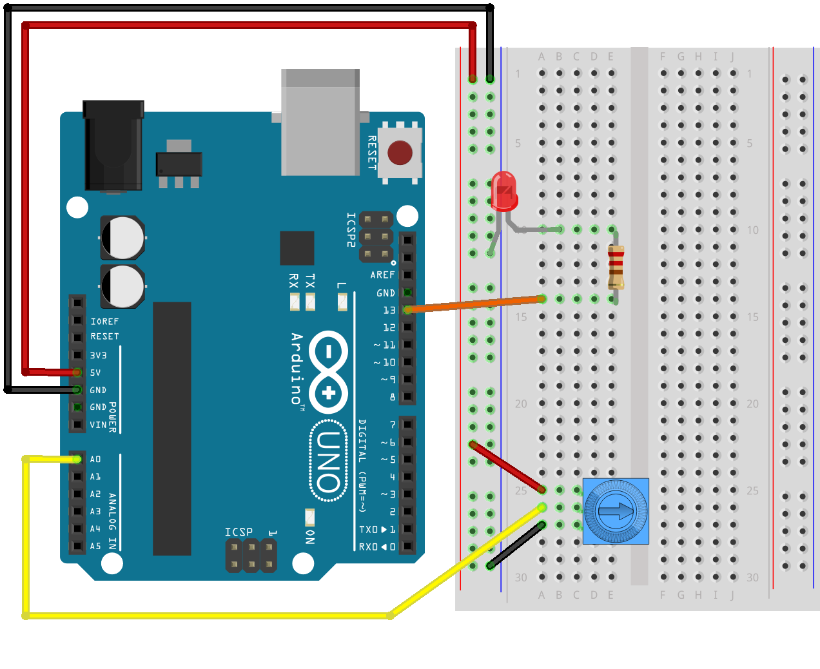
Notes:
Make these connections with your Arduino and breadboard before proceeding. It is recommended to use a 220 Ohm resistor for a bright LED.

Slide 29
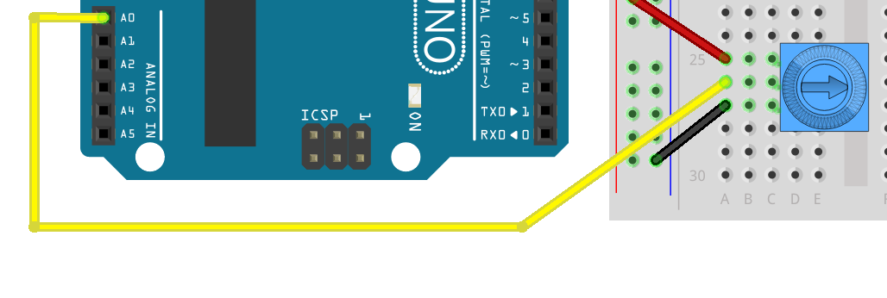
Notes:
Recall from the circuits workshop that the potentiometer is a variable resistor. It takes a power input on VIN or pin 1 (red wire), and the knob controls the amount of resistance the voltage is subjected to.
The new voltage is output on the VOUT pin which is the middle pin, which will be directed into the analog input A0 on the analog header. This means that the voltage reading will change if the knob is turned, providing different values depending on the potentiometer’s position.

Slide 30
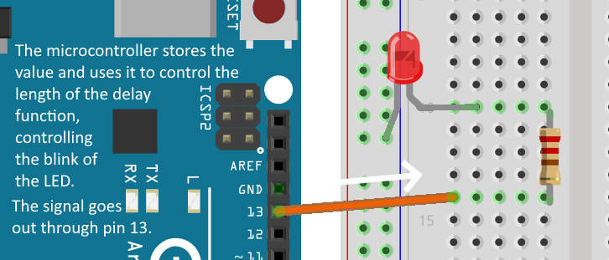
Notes:
The next step takes the reading from pin A0 and stores it within a variable. This variable will be used as the argument that controls the delay function as the program continually turns an LED on and off.

Slide 31
EXAMPLE: POTENTIOMETER
FOR REFERENCE
POTENTIOMETER.INO
potentiometer.ino
Reading voltage from an analog source
Storing the reading in a variable
Using the changing value to control a circuit
Uses analogRead(), digitalWrite, delay
Notes:
This file will demonstrate two forms of looping: the for loop and the while loop. Within this program, a timer will keep track of both the system uptime as well as the time to complete each loop. The time in milliseconds will be displayed in the serial monitor, along with the output from each loop.

Slide 32
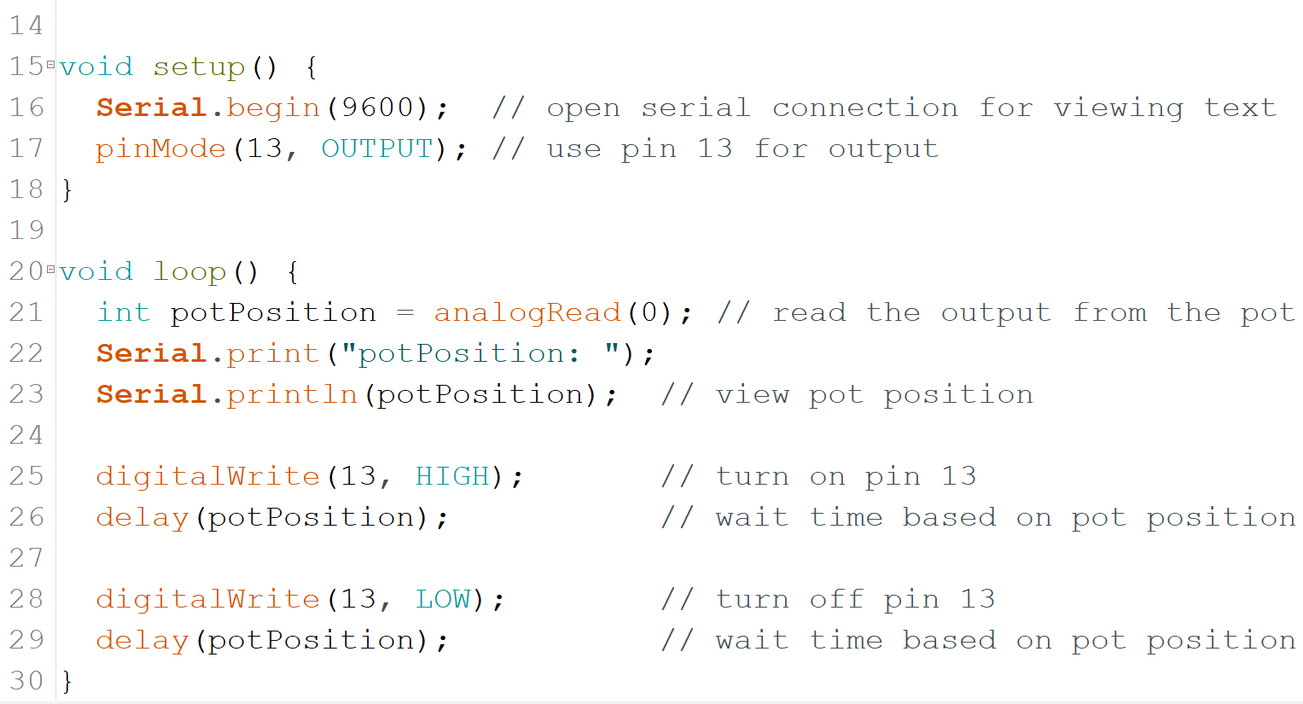
Notes:
This is a simple sketch that looks a lot like the Blink example. It is a simple modification that incorporates readings from an external source to control the blink rate of an LED.
The first step is to prepare the serial monitor for printing and to set pin 13 as an output, which will source the power for the flashing LED.
Within loop, the first step is to read the value coming out of the potentiometer. This value is stored at the beginning of each iteration and changes based on the position of the potentiometer knob.
The next steps print the value stored in potPosition to the serial monitor.
The remaining steps are just like blink, expect this time the delay method’s argument is not a fixed amount of time. The amount of time to delay the program is dependent on the position of the potentiometer.

Slide 33
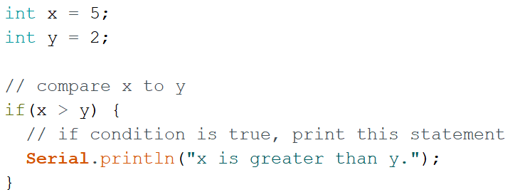
CODING: LOGIC
Logic
Set conditions to be met before doing something
Skipped if not met
if statements
Block triggers if condition is met
if/else
First block triggers if condition is met
Other block triggers if condition is not met
Notes:
Logic introduces a very powerful aspect of working with circuits. Logic in computer science is the ability for a program to make decisions based on quantifiable conditions. Using the Boolean state of true or false as well as comparison operators, the programs you write can be made to operate autonomously and handle all situations based on conditions.
To use the most basic form of checking conditions, we use the if statement. An if statement is first introduced with the keyword if, followed by an argument which is the condition that must be met. Notice that there are a pair of curly braces enclosing a block of code after the if statement in the top image. This is the block of code that will execute when condition within the if argument is met.
Returning to the condition, the if statement will check if x is greater than y. Looking at their values above, we see that x = 5 and y = 2, meaning x > y is a true statement. Now that the condition has been met the statement within the curly braces executes.
If a condition is not met in a single if statement, the block is skipped entirely. There are going to be situations where you will need to do something because a condition is not met, and this is where expanded forms of the if statement come in.
Using the else block allows you to join two blocks into one statement, where only one of the blocks will execute based on the condition. Viewing the image on the bottom, you will see that we have changed the operator to compare if x is less than y.
After the last curly brace of the if statement, you will notice an else keyword, followed by another block wrapped in curly braces. The else keyword means that if anything else besides the initial condition is true (in this case, x and y could be equal, or x could be greater than y) than the else condition will trigger. This gives you the option of having something happen as a result of a failed condition.
There are other forms of logic such as if else/if, switch cases, and a few others so if you are interested please take some time to view Arduino documentation or follow some logic tutorials.

Slide 34
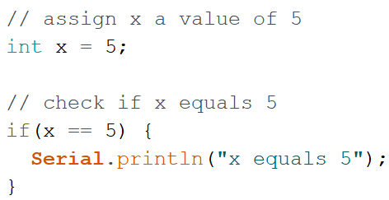
CODING: COMPARISON OPERATORS
== and =
Two different things!
== is for logic and checks if two things are equal
= is the assignment operator, gives value
>= <= > and <
Comparison operators
Notes:
You have just seen a simple comparison operator used as part of a conditional statement. There are a handful of comparison operators that you can reference when using logic.
One thing that needs to be made clear is that == and = are two very different things. == is a comparison operator that checks if two values are equal. As seen in the bottom of the image, the if statement is checking to see if the value of x is equal to 5, which is true, so the block of code will execute.
Above that is the statement declaring a variable that equals 5, using the assignment operator, which is the = sign.
If I were to try and use a statement such as: if(x = 5), the compiler would think I am trying to assign a value in the middle of a logic statement, which won’t work.
Finally, we have your standard comparison operators. Follow their structure as seen in the slide, where the main operand precedes the equal sign when using greater/less than or equal to comparisons.

Slide 35
EXAMPLE: LOGIC
FOR REFERENCE
LOGIC.INO
logic.ino
Review the structure of if statements
View the other forms such as if/else and if/else if
View comparison operators within conditions
View AND, OR, and NOT syntax
Notes:
View the logic.ino file if you would like to see more logic operations in detail.

Slide 36
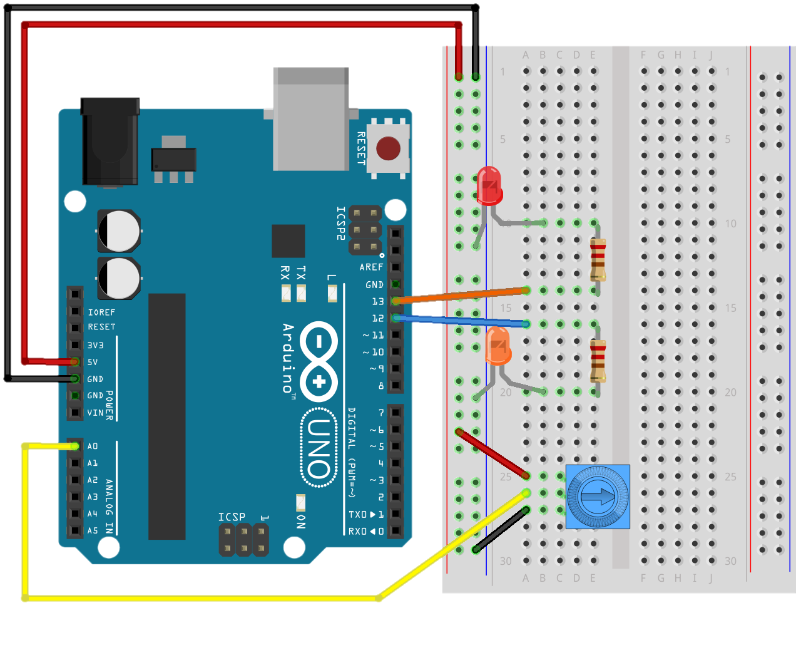
ACTIVITY: POT LOGIC
Modify previous activity
Add another LED using pin 12
Set pinMode for pin 12 as an output
Create boolean variable
Create logic statements to check pot value
Turn either LED on based on value
Print boolean variable
Notes:
The next activity will modify the potentiometer.ino file to add another LED and include some logic into your code. You can go ahead and do this yourself or use the file I have included called potLogic.ino, which has already made the edits for you.

Slide 37
Notes:
Simply add an LED using a wire, a resistor (220 Ohm recommended) and an LED of any color.

Slide 38
EXAMPLE: POT LOGIC
FOR REFERENCE
POTLOGIC.INO
potLogic.ino
Demonstrates using Boolean logic to control circuits
Modification of the potentiometer file
Prints the state of the potentiometer as true/false
Notes:
This file will demonstrate two forms of looping: the for loop and the while loop. Within this program, a timer will keep track of both the system uptime as well as the time to complete each loop. The time in milliseconds will be displayed in the serial monitor, along with the output from each loop.

Slide 39
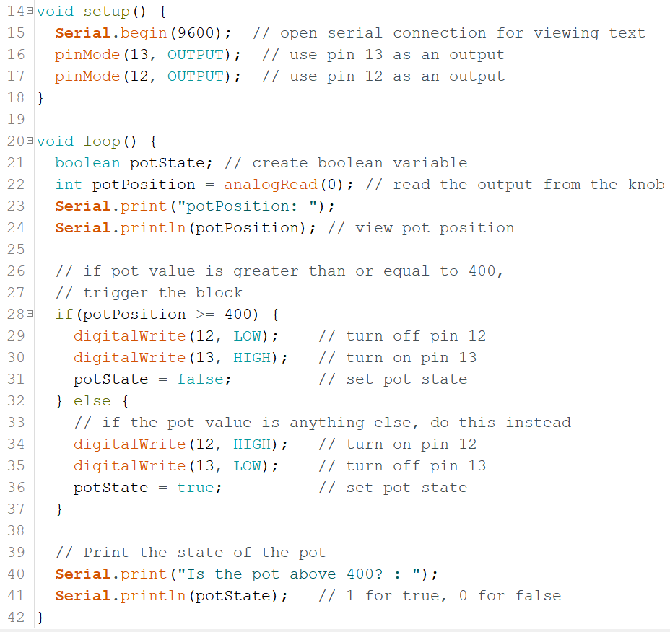
Notes:
This code adds a few simple steps that include logic into the program. Changes made include the pinMode command being invoked to add the new LED as an output, and a potState variable has been created to store a true or false value. Below that you will see an if/else statement with blocks that do almost the same thing, except they turn on opposite LEDs and have different settings for pot state. The condition checks the value coming from the potentiometer and triggers one of the blocks depending on the position. Finally, the serial monitor will display if the value of the pot is above 400. When printing a Boolean, you will notice that it prints a 1 for true, and 0 for false.

Slide 40
CODING: LOOPS
Using for loops
Code to execute a block a specified number of times
Starts at a number, runs block of code, increments, check condition
Number increments until condition is met, then move on
Notes:
This slide will mention the most used loop in the programming world: the for loop.
Looping in programs is an important tool when you need to execute code a finite number of times. This number may be unknown to you as well, and a condition will be checked continuously to decide on the number of iterations.
The structure of a for loop is a series of statements as the argument, followed by a block of code.
You will begin a for loop with the for keyword, followed by some parentheses. The setup for the loop within the argument is: starting variable value, looping (or break) condition, and increment size.
The starting value is where the loop will begin, in this case the integer i is created within the argument to start at 0. You will see the variable i a lot when working with loops, so you can think of this as being short for the word iteration. After the variable statement is terminated with a semicolon, the next part is the looping condition, which is checked each time the loop has completed an iteration. The last piece is the increment size. This is indicated by the ++ command, which is a shorthand way to increment a variable by 1. You can use any size increment you want depending on the situation. Viewing the code block within the loop, it will print the value of i until the condition is met.
In summary, this loop will start at 0, and execute the code block multiple times, incrementing by 1 each time. This happens until i reaches the value of 10. Once i is 10, the loop will break move on with the program. View the loopsAndTime.ino file to see this in action.

Slide 41
EXAMPLE: LOOP AND TIME
FOR REFERENCE
LOOPSANDTIME.INO
loopsAndTime.ino
millis() is system uptime
Stores millis() at start and finish
Subtracts start from finish to get time between markers
Both for loop and while loop demonstrated
Notes:
This file will demonstrate two forms of looping: the for loop and the while loop. Within this program, a timer will keep track of both the system uptime as well as the time to complete each loop. The time in milliseconds will be displayed in the serial monitor, along with the output from each loop.

Slide 42
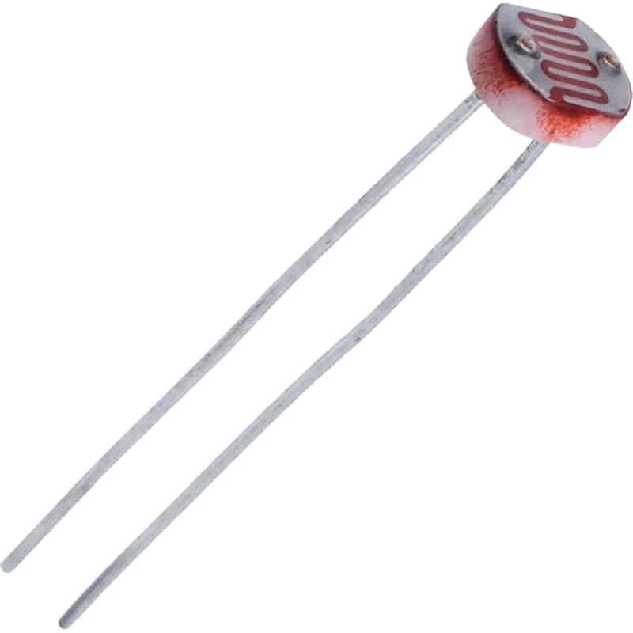
ANALOG SENSORS
Reactive materials that vary in resistance based on a characteristic
Light, vibration, sound, temperature, etc
Output will be voltage
Use formulas to convert into appropriate units
Notes:
These two sensors here will be the first part of our mini payload systems that we are going to build. On top we have the TMP36 thermistor, and next to that is a photoresistor or a photocell.
These analog devices contain reactive materials that increase or decrease resistance within themselves when exposed to specific characteristics. The TMP36 will vary in resistance based on temperature while the photocell will vary in resistance based on the amount of light it is receiving. This resistance variation will change the voltage that runs through it, and that change can be measured and translated into different units.
Your analog sensors here are similar to what your payload could utilize, although the real thing will require much more advance or robust sensors. These are a good starting point to learn how you take readings from analog devices, and reflect the types of connections and coding needed to use them in your system.

Slide 43
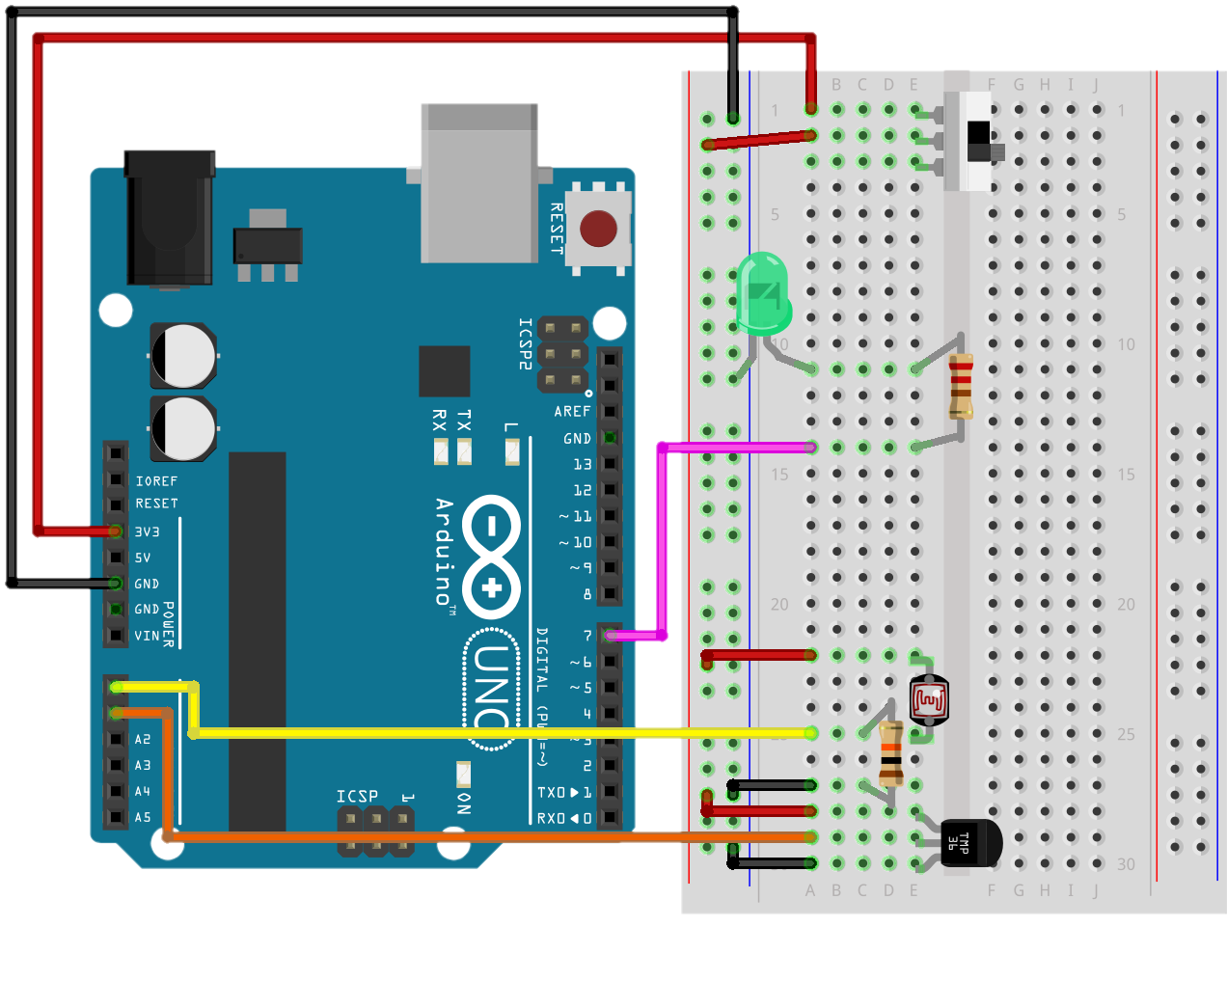
ACTIVITY: THERMO & PHOTOCELL
Using analog sensors
Indicate
Create an LED indicator for readings
Read two analog sensors and store their outputs
Print outputs to the serial monitor
Notes:
We will next build the first part of our weather station’s circuit. Using the analog sensors, a power switch, and an LED, you will make a circuit that reads two analog sensors. Follow the diagram on the next slide for a larger view.

Slide 44
Notes:
Please take note that the power rail has moved from the 5V source to 3.3V. Make the switch before continuing.
Also make note of the photocell and its connection. One leg receives power (red wire) and the other leg jumps to a new row. From here, you will notice a specific arrangement that is a bit different. This is a voltage divide setup and is required for this sensor to work. Follow this diagram exactly as it is to get the sensor to work.
The slide switch has been included to demonstrate a very basic way of cutting power to devices. Since these Arduinos will be powered by a USB cable, it is not possible to design a switch that will drop power to the entire system (at least not without risking damage). This has been included just as a tool to demonstrate using a switch to control a system’s connection to a power supply. If this switch is off, your readings will be unusual or unresponsive, so make sure it is set to on (top position).

Slide 45
EXAMPLE: THERMO & PHOTOCELL
FOR REFERENCE
THERMOPHOTOCELL.INO
thermoPhotocell.ino
Read data from analog sensors
Convert reading to different formats
Using for loops to create a flashing event indicator
Notes:
This file will demonstrate two forms of looping: the for loop and the while loop. Within this program, a timer will keep track of both the system uptime as well as the time to complete each loop. The time in milliseconds will be displayed in the serial monitor, along with the output from each loop.

Slide 46
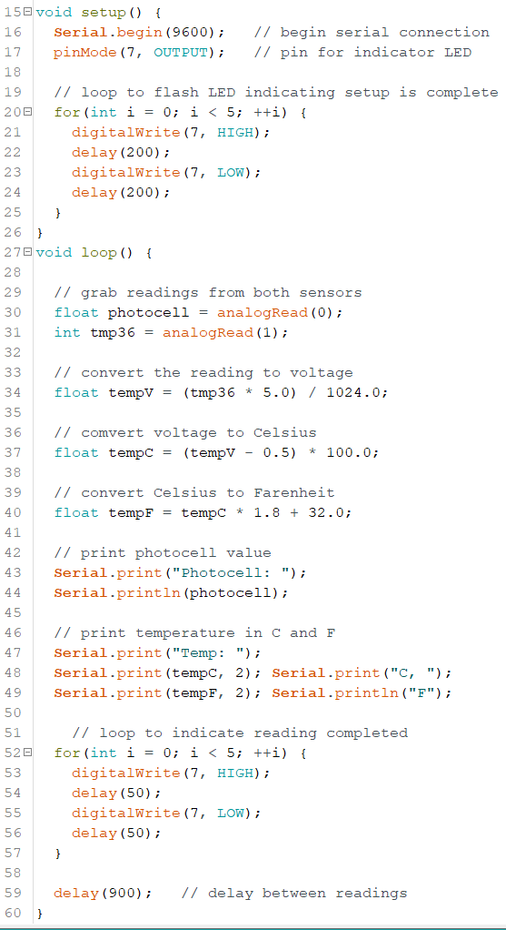
Notes:
This program begins with your standard statements to prepare the devices for operations, but you will notice something different this time: there is a for loop included at the end of setup.
When designing your payloads, it’s a good idea to create external indicators that will tell you things about your system and its operating state. Before the official launch, payloads must be turned on manually and you will have to ensure you can tell when the device is working. By using a for loop and some commands to flash an LED on and off, you can use blink intervals or specific LEDs to deliver messages. In this situation, the system will blink in a specific pattern when the system has initialized itself and is about to enter the main program.
Within the loop you will see that it begins by taking readings from the analog pins. This captures the current value of the connected analog sensors.
The next steps have come from what is called a datasheet, which provides the required formulas to convert this signal into temperature units. View some of the next slides to see more on datasheets.
The formulas convert from the reading into voltage units. The next conversion take voltage and converts it to Celsius, and finally the temperature is converted to Fahrenheit.
The next steps format the printing process to display in the serial monitor. This uses a combination of print and println to provide a cleanly formatted set of data points on screen.
The final step s a for loop that has a different blinking pattern to indicate the end of a reading. This will be useful when writing data, when you want to ensure your data has successfully been saved to the storage device. This blinking pattern is much faster and stands out from the initialization pattern, providing a clear message using the same LED.

Slide 47
EXTRA SLIDES

Slide 48
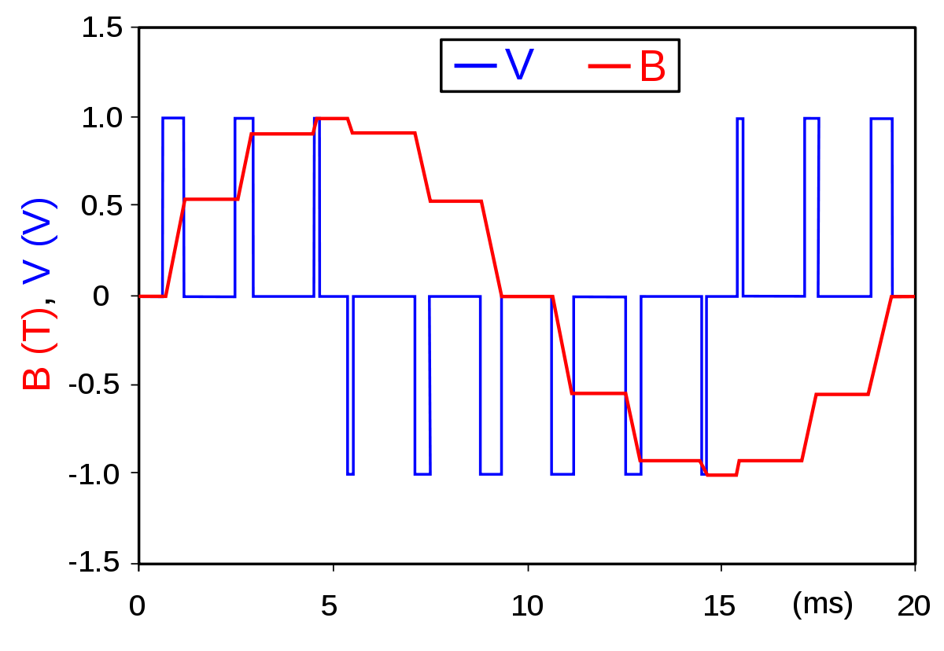
CODING: PWM SIGNAL
Notes:
This is an example of pulse-width modulation, or PWM. As you can see here, the blue lines are square waves, which are the form of communication that uses ON/OFF messages, or binary communication. The red line is the resulting waveform intended to emulate a sine wave. As you can see by the two charts, the width and polarity of the pulses controls the direction and height of the waveform edge.

Slide 49
CODING: LOGIC
AND &&
Block triggers if all conditions are met
OR ||
Block triggers if any condition is met
NOT !
Block triggers if condition is not met
Notes:
This is a bit of extra logic you can utilize in your programs. When working with conditions, you may want to have more than one condition be true (or not) in order to trigger a block of code. You may want one of many possibilities to trigger the block. You may even want to check only if something is not true.
These are all possibilities using AND, OR, and NOT. These operators are included within your arguments and act as partitions between conditions. The && indicates that both arguments on each side of the operand much be true to trigger the block. The double pipe || is the OR operator, and any of the conditions can be met to trigger the block. The exclamation point ! Is used to indicate the inverse of something. In this case, the if condition checks if testBool is not true, which is the inverse way of checking if something is false. These all increase the complexity of your decision-making programs and expand the potential for what your system can accomplish.

Slide 50
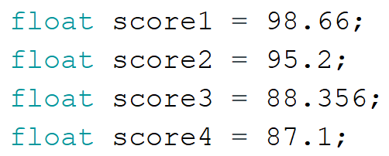
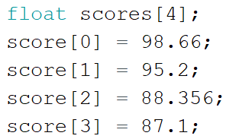
CODING 101: ARRAYS
Arrays consolidate data of the same type into an indexed object. Each element can be accessed by using the array name followed by the index within the brackets.
Notes:
Arrays are a great way to store multiple pieces of information of the same type. Instead of creating 20 integers with different names, I can create an array that contains 20 elements. Viewing the image above, you can see a few ways that these are created.
When creating arrays, you don’t have to assign values to them right away either. You can create an array and reserve the number of elements it contains, such as the image in the top right. The statement up top creates an array of floats reserving 4 positions for storing 4 floats. To access each position in the array, you include the number of the position within the brackets.
You can also initialize and array using the curly braces and inserting values separated by commas.
You may notice that the scores array started at 0, and ended at 3, but has 4 elements. View the next slide to get a better understanding of what is happening here.

Slide 51
CODING 101: ARRAYS
Notes:
This diagram should help explain the indexing situation with arrays. In most programming languages, arrays will start at 0. This convention goes back into some of the earliest days of modern computing, but has been widely adopted as the standard in high-level programming languages.
When referencing the nth object in an array, you will use an index of n-1 to access it within the code. For example, if I want to access the 3rd element in the scores array, I would use scores[2] to access it, since positions 0 and 1 make up the first two.
When using an element in an array, you can treat it just like a normal variable. By referencing its index, you are using the piece of data stored in that position. You can carry on wit using assignments and equations with an array.

