Slide 1
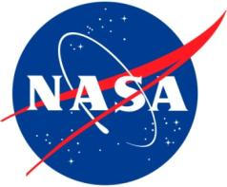
NASA Internships and Other Educational Opportunities
Kevin Newman
and
Kyle Stephens
January 18, 2012
Space Grant Brown Bag Lunch
Notes:
This presentation was created by Kyle Stephens (Intern 2008, Advisor 2009) and Kevin Newman (Intern 2007), both Arizona Space Grant alumni. The goal is to provide a brief introduction to some of the many student opportunities available from NASA and other space-related organizations, and to encourage students to pursue these and other extraordinary opportunities.

Slide 2
NASA USRP
Undergraduate Student Research Program
One of many different NASA internship programs
I participated in NASA USRP during the Summer of 2009
Spent the summer in the nice Alabama heat at Marshall Space Flight Center
Helped develop a space telescope cost model
Co-authored article in Optical Engineering
Notes:
Kyle
USRP Website: http://usrp.usra.edu/

Slide 3
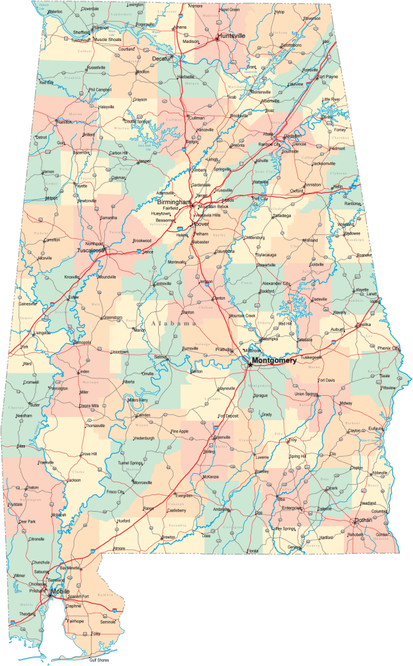
Huntsville, Alabama
“Rocket City”

Slide 4
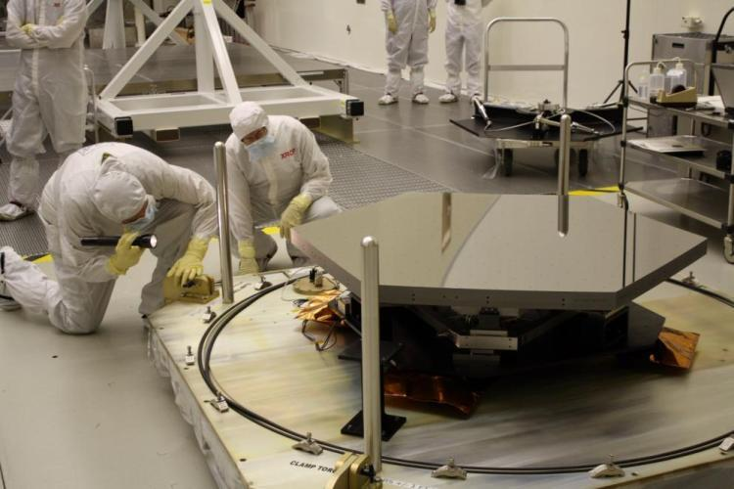
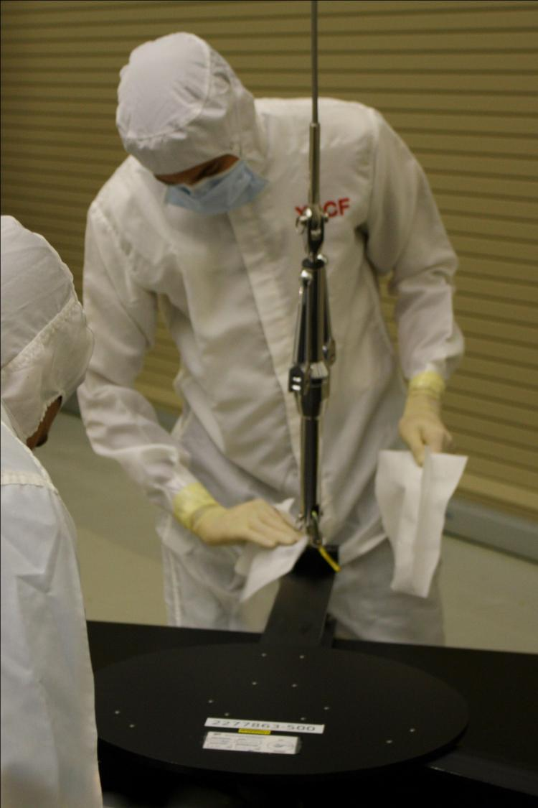
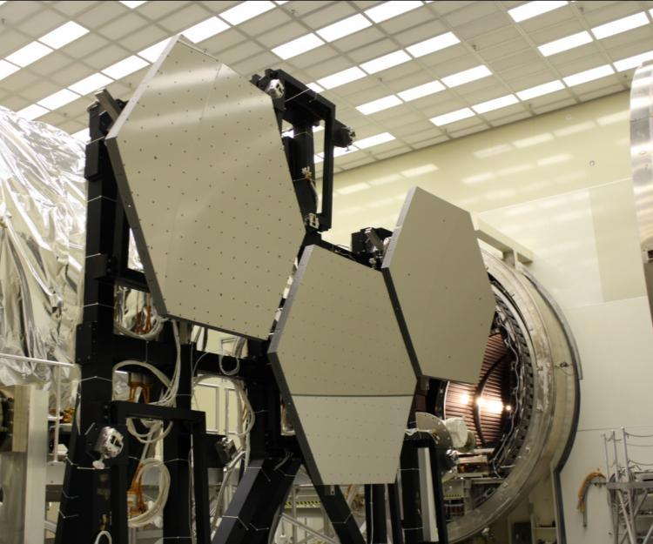
Notes:
As an intern, I was given the opportunity to get involved with James Webb Space Telescope (JWST) Primary Mirror Segment Assembly (PMSA) testing.

Slide 5
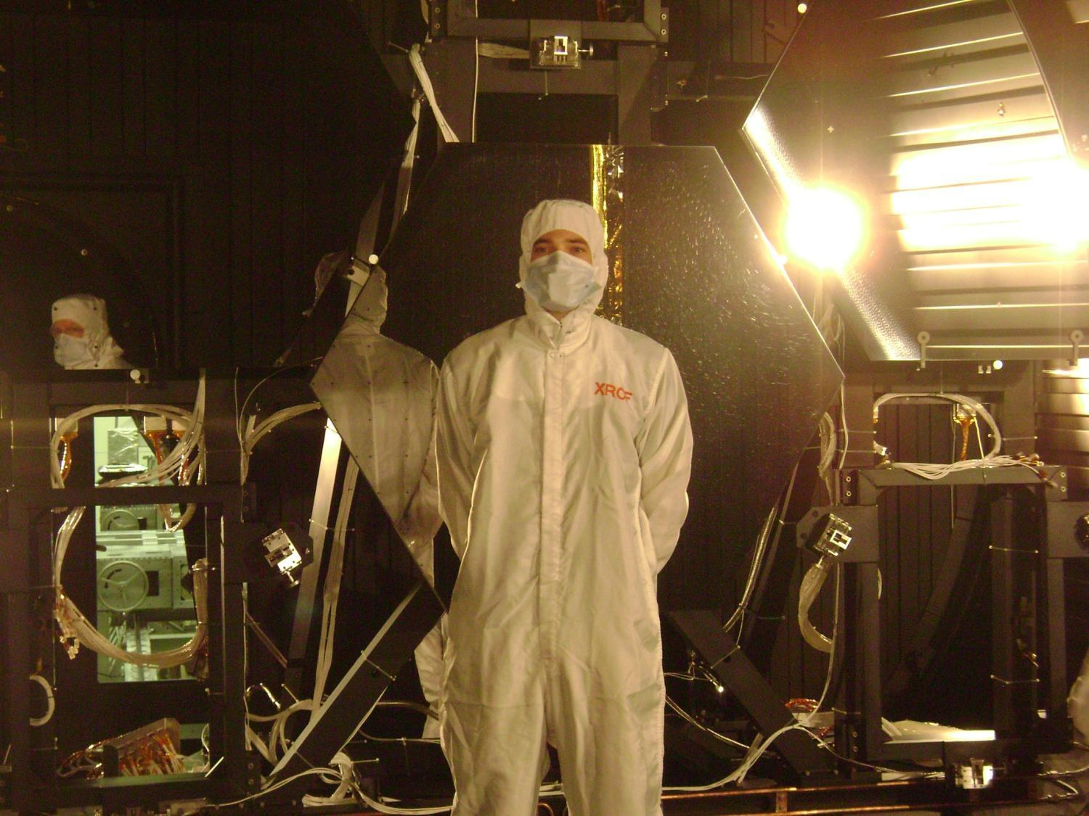
Notes:
JWST mirrors in the vacuum chamber before pump-down

Slide 6
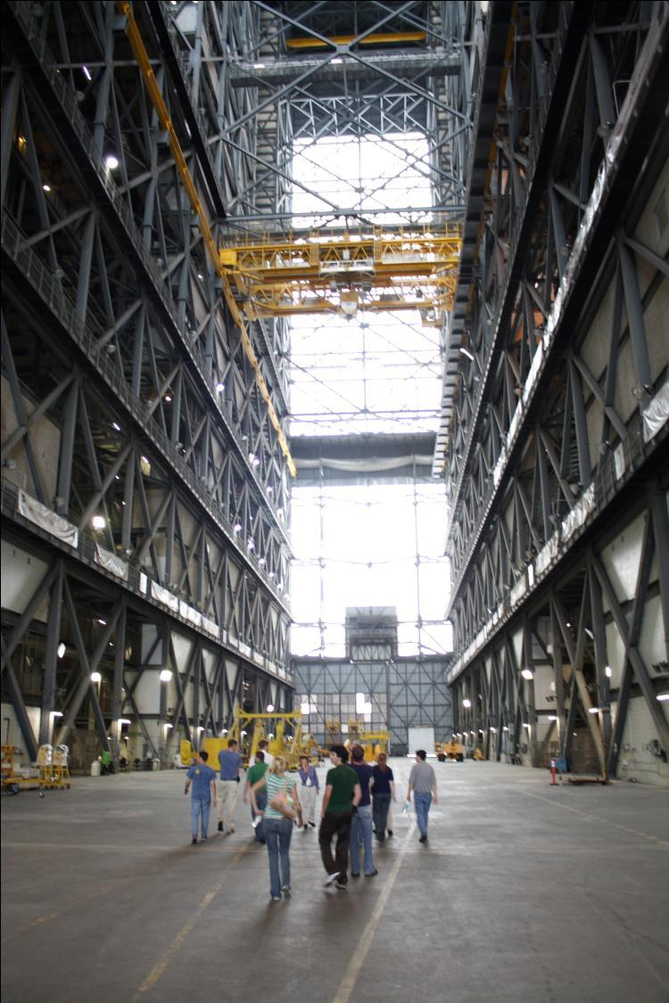
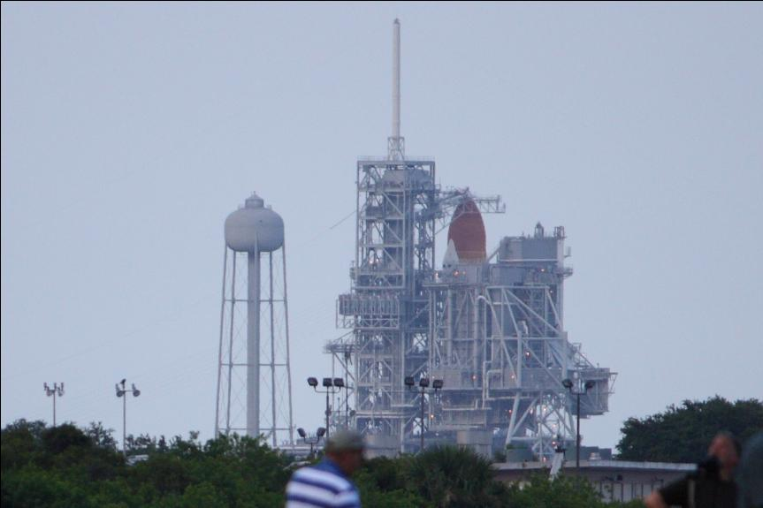
Notes:
As an NASA intern, you have the ability to tour other NASA centers on your own time. I went to Florida and visited Kennedy Space Center twice that summer in an attempt to see the STS-127 launch.

Slide 7
Marshall Space Flight Center Summer 2009 Interns
Notes:
Every NASA center has a large amount of interns every summer. Make sure to take the opportunity to network with these individuals.

Slide 8
What is the NASA Academy?
10 Week summer internship at a NASA center to perform research with the guidance of a NASA mentor, develop leadership skills, and network within the space industry
~8-14 students per group
Individual research project
Group research project
Talks with space industry leaders
Trips to space related places
Opportunity for Academy program management
Notes:
Both Kyle and Kevin have participated in the NASA Academy program (https://www.academyapp.com/). There are several Academies every summer at multiple locations, usually including Marshall Space Flight Center, Ames Research Center, Glenn Research Center, and Goddard Space Flight Center. The “leadership” Academies are designed to provide research experience with a NASA mentor, while also developing teamwork and leadership skills. The robotics and propulsion Academies have the same goals with an emphasis on specific areas of research. Programs often include talks with space industry leaders and trips to space-related places of interest. Some programs include the opportunity to help manage the program in the following year.

Slide 9
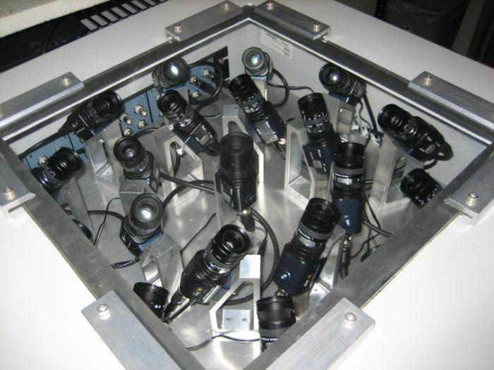
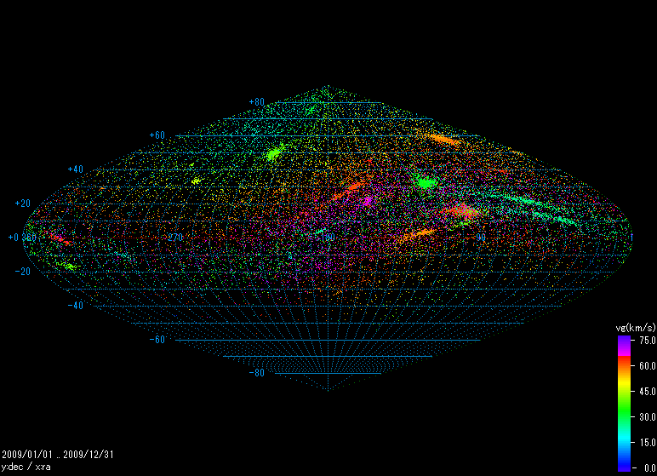
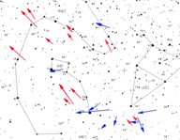
My project: California Allsky Meteor Surveillance
Notes:
Kevin participated in the 2010 Academy at the Ames Research Center. His research project involved creating a system of cameras to track and record meteors for the purpose of identifying minor meteor showers (cams.seti.org). Kevin returned to Ames the following summer to help manage the 2011 Academy.

Slide 10
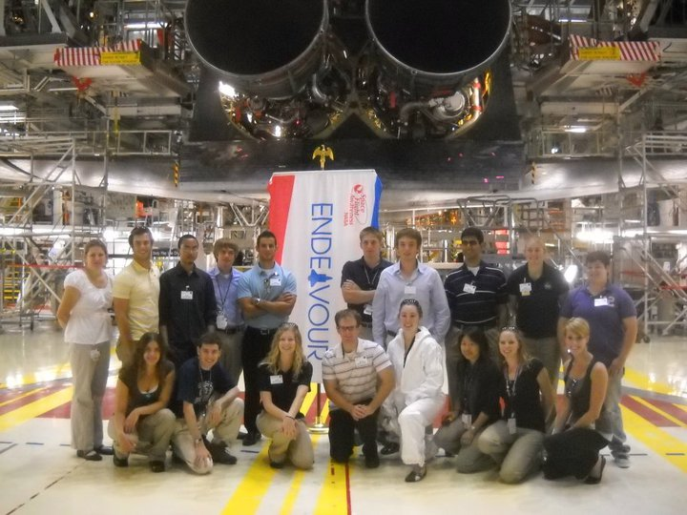
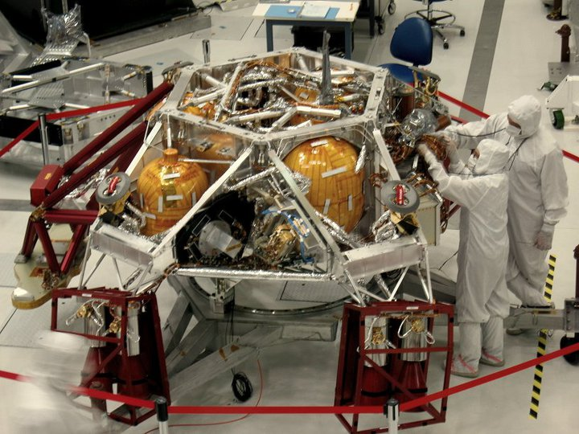
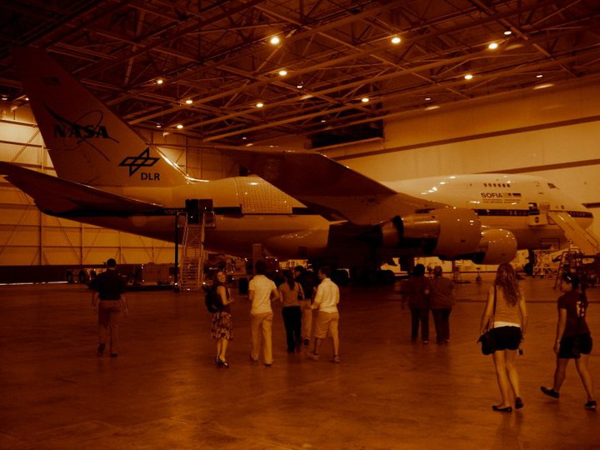
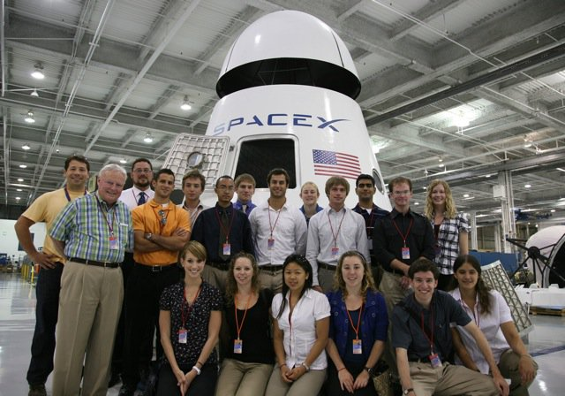
Notes:
Group trips in 2010 included Kennedy Space Center (top left with the Space Shuttle Endeavour), the Jet Propulsion Laboratory (top right with the Mars Science Laboratory), Dryden Flight Research Center (bottom left with Sofia, the airborne observatory) and SpaceX (bottom right with the Dragon Capsule).

Slide 11
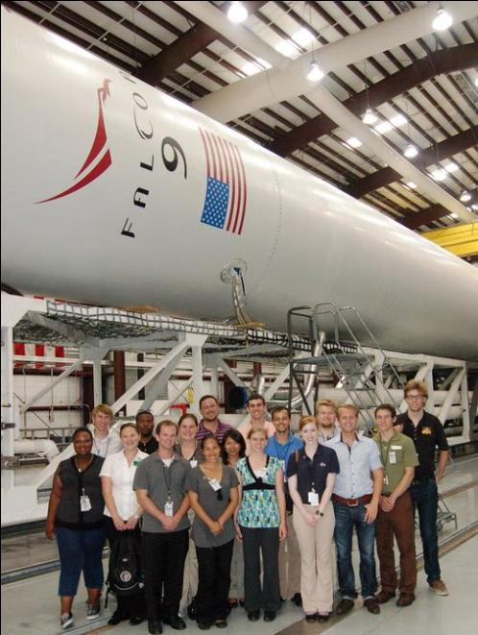
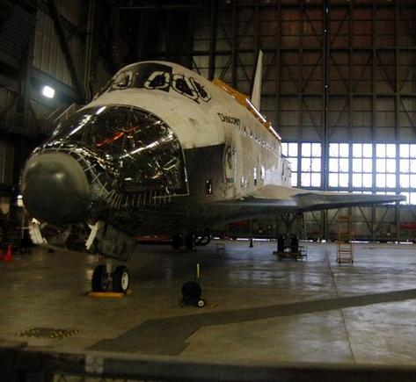
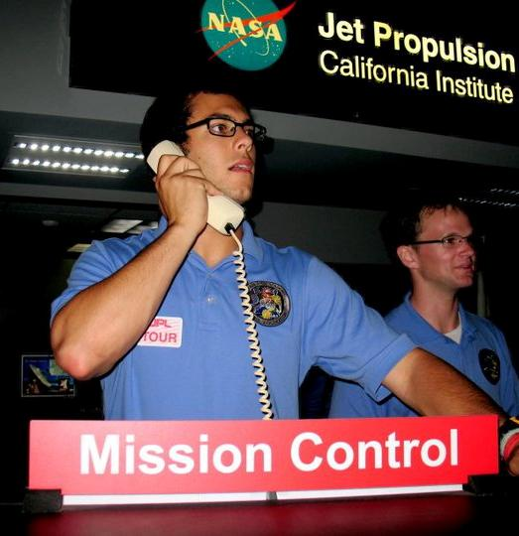
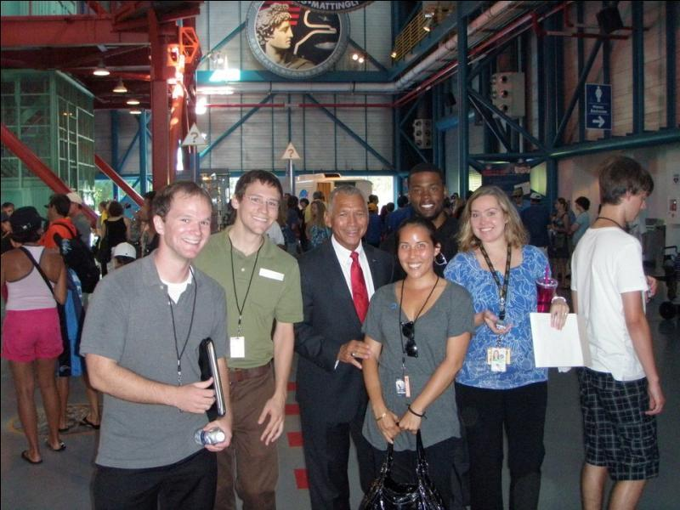
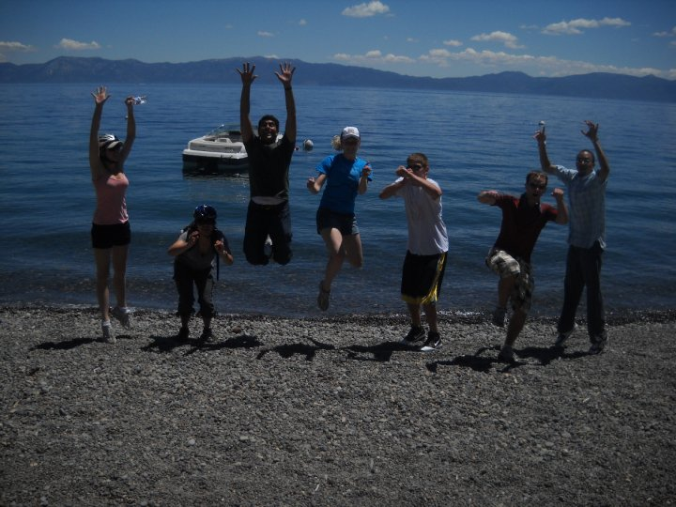
Trips: Lake Tahoe
Notes:
Group trips in 2011 included Kennedy Space Center for the launch of the Juno Spacecraft, and an opportunity to meet NASA Administrator Charles Bolden (bottom right).

Slide 12
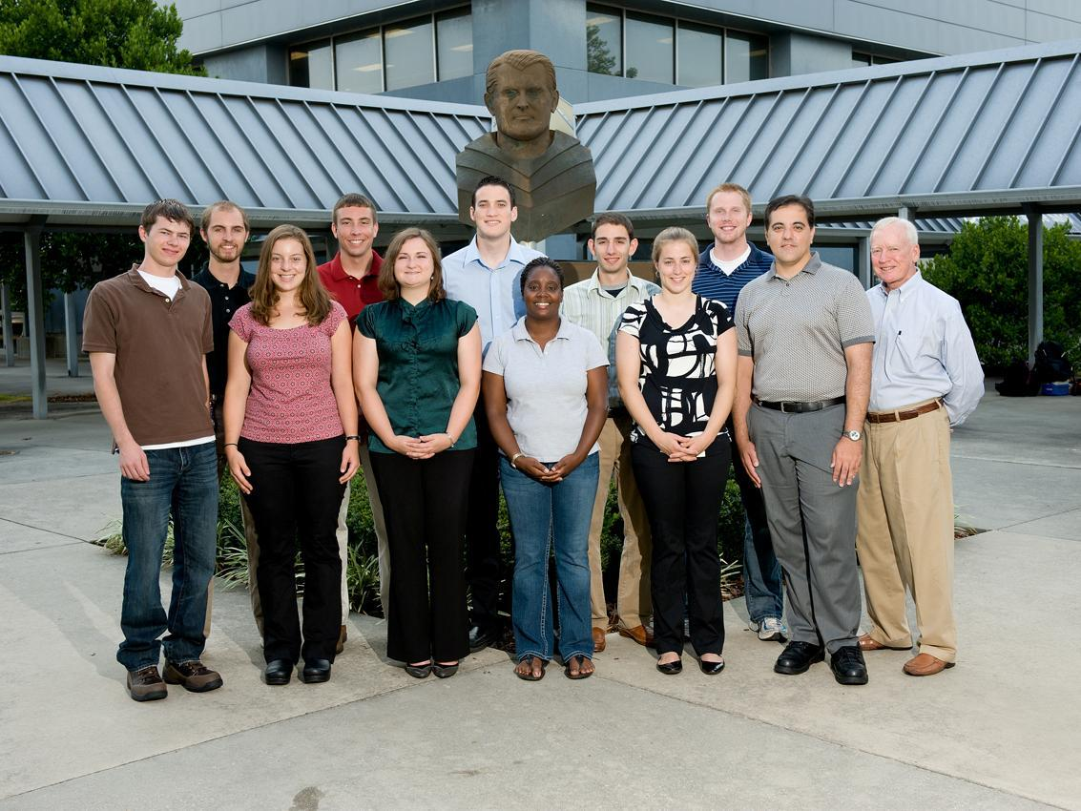
NASA Academy 2010 - Marshall Space Flight Center
Notes:
Kyle

Slide 13
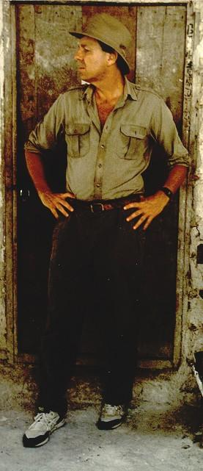
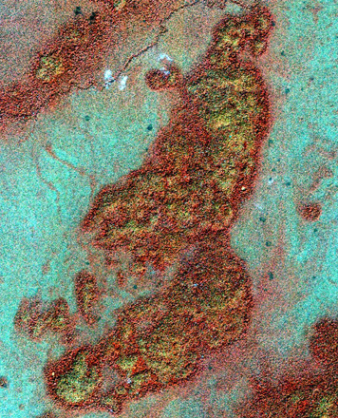
My Research
Archeological remote sensing project
Notes:
Kyle: I worked for Dr. Tom Sever and used remote sensing datasets from the IKONOS satellite to search for archeological sites in northern Guatemala.

Slide 14
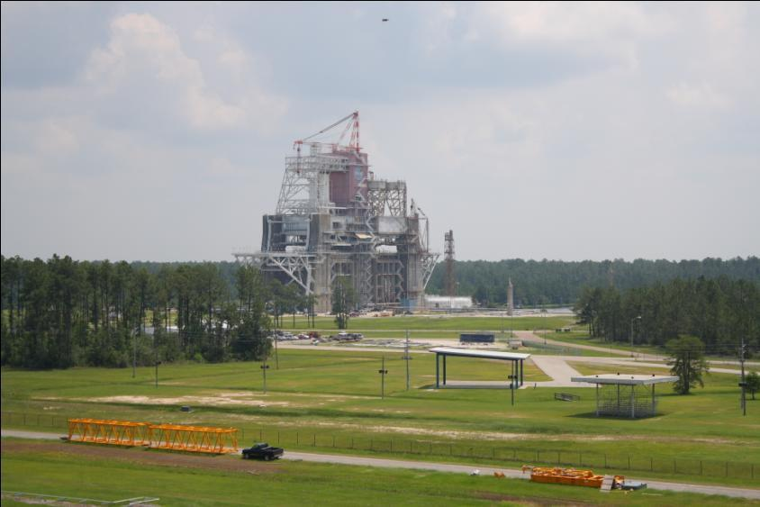
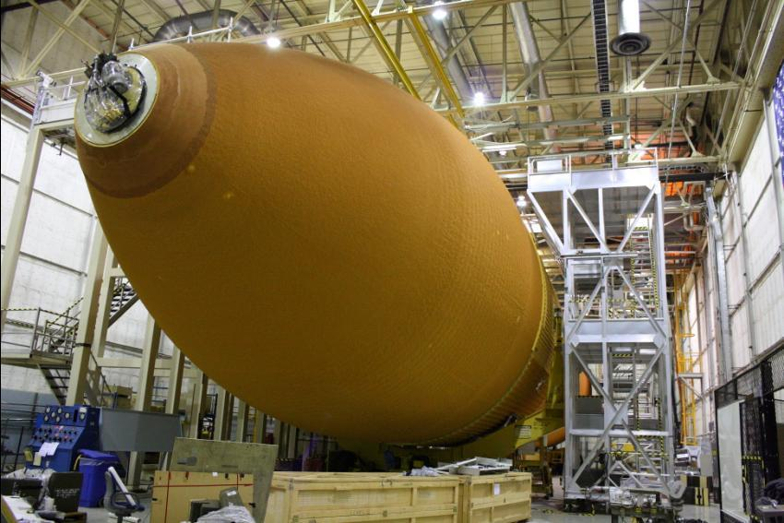
Notes:
In the NASA Academy, you are given the opportunity to tour several different NASA Centers and space companies. The pictures above are from Stennis Space Center in Hancock County, Mississippi and Michoud Assembly Facility in New Orleans, LA.

Slide 15
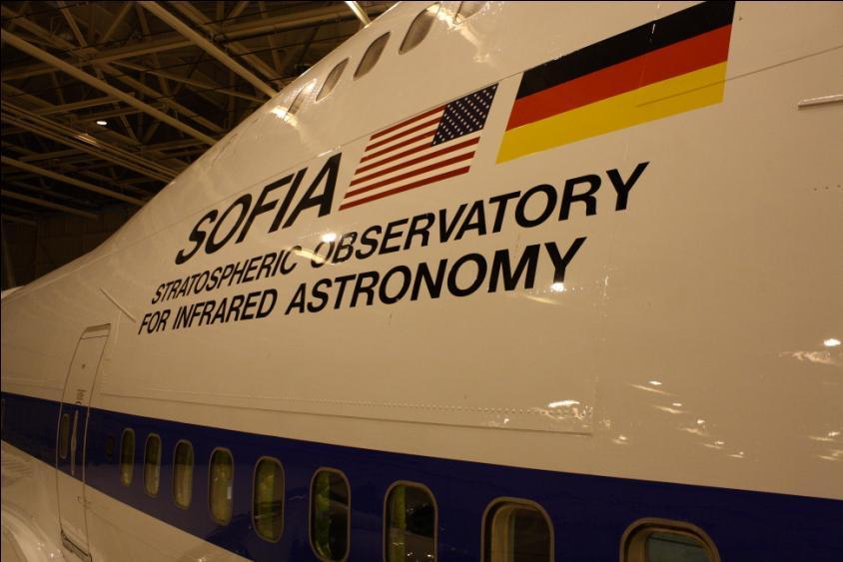
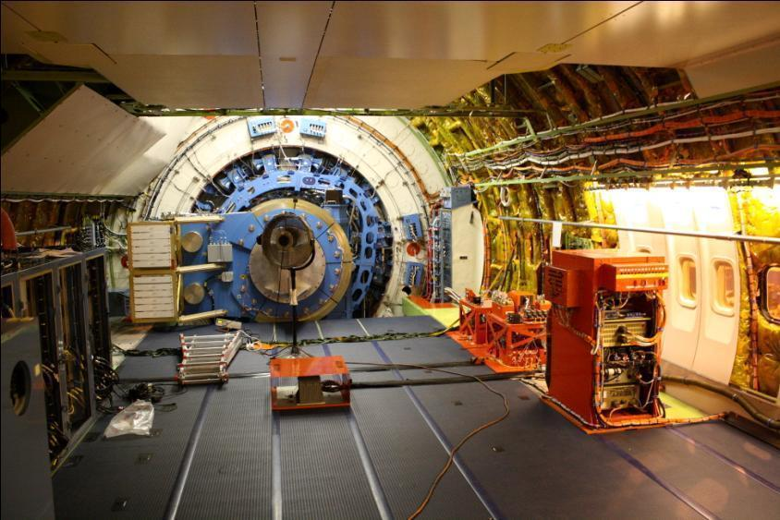
Notes:
Dryden Flight Research Center in near Mojave, CA; Onboard the Stratospheric Observatory for Infrared Astronomy (SOFIA)

Slide 16
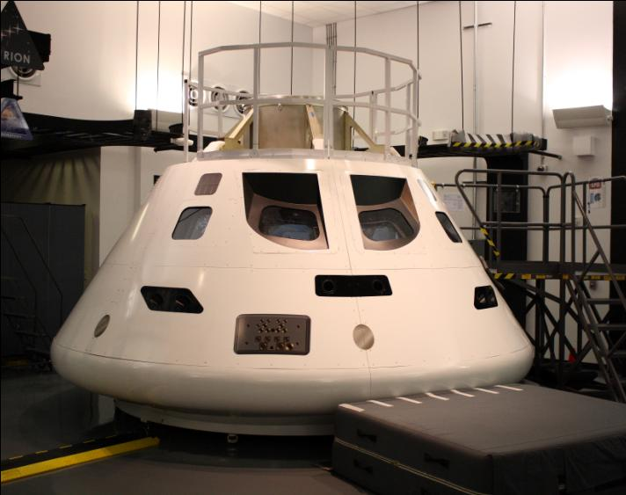
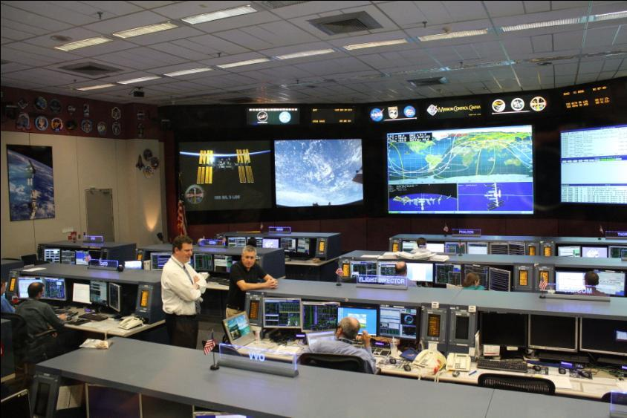
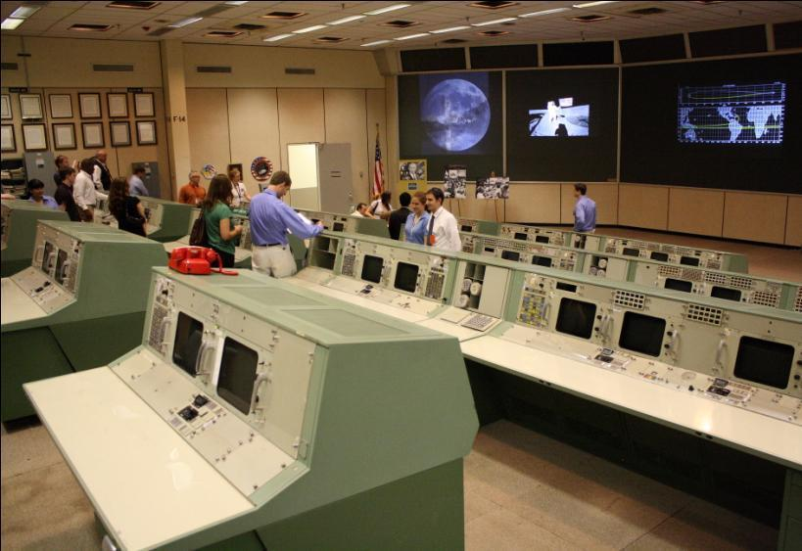
Notes:
Top left: Engineering mock-up of the Orion Multi-Purpose Crew Vehicle at Lockheed Martin in Houston, TX; All other pictures: from tours of Johnson Space Center in Houston, TX

Slide 17
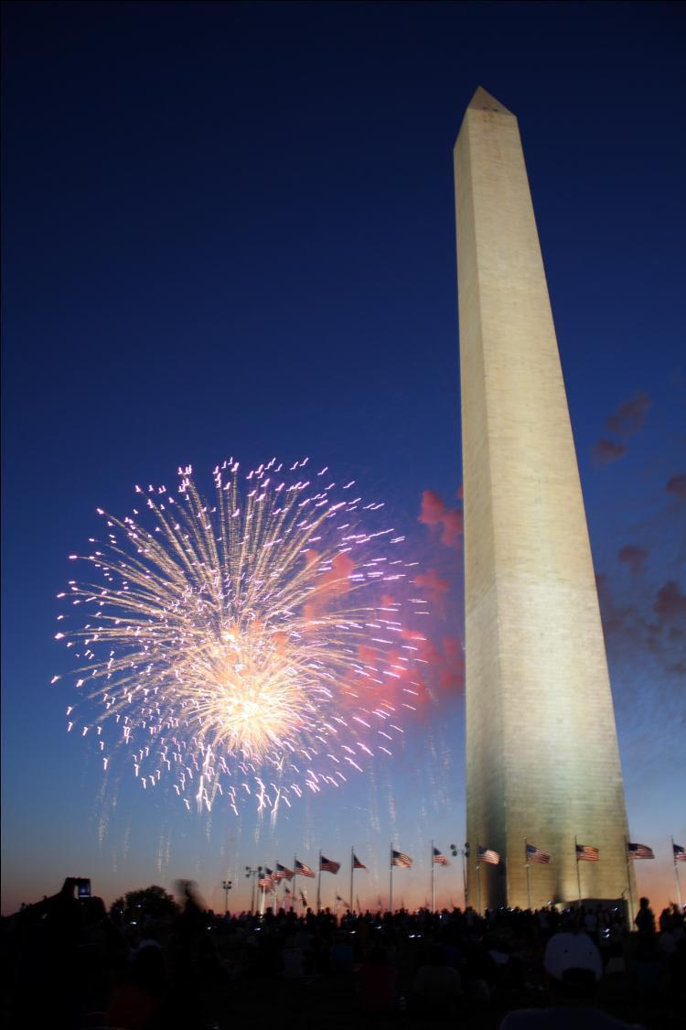
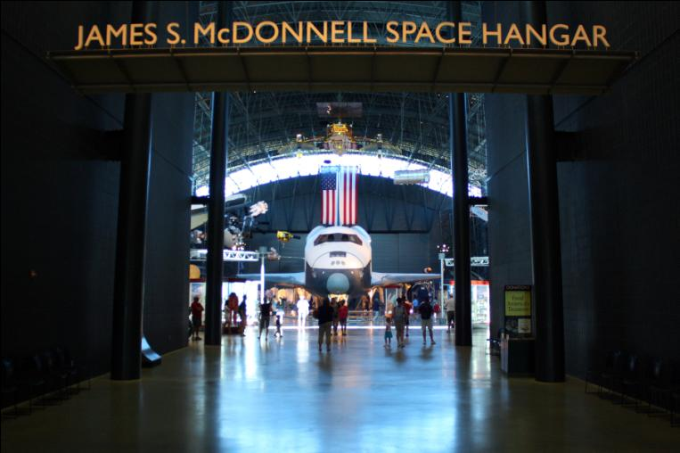
Notes:
For the 4th of July, my Academy went to Washington, D.C. and toured the museums and Goddard Space Flight Center.

Slide 18
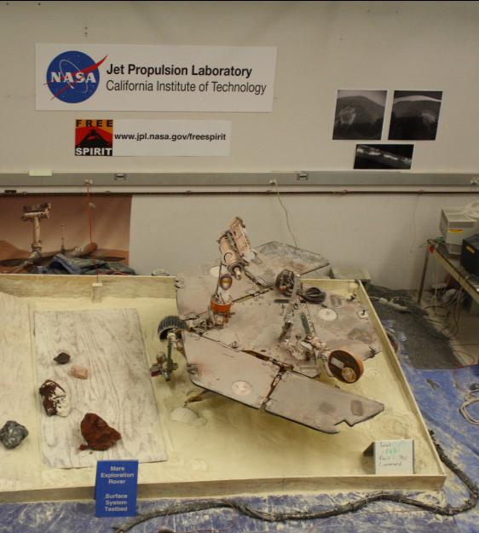
Notes:
Also in California, we toured the Jet Propulsion Lab and saw the Mars Exploration Rover (bottom left).

Slide 19
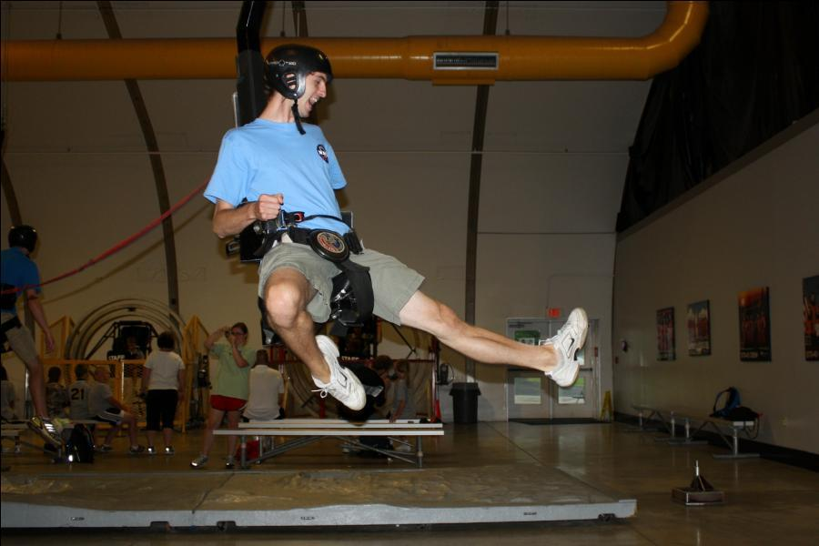
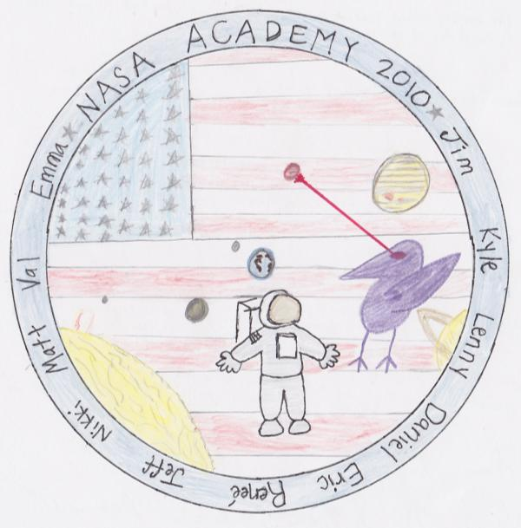
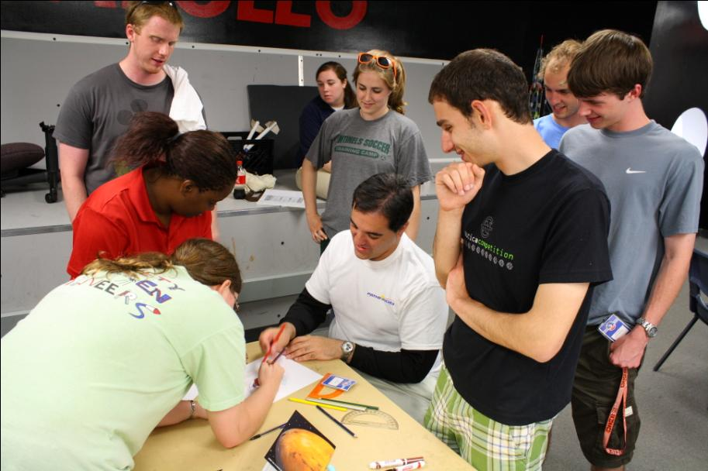
Notes:
Kyle’s academy also went to Space Camp at the US Space and Rocket Center in Huntsville, AL.

Slide 20
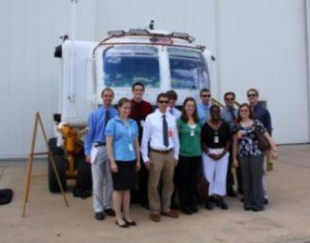
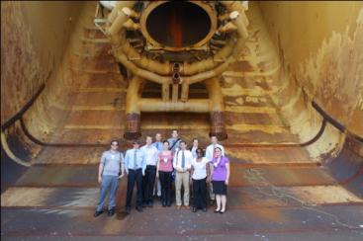
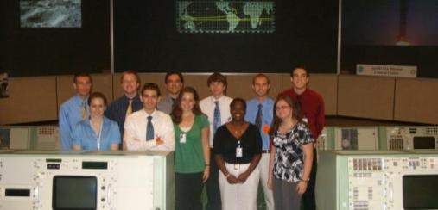
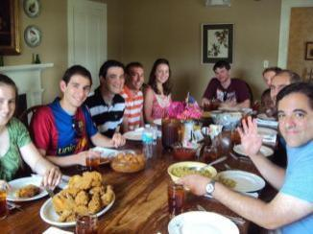
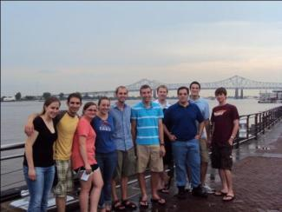
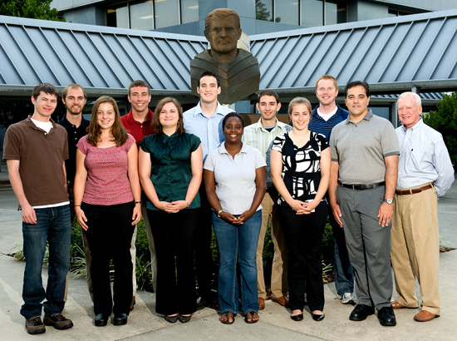
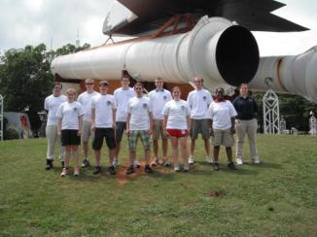
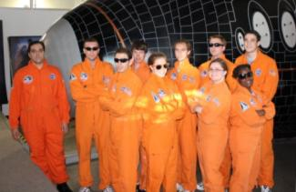
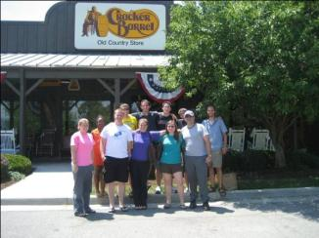
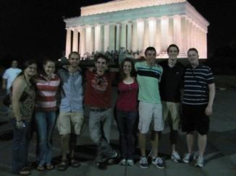
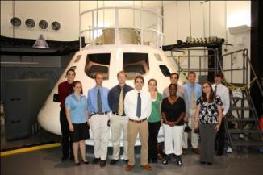
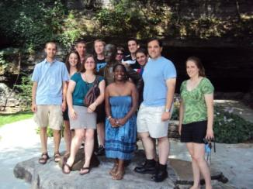
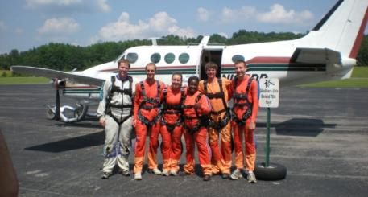
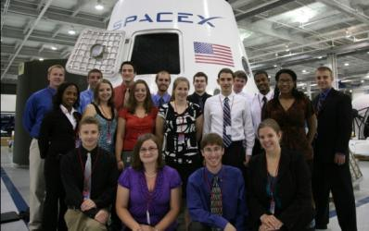
Notes:
The academy is really about the people. By living and working with a small group of your peers for the whole summer, you have the opportunity to get to know individuals with similar interests and form lasting friendships.

Slide 21
NASA - Reduced Gravity Program
Notes:
Kevin and Kyle participated in NASA’s Reduced Gravity Program during the “Grant Us Space” Flight week in July 2011. For more info, visit: http://microgravityuniversity.jsc.nasa.gov/

Slide 22
Notes:
Our mission patch

Slide 23
Notes:
Flight profile for the microgravity flight – We each flew a total of 32 parabolas.

Slide 24
Notes:
We were required to build a structure to house our experiment that would be able to withstand a 9-g load in the forward direction. The picture on the right shows us testing this 9-g case.

Slide 25
Notes:
Left: Experiment and structure loaded on the plane; Top right: Inside the plane before the experiments are loaded; Bottom right: Inside the hanger where experiments and structures were finalized

Slide 26
Our Experiment: Liquid Lenses
Notes:
Our experiment was entitled ANalysis of Gravitational Effects on Liquid lenses (ANGEL). We studied how gravity affects surface quality of large-aperture liquid lenses. We used the SCOTS test developed at the UA’s College of Optical Sciences to test image quality in the different gravity conditions (data – top left).

Slide 27
Notes:
Kevin with other team members on the plane

Slide 28
Notes:
Other individuals having some fun on the plane

Slide 30
Publicity
UANews
(Shelley Littin)
UA Teams Selected for Zero-Gravity Flights
Experimenting in a Weightless Laboratory
Zero-Gravity Student Experiments Completed in Houston
Notes:
Shelley Littin, Space Grant intern and science writer for UANews, had the opportunity to share in the microgravity flight experience and write three published articles.

Slide 31
Publicity
Arizona Daily Star (Victoria Blute)
UA students in NASA program to test their work in microgravity
Lens idea might yet prove to have weight
UA students' zero-g experiment hunts origin of earthly life
Oddest thing: It's almost like being in love
Notes:
Victoria Blute, Space Grant intern and science writer for the Arizona Daily Star, also had the opportunity to fly in microgravity and write four published articles about her experience.

Slide 32
Notes:
Kyle and the second day flight team after their flight.

Slide 33
Mars Desert Research Station
“As an operational testbed, the stations will serve as a central element in support of parallel studies of the technologies, strategies, architectural design, and human factors involved in human missions to Mars.” – marssociety.org
Mars Analog Research Station (MARS) Project
Canadian Arctic
American Southwest (Utah – MDRS)
Australian Outback
Iceland
Notes:
The Mars Society has created several facilities to simulate the living and working conditions of Mars. One such facility, the Mars Desert Research Station, is located in the desert of southern Utah and provides the opportunity for students and others to conduct research.
http://www.marssociety.org/

Slide 34
Notes:
The Mars Desert Research Station (center), along with greenhouse habitat (right), and Musk observatory (left). The research station is mostly isolated in the desert and is designed to be self-sufficient.

Slide 35
Notes:
The mission patch for Kevin’s visit to MDRS. The main research project (LAMBDA) was a continuation of the group research project started with the 2010 NASA Ames Academy.
http://www.universetoday.com/82963/all-student-crew-lands-at-mars-research-station/#more-82963

Slide 36
Notes:
In group simulation, a mock space suit is usually worn for all activities outside the habitat. Our mission happened to overlap with the 2011 Superbowl, so of course a traditional game of football was in order!

Slide 37
Notes:
The Life And Metabolic Detection Apparatus (LAMBDA) is designed to detect the metabolic process of living organisms. Basically you put in a soil sample and it tells you if it contains life; a device that could be useful for a Mars mission.

Slide 38
Notes:
Other projects included the balloon launch of a small cube with blinking LEDs (bottom left). The LEDs are used to calculate the astronomical seeing when viewed through a telescope. In our spare time, the group explored the many unique and interesting areas surrounding the habitat using ATVs (top).

Slide 39
Notes:
The group geologists spent time mining and analyzing rocks (bottom left), and exploring the geological features of the desert. Moon landing? (bottom right)

Slide 40
What is SEDS?
SEDS was founded in 1980 by Peter Diamandis at MIT
Notes:
SEDS: Student for the Exploration and Development of Space; Founded by Peter Diamandis (he also founded the organizations listed above).
For information about the UA chapter, visit: http://www.seds.org/uaseds

Slide 41
What is SEDS?
SEDS Mission Statement (short version):
Educating people about the benefits of space
Supporting a network of interested students
Providing an opportunity for members to develop their leadership skills
Inspiring people through our involvement in space-related projects.

Slide 42
What is SEDS?
SEDS- USA Map
28 chapters across the nation (as of May 2010)
~750 students pursuing a Bachelors, Masters, or PhD
Members are mainly in engineering or science related majors

Slide 43
What is SEDS?
Notable SEDS Alumni
Peter Diamandis (Founder of everything, except NASA)
Bob Richards (Co-Founder of ISU, Founder of Odyssey Moon Limited)
Jeff Bezos (Founder of Amazon.com, Founder of Blue Origin)
Eric Anderson (CEO of Space Adventures)
Chris Lewicki (Mars Exploration Rover Flight Director, former UASEDS President!)
You…?

Slide 44
ASCEND! Balloon Payload Project
Notes:
ASCEND! Is a program run by NASA/ Arizona Space Grant that involves creating multiple payloads on weather balloon launches. For more info, visit: http://spacegrant.arizona.edu/research/ascend

Slide 45
UA ASCEND! Team – 2010/ 2011

Slide 47
Thank you for your attention!
Questions?
Kyle Stephens: kyle824@email.arizona.edu
Kevin Newman: knewman@email.arizona.edu

