Slide 1
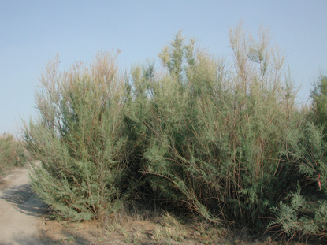
Tamarisk Change in Glen Canyon
Rene Horne Northern Arizona University Mentor: Teki Sankey

Slide 2
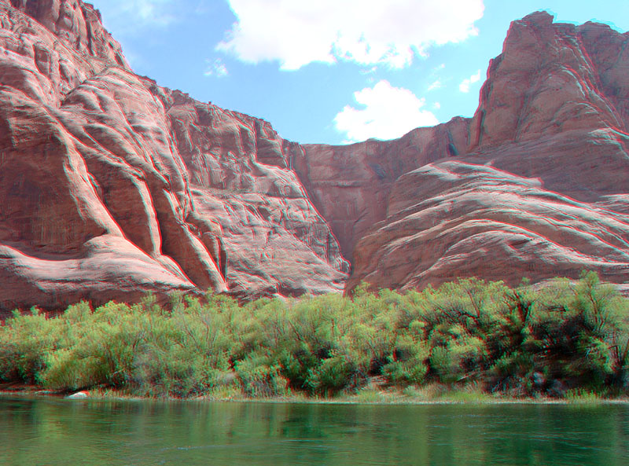
Purpose
Tamarisk Mapping
High resolution multispectral images
Use of new technologies
Estimate rate of Tamarisk defoliation
Tamarisk Beetle

Slide 3
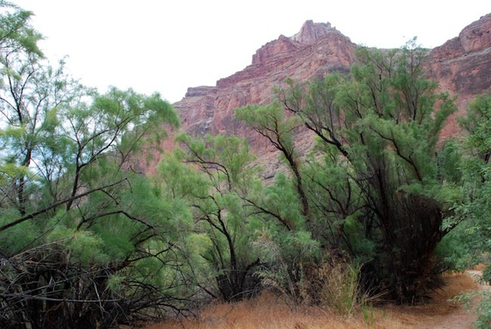
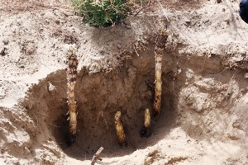
Tamarisk (Tamarix spp.)
History
In the US since 1800s
Decorative species
Invasive species
Biology
Salt cedar
Tap-root
Management
Dominant in the Southwest
Spread rate: 20 km/year
Expensive mechanical control

Slide 4
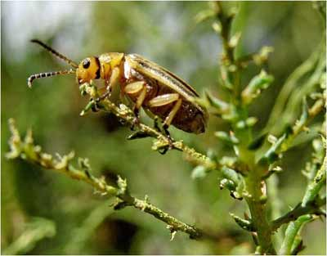
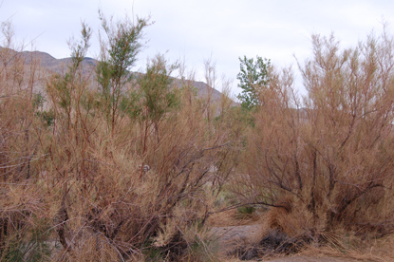
Bio-Control: Tamarisk Beetle (Diorhabda carinulata)
Biology
Natural predator of the shrub
Eats the leaves
Tamarisk defoliation
History of Introduction
Asia
Texas- early 2000s
Utah- 2005
Found in Glen Canyon 2009
Benchmark for data

Slide 5
Data and Method
Airborne Multispectral Images
2009: Pre-beetle image
2013: Post-beetle image
2009:2013 (Pre/Post Comparison)
Computer Software
ENVI
NDVI (Normalized Difference Vegetation Index)
2009
2013
2009:2013
3D Lidar images
2013
Vegetation height
Canopy volume and biomass density

Slide 6
Results

Slide 7
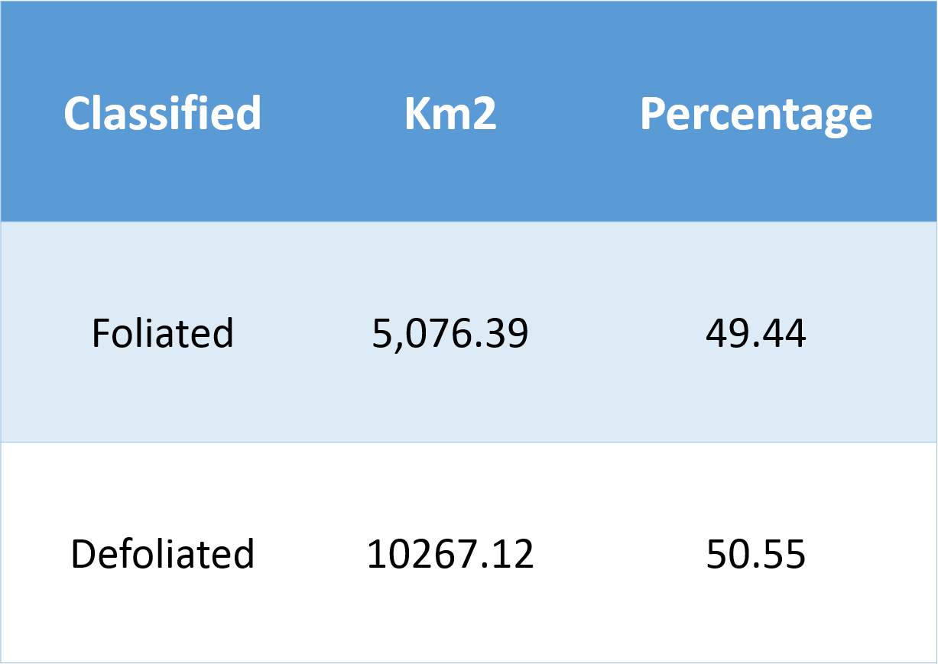

Slide 8
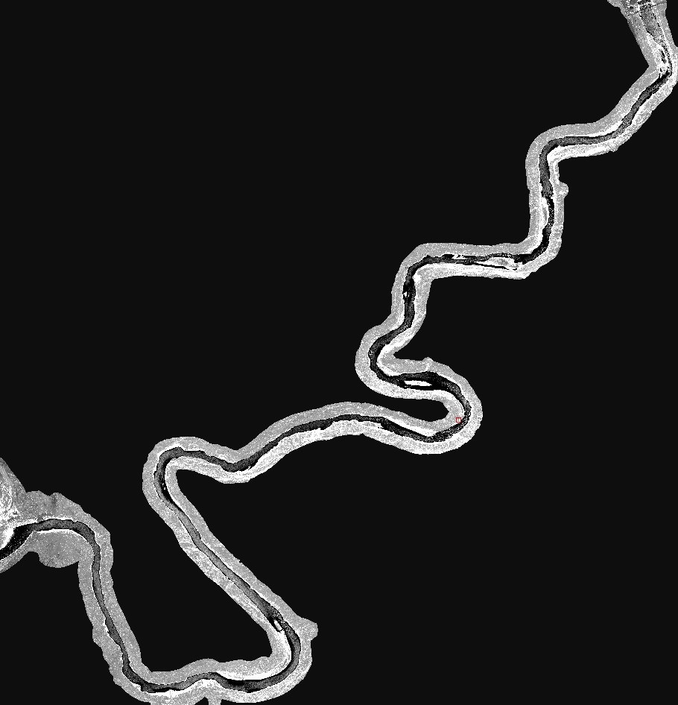
SO WHAT?
Mapping of invasive species
Future management
Impacts on Ecosystem
Erosion
Wildlife
Recreation

Slide 9
Acknowledgments
Teki Sankey: Mentor
NASA Space Grant
USGS, Joel Sankey
Graduate Students in the Computer Lab

Slide 10
Questions?
Thank you!

