Slide 1

Bacterial concentration in the air & human occupancy of a typical classroom
April cobos
Mentor: Dr. MOUNIR EL ASMAR
special THANKS TO dR. mORTEZA abbaszadegan
Space grant symposium, Sheraton hotel, Tempe, AZ
aPRIL 18,2015

Slide 2
Problem
Background Methods Results Conclusions Questions
In the U.S., people spend 87% of their time in buildings, where the indoor environmental quality affects the comfort, productivity, wellbeing, and health of its occupants.
Perhaps due to indoor crowding, respiratory infections are the leading infectious illness in the U.S.
Classrooms are one of the locations that respiratory illnesses are suspected to be most highly transmitted
This study sought to quantify how the bacterial concentration in indoor air changed with the length of occupancy in a classroom

Slide 3
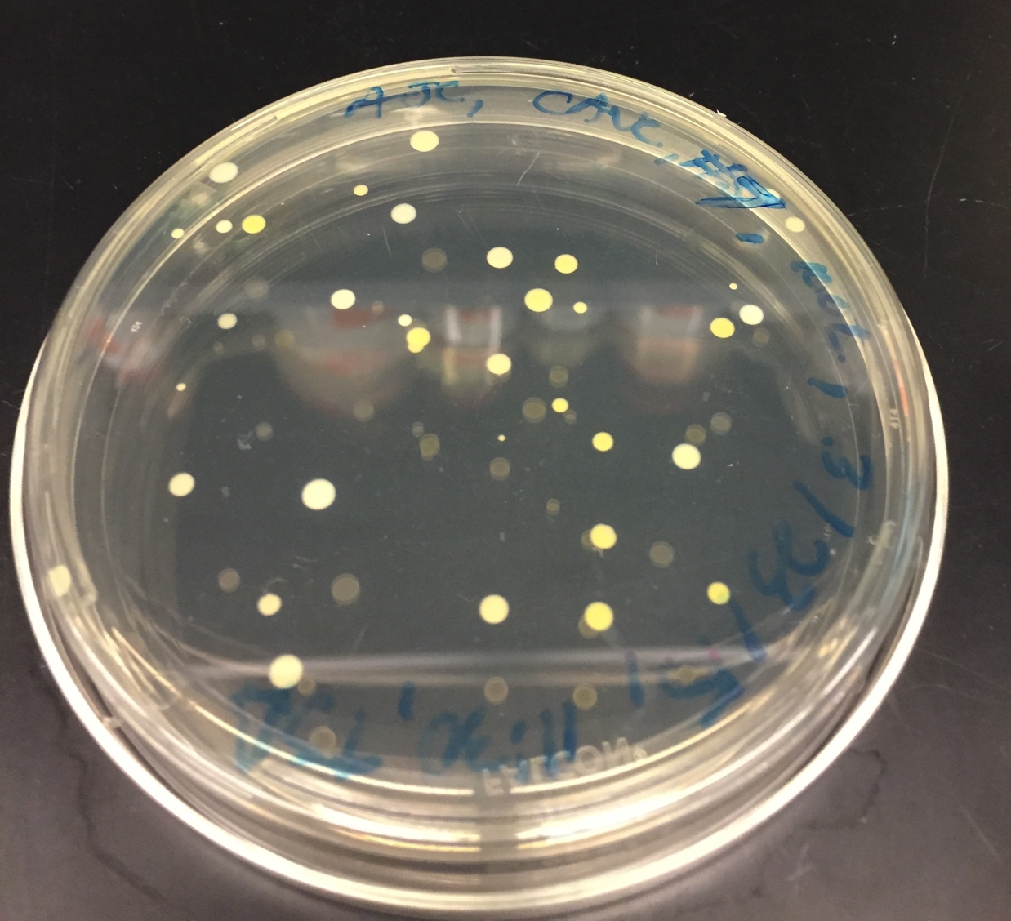
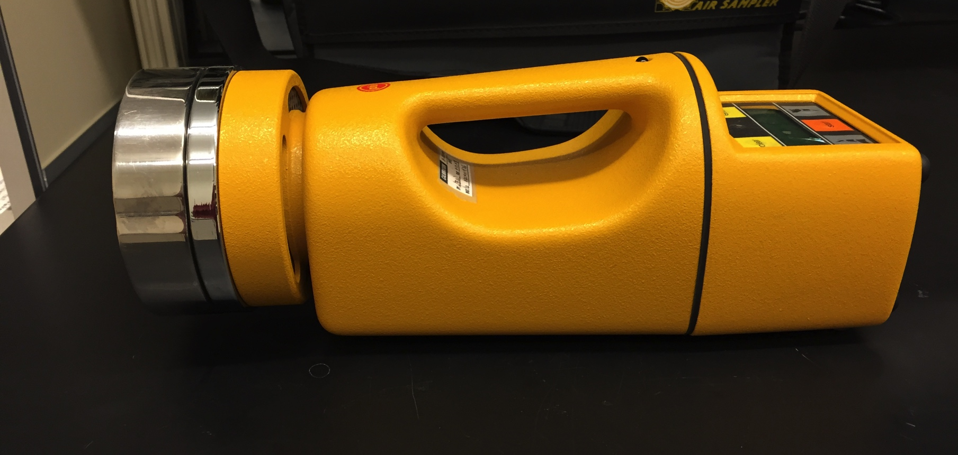
CULTURING BACTERIA FROM AIR SAMPLES
Background Methods Results Conclusions Questions
Collected air samples using a calibrated impactor sampler (SAS Super 180TM)
Incubated samples on trypticase soy agar (TSA) for 48 hrs
Quantified the colony forming units (CFUs)
Used HOBO data loggers to measure temperature, relative humidity, & light
Measured bacterial concentration of two different classes in the same room
    3 trials of each class

Slide 4
Background Methods Results Conclusions Questions
Figure 1. A comparison of the bacterial concentration in the air of three trials from the same class. Concentration ≥ 100 CFUs/m³ are classified as elevated contamination and concentration ≥ 500 CFUs/m³ are classified as high contamination, according to the Commission of the European Communities (1993). Class ended at 11:20 on Feb. 4th, 11:25 on March 23rd, and 11:28 on March 25th.

Slide 5
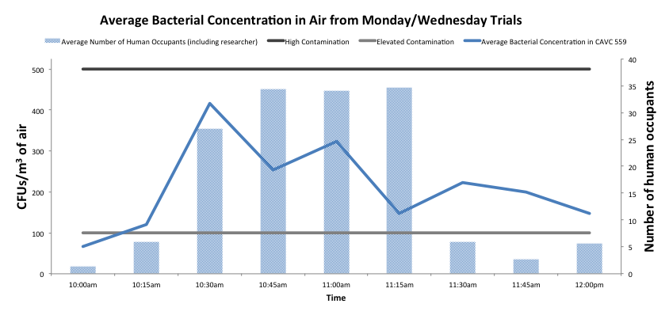
Background Methods Results Conclusions Questions
Figure 2. The average bacterial concentration in the air of three trials from the same class. Concentration ≥ 100 CFUs/m³ are classified as elevated contamination and concentration ≥ 500 CFUs/m³ are classified as high contamination, according to the Commission of the European Communities (1993). Occupancy ended at 11:20 on Feb. 4th, 11:25 on March 23rd, and 11:28 on March 25th.

Slide 6
Background Methods Results Conclusions Questions
Figure 3. A comparison of the bacterial concentration in the air of three trials from the same class. Concentration ≥ 100 CFUs/m³ are classified as elevated contamination and concentration ≥ 500 CFUs/m³ are classified as high contamination, according to the Commission of the European Communities (1993). . Class ended at 4:29 on Feb. 13th, 4:14 on March 20th, and 4:20 on March 25th.

Slide 7
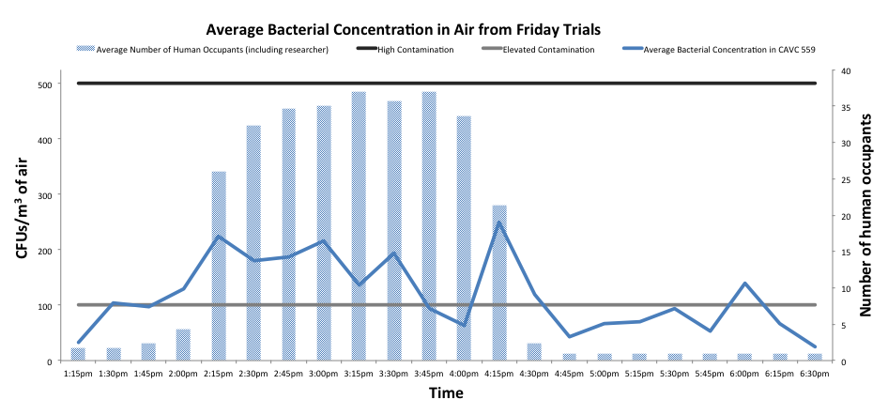
Background Methods Results Conclusions Questions
Figure 4. The average bacterial concentration in the air of three trials from the same class. Concentration ≥ 100 CFUs/m³ are classified as elevated contamination and concentration ≥ 500 CFUs/m³ are classified as high contamination, according to the Commission of the European Communities (1993). Class ended at 4:29 on Feb. 13th, 4:14 on March 20th, and 4:20 on March 25th.

Slide 8
Background Methods Results Conclusions Questions
Figure 5. A comparison of the average bacterial concentrations in the air from two different classes. Concentration ≥ 100 CFUs/m³ are classified as elevated contamination and concentration ≥ 500 CFUs/m³ are classified as high contamination, according to the Commission of the European Communities (1993).

Slide 9
Conclusions
Background Methods Results Conclusions Questions
During occupancy, bacterial concentration levels were elevated but not high, for most trials
    The Monday/Wednesday class did experience some high levels
  Interestingly, the class that lasted longer had lower levels of bacterial concentration in the air
    Number of occupants similar
    Perhaps due to differences in the hosts
  For most trials, bacterial concentration did not return to original levels at the end of the time period
    Remained at elevated levels in Monday/Wednesday trials
    May need more time in between classes
  Limitations: small sample size

Slide 10
Questions
Background Methods Results Conclusions Questions
?

