Slide 1




Pulse Box Engineering
Nikitha Ramohalli
University of Arizona
Advisor: Dr. Stephen Kukolich,
Professor,
Department of Chemistry and Biochemistry,
University of Arizona
Arizona Space Grant Consortium
April 18th, 2015
Phoenix, AZ

Slide 2
Aknowledgements
NASA Space Grant Director: Susan Brew
NASA Space Grant Consortium
National Science Foundation
Research Group, including
  Aaron Pejlovas
  Kexin Li
  Onur Oncer
  Steven Edwards

Slide 3
Background of Microwave Spectroscropy
Use Flygare-Balle type pulsed beam, Fourier Transform microwave Spectrometer
Use the results of this to determine the accurate 3-D molecular structures and electronic charge distributions of transition metal complexes, hydrogen-bonded complexes and small molecules
(Kukolich Research Group Webpage, chem.arizona.edu/kukolich/)
Frequencies of waves are on order of Giga-Hertz (4GHz-16GHz)

Slide 4
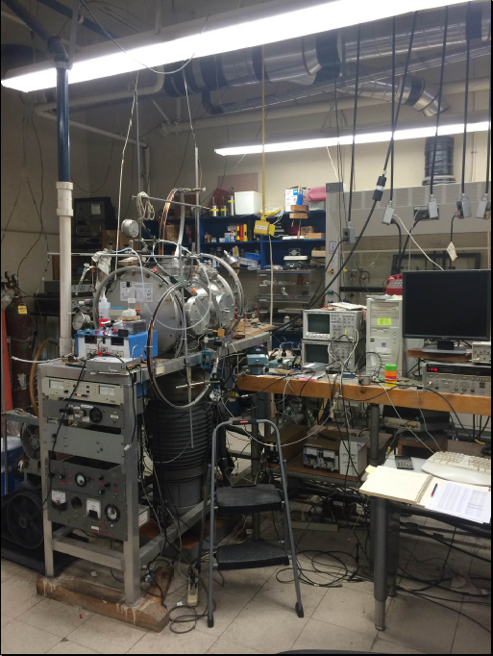
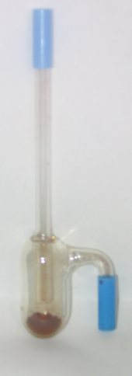
Microwave Cavity
Ne supply
Computer for data collection
Diff. pump
Frequency Synthesizer
Fore pump
Source: Kukolich Research Group Seminar Presentation Aaron Pejlovas

Slide 5
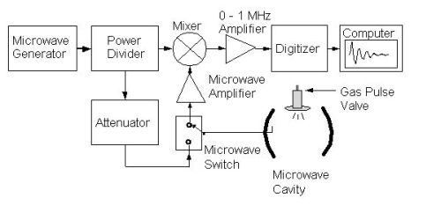
Background of Pulse Box
The Pulse Box controls the timing of the valves, microwaves and gas channels
Controlled by Pulse Box
Source: Kukolich Research Group Webpage, cbc.arizona.edu/kukolich/Microwave.htm

Slide 6
Pulse Box Components
Timer (555): An integrated circuit that generates a square wave in which both the length of the square wave and the separation between the square waves can be externally set by resistors and capacitors
One-Shot (74-123): An integrated circuit that uses an external trigger to generate a square wave. The period (in seconds) of this square wave is determined by a the product of the connected resistor and capacitor
Source: TI Instruments LS555 Data Sheet
Source: TI Instruments 74LS123 Data Sheet

Slide 7
The Problem
Currently the pulse box circuit is too close to the circuit that drives the motor
This causes the pulse box circuit, specifically the one-shot, to receive too many pulses in too short of a time period
Because of this the one-shot does not always predictably trigger and thus shuts off unexpectedly

Slide 8
The Project
to build a circuit that separated the pulses enough to cause the one-shot to trigger predictably
to separate the pulse circuit and the motor driver to prevent the motor driver noise to affect the input of the one-shot

Slide 9
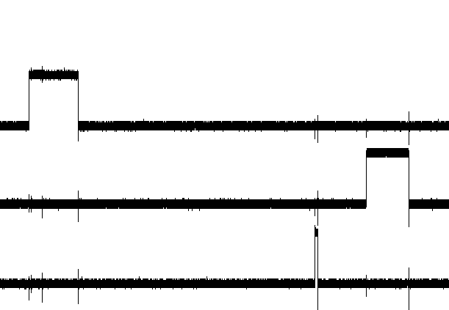
IDEAL WAVEFORMS AND TIMING VALUES
Generating delays with 74LS123
Receive Delay
Transmit Delay
Component | Ideal Value
555 Clock
τ_{between_waves} | 250-500 μs
τ_{duration_of_wave} | 500-1000 μs
One-Shot 1
τ_{duration_of_wave} | 250-500 ms
One-Shot 2
τ_{duration_of_wave} | 10μs < τ < 1ms
Valve Signal
Receive Signal
Transmit Signal
Source: Kukolich Research Group Seminar Presentation Aaron Pejlovas

Slide 10
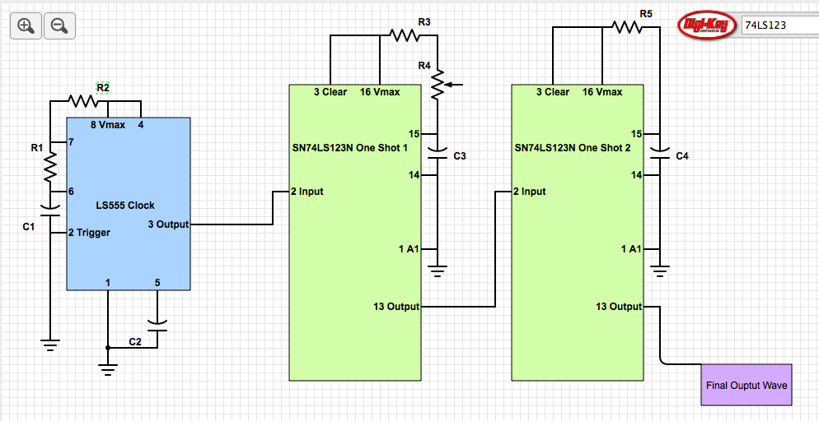
CIRCUIT DIAGRAM
Component | Value
555 Clock
R1 | 6.8KΩ
R2 | 4.7KΩ
C1 | 0.1μF
C2 | 0.1μF
τ_{between_waves} | 252.7μs
τ_{duration_of_wave} | 680μs
One-Shot 1
R3 | 500Ω
R4 Pot | 1 KΩ
C3 | 20μF
τ_{duration_of_wave} | 136-156ms
One-Shot 2
R5 | 239Ω
C4 | 4.3nF
τ_{duration_of_wave} | 15μs

Slide 11
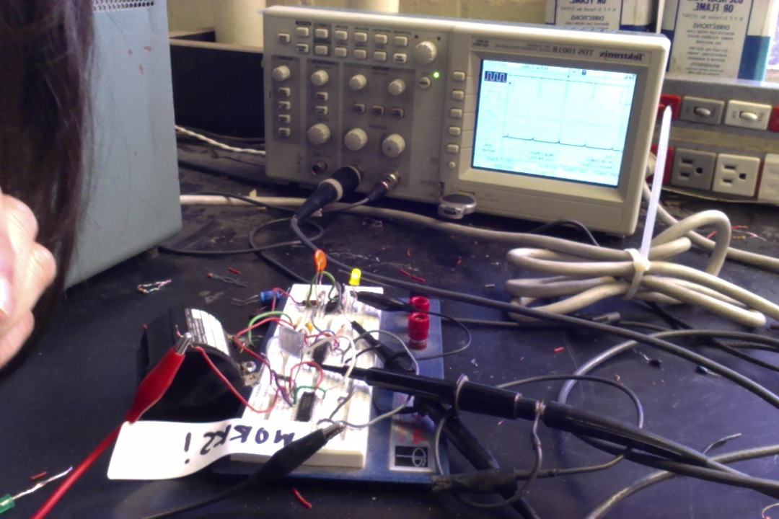

Slide 12
Results from Oscilloscope-timer to first one-shot

Slide 13
Results from Oscilloscope-timer to second one-shot

Slide 14
Future Work
Improve timing so that the wave for the second one shot is not too fast…ie. So that it lasts for 500 milliseconds as opposed to 250 milliseconds
Continue to try and find the right spacing between pulses on the clock to trigger one-shot
Build a pulse box system spatially separated from the motor driver circuit
Solder onto board once correct combination has been found

Slide 15
Thank you!

Slide 16
T. Balle, W. Flygare: Pulsed-Beam Fourier Transform spectrometer (1979-1981)
1 ms pulse
high sensitivity
microwave
source
great resolution (12 kHz)
free induction decay
(FID)
receiver

